Slide 1
Fashion & Talent Show
Special Needs Youth
Ages 3-25
SPONSORSHIP OPPORTUNITIES

Slide 2
Our Mission
Soaring Beyond Our Limits, Inc., is a 501©3 non-profit organization dedicated to encourage and impact the lives of youth with special needs in the community by embracing differences, removing barriers and providing opportunities to create a social support network. This is accomplished through hosting an annual fashion and talent show and coordinating other social events to foster relationships among peers as they face life's everyday challenges.

Slide 3
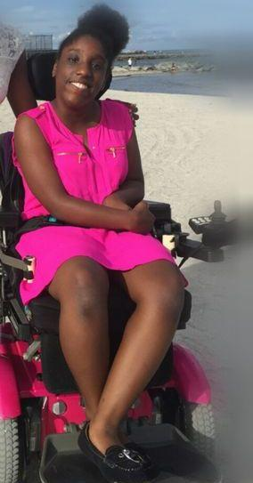
Our President and Founder
Brianna Williams
Brianna Williams, a 25 year old, with Cerebral Palsy, created "Soaring Beyond Our Limits, Inc." because she wants to do away with the stigma that special needs persons can't do anything. Quite the contrary, Brianna says people with special needs can do all sorts of things!
Brianna, a Royal Palm Beach resident and student at Palm Beach Atlantic University, started the organization in 2015 because people look at the diagnosis of a person with a disability and feel they cannot do anything. But this enterprising young woman wants to end that stigma and let the community know that even though these children and young adults may have a disability, they can soar beyond their limits and shine!

Slide 4
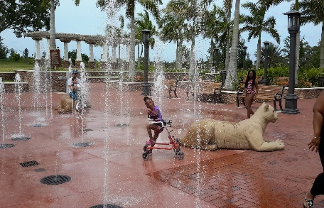
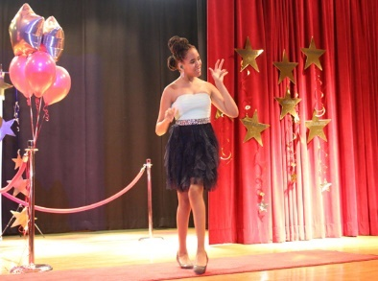
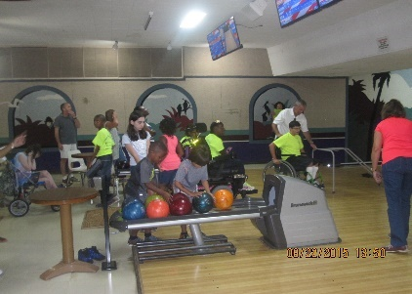
Why Soaring Beyond Our Limits, Inc.?
We are a social support system for disabled kids and young adults
We provide an opportunities to create a social support network
We coordinate several social events to foster relationship among peers as they face life’s everyday challenges

Slide 5
Engagement Opportunities
Sponsorship Opportunities Available – benefits vary based on commitment level.
Monetary Donation – By making a monetary donation you will help us to defer the costs of our showcase and allow us to coordinate and organized other social events for the special needs throughout the rest of the year at little or no cost to them.
Advertise your business with us! We can place your ad or business card in our fashion show book program. The book program will be distributed to over 250 people.

Slide 6
Help Us Change the Future
Sponsorship Opportunities
PLATINUM LEVEL - $5,000
Press release to local media announcing sponsorship
Opportunity for a company representative to address the audience during the event
Company logo placement on event show book program
Logo placement on collateral materials like flyers and posters (contingent on print deadlines)
Corporate banner placed with optimum visibility at the event (banner provided by sponsor)
Logo placement and mention on our website
Logo placement and mention on our Facebook page
6 Free Tickets for our event
SILVER LEVEL -$2,500
Company logo placement on event show book program
Logo placement on collateral materials like flyers and posters (contingent on print deadlines)
Corporate banner displayed at the event (banner provided by sponsor)
Logo placement and mention on our website
Logo placement and mention on our Facebook page
4 Free tickets for our event

Slide 7
Help Us Change the Future
Sponsorship Opportunities
BRONZE LEVEL - $1,000
Company logo placement on event show book program
Logo placement on collateral materials like flyers and posters (contingent on print deadlines)
Logo placement and mention on our website
Logo placement and mention on our Facebook page
2 Free tickets for our event
COMMUNITY SPONSORSHIP LEVEL -$500
Company logo placement on event show book program
Logo placement and mention on our website
Logo placement and mention on our Facebook page
MONETARY DONATION
Logo placement and mention on our Facebook page

Slide 8
Please check your sponsorship choice:
PLATINUM LEVEL-$5,000 SILVER LEVEL-$2,50 BRONCE LEVEL-$1,000
COMMUNITY SPONSOR-$500 MONETARY DONATION: Amount $________________
ADVERTISE WITH US: __Business Card-$25 (2”x4”) ___Half Page-$50 (5”x4”) ___Full Page-$100 (5”x8”)
Name _______________________________________ Title_______________________________________
Company________________________________________________________________________________
Address_________________________________ City_________________ State_____ Zip Code_________
Phone_______________________________ Email______________________________________________
Check Enclosed Please Invoice Me
Please charge $__________ to my credit card. ____Discover ____Visa ____MC ____AmEx
Name (as it appears on card):______________________________________________________________
Card No: _______________________________________________ Exp.Date: _______________________
Signature: ________________________________________________CID:___________________________
To ensure your company logo is included on applicable
Promotional materials, sponsorships must be confirmed by the associated deadline. Sponsors wanting benefits must submit electronic logos in EPS format or JPEG format (jpegs at a minimal 300 dpi at actual size) for color or black and white.
Your contribution is fully tax-deductible.
(Tax identification number available upon request)
Please make all checks payable to:
Soaring Beyond Our Limits, Inc.
P.O. Box 211872
Royal Palm Beach, FL 33411
(561) 204-4184 / 632-3625

Slide 9
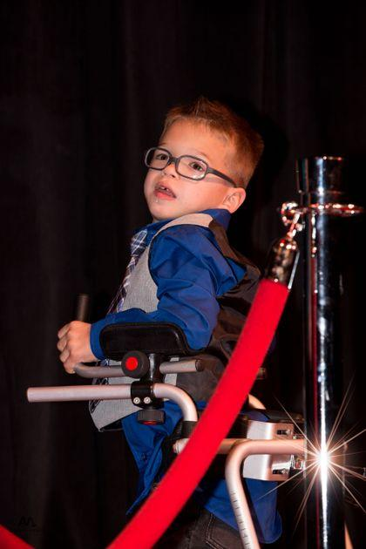
Help Us Change
The Future!
For additional information please contact us at: SoaringBeyondOurLimits@gmail.com
For more information please visit:
www.SoaringBeyondOurLimits.com
Thank You!

