Slide 1

Kanban
Dr. Tammy Sagastizado
Organizeworkorhome.com follow me on twitter@organizeittammy

Slide 2
The World We Live In
Highly Competitive
Dynamic – Fluid – Ever Changing
Companies Require -
  responsiveness
  flexibility
  profitability/consistent cash flow
Lean Manufacturing

Slide 3
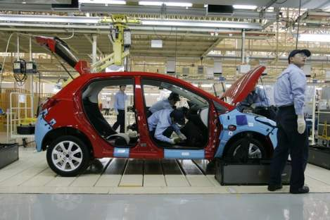
看板 – Kanban limits excess work in progress
看板 – Kanban literally means “visual card,” “signboard,” or “billboard.”
Toyota originally used Kanban cards to limit the amount of inventory tied up in “work in progress” on a manufacturing floor
Not only is excess inventory waste, time spent producing it is time that could be expended elsewhere
Kanban cards act as a form of “currency” representing how WIP Work in Process or in-process inventory) is allowed in a system.

Slide 4
Inventory Control or Scheduling System?
Aligning Inventory to Demand

Slide 5
Kanban: An example
http://www.youtube.com/watch?v=ZIv2e61SH1A

Slide 6
Kanban: A Time Management Tool?
http://www.youtube.com/watch?v=v7_GFdrAxUg

Slide 7
Some Definitions

Slide 8
MRP
Material Requirements Planning
A system for determining the quantity and timing requirements for materials used in a production operation.
Notes:
MRP is the scheduling and inventory management portion of the ERP system.

Slide 9
JIT
Just-in-Time
A system for producing and delivering the right items at the right time in the right amounts
Key elements of Just-in-Time are flow, pull, standard work, and takt time
Notes:
JIT is part of the lean manufacturing system

Slide 10
Standard Work
A precise description of each work activity specifying cycle time, takt time, the work sequence of specific tasks, and the minimum inventory of parts on hand needed to conduct the activity.

Slide 11
Takt Time
An important concept in pacing operations
The “heartbeat” of a lean system
Takt time = (available production time) / (rate of customer demand)
Example: Customer demand is eight widgets per day. The plant operates 16 hours per day. Takt time is two hours (16/8 = 2).

Slide 12
Kanban
A card attached to boxes of parts that regulates pull in the Lean System by signaling upstream production and delivery.

Slide 13
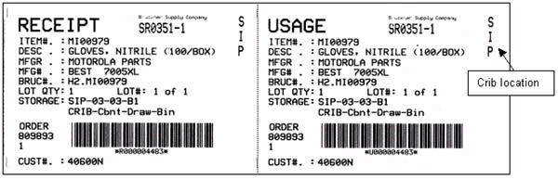
Kanban Card

Slide 14
Kanban Example
http://www.youtube.com/watch?v=tum1lLwy6gE

Slide 15
Pull
A system of cascading production and delivery instructions from downstream to upstream activities in which nothing is produced by the upstream supplier until the downstream customer signals a need.
Nothing is produced without a signal from the next station in the line.

Slide 16
Kanban and Pull
http://www.youtube.com/watch?v=bK78YS9j51k

Slide 17
Lean Approach
Single piece flow
Eliminate bureaucracy, departmentalization
Eliminate batch and queue
Notes:
Three typical areas for lean.

Slide 18
Kanban
Adopt a just-do-it mindset
Focus on value

Slide 19
Value
Created by the producer
May be hard for producers to define
Can only be defined by the final customer

Slide 20
Value Stream
The irreducible minimum set of activities needed to design, order, and make a machine – flowing smoothly, continuously, and rapidly

Slide 21
Value Stream – Not Just the Shop Floor
Raw material to finished good
Order to delivery
Concept to launch

Slide 22
Eliminate Waste (Muda)
Any activity that consumes resources but creates no value is waste (muda)
Notes:
The antidote to muda: lean thinking

Slide 23
Examples of Waste (Muda)
Mistakes
Unneeded inventories
Unnecessary steps
Idle workers
Unnecessary moves
Goods and services that don’t meet customer needs

Slide 24
Lean Principles
Arrange production by specific products
Identify the value stream for each product
Make value flow without interruptions
Let the customer pull value from the producer
Pursue perfection
Notes:
Product groups – group technology.
Outdated thinking about economics of scale.

Slide 25
Lean Principles
Don’t make anything until it is needed and then make it very quickly.
Schedule changes may be made almost instantaneously upon order receipt.
Quality improves as pull thinking is introduced.

Slide 26
Lean Principles
Don’t build inventory
Right size tools to fit product lines
Reduce set-up times
Use statistical process control to achieve zero defects
Implement planned maintenance
Get frequent deliveries from suppliers

Slide 27
Negatives of Lean
While periodic review of Kanban lot size is necessary and desirable, resizing lots to meet large fluctuations - highly variable demand and/or rapidly shifting supply chain uncertainty is difficult
Kanban doesn’t work well when there is a highly variable system

Slide 28
Replenishment
Replenishment
  a non-value activity
  a gating factor to manufacturing
  a significant factor in cash flow management
  directly impacts profits

Slide 29
Toyota's Six Rules
Do not send defective products to the subsequent process
The subsequent process comes to withdraw only what is needed
Produce only the exact quantity withdrawn by the subsequent process
Level the production
Kanban is a means to fine tuning
Stabilize and rationalize the process
http://en.wikipedia.org/wiki/Kanban

Slide 30
Benefits of Kanban
http://www.youtube.com/watch?v=iqw43gvYAlQ

Slide 31
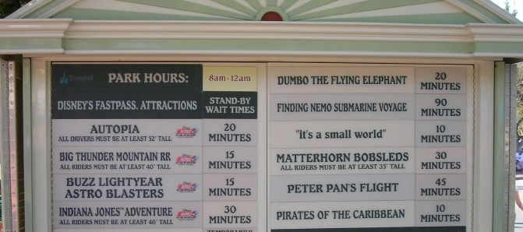
Display and manage cycle times
Disneyland’s public display of cycle-times
Reduce the number of Kanban slots allowed until cycle time remains unchanged
Reduce the size of development items
Work in progress is actually the number of items * the average size of items
Identify and act on bottlenecks immediately
Relieve repeated bottlenecks by changing the number and types of people in each role and cross training
www.agileproductdesign.com/downloads/patton_kanban.ppt

Slide 32
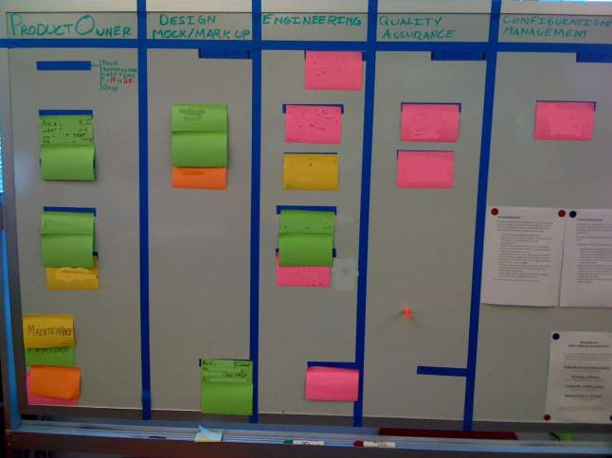
Kanban Boards
www.agileproductdesign.com/downloads/patton_kanban.ppt

Slide 33
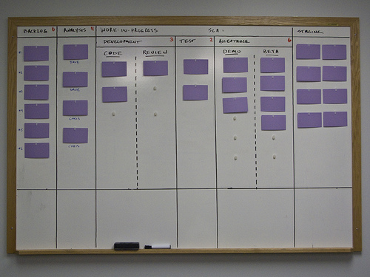
Kanban Boards

Slide 34
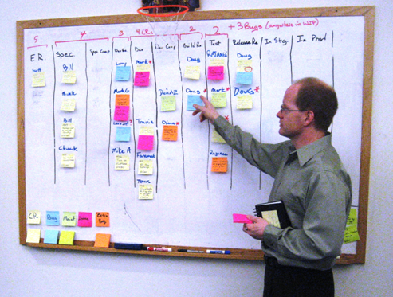
Kanban Boards
www.agileproductdesign.com/downloads/patton_kanban.ppt

Slide 35
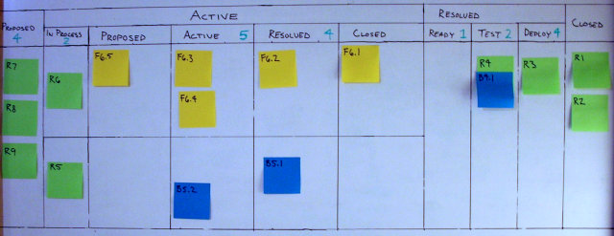
Kanban Boards
www.agileproductdesign.com/downloads/patton_kanban.ppt

Slide 36
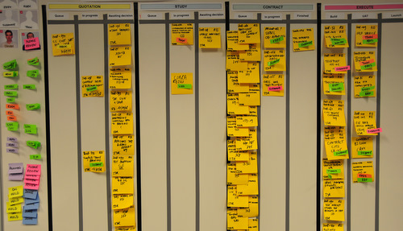
Kanban Boards
www.agileproductdesign.com/downloads/patton_kanban.ppt

Slide 37


Explode large process steps into tasks to improve visibility
When a feature or work item is large:
  Takes longer than a couple days to complete
  Requires that multiple people collaborate on its completion
Breakdown those steps into cards to track independently
Feature to develop
Tasks in progress
Tasks complete
Feature complete
Tasks in queue
www.agileproductdesign.com/downloads/patton_kanban.ppt

Slide 38
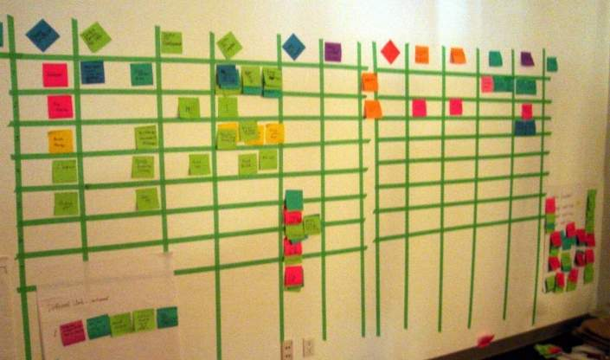
Kanban Board with Task Decomposition
www.agileproductdesign.com/downloads/patton_kanban.ppt

Slide 39
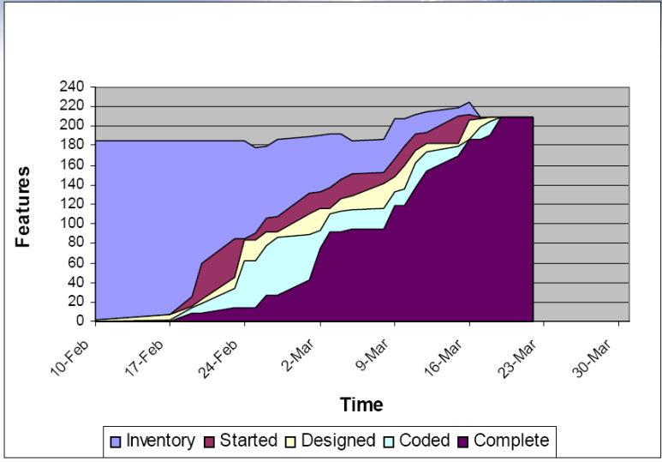
Use cumulative flow diagrams to visualize work in progress
www.agilemanagement.net/Articles/Papers/BorConManagingwithCumulat.html

Slide 40
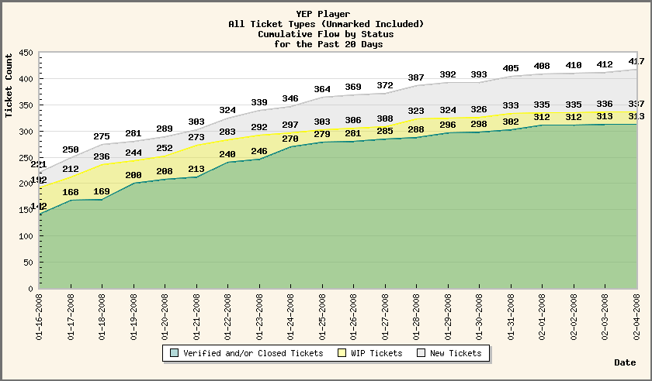
Use cumulative flow diagrams to visualize work in progress
www.agilemanagement.net/Articles/Papers/BorConManagingwithCumulat.html

Slide 41
Electronic Kanban
http://www.kanban.com/ResourceCenter/ULSuite/ULSuite.htm?VPButton

Slide 42
Keep time-boxed product and process inspection
Keep regular time-boxes in your process as a cue for product inspection:
Evaluate the quality of the growing product from a functional, engineering, and costumer perspective
Evaluate your pace of development:
Look at the number of development items completed relative to goals
Look at the average cycle time per development item
Calculate the ratio of developer days per completed item. Use this ratio to estimate the completion time for undeveloped items
Adjust your development plan as necessary
Evaluate and adjust the process you’re using
Use a process reflection session to identify changes you could make to improve your product or pace
Ending cycles right: http://www.stickyminds.com/s.asp?F=S14865_COL_2

Slide 43
Setting up a simple Kanban system starts to focus the team on the cycle-time of delivered work and gives a way to detect and begin to resolve bottlenecks
www.agileproductdesign.com/downloads/patton_kanban.ppt

Slide 44

Kanban simulation
Let’s simulate a simple process, then see if we can improve it by adding a Kanban system.
I’ll need some volunteers to manufacture the latest in high-tech aircraft

Slide 45
Three Case Studies

Slide 46
Case #1: Automotive Supplier
Massive inventories
Large batches
Long machine changeovers
Push production system
Slow response to customers (long lead times)

Slide 47


Manufacturing Sequence
Blanking
Stamping
Welding

Slide 48
Kanban
Welding booth is given the daily schedule
Empty parts tub with Kanban (signal card) slides to stamping press from welding booth
When stamping press uses up blanks, empty parts tub is sent down the slide to the blanking press
Notes:
The Kanban drives the pull system. Welding gets the schedule and sends the Kanban with the parts tub back to the stamping press. The stamping press sends the empty parts tub to the blanking press.

Slide 49
Kanban Production System
Circles = Machines/
Work Cell
Triangles = Buffers
Blanking
Stamping
Welding
FG
Finished Goods Inventory
Green Arrows = Circulation of Kanban
Blue Arrows = Movement of parts

Slide 50

After Conversion to Lean and Kanban
Shipping schedule drives production
Takt time paces the lines
Right sizing of equipment
Notes:
Machines should be available for production about 90% of the time and down for change-over 10% of the time, according to Toyota.

Slide 51
Case #2: Machine Manufacturer
Long lead times
Complex production processes
Product variety
Batch production
Large WIP and finished inventories

Slide 52
Conflicting Planning Systems
Master Schedule worked out by the Scheduling Dept. based on sales forecasts
Ever changing demands from the Sales Dept. intent on pleasing customers

Slide 53
Problems
Sales tries to beat the system and enters orders based on speculation
Sales alters options requested when the real order is received
Expediters move through the plant with a “hot list” for overdue orders

Slide 54
External Threat
Company made money despite its weaknesses
Suddenly, low priced competition entered the market
Notes:
Patents were circumvented.

Slide 55
Efforts at Change
Reorganization by standards or specials
Team orientation
Customer focus
MRP system with real time data input
Notes:
Chronological list of interventions designed to meet the low cost competition.
MRP with data entry in real time was “muda to the people.”
New computer, large data entry department.

Slide 56

A Lean Revolution
Conversion from a batch and queue system to a flow organization
Single piece flow (no buffer stock)
Value stream
One machine, one design, one order at a time
The Result: Production lead time reduced from 16 weeks to 14 hours

Slide 57
Kanban: New Scheduling System
MRP system retained for long-term ordering of materials
Day-to-day scheduling now run off a large whiteboard
Production day divided into slots by takt times
Orders written on the whiteboard as they are confirmed

Slide 58
Kanban (New Scheduling System)
Nothing produced without a confirmed order
Management Information Systems department was eliminated
Parts within the plant are pulled to the next station automatically
Product and information are combined
Notes:
Distributors and buyers of industrial equipment were unaccustomed to getting deliveries quickly.

Slide 59
Initial Problems
People missed the excitement of fire fighting
Lean operations revealed problems that had been covered up by high inventory levels
Deliveries of purchased components to the cells were not dependable
Notes:
There is a rush that comes from having to meet a deadline. Quality problems are especially hidden by high inventories. There was a touchup department that fixed up the nicks and scratches that are incurred during movement and storage.

Slide 60
Employee Issues
Will the company honor its commitment to retain excess workers?
Will contributions to improvement activities be recognized and rewarded?
People ask, “What will the changes mean for my career?”
Notes:
Lean but not mean.

Slide 61
Case #3: Electrical Components
Large inventories
Enormous batches
MRP system with 50% extra margin added to safety stocks
Machine maintenance neglected
Notes:
A manufacturer of electrical building materials used an MRP system. The large inventories masked quality problems and maintenance issues such as worn cutting tools, etc.

Slide 62
Under the MRP System
MPS used forecasts to ensure finished goods were on hand in a huge warehouse
Orders were processed in a batch mode
Few orders were shipped complete
Large customer service department was required to keep track and expedite orders
Many potential sources for errors

Slide 63
Initial JIT Challenges
Implementation not understood
Didn’t know how to reduce changeover times
Difficulty creating to a level schedule
Large inventories had glossed over problems
Express freight to make deliveries
Added customer service staff to explain later deliveries

Slide 64
Review Work Processes
Value creating jobs
Non-value creating jobs – but currently necessary to run the business
Non-value creating and unnecessary jobs
Notes:
Three types of jobs

Slide 65
Deming Philosophy
Fear of job loss can derail the conversion to lean – taking away fear of job loss is at the core of a lean conversion.
Notes:
You can’t expect cooperation if people are concerned about their job security. Who will work to eliminate their own job?

Slide 66
Get Management Involved
Manager’s should personally lead the implementation activities
Manager’s need to go out to the shop floor to work hands-on making improvements
The more senior the better - They need to see the waste and understand where change is needed

Slide 67
Results from the Lean System
Order-receipt-to-ship time reduced from more that a week to less than a day
As shipper withdrew parts from finished stock racks, this became the signal to make more of a given part
Fewer people & fewer errors
Instead of one month batches, parts were produced every day

Slide 68
Conclusions
Kanban can:
  simplify operations and improve control
  reduce inventories and improve cash flow
  reduce lead times
Set-up times must be reduced for lean to work to be able to reduce lot sizes
As internal issues are addresses – look to include vendors

Slide 69
In Conclusion
Kanban:
  offers greater responsiveness and therefore better customer satisfaction
  identifies mistakes quickly
  helps to identify muda (waste)
  is applicable to other areas of the firm in addition to production
MRP still may be used to maintain inventories, but in a reduced role
Notes:
Other areas for lean include order entry and design processes.

Slide 70
Questions?

Slide 71
Kanban References:
Anderson, Kanban in Action: http://www.agilemanagement.net/Articles/Weblog/KanbaninAction.html
Hiranabe, Kanban Applied to Software Development: from Agile to Lean: http://www.infoq.com/articles/hiranabe-lean-agile-kanban
Ladas, Scrum-ban: http://leansoftwareengineering.com/ksse/scrum-ban/
Belshee, Naked Planning, Kanban Simplified: http://joearnold.com/2008/03/naked-planning-kanban-simplified/
http://en.wikipedia.org/wiki/Kanban

