Slide 1
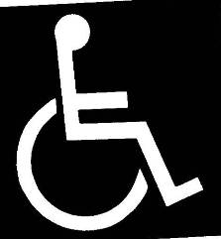
Universal Access Meeting Accessibility Requirements in Public Rights of Way

Slide 2
BACKGROUND & CURRENT ISSUES (WHY ADA EMPHASIS)

Slide 3
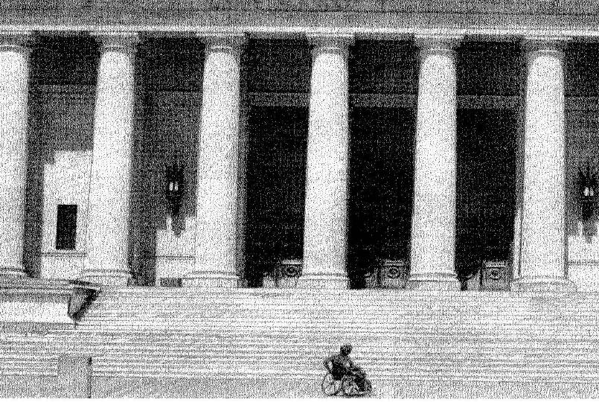
Universal Access for All - ADA
Notes:
Prior to the mid-70’s – A person with a disability had many challenges
Originally focused on access to buildings
Universal access considers all people (elderly, children, persons with disabilities)

Slide 4
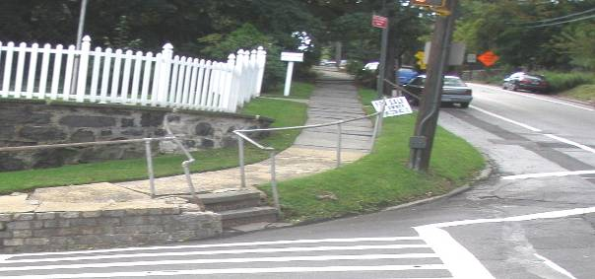
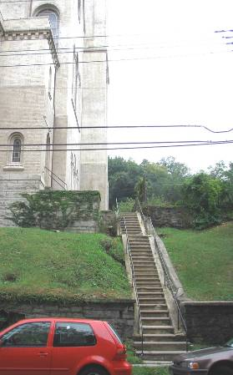
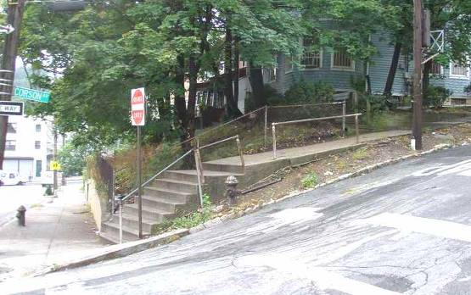
Notes:
Examples of what could be seen around the country

Slide 5
LAWS
The Rehabilitation Act
American Barriers Act (ABA)
Americans with Disabilities Act
1968
1973
1990
1982
1991
2002
2005
2007
1984
Minimum Guidelines
and Requirements for Accessible Design
1990
Special Report (PROWAC)
Draft Guidelines (PROWAC)
ADA Standards for Accessible Design
ADA Accessibility Guidelines (ADAAG)
Uniform Federal Accessibility Standards
Revised Draft Guidelines (PROWAC)
GUIDANCE
Notes:
American Barriers Act (ABA) 1968 becomes law
Required access to facilities designed, built, altered or leased with Federal funds
The Rehabilitation Act of 1973
Obligated State and Local Governments who Receive Federal funds
Ensure persons with disabilities have equal access to programs, activities & facilities
Access Board created. ROLE:
(US Architectural and Transportation Barriers Compliance Board)
Compliance of ABA
Ensure development of design standards
Americans with Disabilities Act (ADA) July 26, 1990
Prohibits discrimination against people with disabilities
Applies to all State and Local governments and New construction & alterations
Applies to private business that meet the definition of “public accommodation”
Includes those that receive no federal financial assistance
Minimum Guidelines and Requirements for Accessible Design 1982 published
Basis for development of standards
Uniform Federal Accessibility Standards (UFAS) August 1984,
Architectural standards for buildings
ADA Standards for Accessible Design July 1990 published
Defined requirements to make buildings & facilities accessible to peoples with disabilities
ADA Accessibility Guidelines (ADAAG) July 1991 published
Sept. 1991 ADAAG for Transportation Facilities
July 2004 update
Supplemented 2006 and 2007* US DOT
Public Rights of Way Accessibility Committee (PROWAC) 1999 Access Board establishes
Develop recommendations on guidelines for accessible public rights-of-way
Draft Guidelines, June 2002
Revised Draft Guidelines, Nov. 2005
Special Report: Planning and Designing for Alterations, July 2007
Show examples of application for Alterations.

Slide 6
Background
Americans with Disabilities Act (ADA)
July 26, 1990
Applies to State and Local governments
Applies to private business that meet the definition of “public accommodation”
Includes those that receive no federal financial assistance
New construction and alterations
Notes:
Public accommodation: restaurants, hotels, movie theaters, and doctors’ offices are just a few examples), commercial facilities (such as office buildings, factories, and warehouses), and many private employers

Slide 7
Background
Public Rights of Way Accessibility Committee (PROWAC)
Established 1999
Develop recommendations on guidelines for accessible public rights-of-way
Draft Guidelines, June 2002
Revised Draft Guidelines, Nov. 2005
Special Report: Planning and Designing for Alterations, July 2007

Slide 8
Types of Pedestrians
Older Adults
Children
Mobility Impairment
Sensory Impairment
Cognitive Impairment
Other Medical Concerns
Notes:
Although most guidance for the law is currently for wheel chair and sensory disabilities, need to consider others in design of facilities
OLDER ADULTS
Safety – More likely to get hurt
Ambulation – Slower walking speed
Object Manipulation – Reduced dexterity, coordination
Visual and Cognitive – Reduced sight and sensory processing or problem solving
CHILDREN
Reaction time
Less predictable behavior
Vision- peripheral vision development
PEOPLE WITH MOBILITY IMPAIRMENTS
Wheelchair, scooters, wheeled mobility devices
Walking-Aids (canes, walkers)
Prosthesis
PEOPLE WITH SENSORY IMPAIRMENT
Visual, deafness (total or partial) guide-dog users
PEOPLE WITH COGNITIVE IMPAIRMENT
Perceive, recognize, understand, interpret, and respond
OTHER MEDICAL CONCERNS
Such as heart problems – may reduce ability to travel the longer distances (such as ramps that weave back and forth)

Slide 9
TERMINOLOGY
Notes:
May want to show a Access Board video at this time.
Handout of Definitions (In Spanish, too)
Goal: Common Language. Changes in Oklahoma DOT standards (Manuals/Standard Plans) to reflect terminology found in the ADA guidance

Slide 11
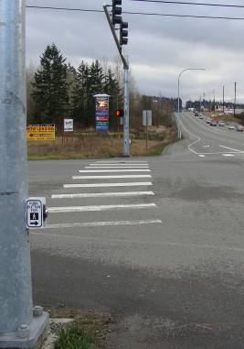
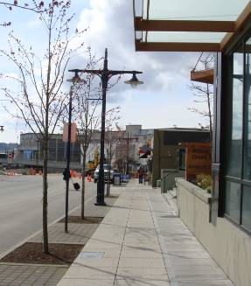
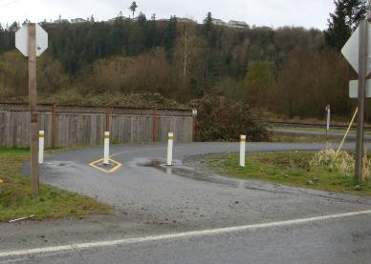
Pedestrian Access Route
Sidewalk or paved shoulder.
Running slope may match roadway grade.
2% cross slope required.
Notes:
Pedestrian Access Route (PAR) can be a shoulder, sidewalk or trail (shared use)
NOTE: Detectable waning surfaces are missing at the crosswalk on the shoulder and where trail meets the shoulder

Slide 12
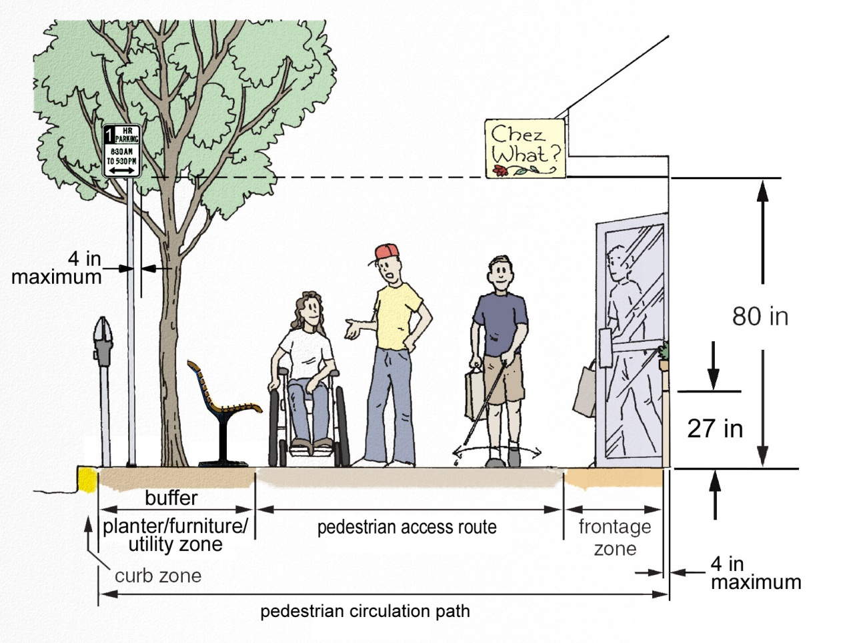

Slide 13
Pedestrian Facility Elements
The zone system divides the sidewalk corridor into four zones to ensure that pedestrians have a sufficient amount of clear space to travel.
Zone Min. Width
Curb 6 in.
Planter/Furniture/Utility 24 in., 48 in.
if planted
Pedestrian Access Route 60 in.
Frontage 30 in.
Total Sidewalk Corridor 10 ft. – 12 ft.
Zone Min. Width
Curb 6 in.
Planter/Furniture/Utility 24 in., 48 in.
if planted
Pedestrian Access Route 60 in.
Frontage 30 in.
Total Sidewalk Corridor 10 ft. – 12 ft.

Slide 14
Pedestrian Facility Elements
Zone Min. Width
Curb 6 in.
Planter/Furniture/Utility 24 in.,
48 in. if planted
Pedestrian Access Route 60 in.
Frontage 30 in.
Total Sidewalk Corridor 10 ft. – 12 ft.

Slide 15
Walking is the most fundamental form of transportation
Walkability takes into account the quality of pedestrian facilities, roadway conditions, land use patterns, community support, security and comfort for walking.
Land Use Setting
Community
Accessibility
Location of Destinations
Quality of Connections
Site Design
Pathways
Building Access ways
Related Facilities
Street Design Sidewalks Crosswalks Roadway Conditions Widths Traffic Volumes Traffic Speeds Accessible Pedestrian Signals

Slide 16
Curb Ramp Mess Gives Bend Council Headaches
By Mackenzie Wilson and Barney Lerten, KTVZ.COM
POSTED: 12:09 pm PDT September 2010
http://www.ktvz.com/news/24858262/detail.html

Slide 18
Cross Slope
Steep cross slopes make the sidewalk difficult for a wheelchair to travel across.
FHWA Designing Sidewalks and Trails for Access Part II of II
Notes:
Perpendicular to the direction of travel.
A steep cross slope makes it difficult wheelchairs, walkers, canes, or other types of walking aids. Refer to the Video.

Slide 19
Cross Slope
When cross slopes change rapidly over a short distance, the use of wheelchairs or other types of walking aids becomes extremely unstable.
FHWA Designing Sidewalks and Trails for Access Part II of II

Slide 20
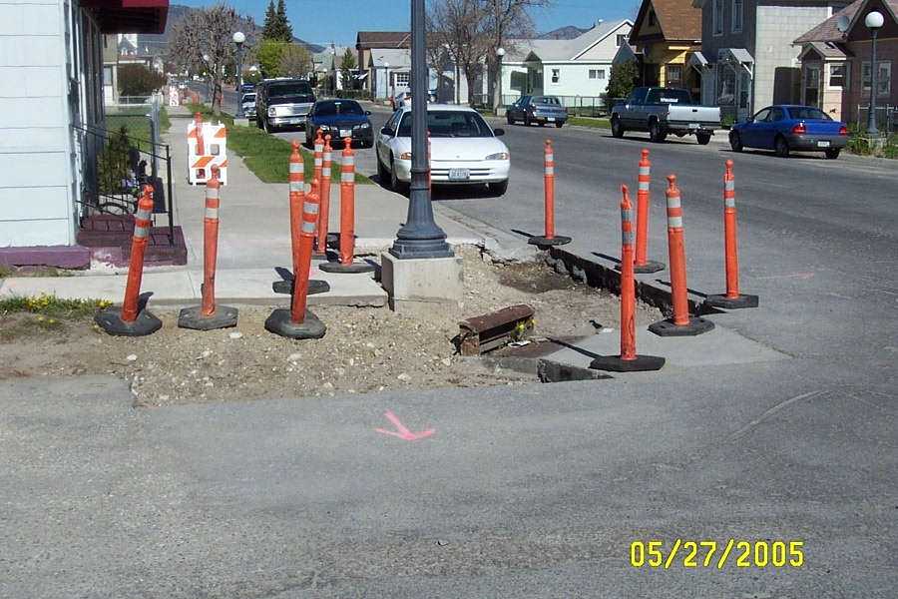
Notes:
Before
Example scenario as depicted in plan detail, light pole and curb inlet.

Slide 21
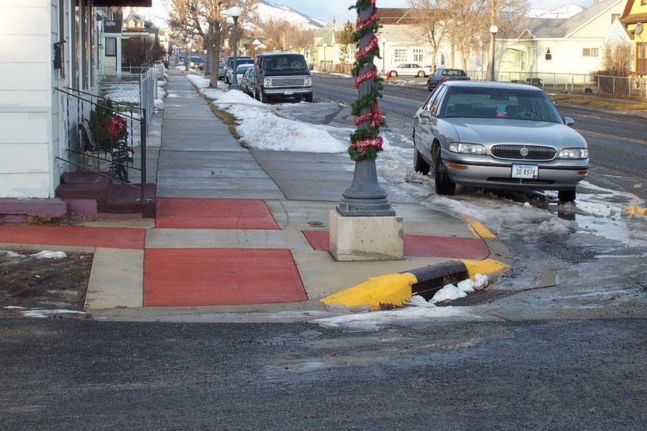
Notes:
After
Example ramps with common landing located at the top of ramp. In this scenario, additional ramps were constructed to transition into the sidewalk sections.
Note the water valve behind the light foundation

Slide 26
HOW BIG?
(It’s just a little gap…)

Slide 27
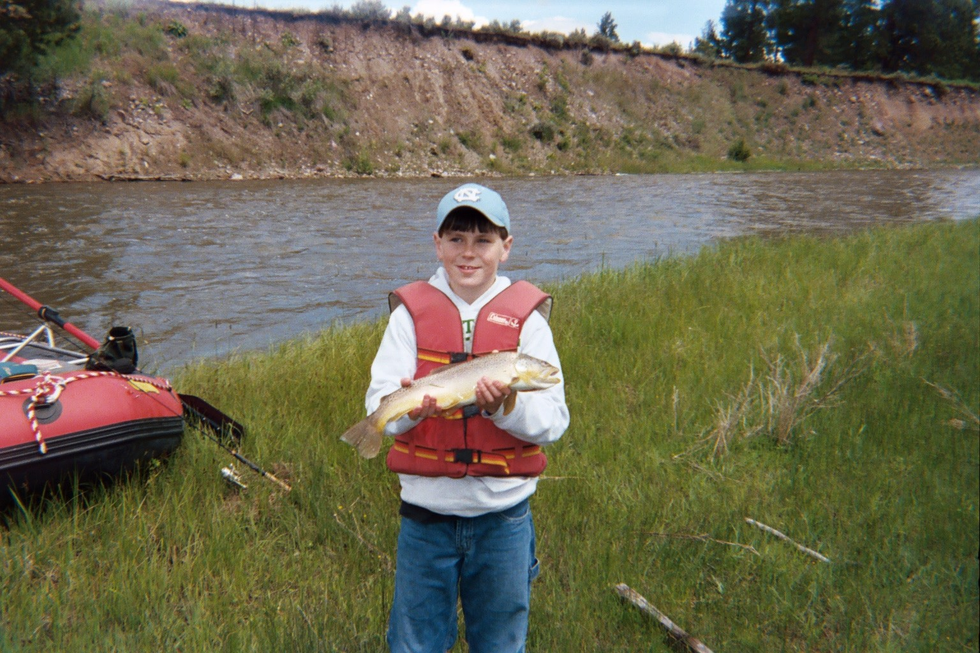
< 36” >
Notes:
Here’s my “claim” Joe is 11 years old and measures 36” across the chest! Prove me wrong.

Slide 29
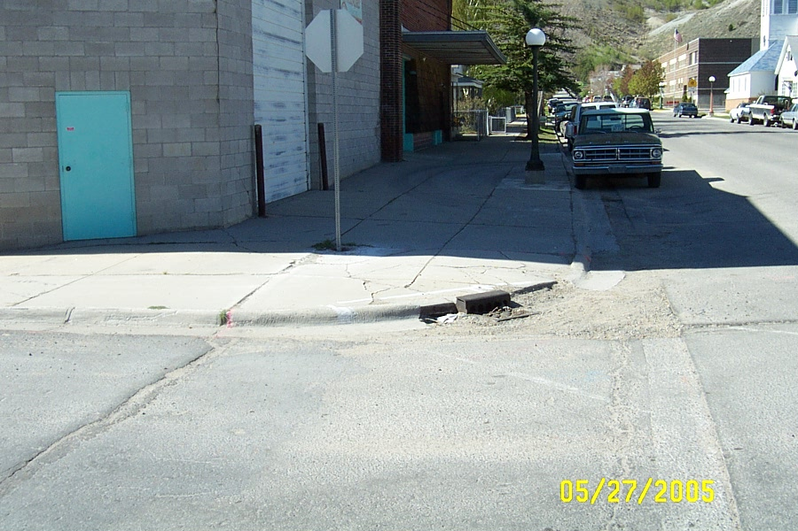
Notes:
Example of other features that effect design and layout.

Slide 31
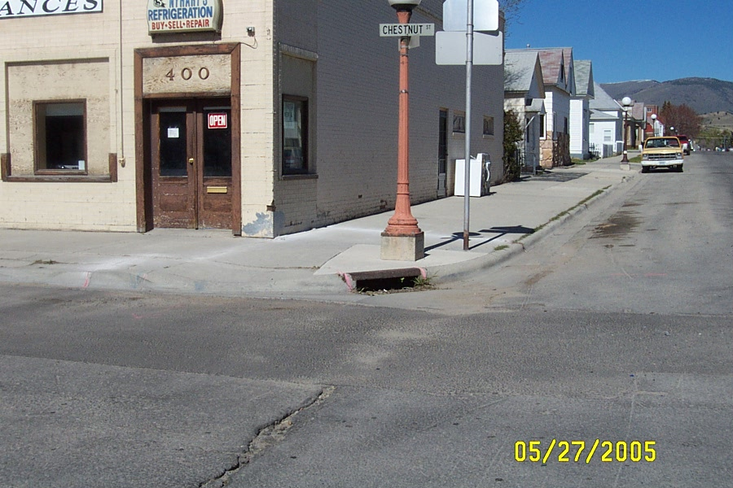
Notes:
Note other conflicting features: sign & building corner.

Slide 33
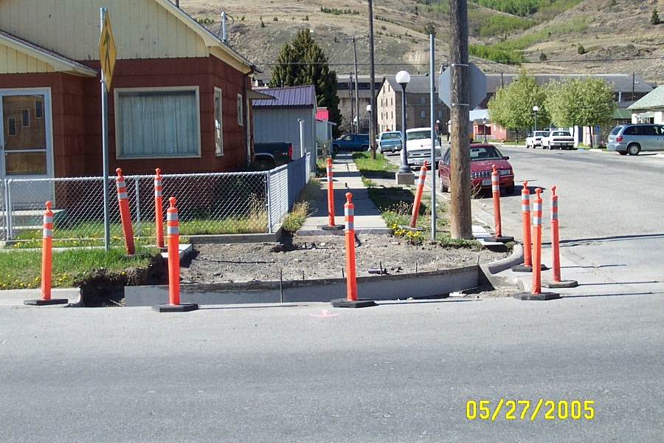
Notes:
Note other conflicting features: (3) signs, water valves & power pole.

Slide 35
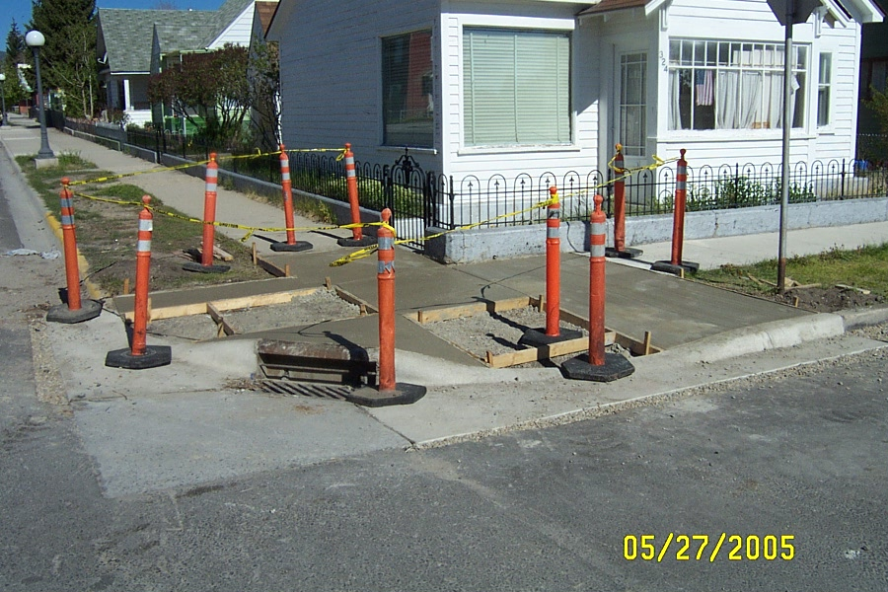
Notes:
Contractor contended multiple pours were required due to design changes. Claimed sequencing of pours was changed.
Common landing area, ramps tying to existing sidewalk and effected boulevard areas poured at once.

Slide 37
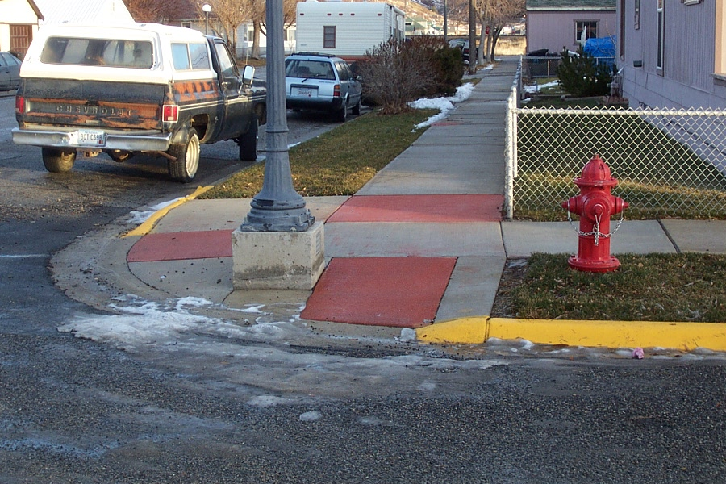
Notes:
An example where a ramp was constructed to transition from the landing to the sidewalk.

Slide 39
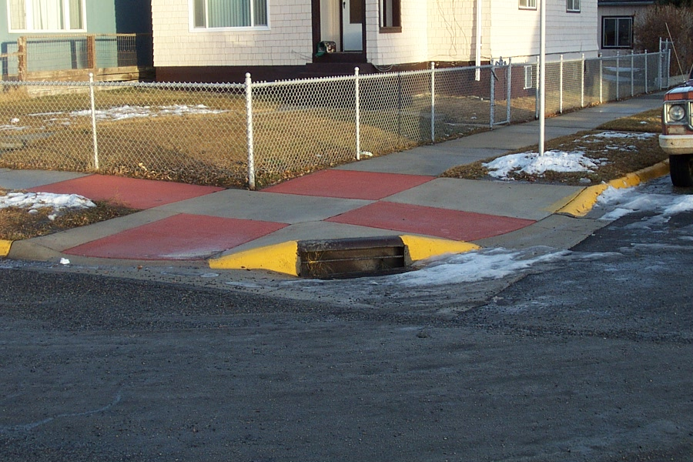
Notes:
An example where a ramp was constructed to transition from the landing to the sidewalk.

