Slide 1
Guided Mindfulness Meditation in SUD Treatment with Substance Abusing Offenders
DR. RON MOTTERN,
TCSA, 8/28/15

Slide 2
Agenda
What is Guided Mindfulness Meditation (GMM)?
Why should I care about it?
How we are using GMM
Results of using GMM
Theory
Practice
Resources

Slide 3
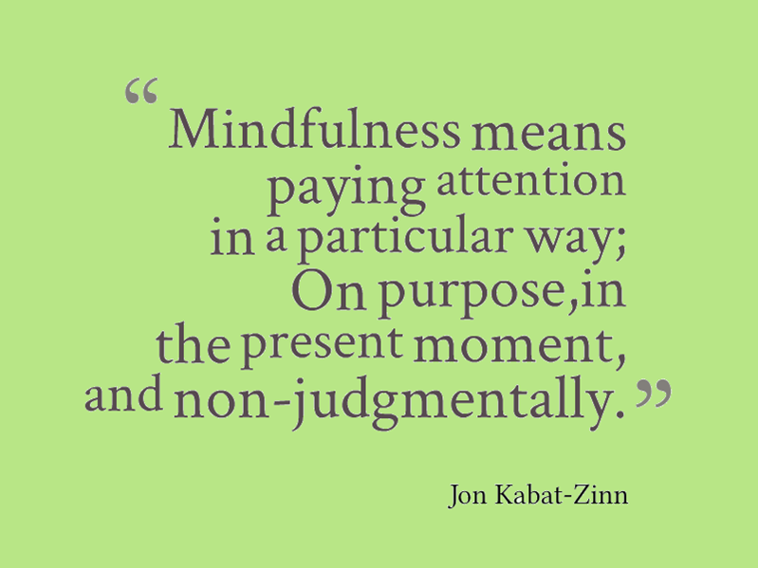
What is mindfulness?
Mindfulness is paying attention on purpose.

Slide 4
Origins of mindfulness
Sati is a Pali term meaning “to remember,” or, “memory,” but implies presence of mind, rather than the faculty of memory.
  First translated into English as “right mindfulness; the active, watchful mind” in 1881 by Pali-language scholar T. W. R. Davids.
  The corresponding Sanskrit term is smrti, and means “recollection.”
“The word sati derives from a root meaning 'to remember,' but as a mental factor it signifies presence of mind, attentiveness to the present, rather than the faculty of memory regarding the past. It has the characteristic of not wobbling, i.e. not floating away from the object. Its function is absence of confusion or non-forgetfulness. It is manifested as guardianship, or as the state of confronting an objective field. Its proximate cause is strong perception (thirasaññā) or the four foundations of mindfulness” (Retrieved from https://en.wikipedia.org/wiki/Mindfulness).

Slide 5
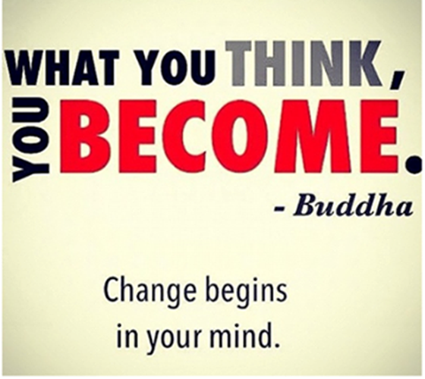
From religion to philosophy

Slide 6
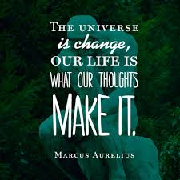

Philosophy
(and a brief hx of cognitive restructuring)

Slide 7
What is mindfulness?
Mindfulness is a form of mental training intended to enhance awareness and the ability to disengage from maladaptive patterns of mind that make one vulnerable to stress responses and psychopathology.
Training in mindfulness attempts to increase awareness of thoughts, emotions, and maladaptive ways of responding to stress, thereby helping participants learn to cope with stress in healthier, more effective ways ... (Shapiro, Astin, Bishop, & Cordova, 2005, p. 168).

Slide 8
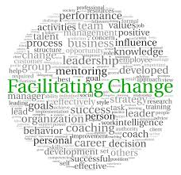
What is GMM?
Guided Mindfulness Meditation is the facilitated experience of mindfulness.
GMM is paying attention on purpose to what is being presented to you or through you.
GMM is the facilitation of change.

Slide 9
Why should I care?
1. It will make my job easier.
2. See Number 1.

Slide 10
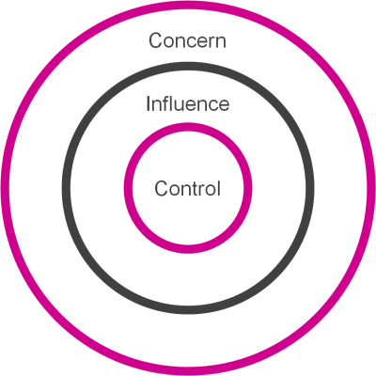
Why should I care?
1. It will make my job easier.
2. It will benefit the clients.
3. It will make the community safer.

Slide 11
Self-care
Working in SUD treatment with SAO is stressful and can lead to burnout (Garner, Knight & Simpson, 2007).
Increased stress can lead to a variety of problem:
  Depression,
  Decreased job satisfaction,
  Disruption in personal relationships,
  Psychological distress,
  Suicide
  Decreased professional effectiveness
    Decreases attention
    Reduces concentration
    Affects decision-making skills
    Reduces ability to form therapeutic alliance (Shapiro, Astin, Bishop & Cordova, 2005).
Mindfulness can reduce stress, anxiety, and depression (Miller, Fletcher & Kabat-Zinn, 1995).

Slide 12
Self-care
MM promotes relaxation.
Benefits of relaxation:
  Blood pressure lowers
  Immune system functions at a higher level
  Heart rate lowers
  Breathe at a slower rate
  Sleep patterns improve
  Digestion function increases
  Inflammation is reduced
    AMA states that 60% of all illness is related to STRESS

Slide 13
Companies using Mindfulness
Google
Twitter
Facebook
LinkedIn
Cisco
Ford
PayPal
Aetna
Intel
Keurig Green Mountain
General Mills
Goldman Sachs
Etc. …
“‘All the woo-woo mystical stuff, that’s really retrograde…. This is about training the brain and stirring up the chemical soup inside’” (Folk in Shachtman, Wired, 2013).
“‘Meditation here isn’t an opportunity to reflect upon the impermanence of existence but a tool to better oneself and improve productivity’” (Duane in Shachtman).
“Mindfulness should no longer be considered a “nice-to-have” for executives. It’s a ‘must-have’: a way to keep our brains healthy, to support self-regulation and effective decision-making capabilities, and to protect ourselves from toxic stress” (Congleton, Holzel and Lazar, Harvard Business Review, 2015).

Slide 14
Steve jobs and mindfulness
Steve Jobs
  Jobs studied Zen Buddhism and mindfulness meditation to increase his focus, clarity, productivity, and creativity.
  http://www.inc.com/geoffrey-james/how-steve-jobs-trained-his-own-brain.html
  http://www.news.com.au/technology/innovation/apple-founder-steve-jobs-used-zen-mindfulness-as-path-to-success/story-fnjwubd2-1227278750216

Slide 15

Stress
Stress: Portrait of a Killer
https://www.youtube.com/watch?v=eYG0ZuTv5rs

Slide 16
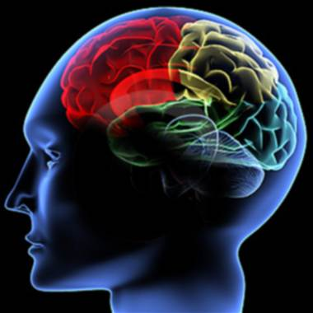
Client care
GMM facilitates the use of cognitive restructuring
GMM can be used to address relapse triggers with clients

Slide 17
neuroplasticity
OLD
NEW
The brain is concrete and can’t be changed
If brain cells die then they’re gone forever
The mind and the body are two separate things
The brain is plastic and can be molded
Brain cells can be regenerated
If part of the brain doesn’t function, other parts can compensate
The mind and body are intimately connected

Slide 18
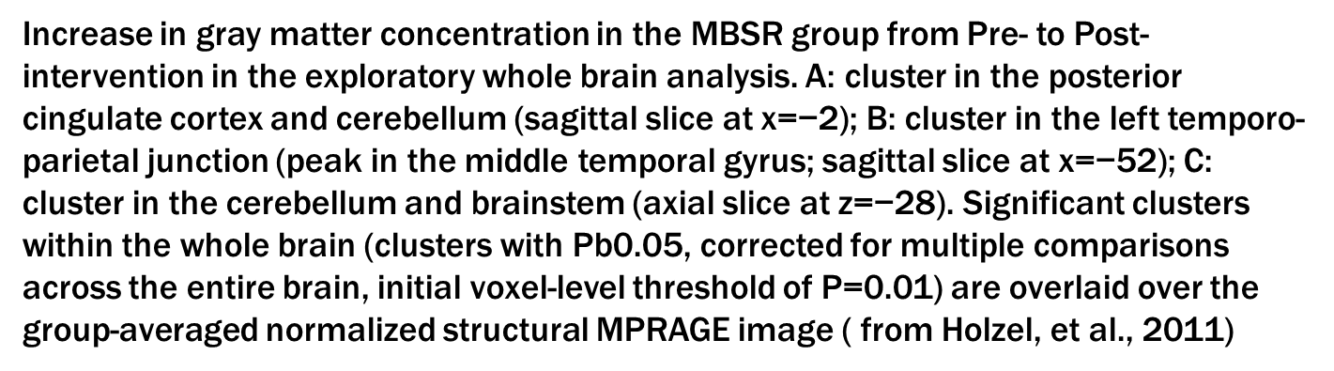
MM and brain plasticity

Slide 19
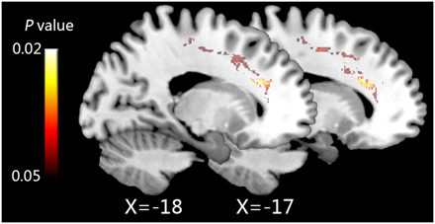
MM and Brain plasticity
Eleven hours of IBMT increases fiber integrity in the left anterior corona radiata (after versus before training, two sagittal sections, x = −17 and −18). (from Tang, et al., 2010)

Slide 20
mindfulness & Cognitive restructuring
MINDFULNESS
COGNITIVE SELF-CHANGE
Mindfulness is a form of mental training intended to enhance awareness and the ability to disengage from maladaptive patterns of mind that make one vulnerable to stress responses and psychopathology.
Training in mindfulness attempts to increase awareness of thoughts, emotions, and maladaptive ways of responding to stress, thereby helping participants learn to cope with stress in healthier, more effective ways ... (Shapiro, Astin, Bishop, & Cordova, 2005, p. 168).
Cognitive Restructuring
  1. Pay attention to my thoughts/feelings.
  2. Identify risk in my thoughts/feelings leading to unwanted consequences.
  3. Replace my risk thoughts with new thoughts that reduce my risk and move me closer to what I want in a way that doesn’t hurt me or others.

Slide 21
Mindfulness and Relapse triggers
Mindfulness can be used to address relapse triggers:
  Stress (Brewer, et al., 2011; Grossman, Niemann, Schmidt & Wallach, 2004)
  Anxiety (Miller, Fletcher & Kabat-Zinn, 1995)
  Pain (Kabat-Zinn, 1982; Rosenzweig, et al., 2010)
  PAWS symptoms, including cravings/urges (Alberts, Thewissen & Raes, 2012; Westbrook, et al., 2011 ; Witkiewitz & Bowen, 2010)
  “Neuroscientists have also shown that practicing mindfulness affects brain areas related to perception, body awareness, pain tolerance, emotion regulation, introspection, complex thinking, and sense of self” (Congleton, Holzel and Lazar, Harvard Business Review, 2015).

Slide 22
Mindfulness and empathy
The purpose of this study was to investigate the effects of a Buddhist meditation intervention on empathy, perceived stress, mindfulness, self-compassion, and of particular interest, the dispositional tendency to feel empathic concern rather than personal distress when perceiving another as in need, termed altruistic orientation. Participants were randomly assigned to an intervention group (n020) or a waiting list control group (n022). Results indicated a trend towards increases in altruistic orientation in the intervention group—an increase that significantly correlated with meditation time, decreases in perceived stress, and increases in self-compassion and mindfulness. Additionally, compared to the controls, significant increases in mindfulness and selfcompassion and a significant decrease in perceived stress were obtained for the intervention group. (from Wallmark, et al., 2012)

Slide 23
Mindfulness and empathy
Empathic responding, most notably perspective-taking and empathic concern, has important implications for interpersonal functioning. While empathy training approaches have received some support for a variety of populations, few extant interventions have targeted empathic responding in couples. Mindfulness- and acceptance-based behavioral approaches, for couples as a unit and ⁄ or for individual family members ⁄ partners, are proposed as an adjunct to empathy training interventions. Preliminary findings suggest that the viability of these interventions for increasing empathic responding should be further investigated, and specific suggestions for this line of research are offered. (from Block-Lerner, et al., 2007)

Slide 24

How we are using gmm
GMM is used at the beginning of each IOP session.
  Diaphragmatic breathing
  Guided exercise focusing on being mindful of sensory experiences occurring in the meditation
  Cts are encouraged to use MM to find the space between risk thinking and behavior allows them to use new thinking
  Cts are encouraged to use skills instead of pills to deal with things such as anxiety, stress, pain, and other relapse triggers.

Slide 25

Results of using gmm
A review of program evaluations submitted by clients who have successfully graduated from one class in the IOP program indicate that the GMM is generally seen as useful by the clients.

Slide 26
theory
Diaphragmatic breathing: https://www.youtube.com/watch?v=1WMt_1jw47Q

Slide 27
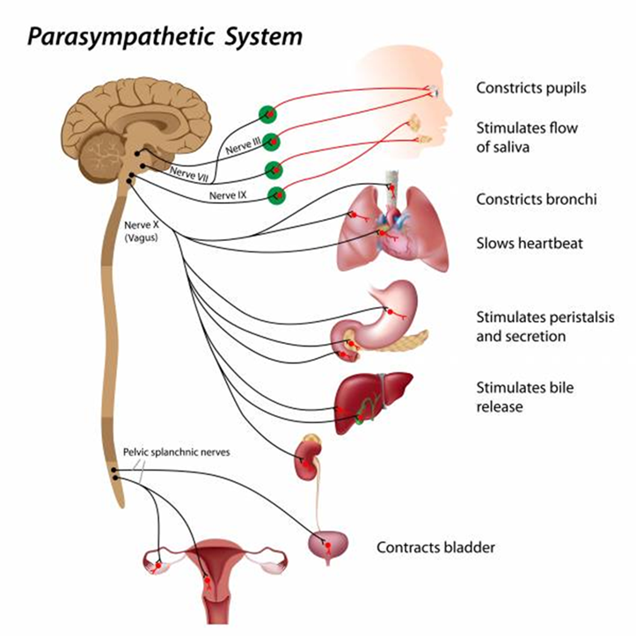
Vagus nerve

Slide 28
Stimulation of the vagus nerve
Immerse your face (especially the forehead, eyes, and two-thirds of your cheeks) in cold water for three minutes.
Practice restorative yoga and include gentle backbends, forward bends, and twists.
Inversion such as downward dog or legs up the wall.
Chant and sing in low resonant tones.
Immerse your tongue in saliva while doing long deep breathing.
Practice qigong.
Laugh with deep diaphragmatic laughs (Fredrickson, 2015).

Slide 29

Practice
Breathe IN through the nose for a count of 4
HOLD the breath for a count of 4
Breathe OUT through the mouth for a count of 8

Slide 30

practice
Lemon Exercise (used to teach Total Behaviors)

Slide 31

Practice
Ron’s Rocks

Slide 32
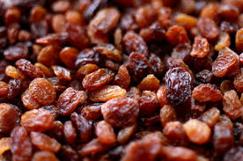
Practice
The Amazin’ Raisin

Slide 33
resources
YouTube for GMM
  https://www.youtube.com/watch?v=Fpiw2hH-dlc
  https://www.youtube.com/watch?v=8v45WSuAeYI
Mindfulness CD resources
  http://www.healthyvisions.net/
App for mindfulness (and sleep)
  CBT-i Coach
UCLA Mindful Awareness Research Center
  http://marc.ucla.edu/body.cfm?id=22

Slide 34
References
Alberts, H. J. E. M., Thewissen, R., & Raes, L. (2012). Dealing with problematic eating behavior: The effects of a mindfulness-based intervention on eating behavior, food cravings, dichotomous thinking and body image concern. Appetite, 58(1), 847-851. Retrieved from http://www.researchgate.net/profile/Roy_Thewissen/publication/221767056_Dealing_with_problematic_eating_behaviour._The_effects_of_a_mindfulness-based_intervention_on_eating_behaviour_food_cravings_dichotomous_thinking_and_body_image_concern/links/54cd30c40cf24601c08cedf4.pdf
Block-Lerner, J., Adair, C., Plumb, J. C., Rhatigan, D. L., & Orsillo, S. M. (2007). The case for mindfulness-based approaches in the cultivation of empathy: Does nonjudgmental, present-moment awareness increase capacity for perspective-taking and empathic concern. Journal of Marital and Family Therapy, 33(4), 501-516. Retrieved from http://kcarrieadair.web.unc.edu/files/2014/10/Block-Lerner.Empathy_20071.pdf
Brewer, J. A., Sinha, R., Chen, J. A., Michalsen, R. A., Babuscio, T. A., Nich, C., Grier, A., Bergquist, K. L., Reis, D. L., Potenza, M. N., Carroll, K. M., & Rounsaville, B. J. (2009). Mindfulness training and stress reactivity in substance abuse: Results from a randomized, controlled stage I pilot study. Substance Abuse, 30(4), 306-317. Retrieved from http://www.ncbi.nlm.nih.gov/pmc/articles/PMC3045038/
Frederickson, D. (1986, May 13). The vagus nerve: An unexpected key to better performance. Breaking Muscle. Retrieved from facebook
Garner, B. R., Knight, K., & Simpson, D. D. (2007). Burnout among corrections-based drug treatment staff: Impact of individual and organizational factors. International Journal of Offender Therapy and Comparative Criminology, 51(5), 510-522.
Grossman, P., Niemann, L., Schmidt, S. , & Walach, H. (2004). Mindfulness-based stress reduction and health benefits: A meta-analysis. Journal of Psychosomatic Research, 57(1), 35-43. Retrieved from http://s3.amazonaws.com/academia.edu.documents/30863901/MBSRMAJPR2004.pdf?AWSAccessKeyId=AKIAJ56TQJRTWSMTNPEA&Expires=1440094987&Signature=EIlj15hp6P0e8cvxQJf8zqF21HQ%3D&response-content-disposition=inline

Slide 35
Holzel, B. K., Carmody, J., Vangel, M., Congleton, C., Yerramsetti, S. M., Gard, T., & Lazar, S. W. (2011). Mindfulness practice leads to increases in regional brain gray matter density. Psychiatry Research: Neuroimaging, 191(1), 36-43. Retrieved from http://www.umassmed.edu/uploadedfiles/cfm2/psychiatry_resarch_mindfulness.pdf
Kabat-Zinn, J. (1982). An outpatient program in behavioral medicine for chronic pain patients based on the practice of mindfulness meditation: Theoretical considerations and preliminary results. General Hospital Psychiatry, 4(1), 33-47. Retrieved from http://brainimaging.waisman.wisc.edu/~perlman/0903-EmoPaper/kabatzinn-mbsr-1982.pdf
Miller, J. J., Fletcher, K., & Kabat-Zinn, J. (1995). Three-year follow-up and clinical implications of a mindfulness meditation-based stress reduction intervention in the treatment of anxiety disorders. General Hospital Psychiatry, 17(1), 192-200. Retrieved from http://www.psicoterapiabilbao.es/mediapool/104/1048833/data/Curso_COP/three-year_follow-up_and_clinical_implications_of_a_mindfulness_meditation-based_.pdf
Rosenzweig, S., Greeson, J. M., Reibel, D. K., Green, J. S., Jasser, S. A., & Beasley, D. (2010). Mindfulness-based stress reduction for chronic pain conditions: Variation in treatment outcomes and role of home meditation practice. Journal of Psychosomatic Research, 68(1), 29-36. Retrieved from http://www.researchgate.net/profile/Jeffrey_Greeson/publication/40682157_Mindfulness-based_stress_reduction_for_chronic_pain_conditions_variation_in_treatment_outcomes_and_role_of_home_meditation_practice/links/00b49523d0df25001f000000.pdf

Slide 36
Shachtman, N. (2013, June 18). In Silicon Valley, meditation is no fad. It could make your career. Wired. Retrieved from Facebook
Shapiro, S. L., Astin, J. A., Bishop, S. R., & Cordova, M. (2005). Mindfulness-based stress reduction for health care professionals: Results from a randomized trial. International Journal of Stress Management, 12(2), 164-176.
Tang, Y. Y., Lu, Q., Geng, X., Stein, E. A., Yang, Y., & Posner, M. I. (2010). Short-term meditation induces white matter changes in the anterior cingulate. Proceedings of the National Academy of Sciences of the United States of America, 107(35), 15649-15652. Retrieved from http://www.pnas.org/content/107/35/15649.full
Wallmark, E., Safarzadeh, K., DaukantaiteD., & Maddux, R. E. (2012). Promoting altruism through meditation: An 8-week randomized controlled pilot study. Mindfulness, 4(1), 223-234. Retrieved from http://citeseerx.ist.psu.edu/viewdoc/download?doi=10.1.1.378.7804&rep=rep1&type=pdf
Westbrook, C., Creswell, J. D., Tabibnia, G., Julson, E., Kober, H., & Tindle, H. A. (2011). Mindful attention reduces neural and self-reported cue-induced craving in smokers. Social Cognitive and Affective Neuroscience, 8(1), 73-84. Retrieved from http://scan.oxfordjournals.org/content/8/1/73.full
Witkeiwitz, K., & Bowen, S. (2010). Depression, craving and substance use following a randomized trial of mindfulness-based relapse prevention. Journal of Consulting Clinical Psychology, 78(3), 362-374. Retrieved from http://www.ncbi.nlm.nih.gov/pmc/articles/PMC3280693/

