Slide 1
WELCOME TO OUR BIBLE STUDIES NIGHT
WHERE LEARNING GOD’S WORD IS OUR
SOURCE FOR FIGHTING THE GOOD FIGHT OF
FAITH!

Slide 2
HOW TO DEAL WITH THE STRONGMAN
Part 5
CHALLENGING
SPIRITUAL
FORCES

Slide 3
TONIGHT WE WILL BE LOOKING AT ANOTHER ONE OF SATAN’S EMMISARY
THE
SPIRIT
OF
JEALOUSY

Slide 4
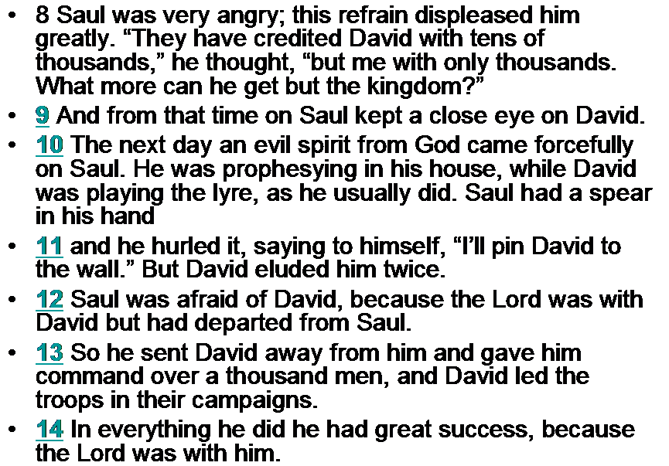
1 SAMUEL 18:8-14
Notes:
SAUL SAID WITHIN HIMSELF THAT THE ONLY THING LEFT FOR DAVID TO DO WAS TO TAKE OVER THE KINGDOM!!
SAUL KEPT A CLOSE EYE ON DAVID….OUR ENEMY SATAN HAS A CLOSE EYE ON ALL OUR DOINGS!!
THE REASON DAVID HAD GREAT SUCCESS WAS BECAUSE HE TRUSTED HIS GOD IN EVERYTHING!!!

Slide 5
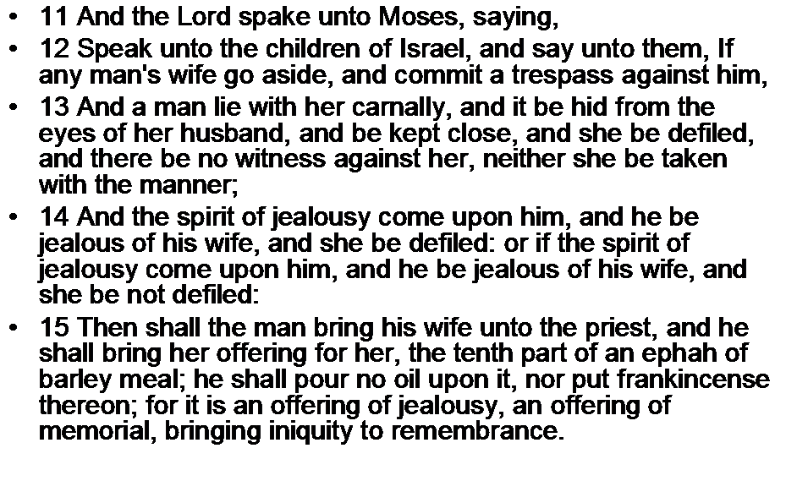
NUMBERS 15:11-15

Slide 6
To be jealous of someone is to be intolerant and hostile toward a person who is perceived to be a threat or a rival to one’s position or authority. A jealous spirit stems from feelings of over-possessiveness and holding too high an opinion of oneself. The jealous person feels like no one else can—or should be able to—do what they do; the jealous person feels that no one else has the right to do what they can do. Instead of admiring the capabilities, competence, excellence or talents of another, the jealous person views these qualities as a challenge to who they are.
A MAJOR CHALLENGE IN CHURCHES TODAY
THAT NEEDS TO BE DEALT WITH IMMEDIATELY
WHEN NOTICED!!

Slide 7
BELOVED, THIS STRONG SPIRIT PROVOKES TO JEALOUSY BY DECIEVING A PERSON WITH INSINUATING, CIRCUMSTANCES. IT SETS THE SNARE WITH CIRCUMSTANTIAL EVIDENCE. THIS SPIRIT IS A STRONGMAN SENT FROM SATAN; HE IS A PRINCIPAL POWER, WITH PERHAPS MANY COMMON DEMONS WORKING WITH HIM. WE MUST RECOGNIZE HIM AND HIS MANIFESTATIONS, ELSE WE MAY FALL RIGHT INTO HIS SNARE AND COOPERATE WITH HIM !!!!
A WORD TO THE WISE IS SUFFICIENT !!!

Slide 8
BRETHEREN….
WHAT IS CIRCUMSTANTIAL EVIDENCE?
Circumstantial Evidence is known as indirect evidence.
Circumstantial evidence is best explained by saying what it is not - it is not direct evidence from a witness who saw or heard something.
Indirect evidence that implies something occurred but doesn't directly prove it; proof of one or more facts from which one can find another fact; proof of a chain of facts and circumstances indicating that the person is either guilty or not guilty.

Slide 9
Here is how jealousy works…
The spirit of jealousy destroys Christian Friends by planting suspicious thoughts about another person in the mind, thus causing one to take offense where none is really intended. Then he will use an available mouth, it could be yours, to relay an innocent remark made by one of the parties. The other party is offended, and in turn reciprocates with a few remarks of its own. They have fallen into the “snare of the fowler” and before they know it , they have lost each other as friends.

Slide 10
In Saul's case he allowed this spirit to trick his mind causing him to feel insecure. Saul may have felt that the people may have loved David a whole lot more than him, that set off a state of insecurity. Saul may have also felt inferior, and unworthy. He may have felt less favored and less blessed by God . He felt distrustful.
What is the best anecdote to the evil works of this kind of assault on a persons mind.??

Slide 11
A MAJOR QUESTION TO BE ASKED IS THE FOLLOWING……
DID THIS EVIL SPIRIT OF JEALOUSY REALLY COME FROM THE LORD ????
IN 1 SAMUEL 15:26 STATES THAT SAUL WAS NO LONGER LISTENING TO THE LORD, SO GOD DIRECTED THE PROPHET SAMUEL TO ANOINT DAVID AS KING IN PLACE OF SAUL. VERSE 14 SAYS THAT THE SPIRIT OF THE LORD LEFT SAUL!!! AND AN EVIL SPIRIT FROM THE LORD TROUBLED HIM!!
BELOVED WHEN THE SPIRIT OF THE LORD LEFT SAUL IT LEFT AND OPENING FOR THE DEVIL’S SPIRTS TO ENTER IN AND CAUSE HAVOC. WHEN THE BIBLE SAYS THAT A SPIRIT FROM THE LORD TROUBLED HIM IT DOESN’T MEAN THAT GOD IS SAYING …”I HAVE A DEVIL I’M GOING TO GIVE YOU”. WHAT THE BIBLE IS ACTUALLY TRYING TO COMMUNICATE TO US IS THAT…BECAUSE SAUL REJECTED GOD HE ALSO REJECTED GOD’S PROTECTION. THIS OPENING GAVE SAUL A STATE OF DEPRESSION CAUSED BY THIS DEMONIC ,SATANIC, MENACING, EVIL , WICKED SPIRIT FROM SATAN.

Slide 12
LET US ALSO UNDERSTAND THAT GOD IS NOT THE ONE DOING THE TEMPTING….James 1:13 says…. LET NO ONE SAY WHEN HE IS TEMPTED, I AM TEMPTED OF GOD FOR GOD CANNOT BE TEMPTED BY EVIL, NOR DOES HE HIMSELF TEMPT ANYONE. (WITH EVIL)
BELOVED GOD ALLOWS TEMPTATION TO COME IN ORDER TO STRENGTHEN OUR CHARACTER , BUT HE DOESN’T SEND IT!!

Slide 13
Jesus taught in scriptures, do good to those who despitefully use you, overcome evil with good; bless those who curse you; love those who hate you…
beloved this is certainly not an easy thing to do!!!
Listen, when dealing with this spirit we must recognize that this is not some little ordinary spirit, you are wrestling a prince of the power of the air!! To this spirit we show the edge of the word of God which will cut him asunder, and send him out of our midst!!
We are not fighting against flesh and blood!!

Slide 14
In the book of Numbers..5:12,14 we read a story of the “spirit of jealousy” falling on a husband!
12 Speak unto the children of Israel, and say unto them, If any man's wife go aside, and commit a trespass against him,
13 And a man lie with her carnally, and it be hid from the eyes of her husband, and be kept close, and she be defiled, and there be no witness against her, neither she be taken with the manner;
14 And “the spirit of jealousy” come upon him, and he be jealous of his wife, and she be defiled: or if “the spirit of jealousy” come upon him, and he be jealous of his wife, and she be not defiled:
15 Then shall the man bring his wife unto the priest, and he shall bring her offering for her, the tenth part of an ephah of barley meal; he shall pour no oil upon it, nor put frankincense thereon; for it is an offering of jealousy, an offering of memorial, bringing iniquity to remembrance.
16 And the priest shall bring her near, and set her before the Lord:
Notes:
V 13…NEITHER SHE BE TAKEN WITH THE MANNER….IN OTHER WORDS NO ONE COULD POINT A FINGER AT HER!!!
V 14 …SPEAKS OF BOTH SIDES OF THE FENCE …EITHER SHE DID OR SHE DIDN’T….
QUESTION WHAT HAPPENS IF THE WOMAN WERE TO BE JEALOUS OF HER HUSBAND…WHAT THEN”???
ANSWER ….WOMEN HAD NO RIGHTS!!! IT WAS KIND OF …IT IS A MANS WORLD!!!!

Slide 15
¹⁷ And the priest shall take holy water in an earthen vessel; and of the dust that is in the floor of the tabernacle the priest shall take, and put it into the water:
¹⁸ And the priest shall set the woman before the Lord, and uncover the woman's head, and put the offering of memorial in her hands, which is the jealousy offering: and the priest shall have in his hand the bitter water that causeth the curse:
¹⁹ And the priest shall charge her by an oath, and say unto the woman, If no man have lain with thee, and if thou hast not gone aside to uncleanness with another instead of thy husband, be thou free from this bitter water that causeth the curse:

Slide 16
²⁰ But if thou hast gone aside to another instead of thy husband, and if thou be defiled, and some man have lain with thee beside thine husband:
²¹ Then the priest shall charge the woman with an oath of cursing, and the priest shall say unto the woman, The Lord make thee a curse and an oath among thy people, when the Lord doth make thy thigh to rot, and thy belly to swell;
²² And this water that causeth the curse shall go into thy bowels, to make thy belly to swell, and thy thigh to rot: And the woman shall say, Amen, amen.
²³ And the priest shall write these curses in a book, and he shall blot them out with the bitter water:

Slide 17
²⁴ And he shall cause the woman to drink the bitter water that causeth the curse: and the water that causeth the curse shall enter into her, and become bitter.
²⁵ Then the priest shall take the jealousy offering out of the woman's hand, and shall wave the offering before the Lord, and offer it upon the altar:
²⁶ And the priest shall take an handful of the offering, even the memorial thereof, and burn it upon the altar, and afterward shall cause the woman to drink the water.
²⁷ And when he hath made her to drink the water, then it shall come to pass, that, if she be defiled, and have done trespass against her husband, that the water that causeth the curse shall enter into her, and become bitter, and her belly shall swell, and her thigh shall rot: and the woman shall be a curse among her people.

Slide 18
²⁸ And if the woman be not defiled, but be clean; then she shall be free, and shall conceive seed.
²⁹ This is the law of jealousies, when a wife goeth aside to another instead of her husband, and is defiled;
³⁰ Or when “the spirit of jealousy” cometh upon him, and he be jealous over his wife, and shall set the woman before the Lord, and the priest shall execute upon her all this law.
³¹ Then shall the man be guiltless from iniquity, and this woman shall bear her iniquity.

Slide 19
HERE WE READ OF A WOMAN WHO IN A QUESTIONABLE STATE HAS BEEN THOUGHT TO BE DEFILED BY LYING WITH ANOTHER MAN. HOWEVER THE ACT ITSELF WAS NOT KNOWN TO HER HUSBAND; IN FACT, IT WAS “HID FROM THE EYES OF HER HUSBAND: THERE WERE NO WITNESSES AGAINST HER.
HOWEVER VERSE # 14 SAYS..AND THE “SPIRIT OF JEALOUSY “ COME UPON HIM AND HE BE JEALOUS….”
THIS MAN HAD NO PERSONAL KNOWLEDGE OF HIS WIFE’S SIN. IT WAS KEPT A SECRET FROM HIM, AND SHE WAS NOT PREGNANT.
WHAT HAPPENED HERE WAS THAT THE “SPIRIT OF JEALOUSY “THAT FELL ON HIM CAUSED HIM TO SUSPECT HIS WIFE!
QUESTION IS ….DID THE SPIRIT TELL HIM OR REVEAL IT TO HIM????
BELOVED,
THE MARIAGE BONDS ORDAINED BY GOD HIMSELF, OFFER PERFECT SECURITY IF WE ARE CAREFUL TO STAY WITHIN THEM.!!!
THE “ SPIRIT OF JEALOUSY SEEKS TO DESTROY THESE UNIONS WITH DESCREET MIND CONTROL!!
WE ARE TOLD TO PROTECT OUR MIND!!!

Slide 20
SOMETHING TO REMEMBER IS THAT THE “SPIRIT OF JEALOUSY” MANIFESTS ITSELF IN RESENTMENT, HATRED AND BAD FEELINGS TOWARD YOUR FAMILY, YOUR NEIGHBORS, OR YOUR BROTHERS OR SISTERS IN CHRIST.
THE WORD OF GOD SAYS….BY THIS SHALL ALL MEN KNOW THAT YOU ARE MY DISCIPLES IF YE HAVE LOVE ONE TO ANOTHER. JOHN 13:35
PROVERBS 10:12…HATRED STIRRETH UP STRIFES: BUT LOVE COVERTH ALL SINS:
EPHESIANS 5:2 …..AND WALK IN LOVE AS CHRIST ALSO LOVED US.
THE BEST WAY TO AVOID THE TRAP OF THIS ENEMY IS TO ACT ON THE WORD OF GOD…
STUDY… 1 CORINTHIANS 13 THE LOVE CHAPTER IT WILL KEEP US IN GOOD ORDER AND KEEP THIS MONSTER AT BAY!!!

Slide 21
MANIFESTATIONS OF THE “SPIRIT OF JEALOUSY
JEALOUSY
MURDER….GENESIS 4:8
ANGER…….GENESIS 4:5,6
RAGE……….PROVERBS 6:34
WRATH…….GENESIS 4:5
REVENGE…PROVERBS 6:34
SPITE……….PROVERBS 6:34
HATE……….GENESIS 37:3,4,8
CRUILTY, CRUSHING,MALICIOUSNESS…… SONG OF SOLOMON 8:6
SUSPICION…..NUMBERS 5:14
COVETING
COMPETITIVE SPIRIT……GENSIS 4: 4,5
EMULATION…..COMPETITION
SELFISHNESS….ENVY
VARIANCE…DIVIDES, SEPARATES …ESPECIALLY HOMES AND CHURCHES.

Slide 22

END PART 5

