Slide 1
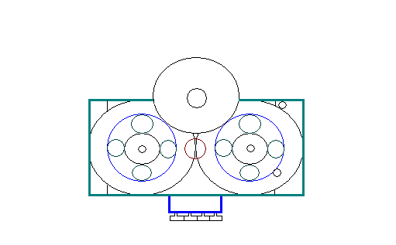
Golden Presentation
Game Changing Transmission
Giving cars a greater fuel efficiency, performance and durability at a lower cost.

Slide 2
Where we are today
Feasibility
Proof of Concept Completed- DOD TRL 3
Plans for 3D printing, Software Simulation and Prototype Model.
Validation
Continued market research and engagement with potential customers including GM, Ford, and Tesla.
Technological Protection
Patent Pending (with patent strength 3.25)

Slide 3
What are we offering
Product Offering:
Energy Management Transmission capable of increasing fuel efficiency by 25% and double the acceleration for performance.
A unique CVT/IVT for ATV Application to enhance performance for off road conditions.
A new transmission that will increase acceleration for After Market Vehicles.
A disruptive transmission that allows for greater fuel efficiency and performance in the automotive market.
Strategic Partners/Investor offering:
Sale of I.P. for $20 Million.
Sale of 30 percent ownership of Golden company for $6 Million.
53%IRR in return for 1.6 Million investment for Automotive OEM market 11 Years for potential profits $37 Million.
Strategic partner willing to spend adequate financial resources for establishing international patent rights and marketing, sales, testing and manufacturing for international markets. Strategic Partner will have ownership of non-U.S.Patents.
Joint-Venture with an ATV Prototype to allow for licensing agreement with a ATV OEMs.
Investment of 1 million dollars with IRR of 45% for aftermarket supplier applications within 4 years for a potential profit of $2.4 Million.

Slide 4
The Marketplace
Volvo is the only company that advertized using similar energy management technology to increase fuel efficiency.
No company has claimed using similar energy management technology to increase performance.
Golden is undertaking the challenge to work with energy management technology to increase both fuel efficiency and performance.
Our major need is to build prototypes to demonstrate technological capabilities with improved designs.

Slide 5
Pricing – 1%-1.5% of value of transmission
Investment Need - $1.6 M
1st investment- $430,000 over 2 years
Expected IRR- 53%
53%IRR in return for 1.6 Million investment for Automotive OEM market 11 Years for potential profits $37 Million.

Slide 6
Golden Business Presentation Business Feasibility Analysis
Questions?

Slide 7
Investment Need
 | 2013 | 2014 | 2015 | 2016 | 2017 | 2018 | 2019
Total Revenue | $0 | $0 | $50,000 | $100,000 | $100,000 | $189,300 | $2,934,248
CAD Software | $5,000 | $5,000 | $5,000 | $5,000 | $10,000 | $10,000 | $10,000
CAD Modeling | $25,000 | $25,000 | $55,000 | $95,000 | $70,000 | $70,000 | $70,000
CAE Analysis | $80,000 | $80,000 | $80,000 | $80,000 | $80,000 | $80,000 | $80,000
Optimization | $10,000 | $15,000 | $15,000 | $15,000 | $20,000 | $20,000 | $20,000
Controls | $20,000 | $40,000 | $80,000 | $120,000 | $80,000 | $80,000 | $80,000
SG&A | $16,300 | $40,000 | $80,000 | $120,000 | $120,000 | $120,000 | $200,000
Prototype assembly | $20,000 | $30,000 | $50,000 | $50,000 | $20,000 | $20,000 | $20,000
3D-Printing | $8,000 | $0 | $0 | $0 | $10,000 | $10,000 | $10,000
Total Costs | $184,300 | $235,000 | $365,000 | $485,000 | $410,000 | $410,000 | $490,000
EBIT | ($184,300) | ($235,000) | ($315,000) | ($385,000) | ($310,000) | ($220,700) | $2,444,248
Net Income | ($184,300) | ($235,000) | ($315,000) | ($385,000) | ($310,000) | ($220,700) | $1,710,974
Total investment need to profitability- $1,650,000
Current investment need- $420,000

Slide 8
Financial Projections to 2023
 | 2013 | 2014 | 2015 | 2016 | 2017 | 2018 | 2019 | 2020 | 2021 | 2022 | 2023
Pre-Production Licensing Fees | $0 | $0 | $50,000 | $100,000 | $100,000 | $80,000 | $0 | $0 | $0 | $0 | $0
Royalty Revenue | $0 | $0 | $0 | $0 | $0 | $113,016 | $2,934,248 | $4,541,843 | $5,109,641 | $8,228,487 | $15,331,157
Total Revenue | $0 | $0 | $50,000 | $100,000 | $100,000 | $189,300 | $2,934,248 | $4,541,843 | $5,109,641 | $8,228,487 | $15,331,157
CAD Software | $5,000 | $5,000 | $5,000 | $5,000 | $10,000 | $10,000 | $10,000 | $10,000 | $10,000 | $10,000 | $10,000
CAD Modeling | $25,000 | $25,000 | $55,000 | $95,000 | $70,000 | $70,000 | $70,000 | $70,000 | $70,000 | $70,000 | $70,000
CAE Analysis | $80,000 | $80,000 | $80,000 | $80,000 | $80,000 | $80,000 | $80,000 | $80,000 | $80,000 | $80,000 | $80,000
Optimization | $10,000 | $15,000 | $15,000 | $15,000 | $20,000 | $20,000 | $20,000 | $20,000 | $20,000 | $20,000 | $20,000
Controls | $20,000 | $40,000 | $80,000 | $120,000 | $80,000 | $80,000 | $80,000 | $80,000 | $80,000 | $80,000 | $80,000
SG&A | $16,300 | $40,000 | $80,000 | $120,000 | $120,000 | $120,000 | $200,000 | $200,000 | $200,000 | $200,000 | $200,000
Prototype assembly | $20,000 | $30,000 | $50,000 | $50,000 | $20,000 | $20,000 | $20,000 | $20,000 | $20,000 | $20,000 | $20,000
3D-Printing | $8,000 | $0 | $0 | $0 | $10,000 | $10,000 | $10,000 | $10,000 | $10,000 | $10,000 | $10,000
Total Costs | $184,300 | $235,000 | $365,000 | $485,000 | $410,000 | $410,000 | $490,000 | $490,000 | $490,000 | $490,000 | $490,000
EBIT | ($184,300) | ($235,000) | ($315,000) | ($385,000) | ($310,000) | ($220,700) | $2,444,248 | $4,051,843 | $4,619,641 | $7,738,487 | $14,841,157
Net Income | ($184,300) | ($235,000) | ($315,000) | ($385,000) | ($310,000) | ($220,700) | $1,710,974 | $2,836,290 | $3,233,749 | $5,416,941 | $10,388,810

Slide 9
Pricing – 1%-1.5% of value of transmission
Investment Need - $1.6 M
1st investment- $430,000 over 2 years
Expected IRR- 53%

Slide 10
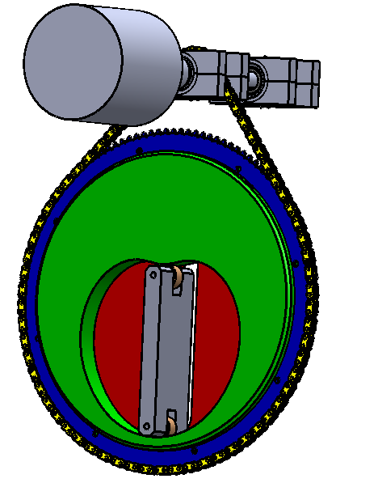
Golden Venture Idea
Develop and license patented design features to automotive OEM’s
Exclusive license to Klovstad Transmission
Unique design does both push and pull
Disruptive design
Smooth energy management
Increases fuel efficiency without sacrificing performance
Potential to make most transmissions obsolete

Slide 11
Our Solution: Full Fwd to Full Reverse
Maximizes potential of Energy Management
Motor
Cam
Chain
Cam Follower
Sprocket
Ratio Plate

Slide 12
Competitors
Category | Competitors | Strengths | Vimana Advantage
OEMs | Ford, GM, Honda, Toyota, Nissan | Decision Power, design capability, tech flexibility | Willingness to work with OEMs
Incumbent Tier 1 Suppliers | Dana, Allison, AAM | Experience, size, customer relationships, manufacturing, incumbency | Energy Management, Fuel Efficiency, Performance
CVT | JATCO, ZF, GETRAG | Sales to major OEMs | Energy Management, lower cost and weight, reliability, towing power
IVT | Ker-Train | Technology used by military | Regenerative braking, lower weight, no torque recirculation

Slide 13
Customer Engagement
Early Engagement with OEM’s
Priorities (based on customer feedback)
Efficiency, packaging size, durability, manufacturability, power
capacity, manufacturing cost
Networking
Team members with high industry visibility
Build Prototypes
Apply for grants
The prototypes we are building are designed to answer direct questions from our customers.
5_E

Slide 14
Next Steps
Resources
Bring in new team members over the next two years with experience in Business, Sales, and Marketing
Formalize licensing agreement
Business Model Validation
Continue engagement with potential customers
Perform Market Research to validate business model
Engineering
Build, test, and measure transmission prototypes

Slide 15
Risk Management
Risks | Impact | Mitigation
Slow Market Uptake | Time to Market | Partner w/customer early & capital efficiency
EGR. Costs | Budget | Fixed cost contracts & regular project status reports
EGR. Timeline | Time to Market | Time based penalties in outsource contracts
CAFE Scaled Back | OEM Demand | Accelerated Development
Technology Risk | Project Suspended | Capital efficiency and early prototype testing

Slide 16
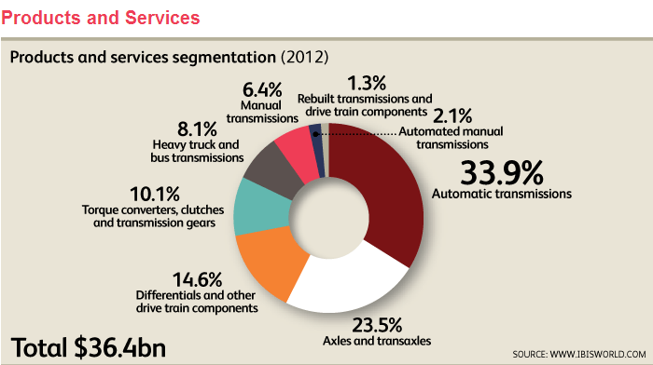
Market Potential
Total Industry |  | $36.4B
Transmissions | 42.4% of industry | $36.4B * 42.4%=$15.4 B
License | 1.5% of revenue | 1.5% * $15.4B=$231M

Slide 17
The Penalty
 | 2012 Sales | 2016 Sales | 2025 Sales | 2013 Avg Fuel Econ | Penalty 2016 | Penalty 2025
GM | 2.8M | 3.4 M | 3.4 M | 21.3 mpg | $3.2 B | $7.1 B
Ford | 2.2M | 2.7 M | 3.1 M | 22.8 mpg | $2.3 B | $5.4 B
Chrysler | 1.7M | 2.0 M | 2.3 M | 20.7 mpg | $1.9 B | $4.3 B
Total Big 3 | 6.7M | 8.1M | 8.8M | 21.7 mpg | $7.4B | $16.8B
Growth Projections: IBISWorld revenue projections to 2018, then 1.5%

Slide 18
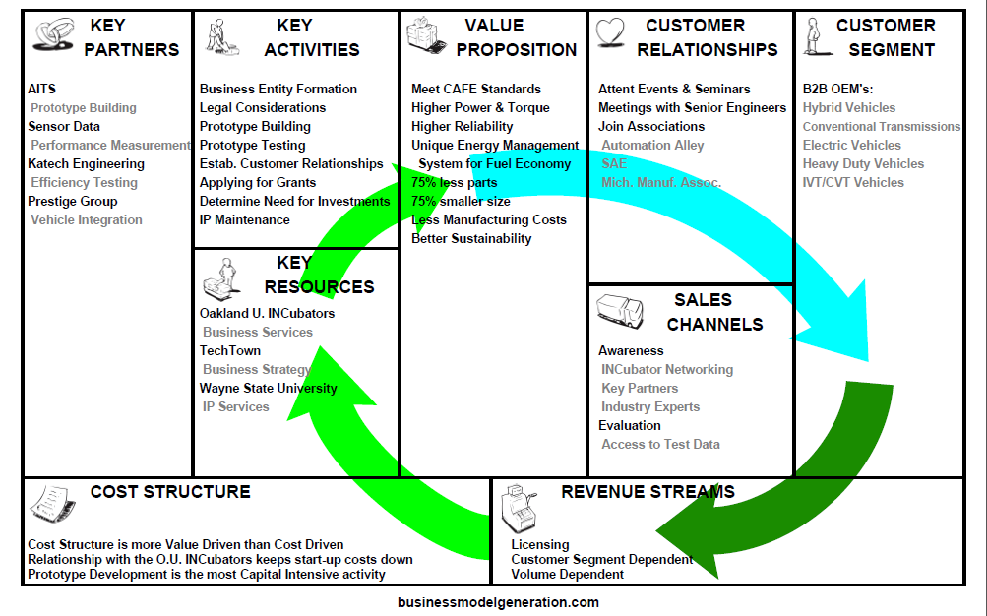
Business Model Canvas

Slide 19
Golden Partnerships – Detail Slide
Technically, the team has identified nearly all the corporate partners that will be required to take the transmission from the prototype phase all the way through to vehicle integration. The team has currently only one member with a formal business degree. It would be beneficial to add someone else to the team who has a business degree. Current business advisors:
TechTown - Pat Salo: Business Strategy
TechTown - Curt Petterson: Business Planning
OU INCubator (Macomb) Larry Herriman: Legal Advice
OU INCubator (Macomb) Wayne Blizman: Commercialization Advice
OU INCubator (Macomb) Mike Brennan: Commercialization and Investment
OU INCubator (Macomb) John Carter: Legal Documentation
Ann Arbor - Amy Klinke, Norm Rapino: Investor Presentations, Business Development
MiCEVC Mentor - Peter Goldberg: Business Advisor
OU INCubator (Oakland) Amy Butler: Energy Technology Networking

Slide 20
Competitive Advantage- Detail Slide
Smooth energy management throughout the entire range of possible gear ratios.
Energy management enables reduced engine weight and capacity without sacrificing performance.

Slide 21
Competitor Technologies
5_E

Slide 22
Golden-S.W.O.T Analysis- long version
Strength:
There are several advantages to this CVT: (KERS) Kinetic Energy Recovery System
(1.) Ability to control the rate of energy recovery
(2.) Relatively inexpensive compare to current CVT Transmissions, Automatic Transmissions.
(3.) Reduction in engine and transmission sizes.
(4.) Better fuel economy.
(5.) Lower fuel consumption resulting in reduced emissions for pollution control.
(6.) Higher efficiency in horse power per engine volume.
(7.) Less vehicle weight.
(8.) Direct regenerative braking.
(9.)Multiple configurations for design. (i.e. four electric motors, one/tire eliminates differentials resulting in better handling characteristics)
(10.) Flexibility in design for all types of engines and vehicle weight classes.
Opportunity for Improvements:
The Challenges for this CVT System include:
(1.) Vehicle Integration current and future.
(2.) Combination of Controllers to work with this CVT.
(3.) Manufacturing Tolerances, Cost for manufacturing in Retooling.
(4.) Few situations like Continuous 20 miles Distance all up hill ( There may be a slowing down of the vehicle)
(5.) Discovery of full potential uses and configurations changes for building various models for this CVT Optimization (i.e, one example: Utilizing usage of Electrorheological or Magnetorheological Technology and another example: Using this CVT as an Energy Management System with Flywheel) (KERS)
Opportunity:
(1.) Grants- comparison with the Ker-Train Transmission.
(2.) OEM opportunities to work directly with them- Infinite Speed Bicycle Motorcycles, Military vehicles, Wind Mills, Segway.The
Best applications of this Type of a CVT is for :All types of I.C.E’s (High Mass Vehicles including: Tractors/ Military
Trucks/Civilian Trucks,Heavy/Medium Vehicles, Three-Wheeler Taxi’s (Rickshaw, Alibaba) Hybrid Vehicles. Electric
Vehicles.
(3.) Investors.
Threats:
The Challenges for this CVT System include:
(1.) Similar Technology (i.e. Ker-Train Transmission more developed )
(2.) Manufacturing Tolerances.
(3) Funding
5_A

Slide 23
Active Engagement
Reelab: Small vehicle validation
Evolver (ATV): (Gene Bachman, Pres.) Performance
DOE Webinar: Energy Management
Ford: Ed Debler (ret.) Front Wheel Drive Transmission space restrictions
GM: Manager Transmission Systems Lab (Robert Gonzales) Durability, Power Specs, Torque Flow
Technology Consultant on DoD Programs: (John Bedz)
Heavily armored amphibious vehicles have weight restrictions – must float!
5_E

