Slide 1
Helping Children and Families through COVID-19
David Goodwin M.Min, Dip.Couns, Cert IV AWT.
Kidsreach.org.au
Kidsreach.co.nz
Notes:
The outbreak of COVID-19 is understandably stressful for many people.
Some say it is unlike anything we have experienced since the end of WW2 and many families do not know how they are going to cope.
Fear and anxiety about a disease can be overwhelming but with COVID-19 it is undoubtably made worse by the constant bombardment of information from different forms of the media including the ever-present social media. Some of the information is helpful but a lot is being said that has either not yet been proven or is an outright fabrication.
There are also the new restrictions on activities like going to work, travelling, shopping, going to a café and even talking with your friends.
The good news is, that if we cope well with this situation,
it will make us all stronger and more resilient. And that goes for your children too.
But please be aware: Everyone reacts differently to stressful situations. And so
we need to be especially mindful of vulnerable members in our community such as the elderly, the sick, the disabled and the very young.

Slide 2
Double Crisis facing Australian Children
Children who are caught up in one crisis situation before they have been able to process a previous one are particularly susceptible to long term anxiety and trauma.
The drought
The bush fires
The virus
Families under stress
For a copy of the COVID-19 Worksheets and this power point go to www.Kidsreach.org.au
Notes:
In this short talk I want to particularly focus in on children and families and give some commonsense things we can all be doing.
A big note of caution.
Our children may not have yet properly processed the effects of the bushfires that covered much of Australia.
There is twice the likelihood that your child will suffer future anxiety disorders if they suffer a second trauma before the first one is properly processed.
Children who are caught up in a crisis situation before they have been able to process a previous one are particularly susceptible to long term anxiety and trauma.
25 percent to 50 percent.
E.g. the Christchurch earthquake
Children who lived in violent or dysfunctional homes and then suffered the earthquake
The Asian tsunami
In Sri Lanka kids who lived in a war zone
Children who were already in crisis are much more vulnerable – they cannot handle trauma on top of trauma.
This is one of my biggest concerns for our kids
In Australia we have had
The drought
The bush fires
The virus
And some kids are also living with problems at home.
So helping children process what is happening becomes an important priority
We also know that normal routines and doing regular activities is one of the best ways to help children settle. We don’t have that today and we don’t know when we will have it.
Let’s look at what we should be doing to help our kids

Slide 3
Listen to Good Advice
Forget the conspiracy theories or what you hear over social media. Look for good websites:
Government and Health Department
Headspace
UNICEF
For a copy of the COVID-19 Worksheets and this power point go to www.Kidsreach.org.au
Notes:
Forget the conspiracy theories or what you hear over social media. There are good websites around that give good sound advice.
UNICEF
2. AUSTRALIAN GOVERNMENT FACT SHEET
3. KIDS HEALTH FROM NEMOURS
4. HELPING CHILDREN WITH STRESS RELATED TO COVID-19

Slide 4
Helping Our Children: Family Talks
Set aside a particular time for talking together with your children as a family – sooner rather than later.
Remove all distractions such as TV and mobile devices.
Talk regularly.
For a copy of the COVID-19 Worksheets and this power point go to www.Kidsreach.org.au
Notes:
Set aside a particular time for talking together with your children as a family – sooner rather than later.
Remove all distractions such as TV and mobile devices.
With the changing situation, you will need to do this regularly.
Ask your children open-ended questions and listen to their responses. For example, you might ask:
What do you know about COVID-19 or Coronavirus?
What do you think is the worst thing COVID-19 could do to our family?
What do you think is the worst thing that could happen to our country that would be caused by COVID-19?
What are some of the things that you think we could do to help?
As children answer these questions, it might be necessary to ask more probing questions. For example,
Could you tell me a bit more about that?
Could you tell me what you mean when you say you are worried about your friend?

Slide 5
Helping Our Children: Family Talks
Use open-ended questions and listen to their responses. Examples:
What do you know about COVID-19 or Coronavirus?
What do you think is the worst thing COVID-19 could do to our family/country/school?
What are some of the things that you think we could do to help?
For a copy of the COVID-19 Worksheets and this power point go to www.Kidsreach.org.au
Notes:
Ask your children open-ended questions and listen to their responses. For example, you might ask:
What do you know about COVID-19 or Coronavirus?
What do you think is the worst thing COVID-19 could do to our family?
What do you think is the worst thing that could happen to our country that would be caused by COVID-19?
What are some of the things that you think we could do to help?
As children answer these questions, it might be necessary to ask more probing questions. For example,
Could you tell me a bit more about that?
Could you tell me what you mean when you say you are worried about your friend?

Slide 6
Helping Our Children: Family Talks
Continue with probing questions. Examples:
Could you tell me a bit more about that?
Tell me what you mean when you say you are worried about your friend?
For a copy of the COVID-19 Worksheets and this power point go to www.Kidsreach.org.au
Notes:
As children answer these questions, it might be necessary to ask more probing questions. For example,
Could you tell me a bit more about that?
Could you tell me what you mean when you say you are worried about your friend?

Slide 7
Helping Our Children: Family Talks
Look for signs of anxiety and give reassurance
For a copy of the COVID-19 Worksheets and this power point go to www.Kidsreach.org.au
Notes:
Pick up any sign that they are distressed or worried. Reassure your children that the risk at this time of getting the disease is minimal, but there are things that you can and need to do as a family.
Reassure your children that although diseases can be scary, and at this time, we have to be more careful than usual, this does not mean everything will change.
Identify the things that will always be the same for the family (e.g. the child's interests which may be curtailed temporarily but they will get back to them, family activities that can be done, Mum and Dad love you, etc.).
Doing this will help reduce a child's anxiety.

Slide 8
Helping Our Children
Children have questions to ask so listen and answer truthfully – in an age appropriate manner.
For a copy of the COVID-19 Worksheets and this power point go to www.Kidsreach.org.au
Notes:
They hear it on the media
They have experienced it with school closures.
They see it in the supermarkets
They have probably seen the often replayed videos of people fighting for toilet paper
It is important that they can talk and for you to answer their questions as openly and factually as you can.

Slide 9
Helping Our Children
Examples of questions children might ask:
Will I die?
Will Grandma die?
How many people have died?
For a copy of the COVID-19 Worksheets and this power point go to www.Kidsreach.org.au
Notes:
These questions should be answered directly and honestly (in an age-appropriate way)– even if it is hard.
Look for misunderstandings so you can correct them.

Slide 10
Helping Our Children
Example answer:
Children generally are less affected than adults in that their symptoms tend to be mild, and they recover quicker. Even when children are not showing any signs, they can still pass the virus onto other, more vulnerable people such as the elderly or sick.
For a copy of the COVID-19 Worksheets and this power point go to www.Kidsreach.org.au
Notes:
Example answer:
Children generally are less affected than adults in that their symptoms tend to be mild, and they recover quicker.
Even when children are not showing any signs, they can still pass the virus onto other, more vulnerable people such as the elderly or sick.

Slide 11
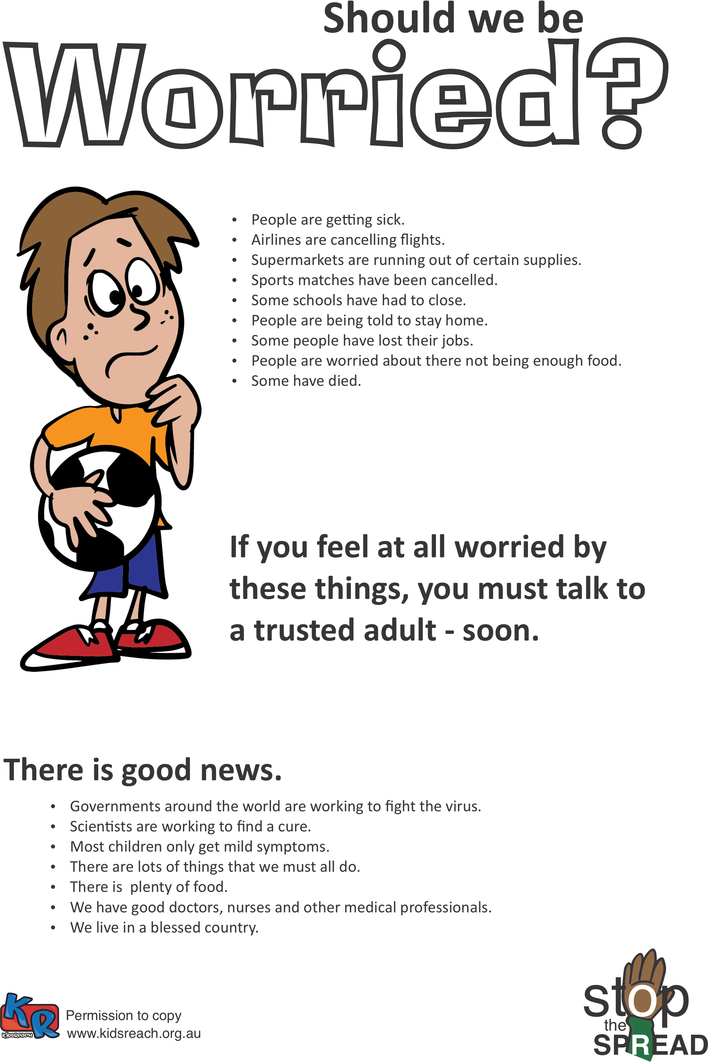
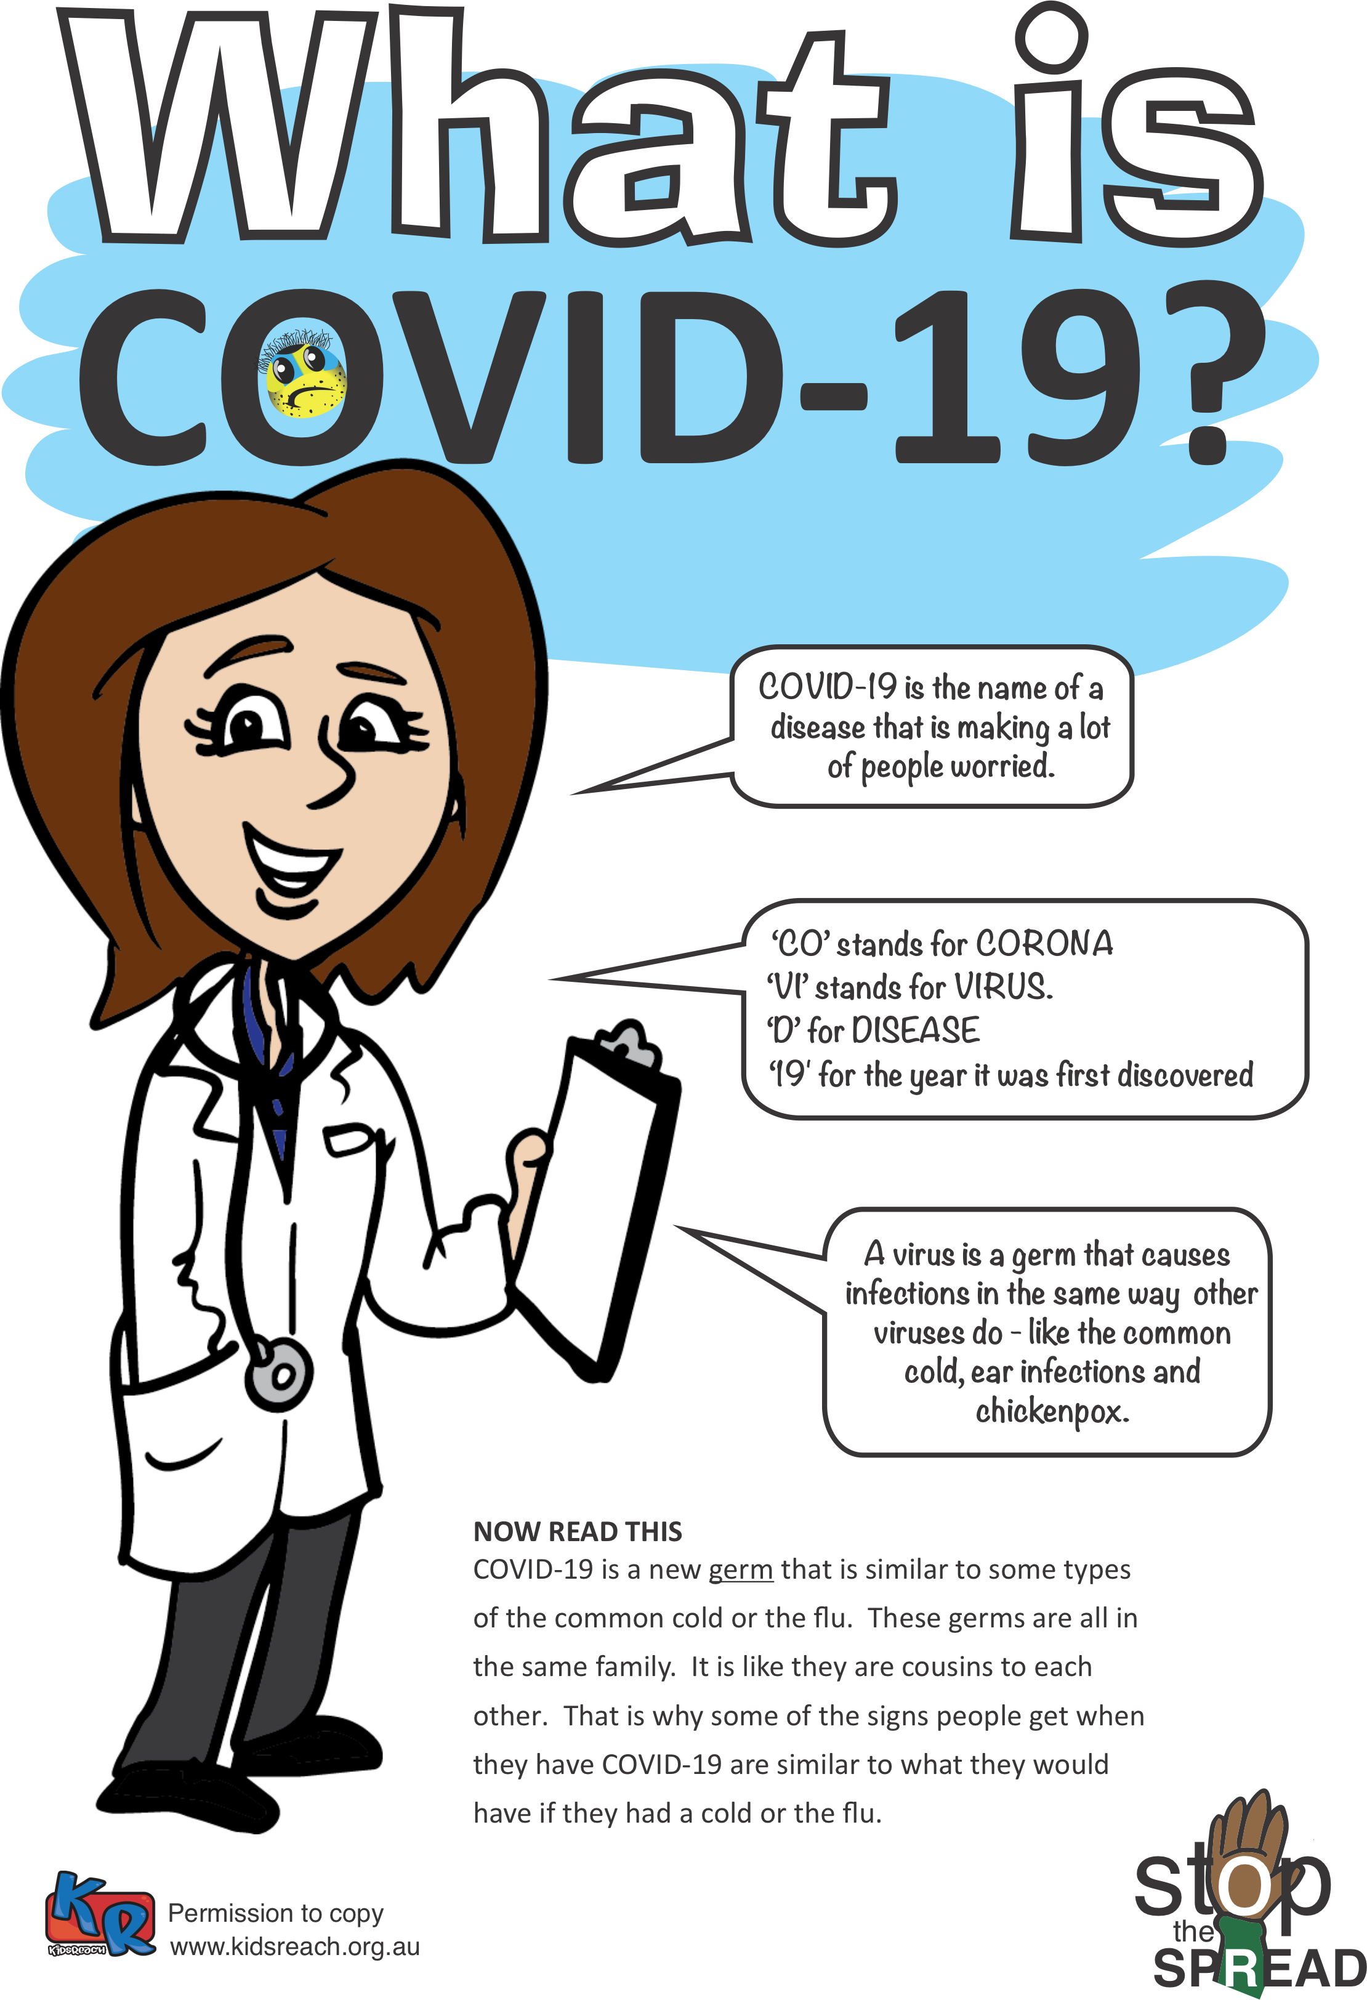
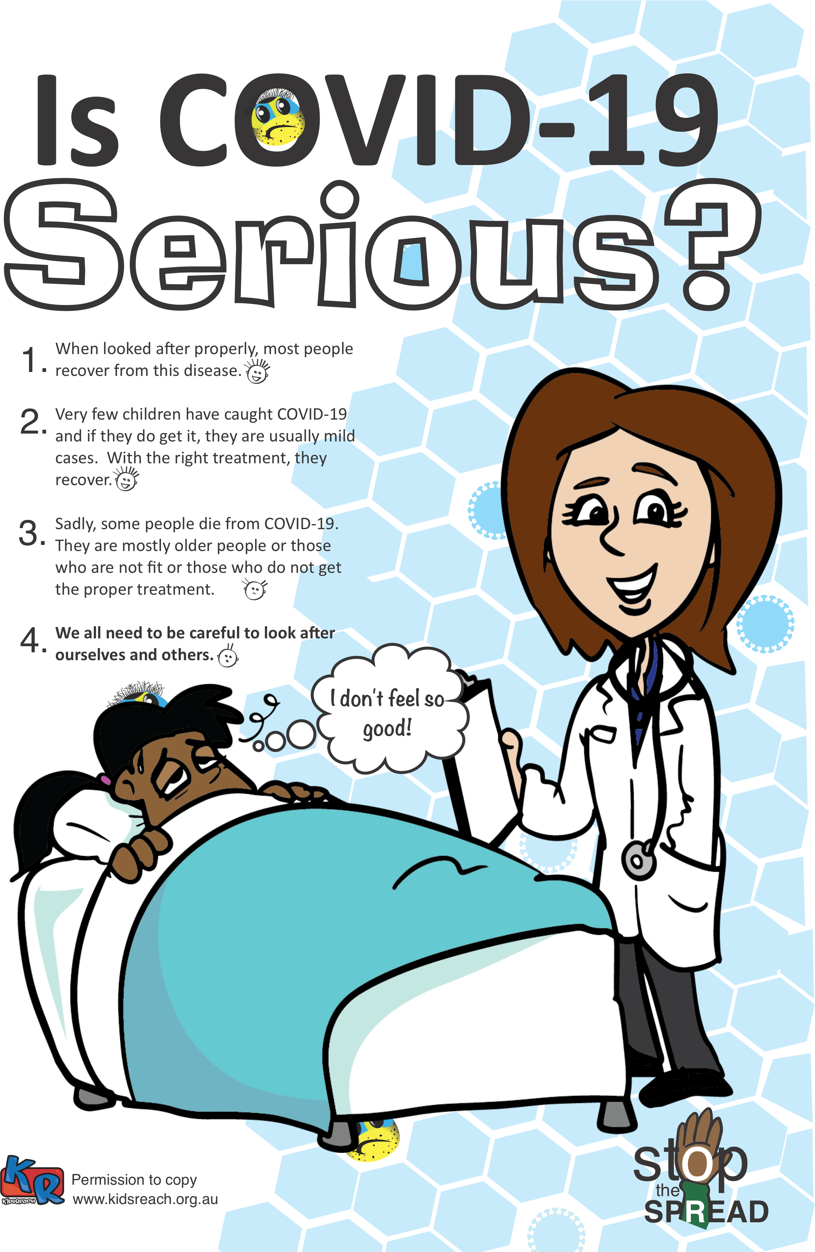
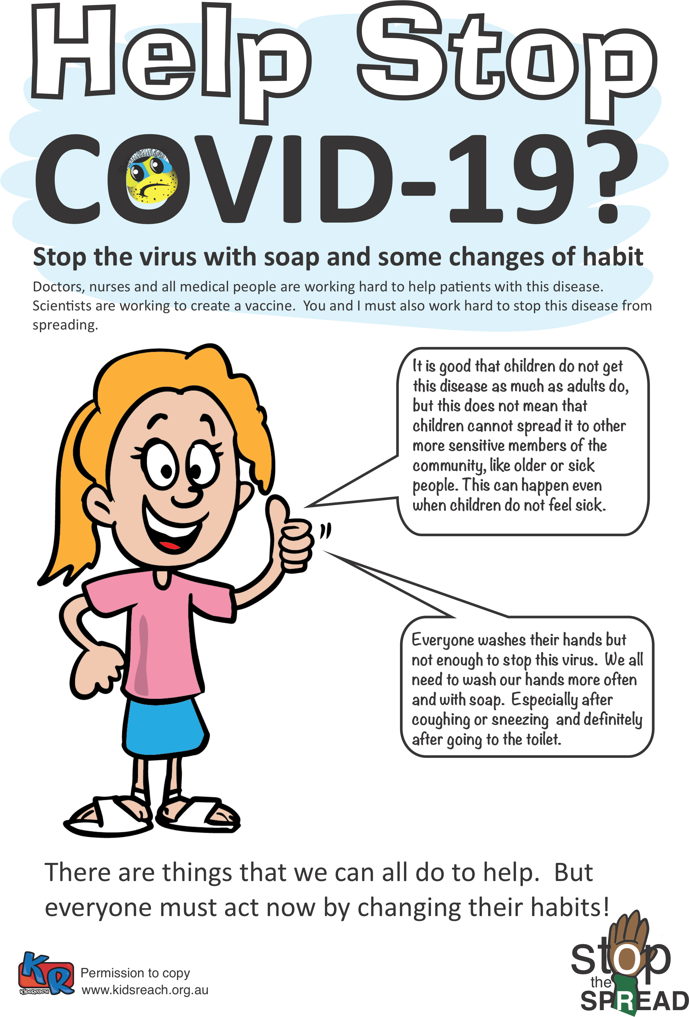
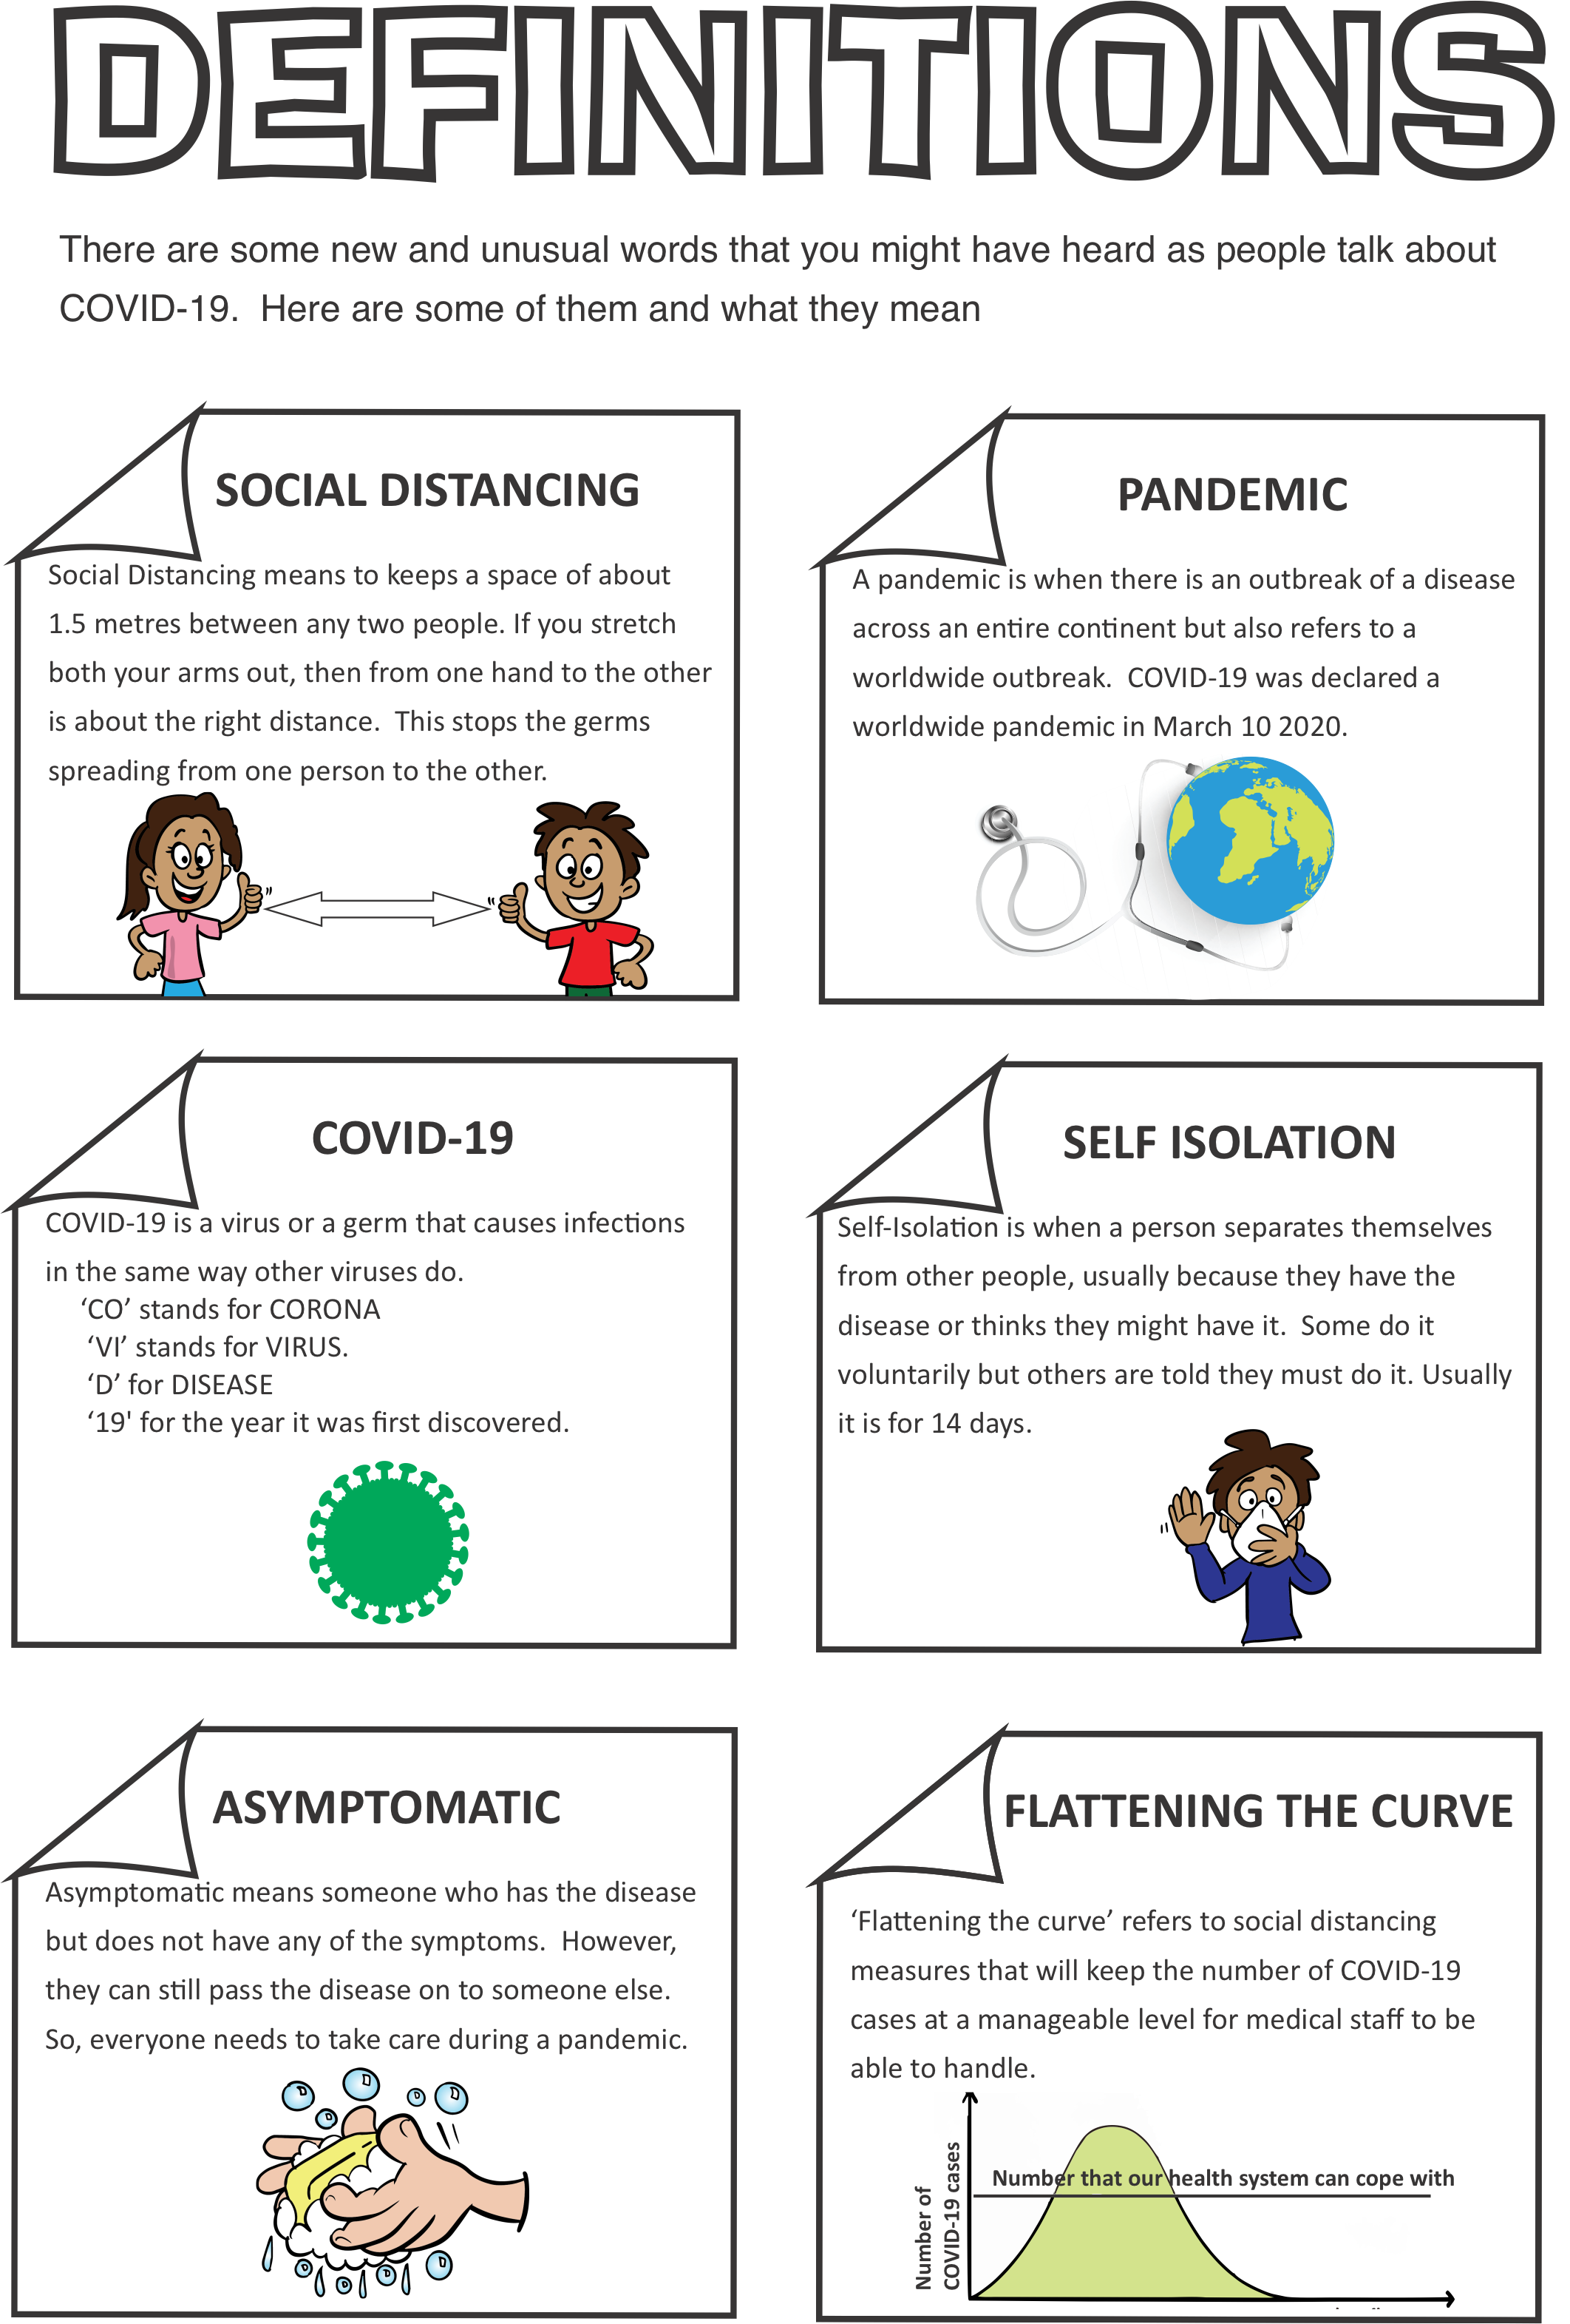
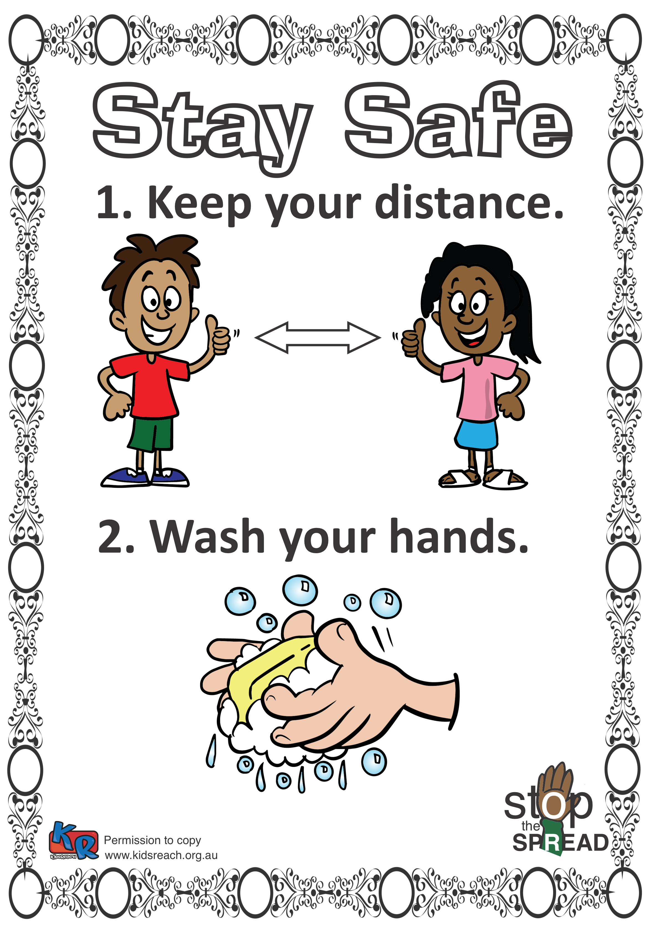
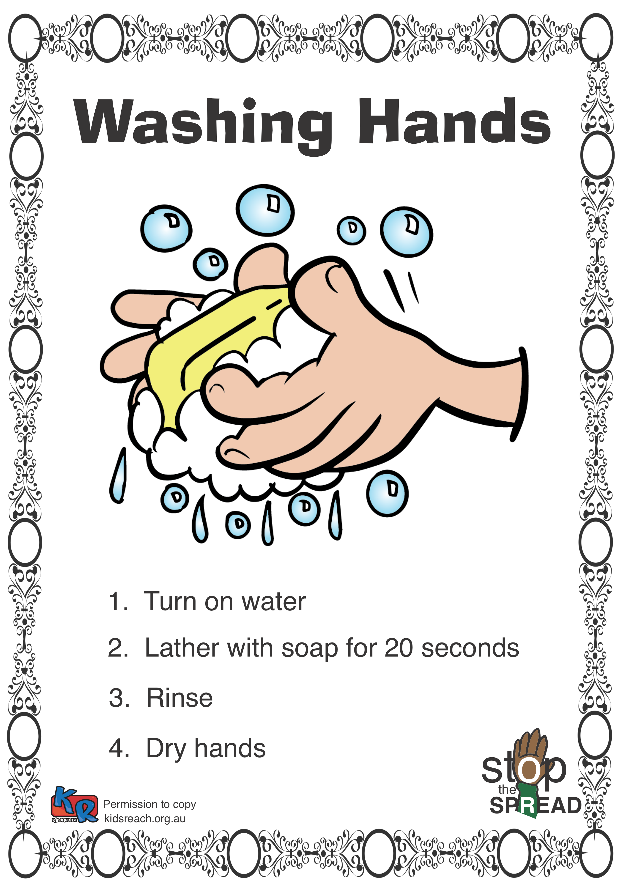
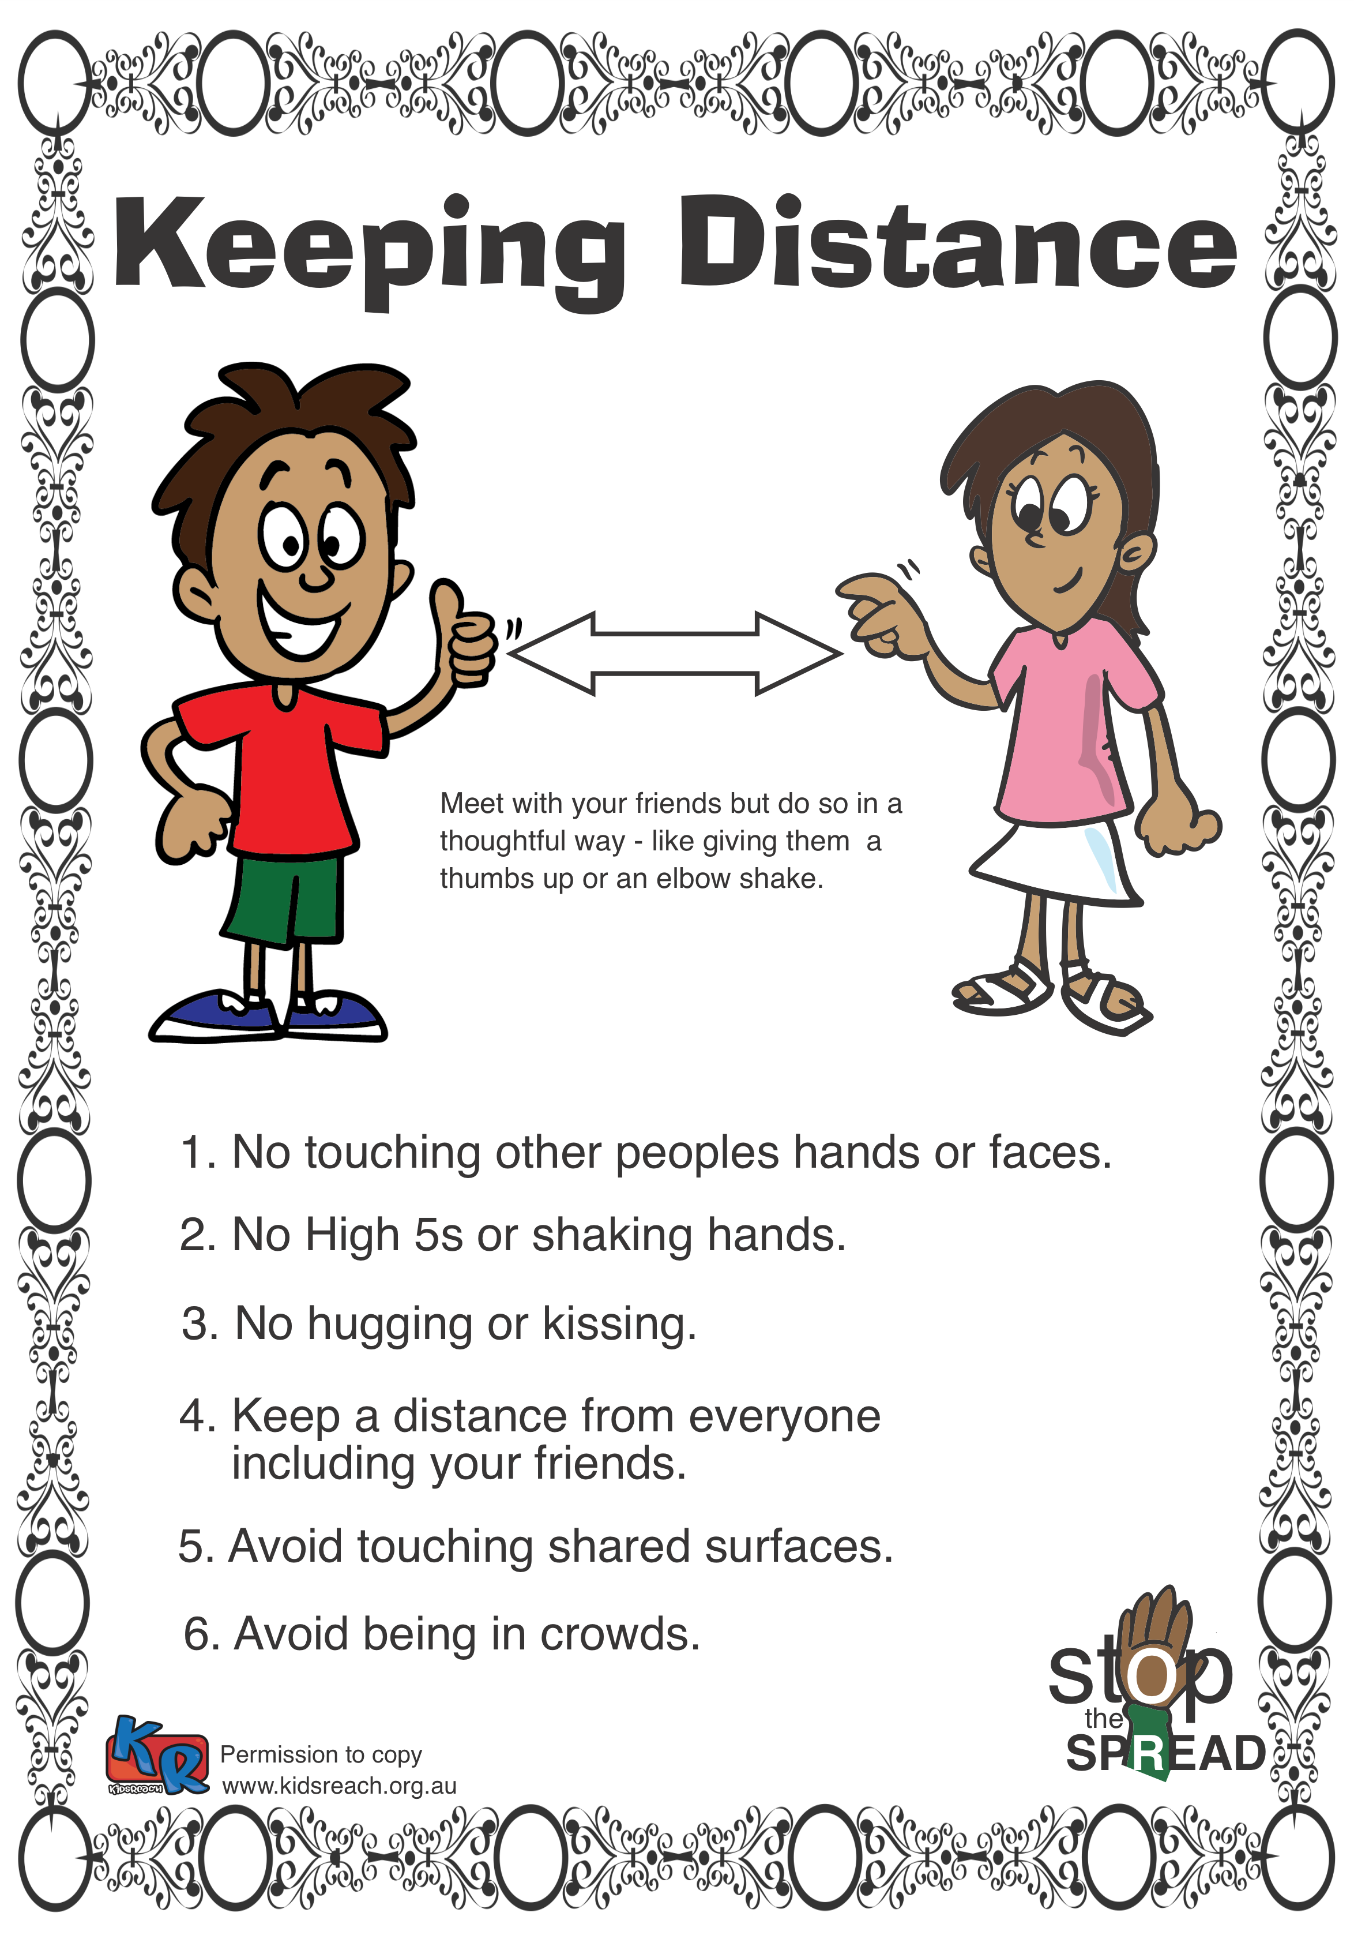
Helping Our Children
Worksheets – download from www.Kidsreach.org.au
For a copy of the COVID-19 Worksheets and this power point go to www.Kidsreach.org.au
Notes:
Ehow you can help the children are on the do the social distancing, attend to proper hygiene, etc are on these worksheets.

Slide 12
Helping Our Children
Play, Fun and Laughter are important to children
Puzzles
Relaxation times together
Board Games
Family night
For a copy of the COVID-19 Worksheets and this power point go to www.Kidsreach.org.au
Notes:
Play, Fun and Laughter are important to children
Have fun when you can.
Puzzles
Relaxation times together
Board Games
Family night
Set aside time for play

Slide 13
Helping Our Children
Routines are important
For a copy of the COVID-19 Worksheets and this power point go to www.Kidsreach.org.au
Notes:
It is easy to get out of routine now the kids don't have to get up and go to school.
Maybe parents are not able to go to work.
Routine is important for children.
Some parents overcome this by insisting their children wear their school uniform during school hours.
Normal routine is an important way for kids to get out of stress.

Slide 14
Helping Our Children
Empower children to help them give some control.
Involve your children in keeping your family (and others) safe
For a copy of the COVID-19 Worksheets and this power point go to www.Kidsreach.org.au
Notes:
Involve your children in keeping your family safe.
This will empower them, knowing there are things that they can do.
What are some of the ways we can help ourselves keep safe?
What are some of the ways we can help others feel safe?

Slide 15
Helping Our Children
Exercise will help
For a copy of the COVID-19 Worksheets and this power point go to www.Kidsreach.org.au
Notes:
Exercise is good for you and for your children.
At least for now, families are allowed to go for a walk together.

Slide 16
Helping Our Children
Try not to transfer your anxieties on to your children
For a copy of the COVID-19 Worksheets and this power point go to www.Kidsreach.org.au
Notes:
Children do pick up what we feel.
Make an effort to not pass on our worries and concerns onto the children. Avoid talking about these things in their company.
This will end
Avoid conspiracy theories

Slide 17
Helping Our Children
Be patient as children learn new habits.
Notes:
We can get impatient with our children and not listen to them properly.
It takes time for children to change – 3 weeks usually.
Washing hands
Not touching their face until their hands are clean.
Social Distancing.

Slide 18
Helping Our Children: Be Creative
Think outside the box
For a copy of the COVID-19 Worksheets and this power point go to www.Kidsreach.org.au
Notes:
Think creatively. What can we creatively do as a family. Here are some ideas

Slide 19
Ideas to do at Home : Be Creative
Behind the News (BTN) is an ABC production – available online.
Go to www.abc.net.au/btn
Notes:
Behind the News is an ABC production
Designed to be a fun accessible way for primary and secondary students to learn about what is happening in the world.
Cover everything from terrorism to the COVID-19
www.abc.net.au/btn

Slide 20
Ideas to do at Home : Be Creative
Write a list of people the children can contact via the internet for a daily chat:
Grandparents.
Elderly friends of the family.
Shut in and lonely people.

Slide 21
Ideas to do at Home : Be Creative
Make a fun family movie
Choose a values-based topic such as:
What is best about our family.
(or ‘what we like’ about our family)
Notes:
There are endless possibilities here. Choose a values based topic such as:
What is best (or ‘we like’) about our family.
Include photos interviews etc.

Slide 22
Ideas to do at Home : Be Creative
Download audio books from Audible at Kindle or from your local library. There are hundreds of freebies. Use the app ‘Overdrive’ or ’Libby’
Notes:
Audio Books
Hundreds of free editions form Audible (Kindle). You don't need to subscribe to the monthly fee to get the free books.
Libraries also have audible books.
The best way to download audiobooks from the library is through Overdrive. You can download the app onto your phone, or access it on your web. All you have to do is find your local library and type in your library card number and pin in order to get access to a vast range of audiobooks.
Audio books are more stimulating and better for the brain than watching on a screen.

Slide 23
Ideas to do at Home : Be Creative
Make a list of books they can read and set a target.
Notes:
Make a list of books they can read and set a target.

Slide 24
Ideas to do at Home : Be Creative
Bake or cook something with your kids. Let them learn something new.
Notes:
Learn to Bake or Cook
This is an opportunity for you to teach child to bake or cook particular meals.
Search Jamie Oliver for ideas.

Slide 25
Ideas to do at Home : Be Creative
Relax together as a family
E.G. Board Games, Craft, Movie, etc.
Notes:
Relax together
E.G. Board Games, Craft, special project.

Slide 26
Ideas to do at Home : Be Creative
Watch Pilgrim's Progress. Available online free until 31 May
Notes:
Watch Pilgrim's Progress.
Available online free at this time.
Discuss different points

Slide 27
Conclusion
Create good memories
Notes:
It is typical at stressful times for children’s emotional to be forgotten.
Create some good memories.

Slide 28
Conclusions
Despair can be our worst enemy.
Read passages such as Psalm 91 together as a family
Notes:
Despair can be our worst enemy
Psalm 91
He who dwells in ªthe shelter of the Most High
will abide in ^{b}the shadow of the Almighty.
2 I will say¹ to the Lord, “My ^{c}refuge and my ^{d}fortress,
my God, in whom I ^{e}trust.”
3 For he will deliver you from ^{f}the snare of the fowler
and from the deadly pestilence.
4 He will ^{g}cover you with his pinions,
and under his ^{h}wings you will ^{i}find refuge;
his ^{j}faithfulness is ^{k}a shield and buckler.
5 ^{l}You will not fear ^{m}the terror of the night,
nor the arrow that flies by day,
6 nor the pestilence that stalks in darkness,
nor the destruction that wastes at noonday.
7 A thousand may fall at your side,
ten thousand at your right hand,
but it will not come near you.
8 You will only look with your eyes
and ^{n}see the recompense of the wicked.

Slide 29
Conclusions: Get Help
Use the free resource from:
www.Kidsreach.org.au
And also download this PowerPoint
Notes:
Use the resource from:
www.Kidsreach.org.au

Slide 30
Conclusions: Get Help
Kids Helpline: 1800 55 1800
Kidshelpline.com.au
Headspace 1800 650 890
Eheadspace.org.au
Parent helpline 1300 1300 52
Beyond Blue 1300 22 4636
Lifeline 13 11 14
Notes:
In cases where you might be really concerned, don’t leave it. There is a lot of help available.

