Slide 1
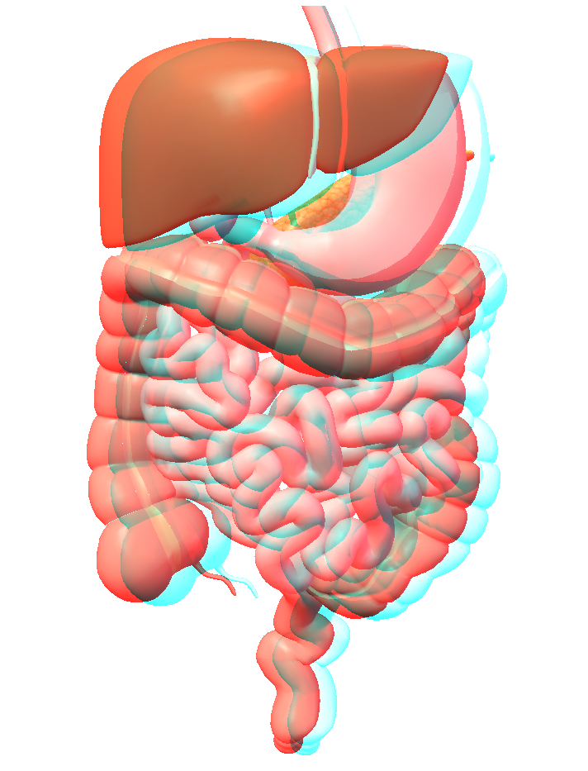
An Introduction to the Digestive System
Rayomand Dubash

Slide 2
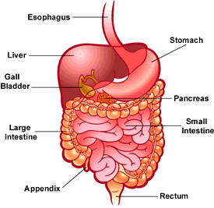
HUMAN DIGESTION
Notes:
By Ray Dubash

Slide 3
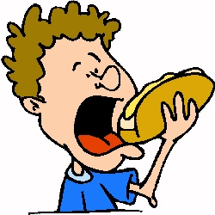
Digestion
Digestion is the breakdown of large, complex organic molecules into smaller components that can be used by the body.
Molecules need to be small enough to diffuse across plasma membranes.

Slide 4
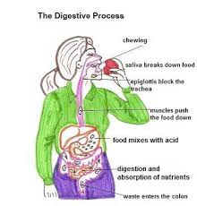
Digestive Process (Food Travel Times)
Food stays in the mouth for approximately 1 minute.
Travels Down to the Oesophagus in around 4 to 8 seconds
Stays in the stomach for 2 to 4 hours where it is churned into a semi-solid state called chyme
Goes down to the small intestine where it stays for 3 to 5 hours
It then moves to the Large Intestine where it can remain for 10 hours to several days
The rectum serves as a collection point where the waste is finally expelled as fecal matter through the anus

Slide 5
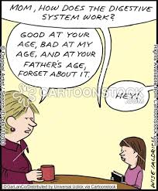
How Does the Digestive System Work

Slide 6
Four Components of Digestion
Ingestion – this is the consumption of or taking in of nutrients.
Digestion – the chemical breakdown of large organic molecules into smaller components by enzymes.
Absorption – the transport or delivery of digested nutrients to body tissues.
Egestion – the elimination of food waste materials from the body.

Slide 7
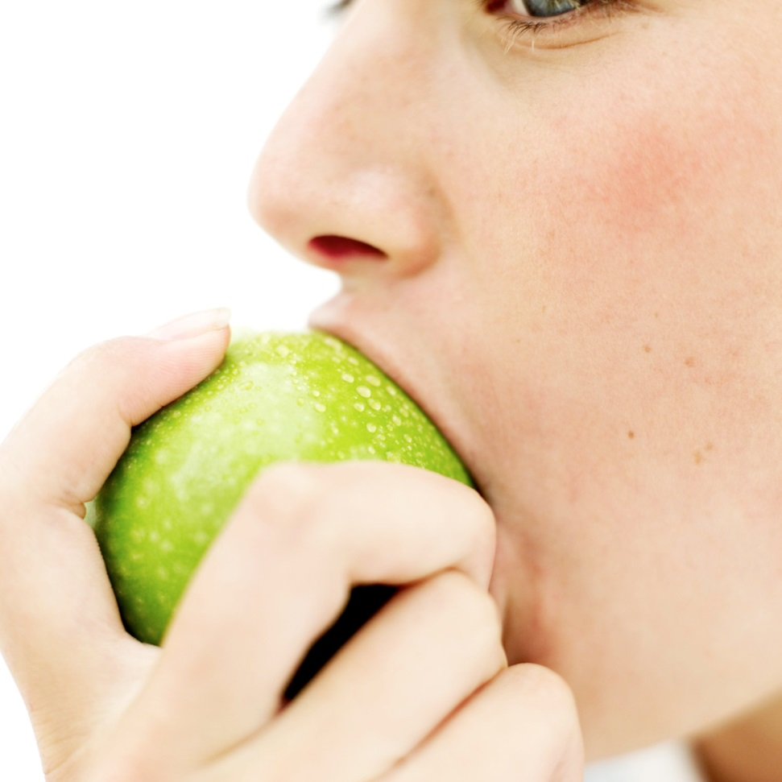
Ingestion
Food enters the human digestive tract through the mouth or oral cavity.
Humans are considered chunk feeders because they consume chunks of food that are then mechanically broken down.
Some pathogens are also transmitted via ingestion, including viruses, bacteria and parasites.

Slide 8
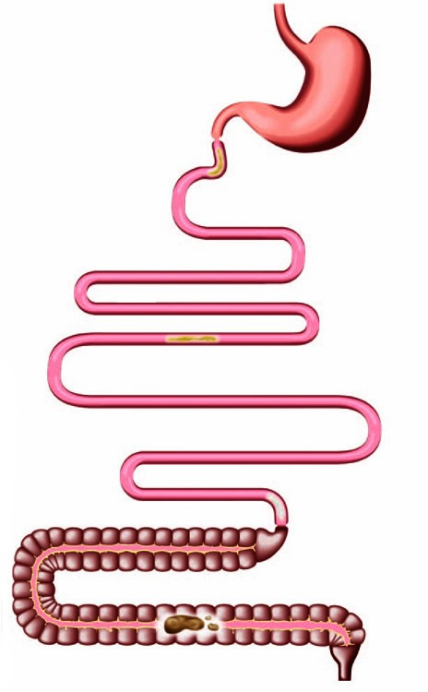
Alimentary Canal
The human digestive tract is often referred to as the alimentary canal.
The alimentary canal of a normal adult is approximately 6.5 to 9 meters long.
The tract may also be divided into foregut, midgut and hindgut, reflecting the embryological origin of each segment of the tract.

Slide 9
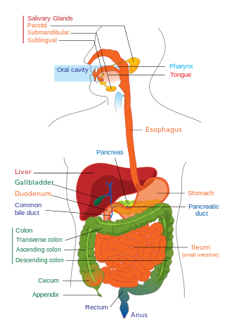
Gastrointestinal Tract
The Upper Gastrointestinal Tract consists of the:
Esophagus
Stomach
Duodenum
The Lower Gastrointestinal Tract consists of the:
Small Intestine
Large Intestine

Slide 10
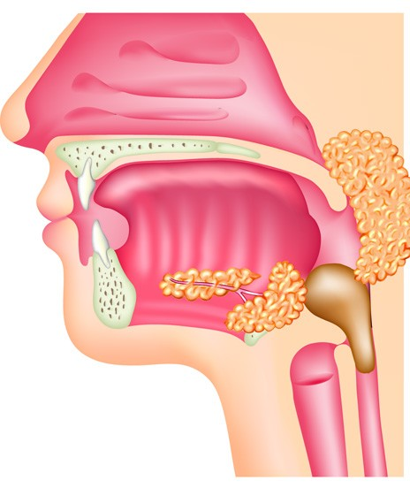
Swallowing
Saliva is a watery substance located in the mouths of organisms, secreted by the salivary glands
Saliva also lubricates the food and helps to form a bolus, the ball of food that is swallowed.

Slide 11
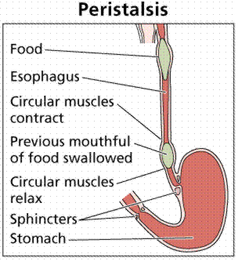
Esophagus
The bolus of food moves down the esophagus propelled by wave-like muscular contractions known as peristalsis.
Peristalsis moves food all the way through the gastrointestinal or GI tract.

Slide 12
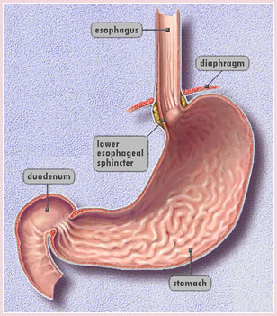
Stomach
The stomach acts as a temporary storage site for food. Food usually spends about 2 to 4 hours in the stomach. It has ridges which allow it to expand to store about 1.5 litres of food.
The stomach is also the site of initial protein digestion.

Slide 13
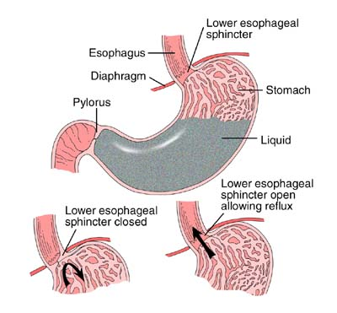
Stomach
Movement of food into and out of the stomach is controlled by circular muscles known as sphincters.
The sphincter at the top of the stomach allows food from the esophagus to enter and prevents food from going back up into the oesophagus.
Another sphincter located at the bottom slowly releases partially digested food into the small intestine. The partially digested food is called chyme.

Slide 14
Stomach
Millions of cells lining the stomach secrete various fluids known collectively as gastric fluids.
Gastric fluid consists of mucus, hydrochloric acid, pepsinogens and other substances.
Mucus coats and protects the lining of the stomach. Hydrochloric acid kills any harmful substances that have been ingested and it also converts pepsinogen into pepsin.
Pepsin is a protein digesting enzyme that breaks large protein chains into smaller chains.

Slide 15
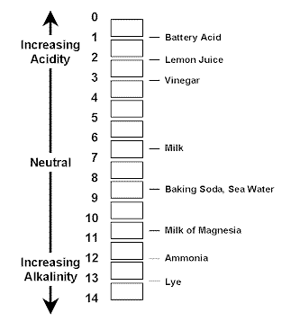
Stomach pH
The pH environment of the stomach normally ranges between 2.0 and 3.0 on the pH scale.
The high acidity allows pepsin to work and makes the HCL effective at killing pathogens

Slide 16
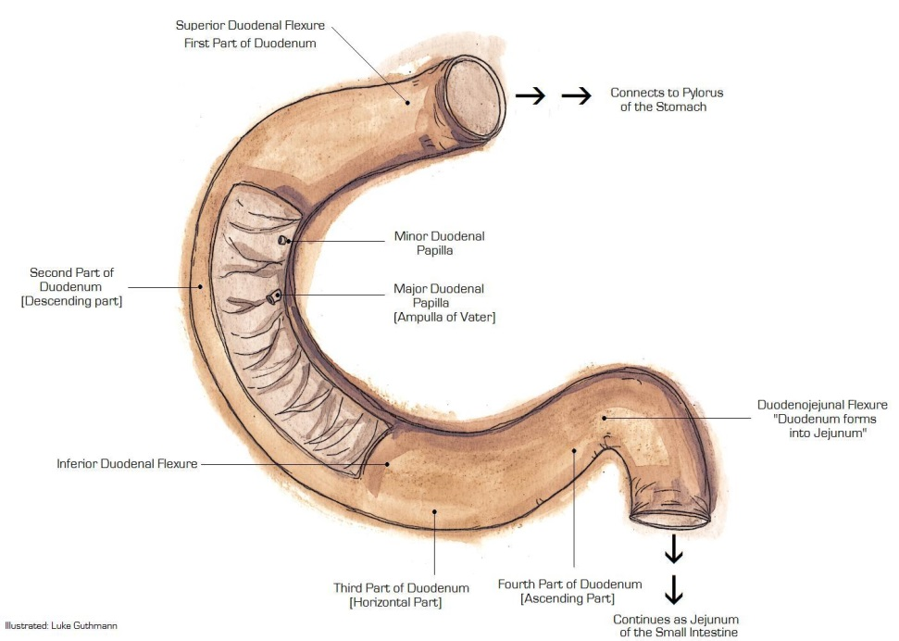
Duodenum
The Duodenum is a hollow jointed tube about 25-38cm (10-15 inches) long connecting the stomach to the jejunum. It begins with the duodenal bulb and ends at the ligament of Treitz.
It is largely responsible for the breakdown of food in the small intestine, using enzymes.
The duodenum also regulates the rate of emptying of the stomach via hormonal pathways

Slide 17
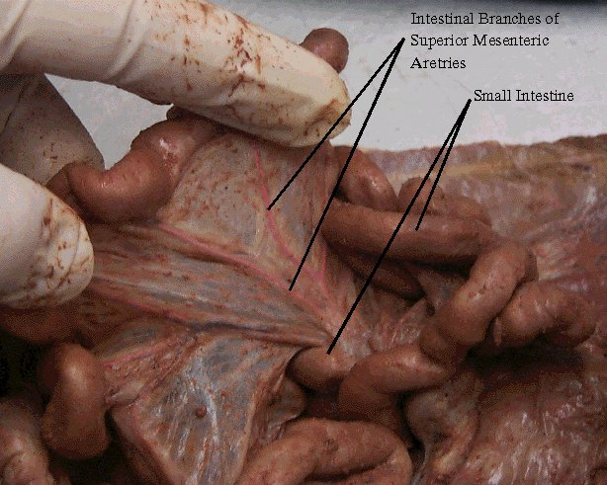
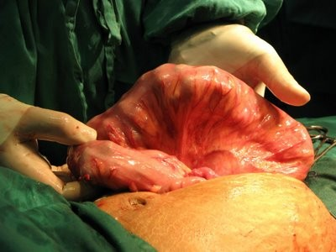
Small and Large Intestine
The intestines are named for their diameter, not length.
The small intestine is up to 7 m in length but only 2.5 cm in diameter.
The large intestine is only 1.5 m in length but 7.6 cm in diameter.

Slide 18
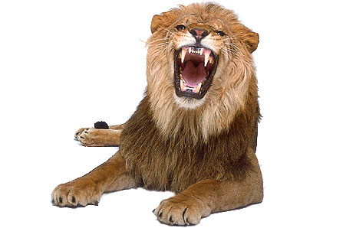
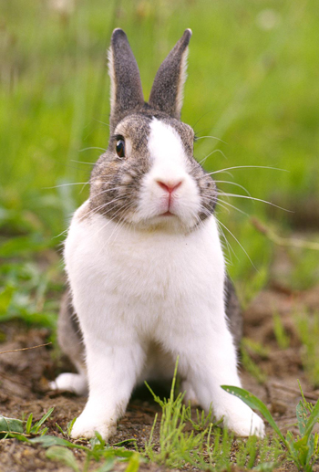
Small Intestine
In mammals the length of the small intestine is directly related to their diet.
Due to the fact that meats are easier to digest than plant materials, carnivores (lion) will have a shorter intestine than herbivores (rabbit). The length of the digestive tract of omnivores falls somewhere in the middle.

Slide 19
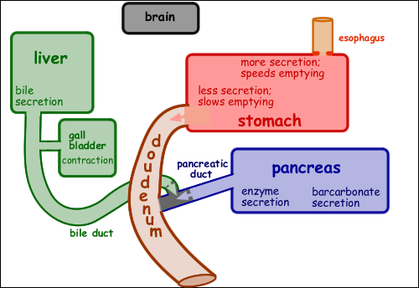
Small Intestine
Food enters the small intestine as a semi-solid mixture known as chyme. The chyme is acidic due to the HCl in the stomach so it needs to be neutralized.
The presence of chyme in the small intestine triggers the conversion of prosecretin into secretin which is absorbed into the blood stream and carried to the pancreas

Slide 20
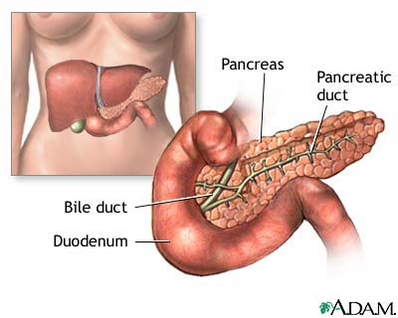
Pancreas
The pancreas is an accessory organ of the digestive system. It releases chemicals to aid in digestion.
Secretin will stimulate the pancreas to release a solution containing bicarbonate ion into the small intestine where it will neutralize the acidic chyme and raise the pH from 2.5 to 9.0. This inactivates the pepsin.

Slide 21
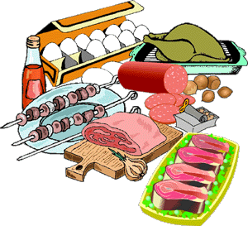
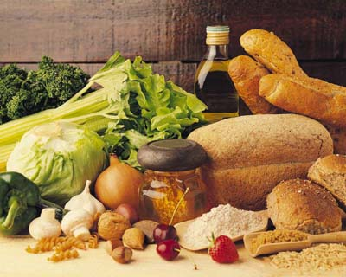
Pancreas and Digestion
The pancreas is an integral part of the digestive system.
It releases digestive enzymes that break down the three macromolecules: carbohydrates, lipids and proteins.

Slide 22
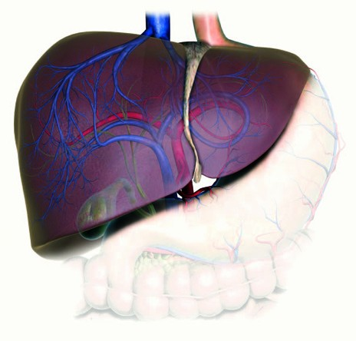
Liver
The liver is a large accessory organ of the digestive system that is constantly producing a fluid known as bile.
Bile is stored in the gall bladder until it is needed in the small intestine.
Liver can regenerate missing pieces if necessary.
It is one of the largest organs in the body.
Notes:
Livers can regenerate missing pieces if necessary. Is one of the largest organs in the body

Slide 23
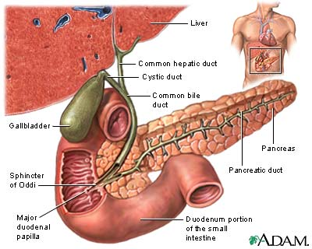
Liver and Gall Bladder
The presence of lipids in the small intestine trigger the release of the hormone cholecystokinin (CCK) which triggers the release of bile from the gall bladder.
Bile contains bile salts that emulsifies fats which means it breaks them into smaller droplets so they can be digested.

Slide 24
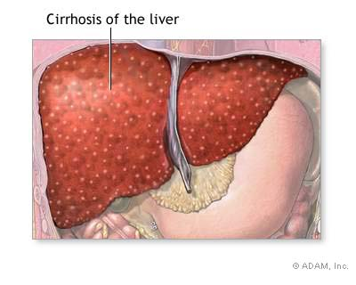
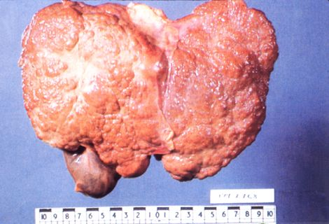
Detoxification and the Liver
The liver is also able to detoxify many substances in the body by making them soluble and they can then be dissolved in the bloodstream and eliminated in urine.
One example would be alcohol. Alcohol can damage liver cells which are replaced by connective tissues and fat. The result is cirrhosis of the liver (shown left).

Slide 25
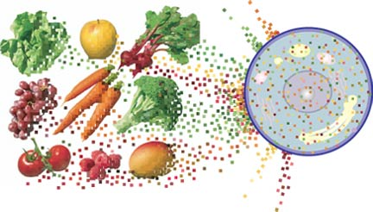
Absorption of Materials
Chemical digestion of nutrients is completed by the time it reaches the large intestine.
Now that nutrients are small enough they need to be absorbed into the blood stream so they can diffuse inside cells.

Slide 26
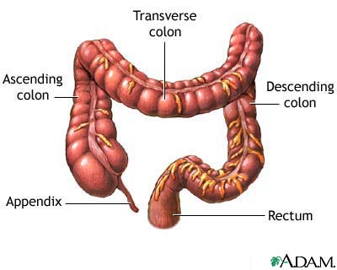
Large Intestine
The large intestine comprises of the Colon, Cecum and the Rectum. It stores waste products long enough for water to be reabsorbed from the wastes.
Along with the water, some inorganic salts, minerals and vitamins are also absorbed.

Slide 27
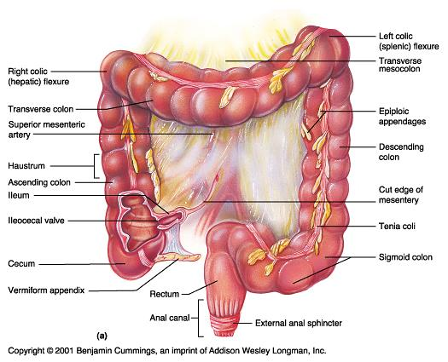
Large Intestine

Slide 28
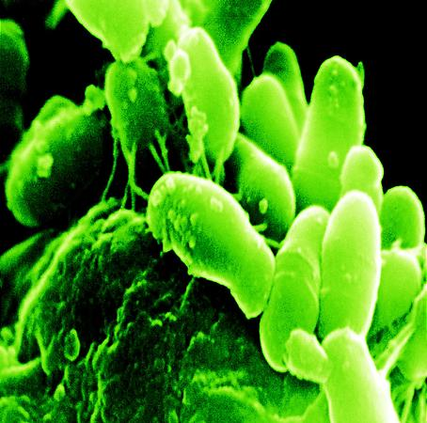
Large Intestine
The large intestine is home to several different types of bacteria.
These bacteria use waste materials to synthesize vitamins B and K. This is an example of a symbiotic relationship.

Slide 29
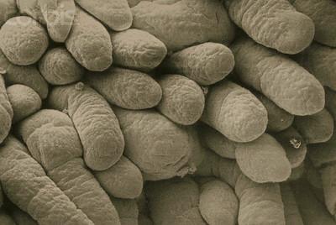
Absorption of Nutrients
Most nutrients are absorbed in the small intestine.
The small intestine is lined with millions of small finger-like projections known as villi.
Fructose is absorbed through passive transport and moves down a gradient from the intestinal lumen to the epithelial cells.

Slide 30
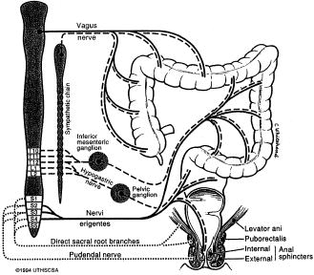
Rectum & Anal Canal
The rectum is the end of the large intestine and is where feces are stored until eliminated through the anus. Two sphincters control the movement feces during defecation.
The internal anal sphincter , the external anal sphincter and the puborectalis muscles act together to keep the rectum closed
Together, they make up the anal sphincter mechanism
Voluntary defecation begins with the sensation of rectal dilatation from stool advancement. This stretches the puborectalis muscle and the rectal wall, which signals the urge to defecate

Slide 31
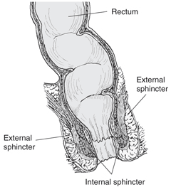
Rectum & Anal Canal
Stool approaches the internal sphincter, which automatically relaxes (recto-anal inhibitory reflex) and the external anal sphincter is voluntarily contracted to maintain continence.
To initiate defecation, the external anal sphincter and the puborectalis muscle are relaxed. Then the glottis is closed, the diaphragm descends, and abdominal muscles contract to raise intra-abdominal pressure via the Valsalva manoeuvre.
Sigmoid peristalsis commence via longitudinal muscle layer contractions and gravity then propels the stool out.

Slide 32
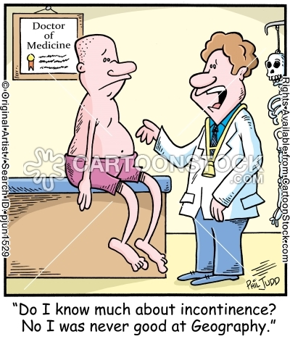
Conclusion
A Colon hydrotherpist should be knowledgeable about Human Anatomy and Physiology
Must maintain a high level of professionalism at all times
The Health, Welfare and Comfort of our client should be our main concern
Recognize your limitations and when indicated, recommend or seek additional opinions & services

Slide 33
Fun Facts
Approximately 75% of human waste is made of water.
During your lifetime, you will produce enough saliva to fill two swimming pools.
Every day the human stomach produces about 2 liters of hydrochloric acid.
Every three days a human stomach gets a new lining.
Bile produced by the liver is responsible for making your feces a brownish, green colour.
Food drying up and hanging out in the large intestine can last 18 hours to 2 days!
Most food products are absorbed by the small intestines, The large intestine is responsible for absorption of water and excretion of solid waste material
In your lifetime, your digestive system may handle about 50 tons!!
Without its lining of mucus your stomach would digest itself
The acid in your stomach is strong enough to dissolve razorblades.

Slide 34
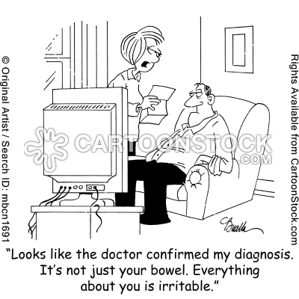

Slide 35


