Slide 1
Benefit Corporations: West Virginia and Beyond Elaine Waterhouse Wilson Associate Dean of Academic Affairs and Professor of Law West Virginia University October 29, 2012

Slide 2
Road Map for Today
Benefits corps as social enterprise
The West Virginia Legislation
Tax Implications

Slide 3
The Burning Question
Why?

Slide 4
The Back Drop: social enterprise
Concept: the use of for profit methods to accomplish charitable goals
Entity: a legal construct designed for the purpose of accomplishing profit motives and charitable outcomes at the same time

Slide 5
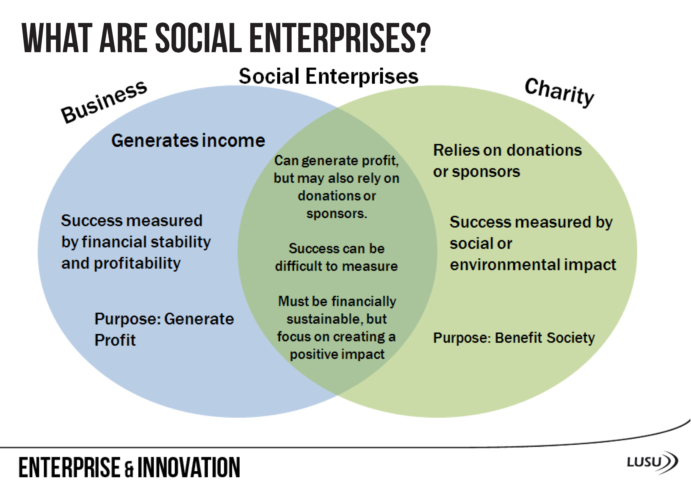
From Lusu.co.uk

Slide 6
Two Layers of Law…
State Business Entity Law
Federal Tax Law:
Of the enterprise?
Of grantors/investors?

Slide 7
Benefit Corporation
Special type of corporation under state law
Changes the fiduciary duty of care for the Board of Directors
Issues of reporting, transparency and enforcement

Slide 8
Public Purposes
§31F-1-102. Definitions. (emphasis added)
(e) “Specific public benefit” means a benefit that serves one or more public welfare, religious, charitable, scientific, literary or educational purposes, or other purpose or benefit beyond the strict interest of the shareholders of the benefit corporation, including:
(1) Providing low-income or underserved individuals or communities with beneficial products or services;
(2) Promoting economic opportunity for individuals or communities beyond the creation of jobs in the normal course of business;
(3) Preserving or improving the environment;
(4) Improving human health;
(5) Promoting the arts, sciences or advancement of knowledge;
(6) Increasing the flow of capital to entities with a public benefit purpose; and
(7) Conferring any other particular benefit on society or the environment.
§31F-1-102. Definitions.
(c) “General public benefit” means a material positive impact on society and the environment taken as a whole, as measured by a third-party standard, from the business and operations of a benefit corporation. (emphasis added)

Slide 9
Formation and Amendment
§31F-1-103. Construction of chapter.
(c) The specific provisions of this chapter control over the general provisions of other chapters of this code.
§31F-2-201. Formation of benefit corporations.
A benefit corporation shall be formed in accordance with article two, chapter thirty-one-d of this code [i.e., the business corporation code], and its articles as initially filed with the Secretary of State or as amended, shall state that it is a benefit corporation.

Slide 10
Fiduciary Duties
Shareholders
Employee
Workforce
Community
Environment
Customers
Long Term and Short Term goals
§31F-4-401. Standard of conduct for directors. (emphasis added)
Subject to [business corporation code], in discharging the duties of their respective positions and in considering the best interests of the benefit corporation, the board of directors…
(1) Shall consider the effects of any corporate action upon:
(2)May consider:
The resources and intent of anyone wanting to acquire control of the benefit corporation; and
Other pertinent factors … they deem appropriate; and
(3) Need not give priority to the interests of a particular person referred to in subdivisions (1) and (2) of this section over the interests of any other person...

Slide 11
Reporting and enforcement
General and Specific Purposes and the failure to make the required benefit report can only be enforced derivatively by other directors and shareholders.
No Attorney General Oversight
Annual benefit report must be given to shareholders and made public
No government filing of annual benefit report

Slide 12
Summary: Benefit Corporation
Strength
Weakness
Fiduciary duty protection
Requires consideration of various social issues
Marketing benefit
Just requires consideration
No “quantum” of charity
Some reporting in some states
Not automatically recognized as a PRI

Slide 13
Distinguish: the B Corp
Not a type of entity – a separate company (B Lab)
A certification by a third party of social enterprise status
Qualifies for “third party standard” as required by some statuts

Slide 14
Cooperatives as Benefit Corps
WV Cooperatives are corporations
Can be business, nonprofit or benefit
Conflict in purpose?

Slide 15
Tax Issues for Benefit Corporations
Taxation of the Entity
Taxation of Grant Makers and Investors

Slide 16
Taxing the Entity
Benefit Corporations are simply for-profit corporations
Taxed as a C
Can qualify as an S
West Virginia – Subchapter T cooperative
So is there any tax benefit?
Information Letter 2016-0063

Slide 17
Consequences to Grant makers
Can a grant maker …
Make a grant to a social enterprise?
Invest in a social enterprise?
Yes, but…
Standard rules for grants to for-profits apply
May be very complicated

Slide 18
What legal rules apply?
If you are a public charity
Standard fiduciary obligation (duties of care and loyalty)
Protect assets for charitable purpose
Make assets productive
If you are a private foundation
Standard public charity obligations, PLUS
Private foundation excise taxes
If you are a public charity with DAFs
Standard public charity obligations, PLUS
DAF excise taxes

Slide 19
I’m a DAF, now what?
Section 4966 imposes a tax on a taxable distribution, which is a DAF distribution to any natural person, or to any other person if…the sponsoring organization does not exercise expenditure responsibility with respect to such distribution in accordance with section 4945(h).
Section 4967 prohibits “a distribution from a DAF which results in such person or any [related] other person …. receiving, directly or indirectly, a more than incidental benefit as a result of such distribution
What do the regs say?
Notes:
4943 Look at Section 4943(e)(1) (page 448).
4958 Look at Section 4958(c)(2) (page 467).

Slide 20
Foundation Grants to Business
Code Section 4945: Private foundation can’t make grants unless
It’s to a public charity OR
You exercise expenditure responsibility over the grant

Slide 21
Section 4944: Jeopardy!
Section 4944 prohibits investments that “jeopardize the carrying out of” the charitable purpose of the foundation.
A program-related investment defined in Code Section 4944(c) does not jeopardize a private foundation’s charitable purpose

Slide 22
Program-Related Investment
Treas. Reg. Section 53.4944-3
Primary purpose is Section 170(c)(2)(B) – “significantly furthers test”
No significant purpose is the production of income or appreciation of property
No purpose is Section 170(c)(2)(D) lobbying/political
Compare L3C enabling language

Slide 23
If you qualify as a PRI
… the excess business holdings rules of Code Section 4943 don’t apply
… it counts for purposes of the minimum distribution requirements of Code Section 4942
… its easier to meet the rules of Code Section 4945
What about functionally related businesses?

Slide 24
Thanks for having me!
Questions?

