Slide 1
The Waverider Spaceplane and Suborbital Transport Aircraft:
Preliminary Design Concept
Kay Runne

Slide 2
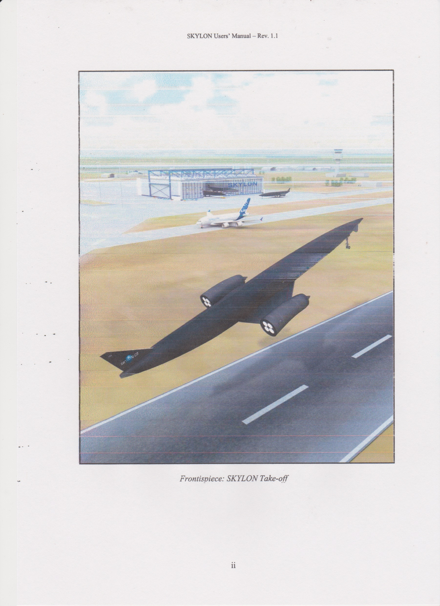
Reaction Engines Ltd. SKYLON

Slide 3
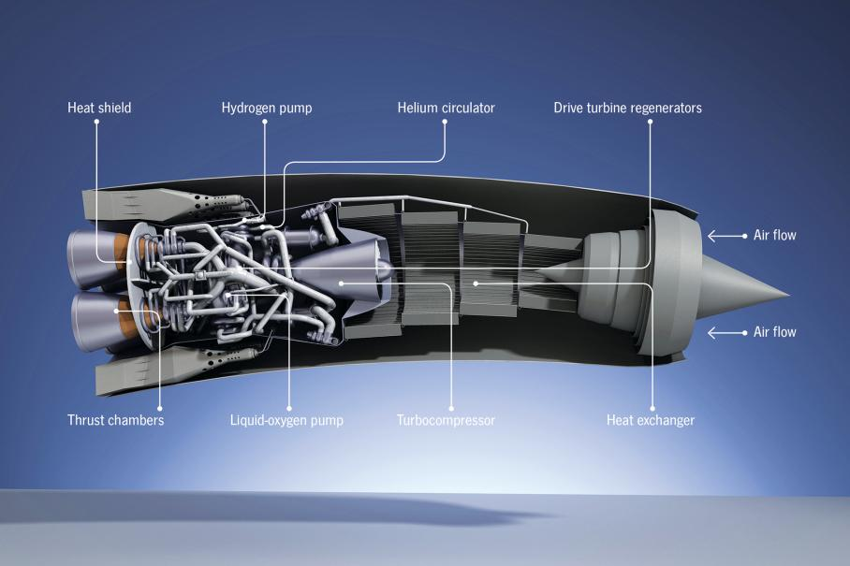
REL: SABRE Turbo-Rocket Engine with Pre-Cooling

Slide 4
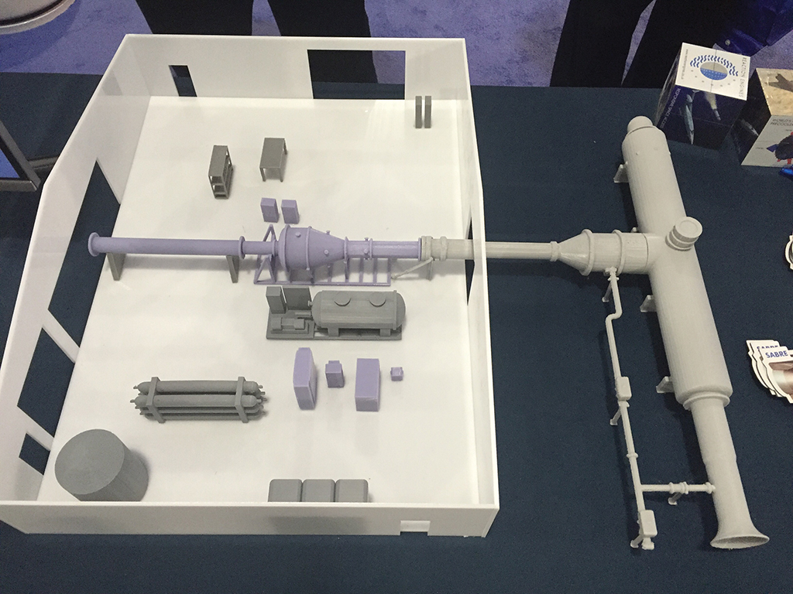
REL: Arrangement of Pre-Cooling Test Installation

Slide 5
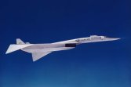
Waverider Aircraft: North American (Boeing) XB - 70

Slide 6
Principal Design Features:
2 Engine Waverider Aircraft with Cranked Wing
Composite Structure with Active Cooling
Pre-Cooled Turbo-Ramjet-Rocket Engines
LH2 Fuel for all and LO2 only for Rocket Propulsion Phase
Variable Near Isentropic Intakes and Plug Nozzles
Closed Cycle helium Coolant System

Slide 7
Top View
Pressure Cockpit
VULCAN II
Waverider Spaceplane Project Study
Propulsion System
OM & C Propulsion
Payload Bay
Manipulator Arm
Air Lock
Pressure Tunnel
LH₂
He
LO₂
N₂: RCS
Side View
Fig.1:
Cutaway system sketch of top & side view of VULCAN II.

Slide 8
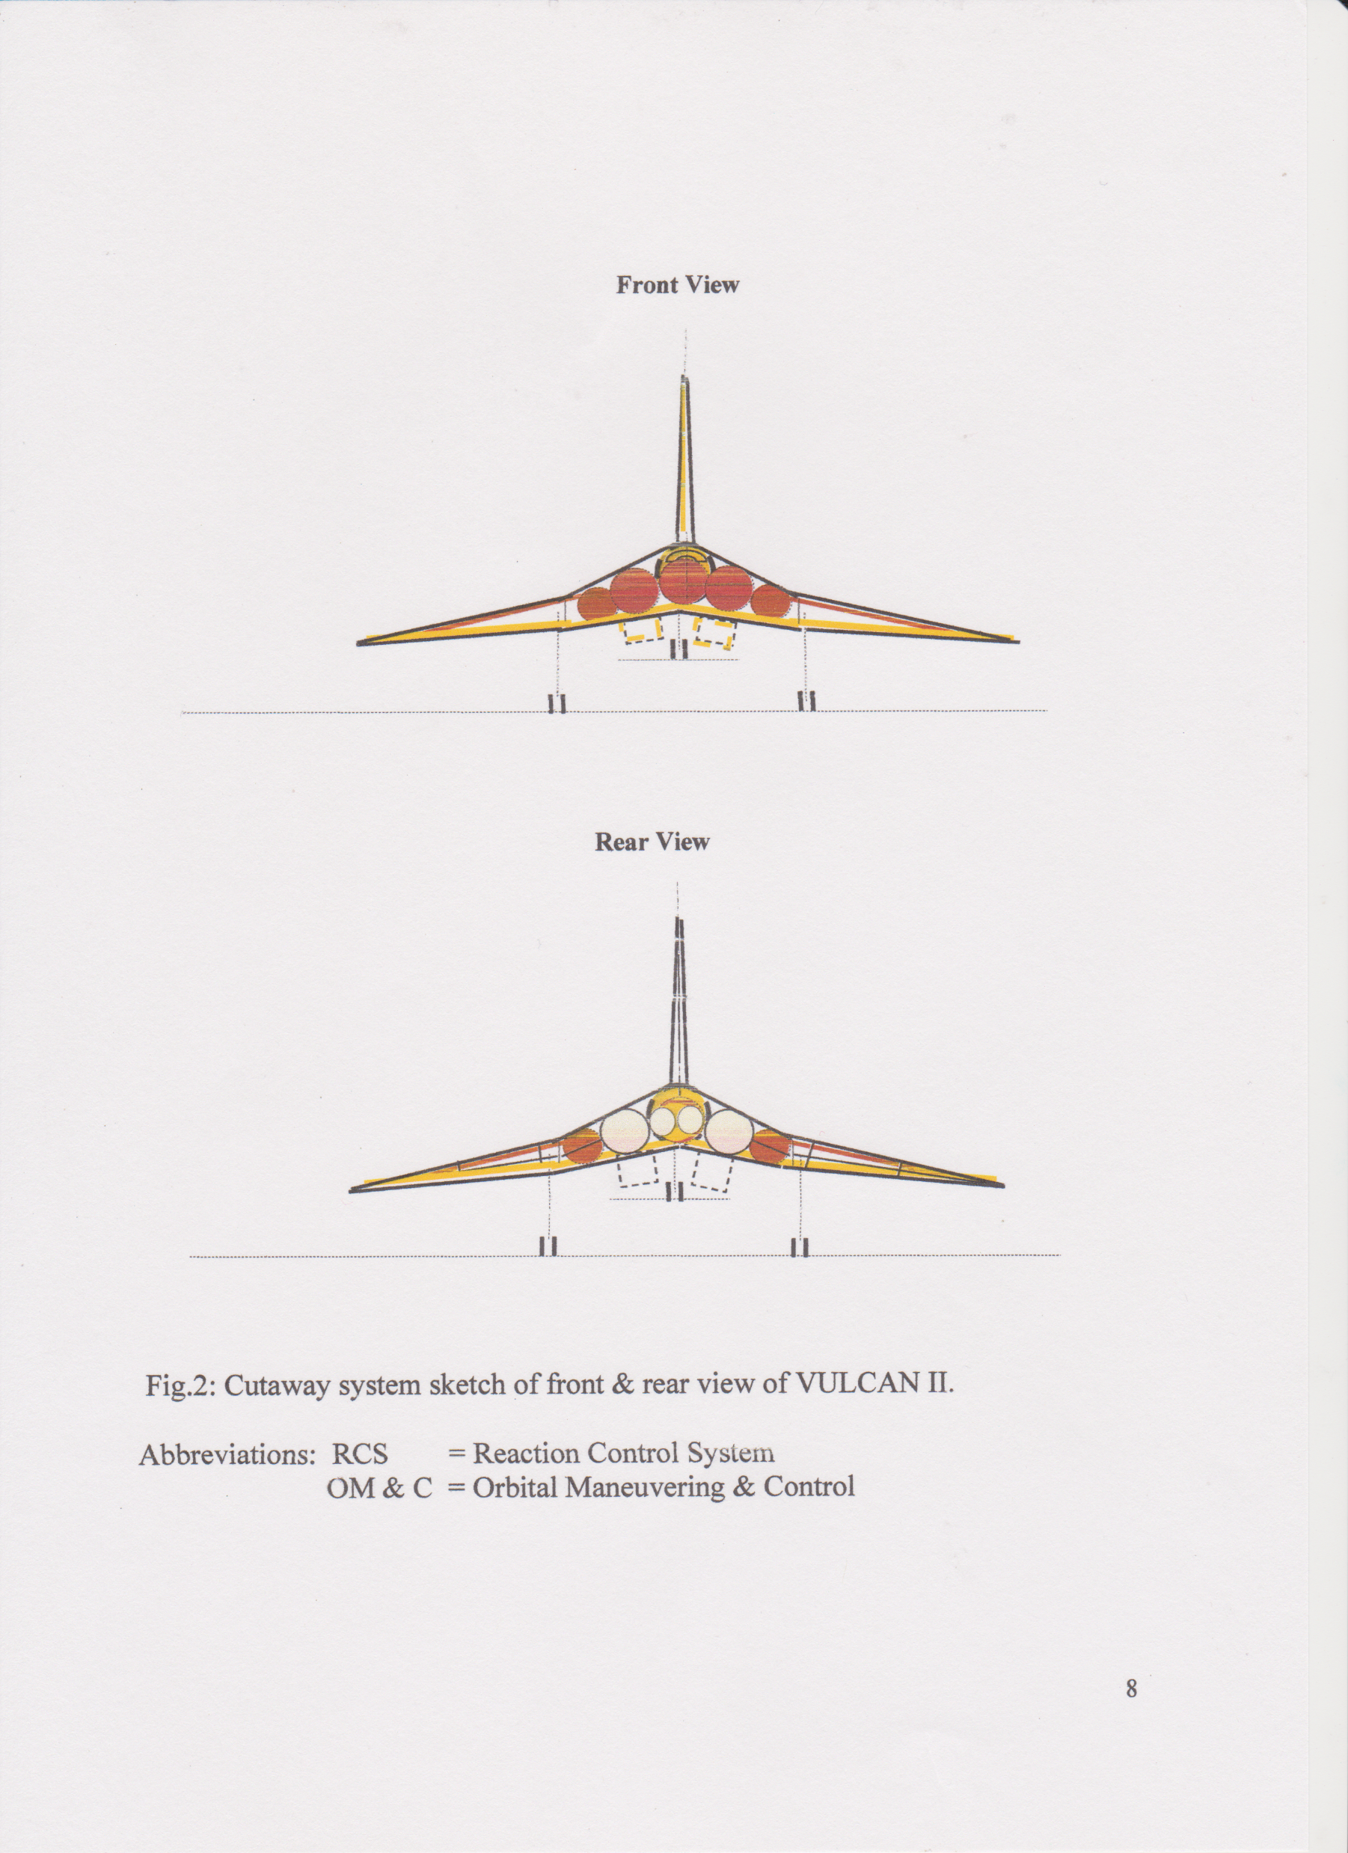
VULCAN II
Waverider Spaceplane Project Study

Slide 9
VULCAN IIL
Waverider Suborbital Transport Aircraft
Project Study
Top View
Propulsion System
Double Wall Pressure Cabin
LH₂
He
Side View
Fig.1:
Cutaway system sketch of top & side view of VULCAN IIL.

Slide 10
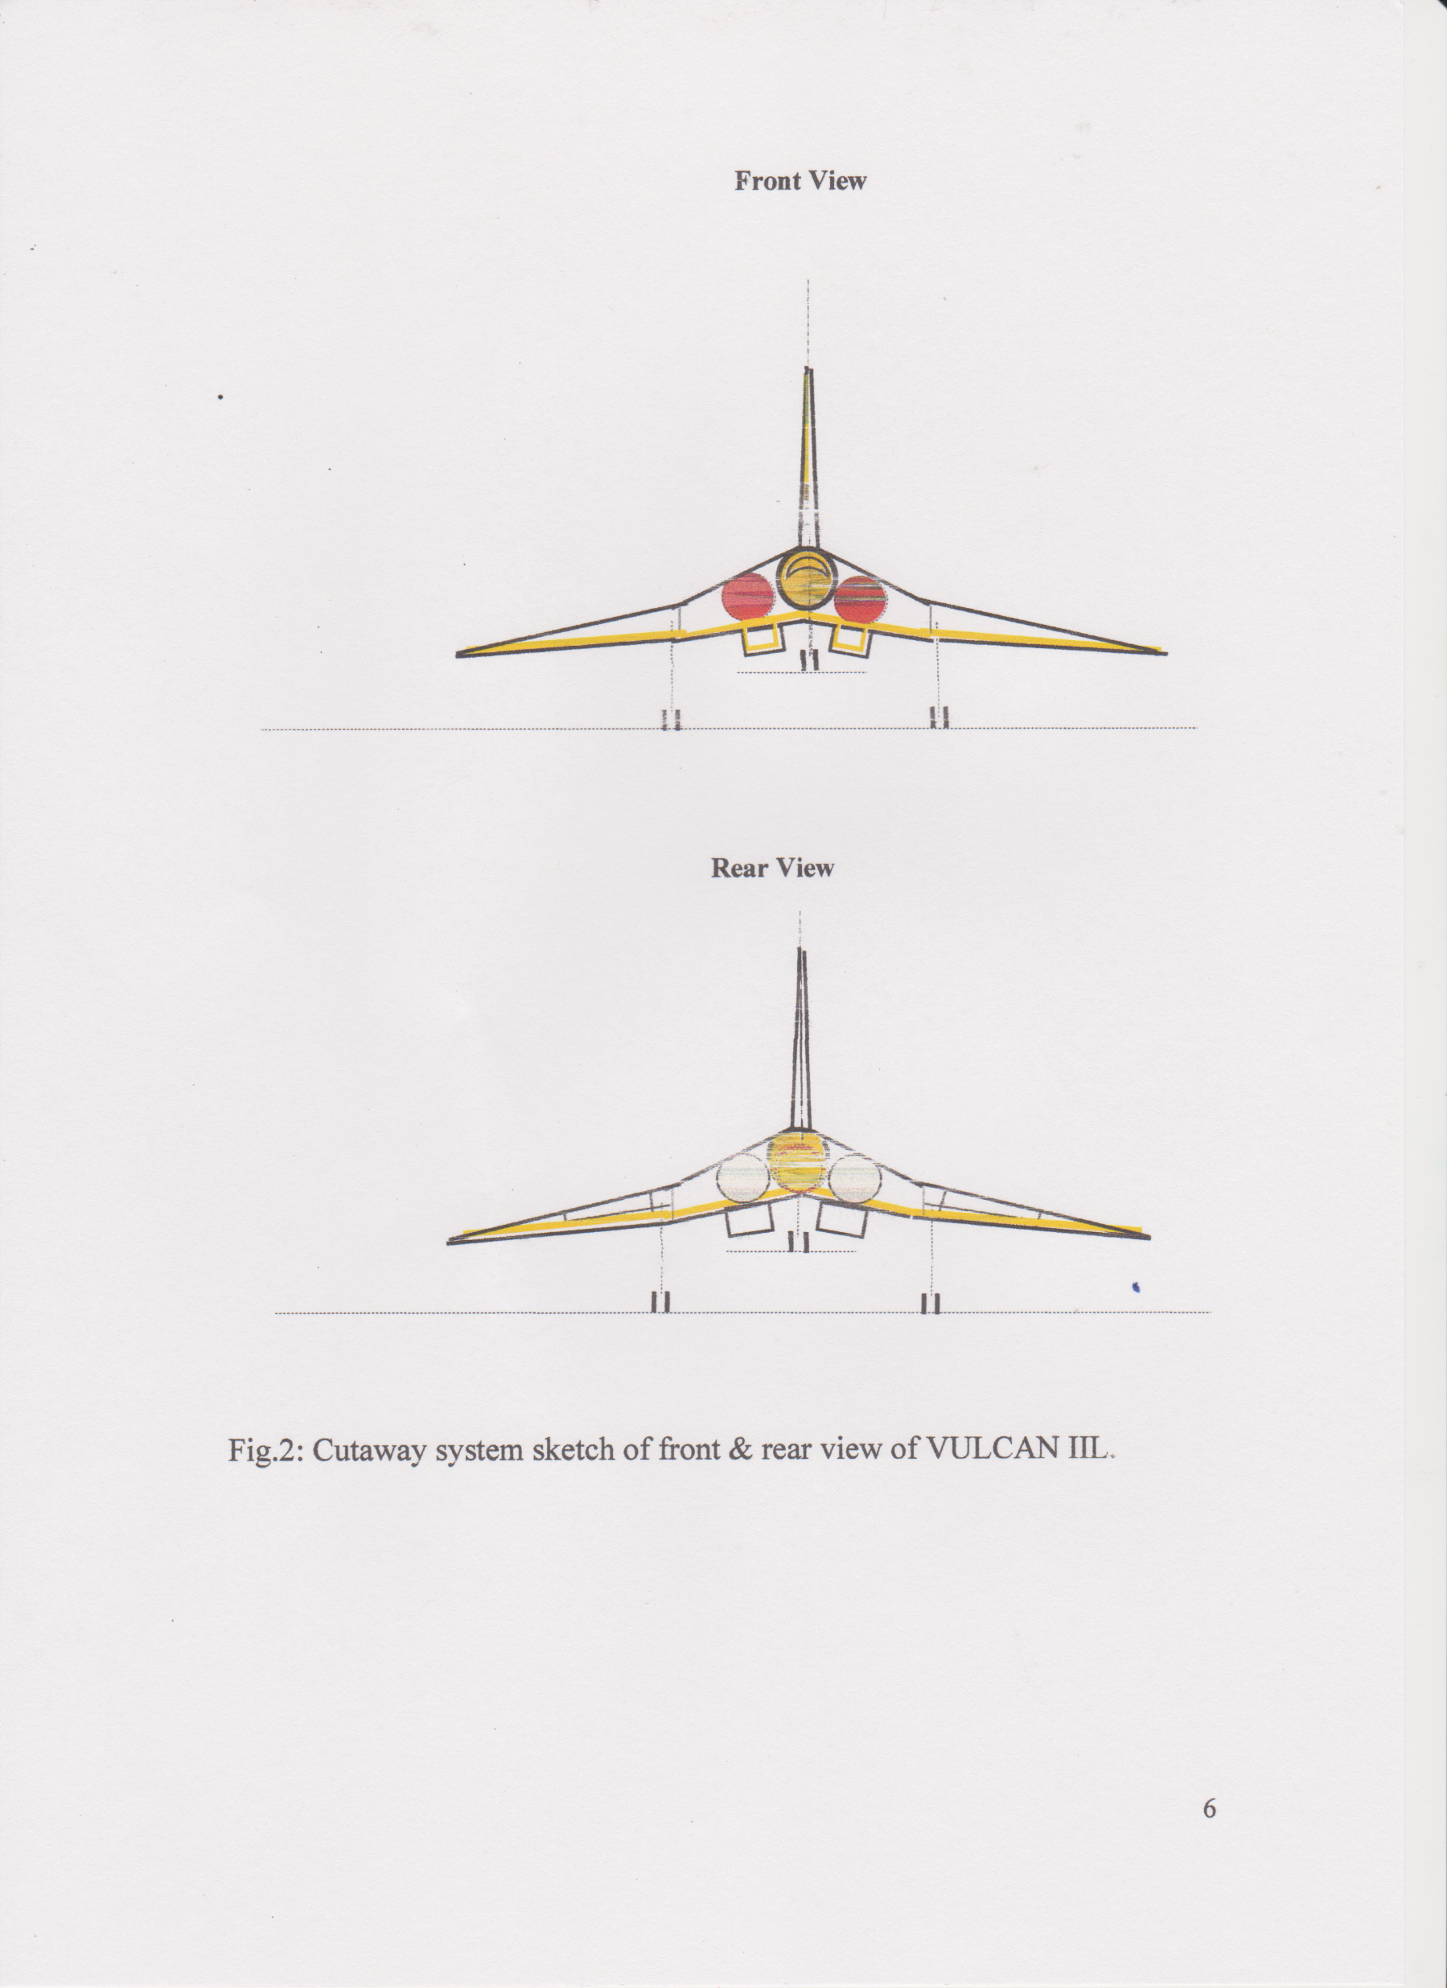
VULCAN IIL
Waverider Suborbital Transport Aircraft
Project Study

Slide 11
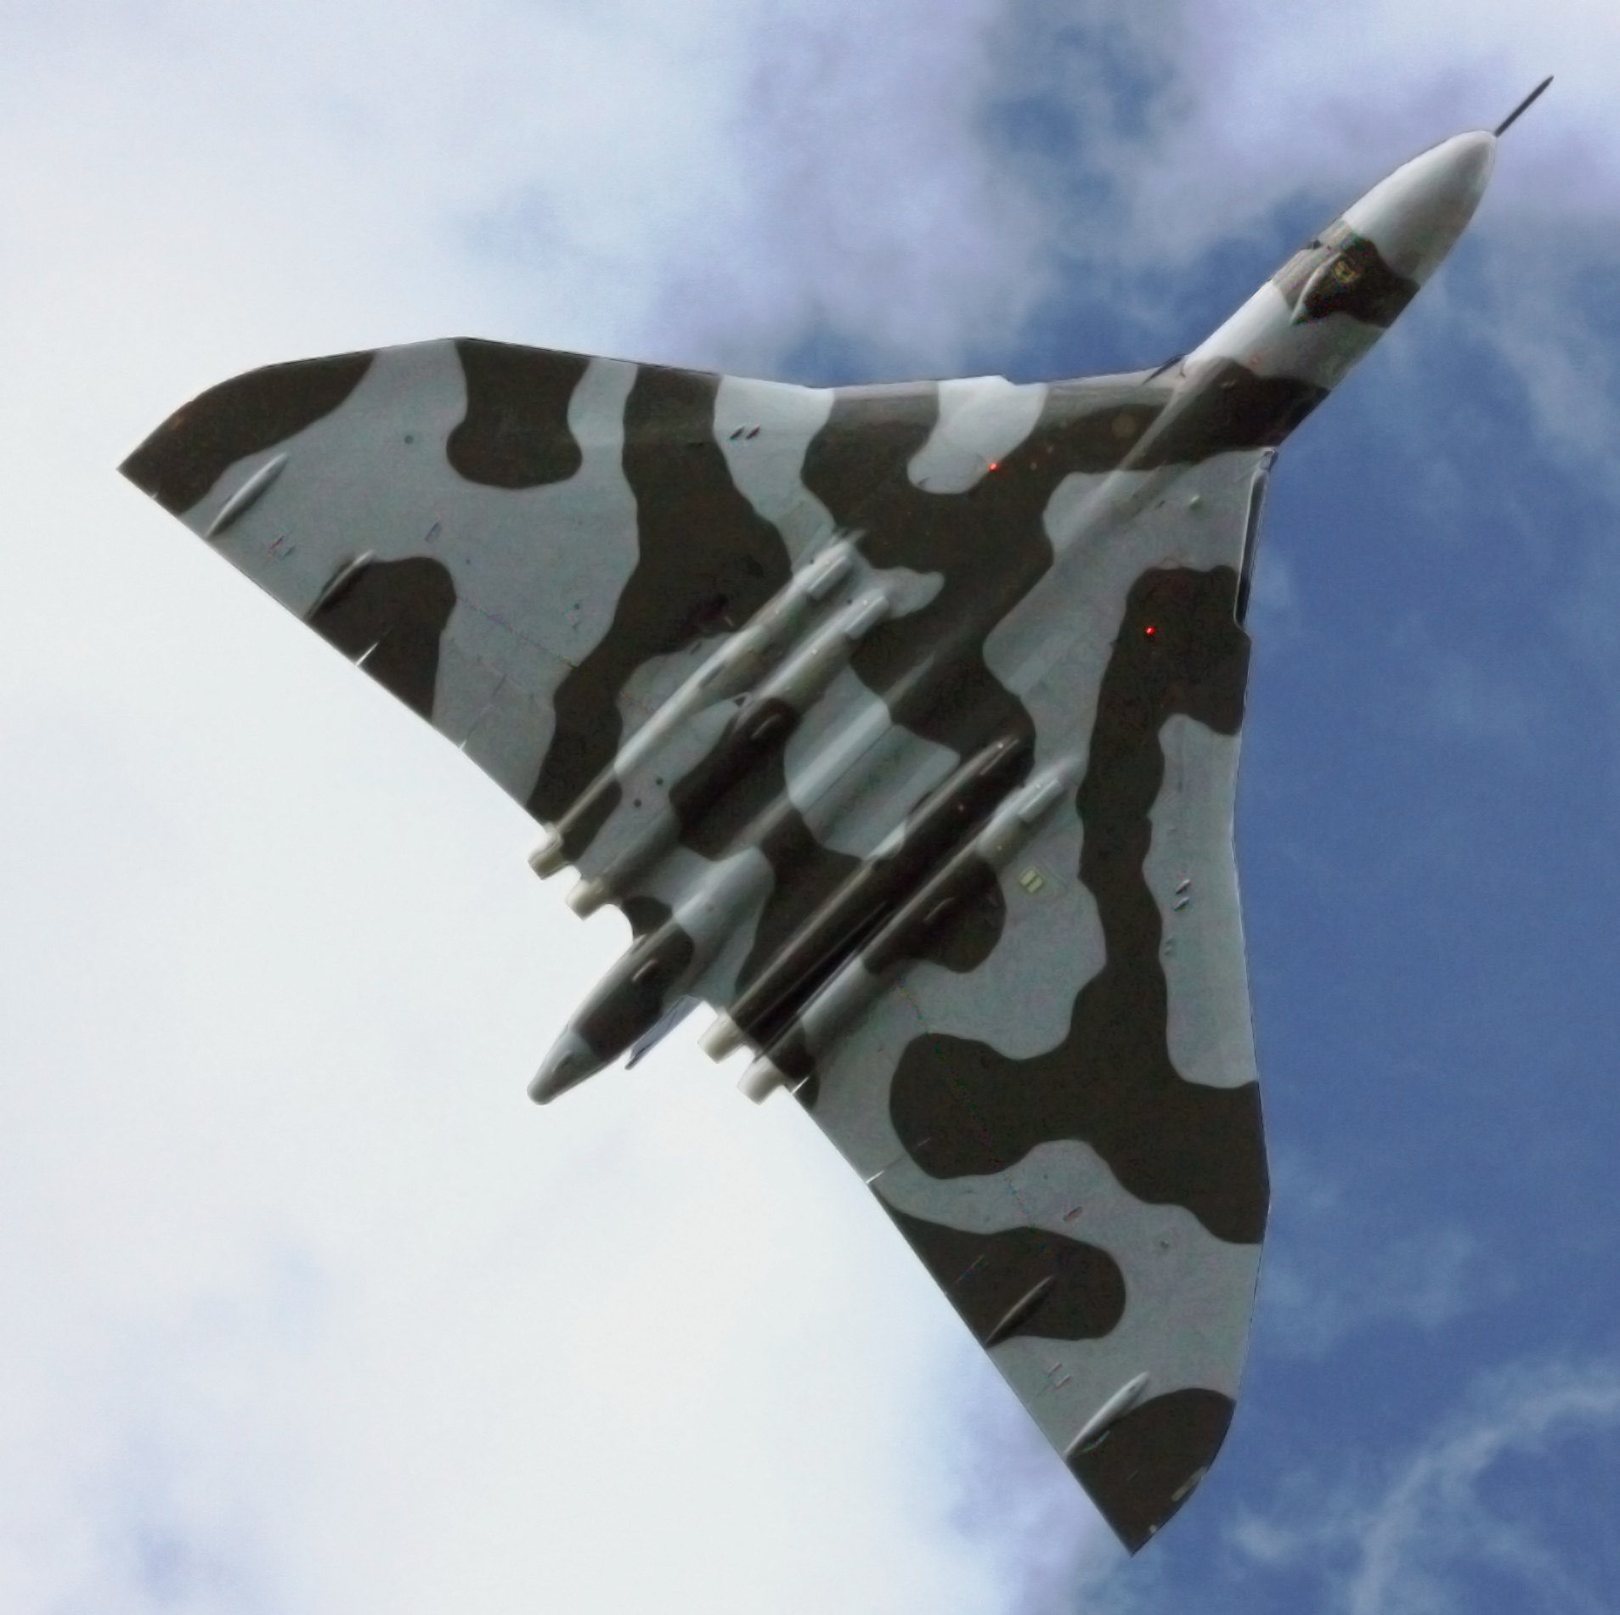
AVRO VULCAN

Slide 12
Structure: Silicium-Carbon (SiC)
Separate components:
Wing-Body: double-wall skin with nanotube structure,
induction welded to spars, active cooling.
Tanks: pressure vesssel with double-wall skin with
nanotube structure, induction welded to spars.
Pressure Cabin: same structure as for tanks except nanotubes
but stricter safety requirements

Slide 13

VULCAN II
Waverider Spaceplane Project Study
To and from structure cooling
~
tanks
To other engine
ø
Prandtl-Meyer axis
□
M > 1
Intake closed off at rocket propulsion and reentry phase
Prandtl-Meyer flow (M > 1)
straight shock
M < 1
Combustion chamber with ejector nozzle

Slide 14
VULCAN IIL
Waverider Suborbital Transport Aircraft
Project Study
to and from structure cooling
~
tanks
To other engine
Prandtl-Meyer axis
ø
□
M > 1
Prandtl-Meyer flow (M > 1)
straight shock
M < 1
Combustion chamber with ejector nozzle
Fig. 3: Schematic functional view of the propulsion system

Slide 15
VULCAN II
Waverider Spaceplane Project Study
Main Dimensions:
Length over all | l | 100 | m
Span | b | 75 | m
Height over ground | Hog | 37 | m
Aerodynamic reference area | Aref | 2800 | m²
Wetted Surface reference area | WSref | 7200 | m²
Aspect ratio | Λ=b²/Aref | 2
Engine main frame diameter | demf | 5 | m
Diameter of payload bay | dbay | 6,25 | m
Length of payload bay | lbay | 14 | m

Slide 16
VULCAN IIL
Waverider Suborbital
Transport Aircraft
Project Study
Main Dimensions:
Length over all | l | 100 | m
Span | b | 75 | m
Height over ground | Hog | 37 | m
Aerodynamic reference area | Aref | 2800 | m²
Wetted Surface reference area | WSref | 7200 | m²
Aspect ratio | Λ=b²/Aref | 2
Engine main frame diameter | demf | 5 | m
Diameter of pressure cabin | dcab | 6,25 | m
Length of pressure cabin | lcab | 61 | m

Slide 17
VULCAN II
Waverider Spaceplane Project Study
Mass Estimation:
Item | parameter | mass relation | mass [10³*kg]
Wing-body structure | unit mass | 4,75 kg/m² | 19,95
Tank structure | unit mass | 3,5 kg/m² | 6,87
Fin structure | unit mass | 4,3 kg/m² | 1,29
Propulsion system |  | estimated | 1,50
Heat exchangers |  | estimated | 1,00
He |  | estimated | 1,00
Landing gear |  | ≈ 4% of MLM | 2,00
Pumps and other equipment |  | estimated | 1,00
Operating Mass Empty |  |  | 32,61
Astronauts + other payload |  |  | 15,00
Zero Fuel Mass |  |  | 47,61
LH₂ | density | 71 kg/m³ | 112,97
LO₂ | density | 1140 kg/m³ | 158,97
N₂ | estimated |  | 1,00
Take-Off Mass |  |  | 319,55
Maximum Landing Mass | estimated |  | 60,00
Wing loading at TOM |  | 114,13 kg/m²
Wing loading at MLM |  | 21,43 kg/m²

Slide 18
VULCAN IIL
Waverider Suborbital Transport Aircraft Project Study
Mass estimation
 |  | R [km] = | 20000 | 15000 | 10000 | 5000
Item | parameter | mass relation | mass [10³∗kg] | mass [10³∗kg] | mass [10³∗kg] | mass [10³∗kg]
Wing-body structure | unit mass | 4,75 kg/m² | 19,95 | 19,95 | 19,95 | 19,95
Pressure cabin structure | unit mass | 3,5 kg/m² | 6,98 | 6,98 | 6,98 | 6,98
Tank structure | unit mass | 3,5 kg/m² | 2,64 | 2,64 | 2,64 | 2,64
Fin structure | unit mass | 4,3 kg/m² | 1,29 | 1,29 | 1,29 | 1,29
Propulsion system |  | estimated | 1,50 | 1,50 | 1,50 | 1,50
Heat exchangers |  | estimated | 1,00 | 1,00 | 1,00 | 1,00
He |  | estimated | 1,00 | 1,00 | 1,00 | 1,00
Landing gear |  | 4% of MLm | 2,00 | 2,00 | 2,00 | 2,00
Pumps and other equipment |  | estimated | 1,00 | 1,00 | 1,00 | 1,00
Crew & cabin equipment |  | estimated | 3,00 | 3,00 | 3,00 | 3,00
Operating Empty mass |  |  | 38,36 | 38,36 | 38,36 | 38,36
300 Pax Pay Load, (PL) |  |  | 31,50 | 31,50 | 31,50 | 31,50
Zero Fuel mass, (ZFm) |  |  | 69,86 | 69,86 | 69,86 | 69,86
Fuel mass, (Fm = mLH₂) | density | 71 kg/m³ | 55,00 | 42,90 | 32,45 | 15,95
Take-Off mass, (TOm) |  |  | 124,86 | 112,76 | 102,31 | 85,81
Max. Landing mass, (MLm) | estimated |  | 60,00 | 60,00 | 60,00 | 60,00
Wing loading at TOm |  |  | 44,28 kg/m² | 40,27kg/m² | 36,54 kg/m² | 30,65 kg/m²
Wing loading at MLm |  |  | 21,43 kg/m² | 21,43kg/m² | 21,43 kg/m² | 21,43 kg/m²

Slide 19
VULCAN II
Waverider Spaceplane Project Study
Aerodynamic data required for performance calculation:
M | cL_{α} [1/ º] | cF | cD₀ | cD* | α* [º] | cL* | L/Dmax
0,25 | 0,0568 | 0,00295 | 0,0083 | 0,0167 | 2,90 | 0,1647 | 9,871
0,5 | 0,0635 | 0,00290 | 0,0082 | 0,0164 | 2,72 | 0,1727 | 10,526
0,8 | 0,0916 | 0,00282 | 0,0080 | 0,0160 | 2,23 | 0,2046 | 12,825
2 | 0,0363 | 0,00232 | 0,0066 | 0,0131 | 3,05 | 0,1108 | 8,442
2,5 | 0,0281 | 0,00220 | 0,0062 | 0,0124 | 3,42 | 0,0962 | 7,726
3 | 0,0233 | 0,00190 | 0,0054 | 0,0107 | 3,53 | 0,0824 | 7,665
3,5 | 0,0203 | 0,00174 | 0,0049 | 0,0098 | 3,68 | 0,0747 | 7,589
4 | 0,0178 | 0,00160 | 0,0045 | 0,0091 | 3,79 | 0,0675 | 7,459
4,5 | 0,0159 | 0,00135 | 0,0038 | 0,0076 | 3,71 | 0,0590 | 7,726
5 | 0,0143 | 0,00131 | 0,0037 | 0,0074 | 3,86 | 0,0550 | 7,422
5,5 | 0,0129 | 0,00120 | 0,0034 | 0,0068 | 3,88 | 0,0501 | 7,381
6 | 0,0118 | 0,00115 | 0,0033 | 0,0065 | 3,97 | 0,0469 | 7,209
6,5 | 0,0109 | 0,00106 | 0,0030 | 0,0060 | 3,98 | 0,0432 | 7,206
7 | 0,0101 | 0,00099 | 0,0028 | 0,0056 | 3,98 | 0,0401 | 7,198
7,5 | 0,0094 | 0,00095 | 0,0027 | 0,0054 | 4,05 | 0,0380 | 7,076
8 | 0,0088 | 0,00089 | 0,0025 | 0,0050 | 4,05 | 0,0356 | 7,074
8,5 | 0,0083 | 0,00084 | 0,0024 | 0,0048 | 4,06 | 0,0336 | 7,061
VULCAN IIL
Waverider Suborbital Transport Aircraft Project Study

Slide 20
VULCAN II
Waverider Spaceplane Project Study
Specific impulse Isp of hydrogen fueled turbo-ramjet with and without pre-cooling.
VULCAN IIL
Waverider Suborbital Transport Aircraft Project Study
Turbo-ramjet with pre-cooling
Turbo-ramjet without pre-cooling
Rocket 2H₂ + O₂

Slide 21
VULCAN II
Waverider Spaceplane Project Study
Total efficiency η for a turbo-ramjet with and without pre-cooling.
VULCAN IIL
Waverider Suborbital Transport Aircraft Project Study
Turbo-ramjet with pre-cooling
Turbo-ramjet without pre-cooling
Rocket 2H₂ + O₂

Slide 22
VULCAN II
Waverider Spaceplane Project Study
Schematic arrangement of forces and climb angle.
+z_{a}
VULCAN IIL
Waverider Suborbital Transport Aircraft Project Study
+x_{a}
_{(flight direction)}
L
Fc
Ft
γc
D
W = m ∗ g
γc

Slide 23
VULCAN II
Waverider Spaceplane Project Study

Slide 24
VULCAN II
Waverider Spaceplane Project Study

Slide 25
VULCAN IIL
Waverider Suborbital Transport Aircraft Project Study
R = Rd = 20000km

Slide 26
VULCAN IIL
Waverider Suborbital Transport Aircraft Project Study
Fuel mass ratio Fm/ZFm depending from range R
VULCAN IIL
Advanced Subsonic Airliner

Slide 27
Thank you for your attention!
Please see for further information:
Kay Runne
E.: KayRunne@msn.com
T.: + 31 – 30 – 228 1649
M.: + 31 – 6 – 2186 2136
www.ramwave.eu

