Slide 1
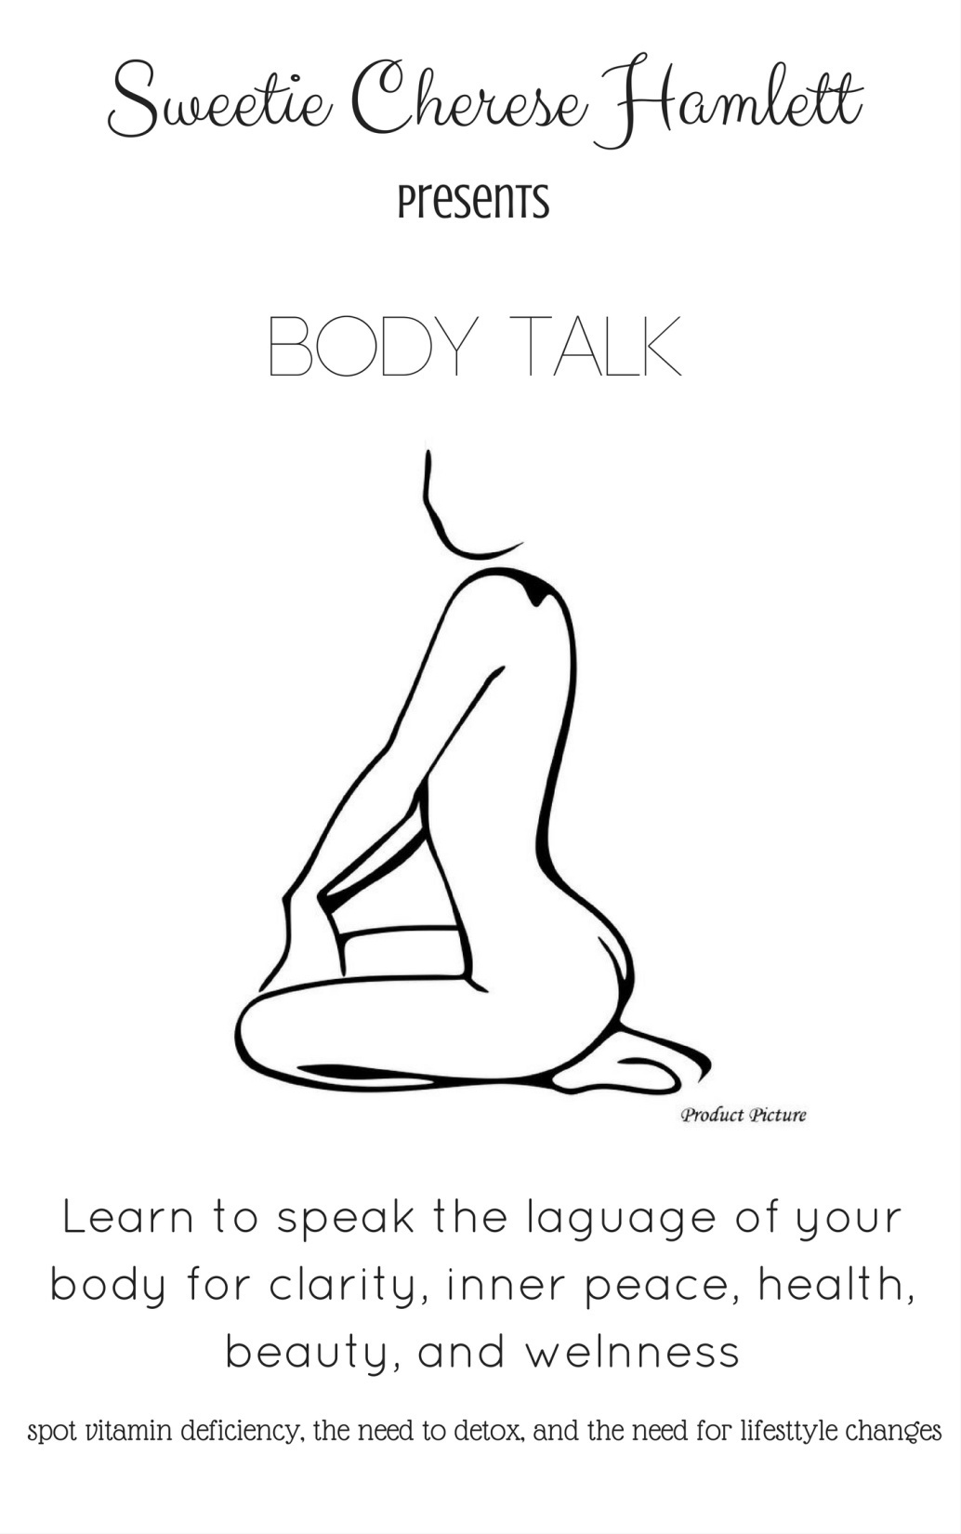

Slide 2
What is body talk
Body talk is the language of our body, it is the way our bodies communicate its needs and wants. It’s not a secret language but more of a forgotten language, that when remembered can be the key to unlocking the door to your healthy self and the ability to build a profound relationship with self from the inside out.

Slide 3
Vitamins for human health
13 essential vitamins for bodily function: Vitamins A, C, D, E, K, and B vitamins: Thiamine, Riboflavin, Nicotinamide, Pantothenic acid, Pyridoxin, Biotin, folic acid/folate, Cobalamin
Water and Fat Soluble Vitamins
There are two types of vitamins- water soluble (i.e. vitamin C, thiamine) and fat-soluble (vitamins D, E, & A). All this means is that some vitamins are found and stored in oils and fats while others dissolve in water and mix easily in your blood. Fat-soluble vitamins tend to stick around in the body longer, while water soluble vitamins are eliminated through the urine quicker and small amounts are stored in the body at one time.

Slide 4
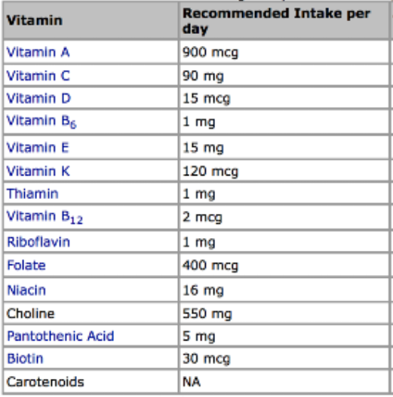
Vitamin RID

Slide 5
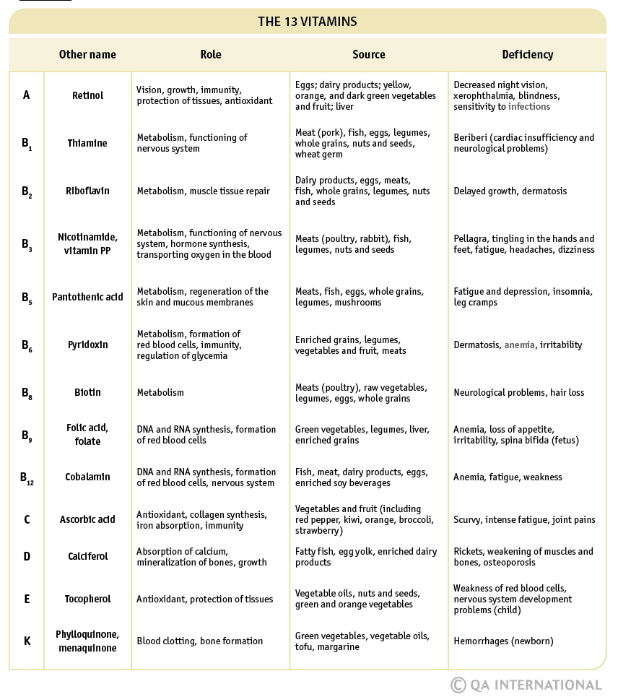

Slide 6
Nutrition Source | Servings | Serving Size
Whole grains | 5-8 | 1 slice of bread, 1 cup of cereal, ½ cup of rice or pasta
Fruits | 3-4 | ½ cup fresh, canned, or frozen, ¼ cup dried
Vegetables | 4-6 | ½ cup raw, 1 cup cooked
Plant oils | Up to 5 | 1 teaspoon
Nuts & Seeds | 1-3 | ¼ cup
Meats | 0-7 | 2-3 oz.
Dairy | 1-3 | 1 cup of milk, ¼ cup cheese, ½ cup cottage cheese
Eggs | 4-6 | 1 egg
Beans, Peas, Lentils | 3-6 | ½ cup cooked, ½ cup tofu, 1 cup soy milk

Slide 7
Vitamins and Beauty
FOODS | Vitamins | Benefits
Fish (salmon, ect…) | Omega 3 | Healthy scalp
Dark greens (spinach, broccoli, ect …..) | A, C, iron, calcium | Anti ageing for skin; Increases natural oil flow for hair/ skin
Beans ( 3 or more cups weekly) | Protein, Iron, Zinc, Biotin | Hair growth
Nuts ( brazil, walnuts, cashews, pecans, almonds) | Selenium, Zinc, E, Alpha-linolenic, omega 3 | Healthy thick shiny hair slows shedding , Anti-ageing for the skin
Poultry (turkey, Chicken) | protein | Strong hair and nails
Eggs | Biotin, B12, B5 | Overall beauty
Whole grains | Zinc, B | Overall beauty
Oysters, Beef , Lamb | Zinc, B | Overall Beauty
Low fat dairy | Calcium | Overall Growth
Orange, Red, Yellow Fruits and veggies | A, Beta-carotene | Over all beauty health
Red and blue fruits | Ferulic acid | Protects from UV rays

Slide 8
Hair signs of deficiency
Symptom | Deficiency
Coarse, brittle hair | Zinc, vitamin A
Dandruff | Vitamin B2, B6, zinc, magnesium, biotin, omega oils
Dry hair | Vitamin A, zinc
Graying hair | B9, vitamin B5, biotin,
Hair loss | Vitamin A, iodine, magnesium, B3, B5, , zinc, vitamin B6, D, sulfur, selenium, biotin, iron, vitamin C, B12
Oily scalp | Vitamin B2

Slide 9
Nails signs of deficiency
Hangnails | Vitamin C, B9, proteins, zinc
White spots/ bands | Zinc, vitamin B6
Peeling nails | Vitamin A, C, calcium
Ridges | Vitamin A, protein, calcium, zinc, vitamin B12
Scaling of cuticles | Biotin
Spoon nails | Iron
Brittle nails | Iron, biotin, omega oils, zinc, vitamin A
Soft nails | Omega 3 oils
Slow growth | Magnesium, iron
Swollen cuticles | Vitamin C
Yellow nails | Diabetes, iron, zinc
Flattened nails | Severe iron
No lunula | Iron, vitamin B12, reduction of oxygen
Splitting nails | Iron, zinc, vitamin A
Thin nails | Iron
Thickening of hyponechium | Iron
Clubbing | Reduction of oxygen

Slide 10
Skin signs of deficiency
Rash | Vitamin C, B6, omega oils, calcium
Red- brown or dark- red spots | Manganese
Rosacea | Vitamin B2
Scaly dermatitis | Vitamin B7,
Scaly eczema around the nose, ears, scrotum or vulva | Vitamin B2, B3
Scar tissue | Vitamin E
Scieroderma | Vitamin E, C, A, magnesium
Sensitivity to insect bites | Vitamin C, B1, calcium
Shingles | vitaminB12, C, A, B, E, zinc, lysine,
Skin cancer | Vitamin A, B6, zinc
Skin folds, red and infected | B3
Stretch marks | Vitamin E, B6, zinc,
Swelling | Zinc, magnesium, vitamins B6, B12
Vaginal itching | Vitamins B2, E, C
Warts, moles | Vitamins C, A, E
Weals | Vitamin B6, C, zinc
White skin patches | Zinc, vitamin B6, B5
Wrinkles | Vitamin C, E, A,

Slide 11
Fungal infection | B vitamins,
Gangrene | Vitamin C, E, B, magnesium,
Greasy dermatitis around eyes and toes | Vitamin B6, zinc, B2, B12
Horny red skin on pressure areas | Zinc, vitamin B6
Hot flushes | Vitamin E, boron, magnesium, calcium,
Ichthyosis | Vitamin A, retinoic acid
Boils and cold sores | Vitamin C, A, B6, zinc, magnesium
Itching | Vitamins B, C, B6, zinc,
Jaundice | Vitamins C, E, A, B2, B12, B6, lecithin, magnesium, zinc,
Keratosis | Vitamin A,
Lemon yellow skin | Vitamin B12
Oily skin, white heads | Vitamin B2, B12
Slow wound healing | Zinc, vitamin C
Cracking in corner of the mouth | Iron, B2,B12
Dermatitis | B6, B7
Bruising | Vitamin C
Ageing | Vitamin B3
Over sensitivity to sunlight | Vitamin B6, zinc, beta carotene
Pale skin | Vitamin B7, B9, B6, iron
Prickly heat rash | Vitamin C
Psoriasis | Vitamin D, avoid gluten
Purple blueish black patches | Vitamin C, B2,

Slide 12
Find the vitamins
Vitamin or Mineral | Related Foods
B1 thiamine | Fish, lean meats, milk, grains
B2 riboflavin | Grains, nuts, milk, eggs, green leafy vegetable, lean meat
B3 niacin | Nuts, eggs, fish, lean meats, poultry
B5 pantithenic acid | Red onion, ginger, bell peppers, carrots, cabbage
B6 pyridoxine | Legumes, beans, grains, fish, eggs
B7 biotin | Avocado, broccoli, cauliflower, nuts, potatoes, mushrooms, spinach
B9 folic acid | Beans, legumes, citrus fruits, grains, dark greens, leafy vegetables,
B12 cobalamin | Eggs, milk, poultry, shell fish
B17 amygclalin | Seeds: apricot, peaches, plums, cherries, prunes, apples, grapes, berries, tubers sprouts, nuts,
C | Citrus fruits, green peppers, strawberries, tomatoes, broccoli, sweet and white potatoes
D | Grains, dairy, fish, the sun
E | Corn, nuts, olives, green leafy vegetables, wheat germ
K | Cabbage, cauliflower, spinach, green leafy vegetables, grains
Zinc | oysters, beef, lamb, toasted wheat germ, spinach, pumpkin seeds, squash seeds, nuts, dark chocolate, pork, chicken, beans, and mushrooms
Calcium | Kale, broccoli, watercress, almonds
Iron | Red meat, pork and poultry, seafood, beans, dark green leafy vegetables, dried fruit, peas
Omega 3 | Flax seeds, walnuts, fish, spinach

Slide 13
These work better together
Vitamins and minerals often work together to perform different functions in the body. For example, vitamin D regulates calcium balance and these nutrients work together to affect bone mass. Vitamin C assists in the absorption of iron, which is essential for prevention of anemia
Pair | Benefit
Vitamin D and Calcium | bones, teeth, blood clotting, nerve transmission, muscle function
Sodium and Potassium | Regulate blood pressure, have less salt more veggies like beets, celery, and carrots
B12 cobalamin and B9 Folate | Cellular functions, folate needs cobalamin to metabolize
Niacin and Tryptophan | Lower cholesterol, The liver can synthesize niacin from the essential amino acid tryptophan. Found in oats, beans, and lentils
Vitamin C and Iron | Aids immunity, eye health, wound healing, cell division,
Magnesium and Calcium | Muscle function, cell membrane function, strong bones and teeth
B Complex | Growth, maintenance and development of the body B vitamins: B1, B2, B3, B6, B7, B9, B12

Slide 14
Face mapping
Face mapping is the ability to see the reflection of the body's organs on each part of the face by observing the face's complexion — such as luster, dullness, and color [and breakouts!] — as well as the tongue and face expression," explains Chinese scholar and co-founder of the skincare line Baszicare Chapman Lee.

Slide 15
Other face mapping factors
Face mapping can indicate organ condition and it can also indicate a need for change in ones lifestyle. There are a few initial things to consider when you are experiencing breakouts.
Skin condition: do you have preexisting skin conditions like acne or eczema?
Skin care: do you have a regular skin care routine?
Water intake: are you getting enough water?
Hormones: are you experiencing menopause, menstruation, pregnancy
other factors to consider when experiencing breakouts: keeping clean pillow cases, environmental toxins, oil/product from the hair

Slide 16
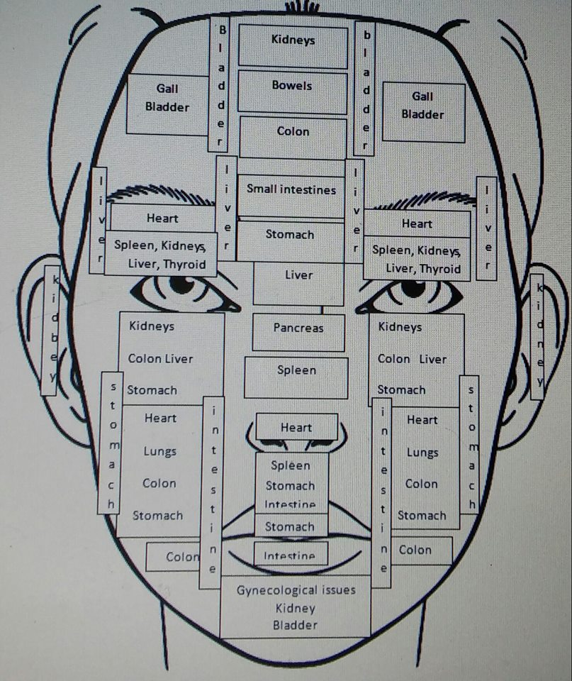

Slide 17
Foods to cleanse the organs
Organ | Cleansing foods
Gall bladder | Garlic, grapefruit, beets, carrots, apples, walnuts, cabbage
Bladder | Cranberry, watermelon, water, eat vegan 1 time weekly
Bowels | Spinach, kale, green olives, celery, cabbage, asparagus
Colon | Garlic, flaxseed, china seeds, beans, avocado
Small intestines | No meat No dairy No processed foods, papaya, pineapple
Stomach | Leeks, onion, garlic, apples, almond, bananas, yams
Liver | Tomatoes , beets, carrots, lemons, limes, turmeric, dandelion
Kidneys | Grape juice, blueberries, cranberries, grapefruit, orange
Heart | Pomegranate, cinnamon, avocados, asparagus, green tea
Spleen | Wheat grass, alfalfa, milk thistle, leafy greens, pumpkin
Pancreas | Blueberries, cherries, broccoli, grapes, spinach, sweet potato
Uterus | Beans, greens, lemons, green tea, olive oil, avocado, almonds
Lungs | Garlic, onions, ginger, chili peppers, cabbage, pineapple, oranges, pomegranates, apples, grapefruits, red bell peppers

Slide 18
BREAK OUT AND LIFESTYLE COMPARRISON CHART
It is possible that you drink water have healthy clean organs and a regular skin care routine and are still having break outs. This is because there are other life style habits that influence the skin, that we will explore in the next chart.

Slide 19
Facial Region | Lifestyle hack
Forehead | Go to bed/relax early 10pm wake by 6am Drink plenty of water 30 minutes of light exercise Eat healthy foods; chew thoroughly
Temples | Eat less processed foods Reduce the amount of fat in your diet Eat cooling foods like cucumbers
Between the brows | Exercise Get more sleep Avoid alcohol Avoid smoking
Nose | Eat less pungent foods like spices and garlic Eat less meat and Eat warm temperature foods Get more fresh air Exercise daily Massage the area around your nose Check for vitamin B deficiency

Slide 20
Facial Region | Lifestyle hack
Left cheek | Cleanse negative energy and relax more Keep cool Eat cooling foods Get rest between 1-3 am , the liver is the strongest Relax between 1-5 pm ,no stress the liver is the weakest If you must work during these hour rest your eyes for 5 minutes each hour
Right cheek | Avoid fast food and Eat less sugar Get more fresh air Lungs are strongest 7-9 am, best time to exercise
Lip area | Eat more fiber Include more fresh fruits and veggies Eat less spicy foods Be mindful of your toothpastes ingredients Massage abdomen in a clockwise motion
Chin and Jaw | Don’t eat before bed Eat more fresh fruits and veggies Get more rest, sleep early 20 minutes of exercise

Slide 21
Implementing lifestyle change
Take it easy on yourself
Make small impactful changes
Celebrate every little success
Challenge yourself reasonably
Stay in YOUR flow and at your pace

