Slide 1
Tbi, The brain, and Exercise
Angela and Sagen

Slide 2
Learning Objectives
Learning Objective 1 The attendees will be able to collaborate to design and label the major parts of the brain.
Learning Objective 2 The attendees will be able to develop the connection between neurocognitive, TBI, and mental health disorders.
Learning Objective 3 The attendees will be able to determine the effectiveness of exercise with the TBI patient and their path towards mental healing.

Slide 3
Parts of the Brain
Shown here are the three main parts of the brain.
Notes:
The brain is a three pound organ that controls all functions of the body, interprets information from the outside world, and embodies the essence of the mind and soul. Intelligence, creativity, emotion, and memory are a few of the many things governed by the brain. Protected within the skull, the brain is composed of the cerebrum, cerebellum, and brainstem.
The brain stem acts as a relay center connecting the cerebrum and cerebellum to the spinal cord. It performs many automatic functions such as breathing, heart rate, body temperature, wake and sleep cycles, digestion, sneezing, coughing, vomiting, and swallowing.
The Cerebellum is located under the cerebrum. Its function is to coordinate muscle movements, maintain posture, and balance.
The Cerebrum is the largest part of the brain and is composed of right and left hemispheres. It performs higher functions like interpreting touch, vision and hearing, as well as speech, reasoning, emotions, learning, and fine control of movement.
The cerebrum has two hemispheres. Each hemisphere controls the opposite side of the body. If a stroke occurs on the right side of the brain, your left arm or leg may be weak or paralyzed. Not all functions of the hemispheres are shared. In general, the left hemisphere controls speech, comprehension, arithmetic, and writing. The right hemisphere controls creativity, spatial ability, artistic, and musical skills.

Slide 4
https://socratic.org/questions/how-many-parts-is-the-human-brain-divided-into-is-one-of-the-parts-the-hind-brai
Notes:
Each of the hemispheres has four lobes: frontal, temporal, parietal, and occipital. Each lobe may be divided, once again, into areas that serve very specific functions. It’s important to understand that each lobe of the brain does not function alone. There are very complex relationships between the lobes of the brain and between the right and left hemispheres.
Frontal lobe
Personality, behavior, emotions
Judgment, planning, problem solving
Speech: speaking and writing (Broca’s area)
Body movement (motor strip)
Intelligence, concentration, self awareness
Parietal lobe
Interprets language, words
Sense of touch, pain, temperature (sensory strip)
Interprets signals from vision, hearing, motor, sensory and memory
Spatial and visual perception
Occipital lobe
Interprets vision (color, light, movement)
Temporal lobe
Understanding language (Wernicke’s area)
Memory
Hearing
Sequencing and organization

Slide 5
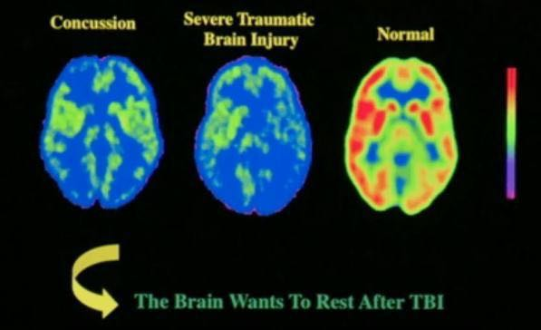
How Trauma Impacts the Brain
https://vitamindwiki.com/VitaminDWiki
Notes:
Imagine you are driving down the road and were just in a car wreck and hit your frontal lobe. Everyone damage your frontal lobe of the brain in front of you. What issues will you be struggling with?
Red - shows more activity
Blue - shows less activity

Slide 6
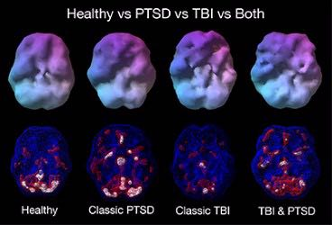
The brain After Trauma
https://www.researchgate.net/figure/Healthy-vs-Classic-PTSD-vs-TBI-vs-Both_fig2_275584043
Notes:
In this slide we are paying attention not so much to the colors but more to the crevices and holes. The colors make the crevices and holes more pronounced. This slide came from Dr. Amen’s clinic. According to Dr. Amen these can be reversed with the right type of counseling techniques.

Slide 7
Notes:
These are the issues that a person with TBI or mTBI may present with when they arrive for counseling. Researchers estimate that sixty-nine million individuals worldwide are estimated to sustain a TBI each year. A TBI is caused by a bump, blow, or jolt to the head that disrupts the normal function of the brain. Not all blows or jolts to the head result in a TBI. The severity of a TBI may range from “mild” (i.e., a brief change in mental status or consciousness) to “severe” (i.e., an extended period of unconsciousness or memory loss after the injury). Traumatic brain injury (TBI) is a major cause of death and disability in the United States. TBIs contribute to about 30% of all injury deaths. Every day, 153 people in the United States die from injuries that include TBI. Those who survive a TBI can face effects that last a few days, or the rest of their lives. Effects of TBI can include impaired thinking or memory, movement, sensation (e.g., vision or hearing), or emotional functioning (e.g., personality changes, depression). TBI can lead to suicide, PTSD, mood disorders, substance and alcohol issues, and impulsive behaviors. These issues not only affect individuals but can have lasting effects on families and communities.

Slide 8
Where do we feel results
Aerobic Exercise: Hippocampus
Lifting Weights: Prefrontal cortex
Yoga: Frontal Lobe
High Intensity Intervals: Hypothalamus
Sports Drills - Prefrontal Cortex and the Basal Ganglia

Slide 9
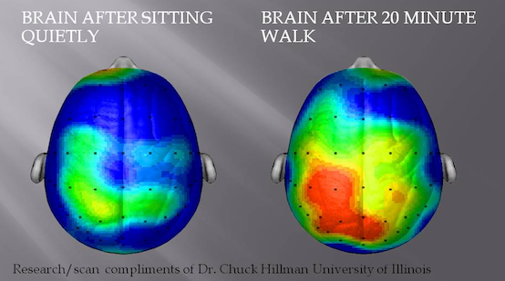

Slide 10
Questions/Comments?

Slide 11
References
Aldossary, N. M., Kotb, M. A., & Kamal, A. M. (2019). Predictive value of early MRI findings on neurocognitive and psychiatric outcomes in patients with severe traumatic brain injury. Journal of affective disorders, 243, 1-7. https://doi.org/10.1016/j.jad.2018.09.001
Archer, T. (2012). Influence of physical exercise on traumatic brain injury deficits: scaffolding effect. Neurotoxicity research, 21(4), 418-434. https://doi-org.ezproxy.liberty.edu/10.1007/s12640-011-9297-0
Chin, L. M., Keyser, R. E., Dsurney, J., & Chan, L. (2015). Improved cognitive performance following aerobic exercise training in people with traumatic brain injury. Archives of physical medicine and rehabilitation, 96(4), 754-759. DOI: 10.1016/j.apmr.2014.11.009
Dewan, M. C., Rattani, A., Gupta, S., Baticulon, R. E., Hung, Y. C., Punchak, M., ... & Rosenfeld, J. V. (2018). Estimating the global incidence of traumatic brain injury. Journal of neurosurgery, 1(aop), 1-18.https://doi.org/10.3171/2017.10.JNS17352
Devine, J. M., Wong, B., Gervino, E., Pascual-Leone, A., & Alexander, M. P. (2016). Independent, community-based aerobic exercise training for people with moderate-to-severe traumatic brain injury. Archives of physical medicine and rehabilitation, 97(8), 1392-1397.doi: 10.1016/j.apmr.2016.04.015
Greco, T., Ferguson, L., Giza, C., & Prins, M. L. (2019). Mechanisms underlying vulnerabilities after repeat mild traumatic brain injuries. Experimental Neurology.https://doi.org/10.1016/j.expneurol.2019.01.012
Imms, P., Clemente, A., Cook, M., D’Souza, W., Wilson, P. H., Jones, D. K., & Caeyenberghs, K. (2019). The structural connectome in traumatic brain injury: A meta-analysis of graph metrics. Neuroscience & Biobehavioral Reviews. doi. 10.1016/j.neubiorev.2019.01.002
Klimova, A., Korgaonkar, M. S., Whitford, T., & Bryant, R. A. (2019). Diffusion tensor imaging analysis of mild traumatic brain injury and posttraumatic stress disorder. Biological psychiatry: cognitive neuroscience and neuroimaging, 4(1), 81-90.doi: 10.1016/j.bpsc.2018.10.004.
Ko, I. G., Kim, S. E., Hwang, L., Jin, J. J., Kim, C. J., Kim, B. K., & Kim, H. (2018). Late starting treadmill exercise improves spatial learning ability through suppressing CREP/BDNF/TrkB signaling pathway following traumatic brain injury in rats. Journal of exercise rehabilitation, 14(3), 327. doi: 10.12965/jer.1836248.124.
Lai, B., Cederberg, K., Vanderbom, K. A., Bickel, C. S., Rimmer, J. H., & Motl, R. W. (2018). Characteristics of adults with neurologic disability recruited for exercise trials: a secondary analysis. Adapted Physical Activity Quarterly, 35(4), 476-497. doi: 10.1123/apaq.2017-0109

Slide 12
References
Leddy, J. J., Haider, M. N., Ellis, M., & Willer, B. S. (2018). Exercise is medicine for concussion. Current sports medicine reports, 17(8), 262-270. doi: 10.1249/JSR.0000000000000505.
Liu, Y., Yan, T., Chu, J. M. T., Chen, Y., Dunnett, S., Ho, Y. S., ... & Chang, R. C. C. (2019). The beneficial effects of physical exercise in the brain and related pathophysiological mechanisms in neurodegenerative diseases. Laboratory Investigation, 1. doi: 10.1038/s41374-019-0232-y.
Moore, T. M., Gur, R. C., Thomas, M. L., Brown, G. G., Nock, M. K., Savitt, A. P., ... & Army STARRS Collaborators*. (2019). Development, Administration, and Structural Validity of a Brief, Computerized Neurocognitive Battery: Results From the Army Study to Assess Risk and Resilience in Servicemembers. Assessment, 26(1), 125-143. doi: 10.1177/1073191116689820
Morris, T. P., Costa-Miserachs, D., Rodriguez-Rajo, P., Finestres, J., Bernabeu, M., Gomes-Osman, J., ... & Tormos-Muñoz, J. M. (2018). Feasibility of aerobic exercise in the subacute phase of recovery from traumatic brain injury: a case series. Journal of neurologic physical therapy, 42(4), 268-275.
Pinto, S., Newman, M., & Hirsch, M. (2018). Perceived Barriers to Exercise in Adults with Traumatic Brain Injury Vary by Age. Journal of Functional Morphology and Kinesiology, 3(3), 47.https://doi.org/10.3390/jfmk3030047
Sullivan, K. A., Hills, A. P., & Iverson, G. L. (2018). Graded Combined Aerobic Resistance Exercise (CARE) to Prevent or Treat the Persistent Post-concussion Syndrome. Current neurology and neuroscience reports, 18(11), 75. doi: 10.1007/s11910-018-0884-9.
Taylor, J. M., Montgomery, M. H., Gregory, E. J., & Berman, N. E. (2015). Exercise preconditioning improves traumatic brain injury outcomes. Brain research, 1622, 414-429. DOI: 10.1016/j.brainres.2015.07.009
Twamley, E. W., Hays, C. C., Van Patten, R., Seewald, P. M., Orff, H. J., Depp, C. A., ... & Jak, A. J. (2019). Neurocognition, psychiatric symptoms, and lifetime homelessness among veterans with a history of traumatic brain injury. Psychiatry research, 271, 167-170.DOI:
10.1016/j.psychres.2018.11.049
Wise, E. K., Hoffman, J. M., Powell, J. M., Bombardier, C. H., & Bell, K. R. (2012). Benefits of exercise maintenance after traumatic brain injury. Archives of physical medicine and rehabilitation, 93(8), 1319-1323.doi: 10.1016/j.apmr.2012.05.009.
Yoon, K. J., & Kim, D. Y. (2018). Immediate Effects of a Single Exercise on Behavior and Memory in the Early Period of Traumatic Brain Injury in Rats. Annals of rehabilitation medicine, 42(5), 643. doi: 10.5535/arm.2018.42.5.643.

