Slide 1
2020 Craft Drills
Chris Clifton

Slide 2
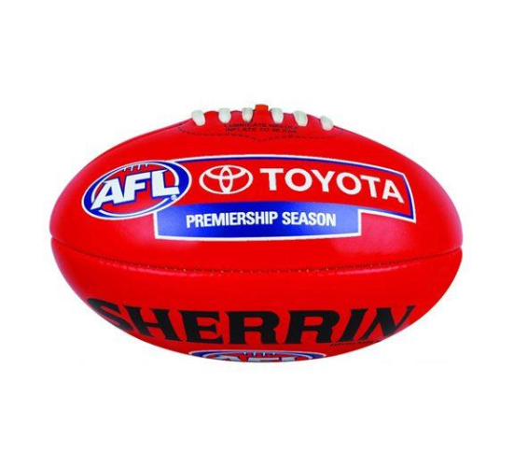
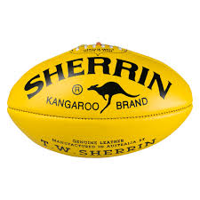
Rapid Touch - One Way Traffic
This is a continuous drill for 2 min with 1 min rest for 8 min - Minimum 12 players
How:
The red footys can only move in one direction back and forth from point to point and the yellow footys in another.
Players follow where they give.
Players go as fast as they can go for 2 min, with 1 min rest
Focus areas:
Handball
Footy IQ
Decision making
Communication

Slide 3
Rapid Touch - 16 Touches
This is a continuous drill for 2 min max with 1 min rest for 8 Min . Min 12 players
√
√
How:
Players move within the grids to get 16 handballs.
The footy that is in each grid must remain within that grid.
When a player reaches 16 touches they get out of the drill.
Focus areas:
Handball
Lateral movement
Work rate
Communication
√
√

Slide 4
Rapid Touch – Piggy in the middle
This is a continuous drill for 5 min max.
30 sec change outs
How:
The middle player works back and forth receiving a handball/kick from the outside player and gives it back, turns and heads for the the other outside player, receives and gives back.
Outside players deliver the ball to the middle player as they turn.
Middle player changes out after 30 sec on the whistle blast.
Focus areas:
Handball/kick under fatigue
Disposal efficiency
Communication
Work rate
Shape for disposal with speed

Slide 5
Handball Grid 1
This is a continuous drill for 5 min max.
8 players per grid
A2
A2
How:
Hit player applies pressure to A1 & the Guard/Lock player protects space
A1 player handballs to an A2 player & the Guard/Lock Player moves to become Hit
Hit now moves back to assume Guard/Lock and protect space
At the whistle blast (every 30 sec) D players move out and waiting D players move in. Players rotate
Focus areas:
Handball under pressure
Footy IQ
Hit player Defensive pressure
Lock player protection of space
Guard
HIT
A2
A1
Hit & Lock
Waiting

Slide 6
Handball Grid - A2 Connect
This is a continuous drill for 5 min max.
8 players per grid
How:
The inside A2 player must move to receive from any A1 player.
When the inside A2 receives, they must give to any outside A2 player.
The inside A2 player then works hard to receive from any A1 player
Hit player applies 100% body pressure to the middle A2 player only (no tackle).
On the whistle blast (30 Sec) the waiting A2 & Hit player comes into the drill and the Hit & A2 players who is in the drill rotates out.
A1
A2
Focus areas:
Handball under pressure
Footy IQ
Contested A2 work
Hit Player defensive pressure
Hit
A2
A1
A2
Hit
A2
Waiting

Slide 7
Kicking - Kick to advantage
This is a continuous drill for 5 min max.
8 players minimum
A2
A2
Focus areas:
Roll outwards
Lead away from the A1 player to space
Kick to space and the advantage of the the A2 player
Penetrate kick in a switch
A1 Kick
How:
Players lead to the corner of the square and away from the A1 player
A1 player kicks to the advantage and out in front of the A2 player.
A2
A2
A2
A2
A2
A1 Kick
A2

Slide 8
Game sense 3 v 3
This is a continuous drill for 8 min max.
12 players min
How:
The Coach blows a whistle for players to break and enter the closed work area by running around the top cones.
Which ever group gets the ball they become the A1 & A2 players whilst the other commences defense as an Hit & Lock players
Players then try and create a turnover through Hit and lock pressure or work into good A2 positions to deliver the ball to the opposing side Asst outside the drill.
Pause the drill after every 3 sets to discuss common fault patterns.
Focus areas:
Handball under pressure
Footy IQ
Contested A2 /A1 work
A1 Slice / Draw Handball
A2 Block, A2 Cut, A1 Draw
Hit Lock Defensive pressure
Coach
Lock
A2
A1
Hit
Asst
Asst
A2
Lock
Waiting

Slide 9
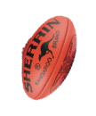
Contested Crunch
This is a continuous drill for 8 min max.
8 players min
How:
The Coach throws a footy into the center of the crunch area
Which ever group gets the ball they become the A1 & A2 players whilst the other commences defense as an Hit & Lock players
Players then drive legs out of the congestion to burst the bubble and get across the score zone
Increase complexity by adding outside player or bump bags inside the crunch area
Pause the drill after every 3 sets to discuss common fault patterns.
Focus areas:
Handball under pressure
Footy IQ
Contested A2 /A1 work
Drive the legs
Burst the bubble
Hit Lock Defensive pressure

Slide 10
Game sense – T Drill 3 v 2
This is a continuous drill for 8 min max.
12 players min
Focus areas:
Handball under pressure
Footy IQ
Contested A1 work
A1 Slice / Draw Handball
A2 Block, A2 Cut, A1 Draw
Hit Player defensive pressure
Lock player defense of space
How:
The Coach kicks the ball out to the open play area.
A players sprint to get possession of the footy and determine the A1 and A2 players
The Hit Player applies pressure to the the A1 player.
The lock player moves central and behind the last A player to protect space and reduce and cover both of free A2 players.
The A1 player is now forced to chose 1 of the 2 x A2 players to handball whilst being under pressure.
Coach
Players in waiting
A
D
A
D
A
Lock
Hit
A2
A2
A1

Slide 11
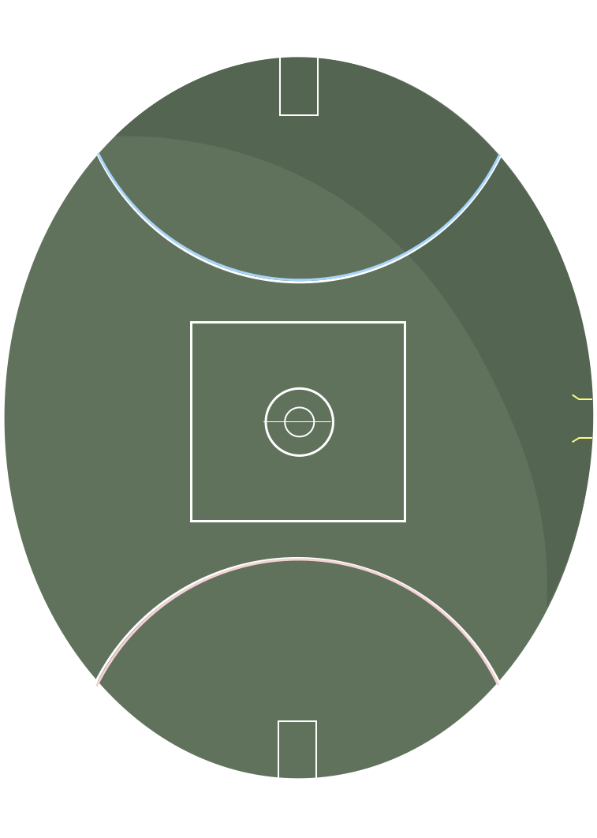
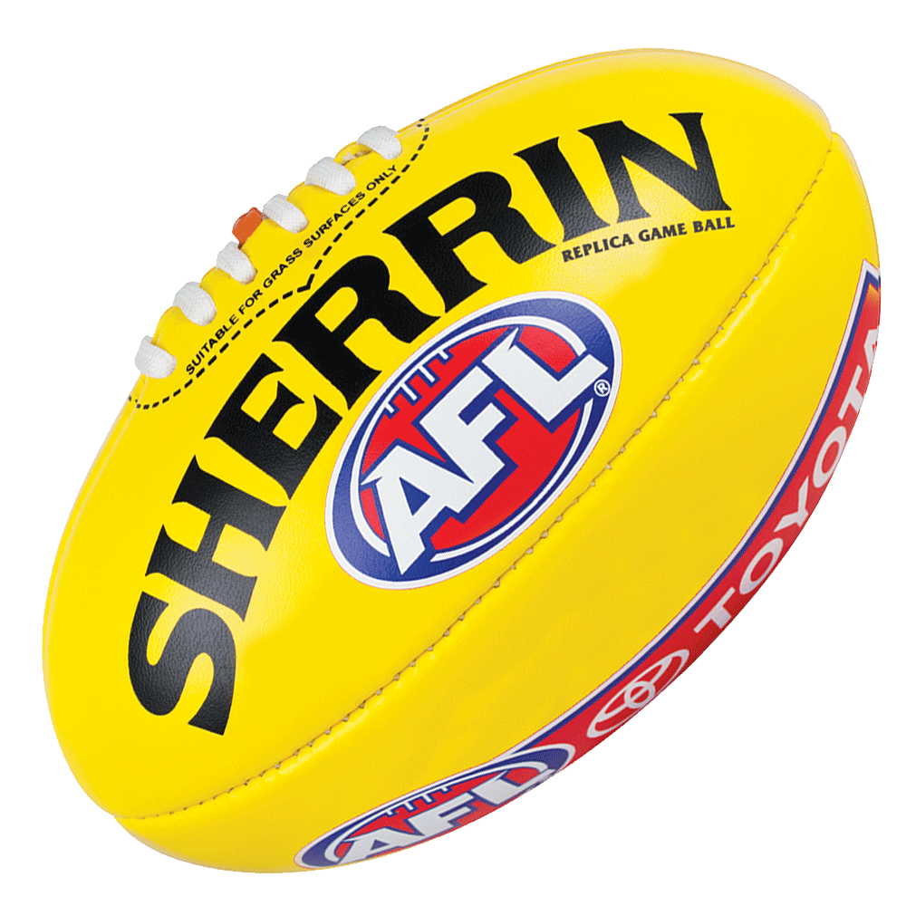
Transition 1
Transition 6 v 6 Full Ground Running Angles
Travel of Footy
Offensive running angles
C
Resting Group
Defensive running angles
Resting Group
C

Slide 12
Transition 2
4 v 4 Square Transition by Hands, Hit & Lock, legs and link with I50 Entry
+ 1 outlet
C
C
C
+ 1 outlet

