Slide 1
COVID-19 Business Reopen/Recovery Task Force
Kick-off presentation Schoharie County business Task Force
May 12, 2020

Slide 2
Proposed Agenda
Introductions:
Dozens of business volunteers, responded to Business Relief & PPE survey, April 2020
Assemblyman Tague, New York State Assembly District 102
Chairman Federice, Schoharie County Board of Supervisors & Mohawk Valley Regional “Control Room” Representative
Reopen Metrics:
New York Forward Regions
Landscape of “Guidance", Decision-makers:
New York Forward
Mohawk Valley Control Room
Schoharie County COVID-19 Task Force, Office of Emergency Service
Burning Questions
Task Force Expectations

Slide 3
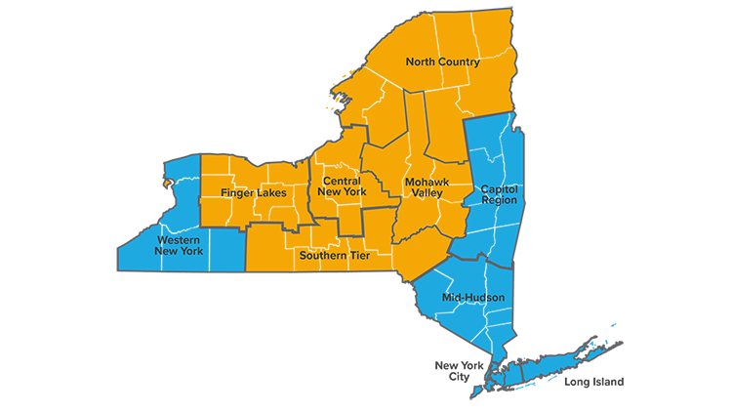
Reopen Metrics: New York Forward
Metrics Met = Phased Reopening
REOPEN
REOPEN
REOPEN

Slide 4
Reopen Metrics: New York Forward
Mohawk Valley meets all seven (7) metrics.
14-day decline in new hospitalizations OR under 15 new hospitalizations | 14-day decline in hospital deaths OR fewer than 5 deaths | New hospitalization (under 2 per 100k residents) | Share of total beds available (threshold of 30%) | Share of ICU beds available (threshold of 30%) | 30 per 1k residents tested monthly (7-day average of new tests per day) | Contact tracers 30 per 100k residents OR based on infection rate
YES | YES | YES | YES | YES | YES | YES
https://forward.ny.gov/metrics-guide-reopening-new-york

Slide 5
New York Forward Control Room
Mohawk Valley:
Regional Captain: RoAnn Destito, OGS Commissioner
Steve DiMeo, former REDC co-chair
Sam DeRiso, UFCW Local 1 & President of the Central New York Labor Council
Oneida County Executive Anthony Picente Jr.
Montgomery County Executive Matt Ossenfort
Fulton County Administrator John Stead
Herkimer County Legislature Chair Jim Bono
Otsego County Board Chair Dave Bliss
Schoharie County Board of Supervisors Chair William Federice
City of Utica Mayor Robert Palmieri
City of Rome Mayor Jackie Izzo
Monitor Regional Metrics:
Hospitalization rate
Death rate
Number of new hospitalizations
Hospital bed capacity
ICU bed capacity
Testing
Contact tracing
Alert the state if the region's metrics no longer meet the reopening guidelines and adjust the reopening plan for that region accordingly.

Slide 6
Landscape of “Guidance”
USA Federal: CDC
New York Forward
MV Control Room: Monitoring Metrics
Assemblyman Tague Advisory Council:
Business Advocacy
Schoharie County COVID-19 Task Force: Public Health
Trade Associations
Local Economic Alliance
Schoharie County Business
Reopen/Recovery Task Force

Slide 7
New York Forward Reopen Phases
Phase One: Construction Manufacturing Wholesale Trade Select Retail for Curbside Pickup Only Agriculture, Forestry, Fishing
Phase Two: Professional Services Finance and Insurance Retail Administrative Support Real Estate, Rental, and Leasing
Phase Three: Restaurants and Food Services
Phase Four: Arts, Entertainment, and Recreation Education

Slide 8
Burning Questions
Who’s guidance do we follow? CDC? State? County?
Legally, what is required of a business once allowed to reopen for staff and consumers (masks required, limiting # of clients, hours of operation..) ?
When can churches or my business open if we follow social distancing?
How will we be able to survive the tremendous loss of income?
Will the county be getting any financial support to implement the guidelines?

Slide 9
Task Force Expectations
Proposed Topics:
Regulatory Clarity: Who, When, How & PPE Supplies
Access to Capital & Assuring “Forgiveness”
Meetings & Other Ways to Connect
Coordinated Communication
Deliverables

Slide 10
director@seecny.org
518-517-1700

