Slide 1
TRANSITIONAL EXPRESSIONS Dr. Mary Custureri
WORDS, PHRASES, CLAUSES
What they are and how they are used

Slide 2
TRANSITIONS…………
Where do your thoughts want to go?
Which direction?
comparison/contrast
cause/effect
addition/illustration
…

Slide 3
What they are
Transitions help the reader understand the purpose of thoughts which follow the transitional expression.
They show different kinds of relationships between ideas which precede the expression and those that follow.
They can be words, phrases or clauses.

Slide 4
How they are used
Addition or sequence
Contrast or contradiction
Comparison
Illustration
Summary
Arrangement by time
Arrangement by place
Cause and effect relation
Notes:
Transitions are used for many purposes. They can show addition or sequence, such as in the words
first, second, also, furthermore…
Or contrast and contradiction, such as nevertheless, on the contrary….
Or……(read out)
We will discuss each category later. You can also find these in the handout TRANSITIONS, as well as in your grammar textbooks.

Slide 5
What to be aware of when choosing transitional expressions
Make sure you use the correct expression.
Use them in the right context.
Use them to help your flow of sentences, to signal your next idea.
Do not overuse them. That is as bad as not using any.
Notes:
1. A number of students sometimes mistakenly use subordinating conjunctions such as although to signal a contrast. The word although must be joined to the rest of the dependent clause. This subordinating clause is an adverb clause preceded by the subordinating conjunction although.
2. Do not use nevertheless when you mean contrary to.
4. Writers should use transitions as they would salt. Too little makes the food (essay) uninteresting. Too much makes the food salty (or bores the reader with too mujch to process) When you revise your paper, try to hit a happy medium.

Slide 6
TRANSITIONS TO SHOW, ILLUSTRATE
In fact
For example
Such as
Specifically
For instance
In any event
in a sense
including
To illustrate
to be specific
In other words

Slide 7
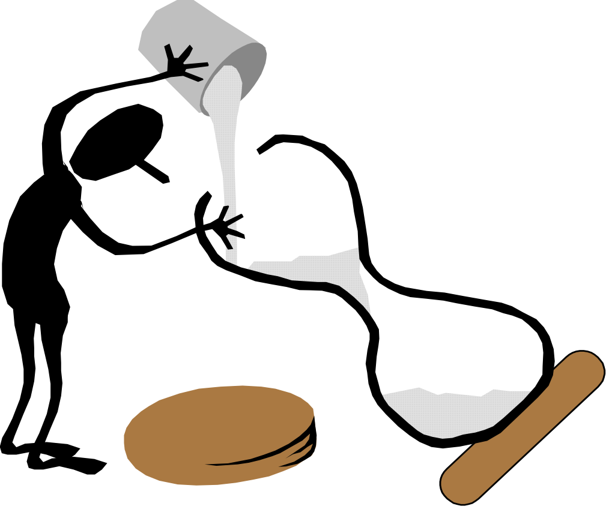
TO SHOW ADDITION OR SEQUENCE
First
Second
Also
Too
Again
Further
Next
Furthermore
Equally important
In addition to…
Besides
In the same way
First of all
Then
Last of all
Finally
And
Consequently
Ultimately

Slide 8
ARRANGE BY TIME
At this point
Later
While…
Often
At that time
First, second…
Meanwhile
Recently
Formerly
Then…soon
Eventually
Until
during
Frequently
Rarely
Recently
At this point
Afterward (or after)
At length
The following…
Next
Now
Since
When…….
Presently
immnediately

Slide 9
ARRANGE BY PLACE
Here
There
Adjacent to
Nearby
Beneath
Under
Opposite to
Below
Next to
At this point
Over

Slide 10
TO SHOW COMPARISON
Similarly
Just like (as)
In like manner
Equally
The similarities
Resembling this
Both
In the same way
Also
Likewise
Like
In comparison

Slide 11
SHOW CONTRAST OR CONTRADICTION
Although
But
On the other hand,
Yet (and yet)
Unlike
Whereas
However
Conversely
In contrast
Opposite (as opposed to)
Despite
Instead
By contrast
On the other hand
In spite of
Rather than
Contrary to (on the contrary)
Even though
Otherwise

Slide 12
TO SHOW CAUSE AND EFFECT
Because
Since
The explanation of
So that
Unless
If
So that
In order to…
As a result…The Result
Consequently
Therefore
As a consequencej
The effect
Hence
Accordingly
Thus

Slide 13
TO SUMMARIZE
On the whole
Therefore
In any case
In short
Thus
In summary
Finally
In order words
To sum up
In conclusion
Ultimately

Slide 14
REMEMBER TRANSITIONS
They are important. They have a purpose.
Transition means to move.
They prepare the reader for understanding the relationships between each idea.
They make it easy for the reader to understand your purpose.
Readers, as well as writers, should be aware of what transition words mean and what the purpose of the transition is.

