Slide 1
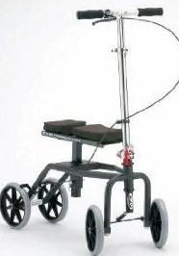
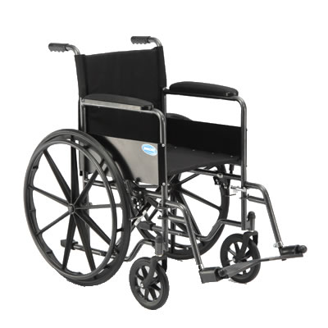
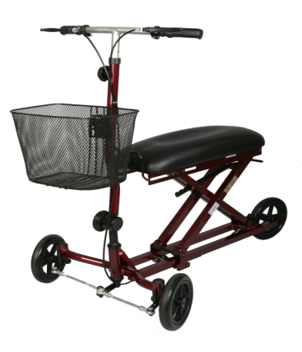
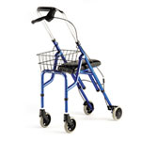
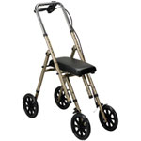
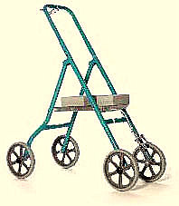
Knee Walker Rentals of Georgia kneewalkerrentalsofga@gmail.com http://www.kneewalkerrentalsofga.com/
While non-weight bearing,
With these mobility aids AVAILABLE,
Why would you ever want to use crutches?

Slide 2
Knee Walker Rentals of Georgia
Is the only Georgia knee walker rental company that comes to your home/office and along with various rental models, educate you on the benefits, maneuverability, and accessibility derived from utilizing a knee walker rental. We show you how to set up and break down the knee walker.
Let you select from different brands, styles, and types of knee walker models.
Prepare/fax your paperwork to your doctor so as to assist your being able to file a claim for reimbursement through your carrier, if qualified.

Slide 3
Who would benefit from renting a knee walker from Knee Walker Rentals?
Knee Walkers are typically rented to those with:
-Fractures of the foot, ankle, heel, or lower leg
-Non-union fractures
-Ruptured Achilles tendons
-Lower extremity ulcers/wounds (e.g., diabetic)
-Sprained ankles
-Bunion removal surgery
-Gout

Slide 4
Crutches vs. Knee Walkers
Crutches have been used for several years vs. Knee Walkers have been around for a few years.
Crutches costs less vs. Knee Walkers costs more to rent/purchase.
Crutches hurt your underarm and causes rash vs. Knee Walkers are painless alternatives.
Crutches are unstable and you may trip/fall vs. Knee Walkers are stable and minimizes falls.
Crutches confine a person vs. Knee Walkers promotes mobility so a person can go shop/work/school.
Crutches can allow atrophy vs. Knee Walkers prevent atrophy by strengthening proximal muscles.
Crutches can tire you out quickly vs. Knee Walkers causes less fatigue due to conserved energy.
Crutches will have you looking for a place to sit vs. Knee Walkers can be used as a foot stool/bench.
Therefore, Knee Walkers win, Knee Walker Rentals of Georgia WIN…….
By greatly improving the quality of life by giving a person greater mobility, stability and comfort with less effort allowing a person to get up and around and back to a near normal life-style, while being non-weight bearing.
JUST SAY NO TO CRUTCHES!

Slide 5
Again-Why rent a knee walker from Knee Walker Rentals of Georgia?
*Knee Walker Rentals of Georgia are the ONLY RENTAL COMPANY IN GEORGIA that stocks, delivers and pickup their rentals within 90 miles of downtown Atlanta with a modest fuel surcharge.
*As such, we provide SAME DAY SERVICE…..
Normally within hours of your call! We even work weekends!
*$140 a month (One month minimum) with a refundable security deposit of $140. You can even write two separate checks and one will be held in escrow until the knee walker is returned in good working order.
*We are a local rental supplier-no shipping needed or 5 to 10 business days wait.
*We EDUCATE AND DEMONSTRATE how to use our knee walkers.
*We stock multiple models for you to choose your rental from.
Call us today! 678-858-5922
http://www.kneewalkerrentalsofga.com/

Slide 6
Need an assistive device during your recovery???
Elevated toilet seats
Elevated commodes
Shower benches
Shower chairs
Transfer benches for floor to tub usage
Grab bars
*All of these devices are brand new and sold, not rented, to you. Let us know what you need and we’ll bring them along with us while delivering a knee walker and/or a wheelchair.

Slide 7
We also rent manual wheelchairs For $100 a month*, plus $140 refundable security deposit, we can/will deliver/pickup a quality manual wheelchair for your usage while recovering from surgery, fractures, etc. These lightweight wheelchairs makes it easier for you and/or someone supporting you to experience more mobility options. *Modest fuel surcharge extra

Slide 8
Knee Walker Rentals of Georgia
Has been referred by/used by most local orthopaedic surgeons/groups/therapists such as Emory Orthopedics, Peachtree Orthopedic Clinic, Resurgens Orthopedics, Piedmont Physician Group, Village Podiatry, Pinnacle Orthopedics, Sports Medicine/Foot & Ankle Surgery, Ankle & Foot Specialists and the list goes on!
Works with Workers Compensation companies/groups to get the worker(s) back to work FAST!
Volunteer(s) with the Atlanta Arthritis Foundation Walk, Susan B. Komen Breast Cancer Walk, American Diabetes Association Walk.

Slide 9
Contact Knee Walker Rentals of Georgia TODAY!
678-858-5922-Ask for Kavin
We are ready, willing and able to assist you NOW!
kneewalkerrentalsofga@gmail.com
See our ads on Craigslist.com
Visit us on Facebook: Knee Walker Rentals of Georgia
See us at: http://www.kneewalkerrentalsofga.com/

Slide 10
Thanks for considering us!
Thanks Atlanta!
We are here to help you in any way possible.
It would be our pleasure to be a part of your recovery.
Have a WONDERFUL DAY!

