Slide 1
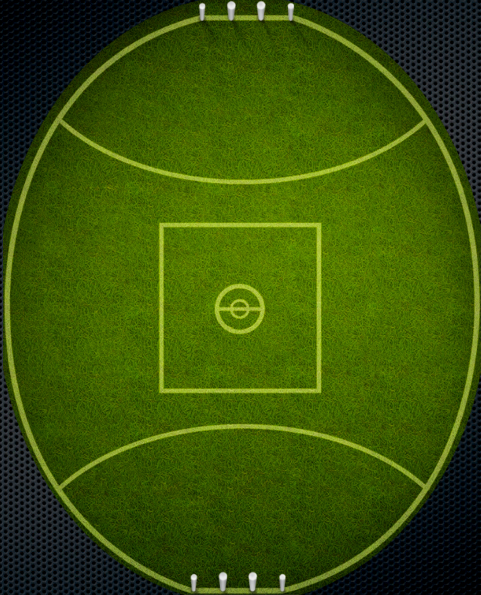
Cross The River
Coach kicks ball into middle group, as a group of five work ball though for a score
Coach

Slide 2
TACKLE GRID
Coach
Coach will advise which side is boundary
AIM:
Cause stoppage
Force out of bounds
or Holding the ball.
Player with footy aim is to get though grid.

Slide 3
TACKLE GRID A1/D1
AIM:
Cause stoppage
Force out of bounds
or Holding the ball.
Player with footy aim is to get though grid.

Slide 4
Pair Off
Coach blows whistle, four players run out around respective cones, then coach will roll ball into one team. Team with ball, are to work ball through grid to other coach by hand. Opposition team is to cause turn over.
Coach
Coach
Coach

Slide 5
Coach
Hurt in FWD 1/2
Coach roles ball in.
AIM to Cause turn over in FWD half
then hurt Oppo with score.
Coach
Coach

Slide 6
Crunch IN
Coach
Coach
Coach
One team has a football and HB to them selves, then coach blows whistle and kicks second ball in. (Yellow ball gets dropped).
Team with red ball need to exit to coaches by hand or foot.

Slide 7
Number up
Coach
Coach kicks ball to player
All defensive players
can then move up to make
even pairs.
Aim is for offence to
score, and defensive team
to cause turn over.

