Slide 1
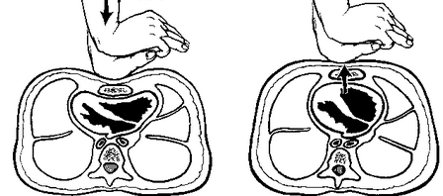
Evolution of CPR
David Wolfe
Crouse Health
SUNY Upstate Medical University

Slide 2
Outline
History of CPR
Group skills ☺
Ventilation
Head-up CPR
Double sequential external defibrillation
CPR-induced consciousness

Slide 3
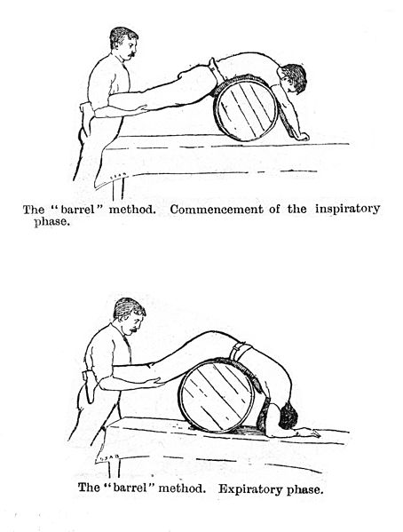
Early to Mid 1700s
Barrel method

Slide 4
1700s
- Physician uses mouth-to-mouth to revive a suffocated coal-pit miner.
1740 - The Academie des Sciences (Paris) officially recommends mouth-to-mouth for drowning victims.
1775 - Veterinarian discovers that after killing a chicken by shocking it, countershocks to the chest could restore the heartbeat.

Slide 5
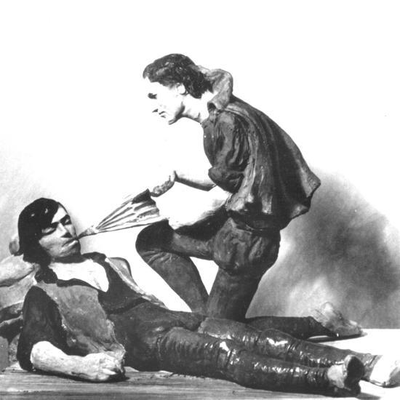
1700s
1782 – The Royal Humane Society expresses preference for using bellows rather than mouth-to-mouth.

Slide 6
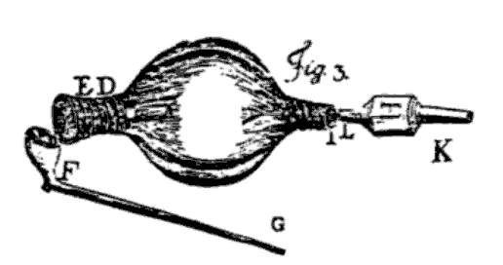
Tobacco Smoke Enemas – Late 1700s
Most commonly used for drowning victims.
Led to tobacco smoke resuscitation devices at various points of main waterways.
Believed that nicotine
(stimulant):
1. made heart
beat stronger
2. warmed the
body
3. dried the insides.
Figure, 1773

Slide 7
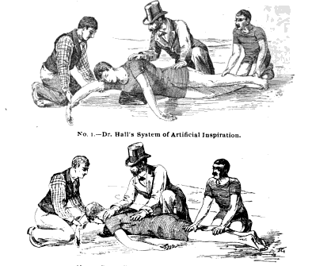
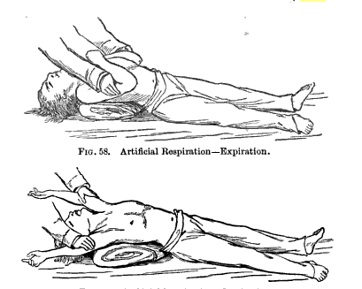
1800s – Artificial Respiration
The Hall Method (1856)
alternately repositioning patient
from face down (exhale) to side
(inhale).
updated later by adding pressure to the thorax.
The Silvester Method (1858)
chest-pressure arm-lift
supine, arms up over head to expand chest (inhale)
cross arms over chest to apply expiratory pressure.

Slide 8
1800s
1874
Massaging an animal’s heart during surgery can restore circulation.
1878
External cardiac compressions provide adequate circulation in cats.

Slide 9
1891 – External Compressions
External compressions restart the heart of 2 young humans.
First promote chest compressions, rather than ventilation alone, to help circulation.
Technique doesn’t take hold
Next 50 years, open-heart massage is the standard.

Slide 10
External Compressions
1903
Research confirms external compressions restore circulation in dogs.
1904
Report of successful closed-chest cardiac massage in 1 human case.
*But, patient’s continue to receive open-heart massage.

Slide 11
1900s
1924
6 cardiologists meet – form the AHA
1933
Accidental rediscover external compressions
- Pressure on a dog’s sternum – adequate circulation keeping animal alive.
-> results confirmed in 100 dogs!

Slide 12
Defibrillation
1947
First successful use of a defibrillator on an exposed human heart

Slide 13
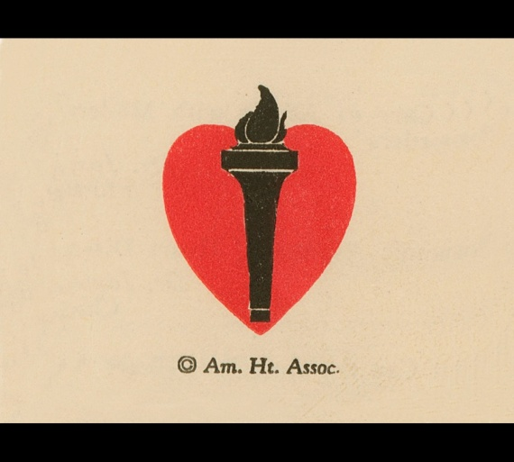
1950s
1950
AHA begins the journal, Circulation.
1954
Proven that expired air sufficient to maintain adequate oxygenation.
1956
Proven that mouth-to-mouth resuscitation is an effective lifesaving method.
-> Rescue breathing is promoted

Slide 14
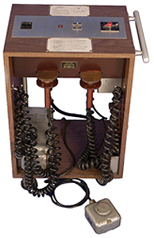
External Defibrillation
1956
External defibrillator successfully
restores a steady rhythm to quivering
heart.
1957
Prototype first portable external defibrillator
-> Hopkins Closed Chest Defibrillator (200 lbs)

Slide 15
The “PR” in CPR.
1957
U.S. military adopts mouth-to-mouth breathing for unresponsive victims.

Slide 16
CPR!
1960
Mouth-to-mouth breathing is combined with chest compressions.
And . . . it’s a girl!

Slide 17
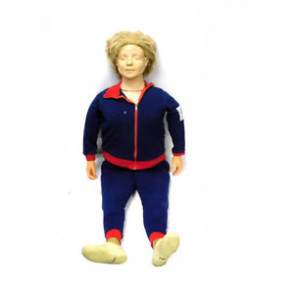
1960
1960
Resusci Anne is born.
Life-size training manikin
Developed by 3 physicians and Åsmund Lærdal (Norwegian toymaker)
1963
AHA’s CPR Committee established
AHA formally endorses CPR

Slide 18
1970s
Mass CPR training begins.
The first ACLS textbook is published (1975).

Slide 19
80s and 90s
1980s
Some emergency dispatchers are trained to give CPR instructions over the phone.
AHA introduces pediatric BLS, PALS and NRP.
1990s
Public AEDs are introduced.

Slide 20
2000s
2004 - AED may be used in children 1-8 yo
2005
AHA develops Family & Friends® CPR Anytime® kit
Learn CPR, AED, choking in 20 minutes.
Guidelines recommend 30:2
2008 – Hands-Only CPR, in adults, is introduced.

Slide 21
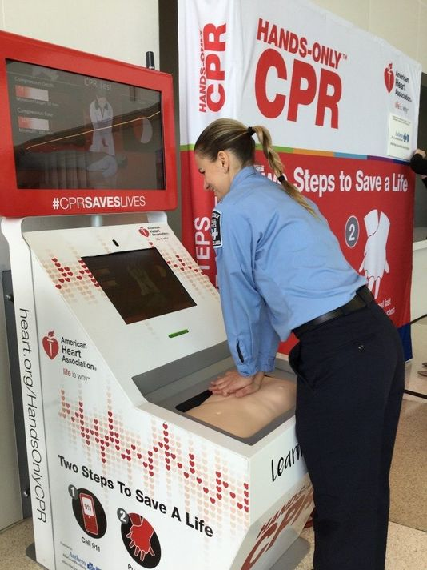

Slide 22
Guideline Changes . . .

Slide 23
Guideline Changes
1995
ABCs becomes ABCD
Compression rate 80-100/min
15:2
2000
Compression rate 100/min for adults

Slide 24
Guideline Changes
2005
Compression rate 100/min all ages.
30:2
2010
CAB
Compression rate at least 100/min
2015
Compression rate 100-120/min

Slide 25
2019 – Feedback Device Required
Compared to standard CPR, effective compressions not improved by feedback device.
Chest compression quality can be improved with CPR feedback technologies.
Feedback significantly improved compression quality by untrained rescuers.
Feedback (OHCA)
improved CPR quality.
increased survival.
increased favorable
functional outcomes.
Zapletal et al, Resuscitation, 2014
Peberdy et al, Resuscitation, 2009
Buléon et al, Am J Emerg Med, 2013
Bobrow et al, Ann Emerg Med, 2013

Slide 26
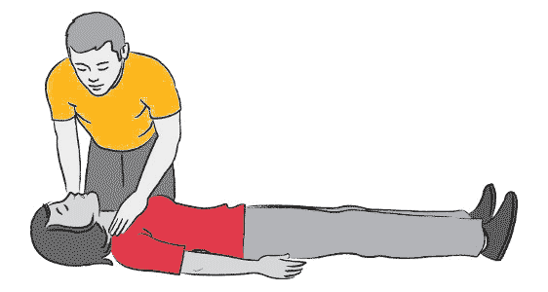
Group Adult BLS Skills Checkoff

Slide 27
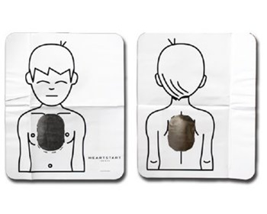
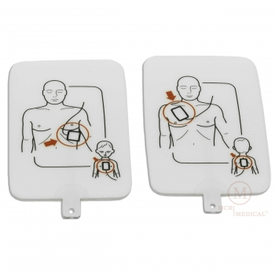
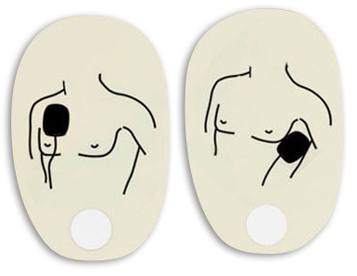
AED

Slide 28
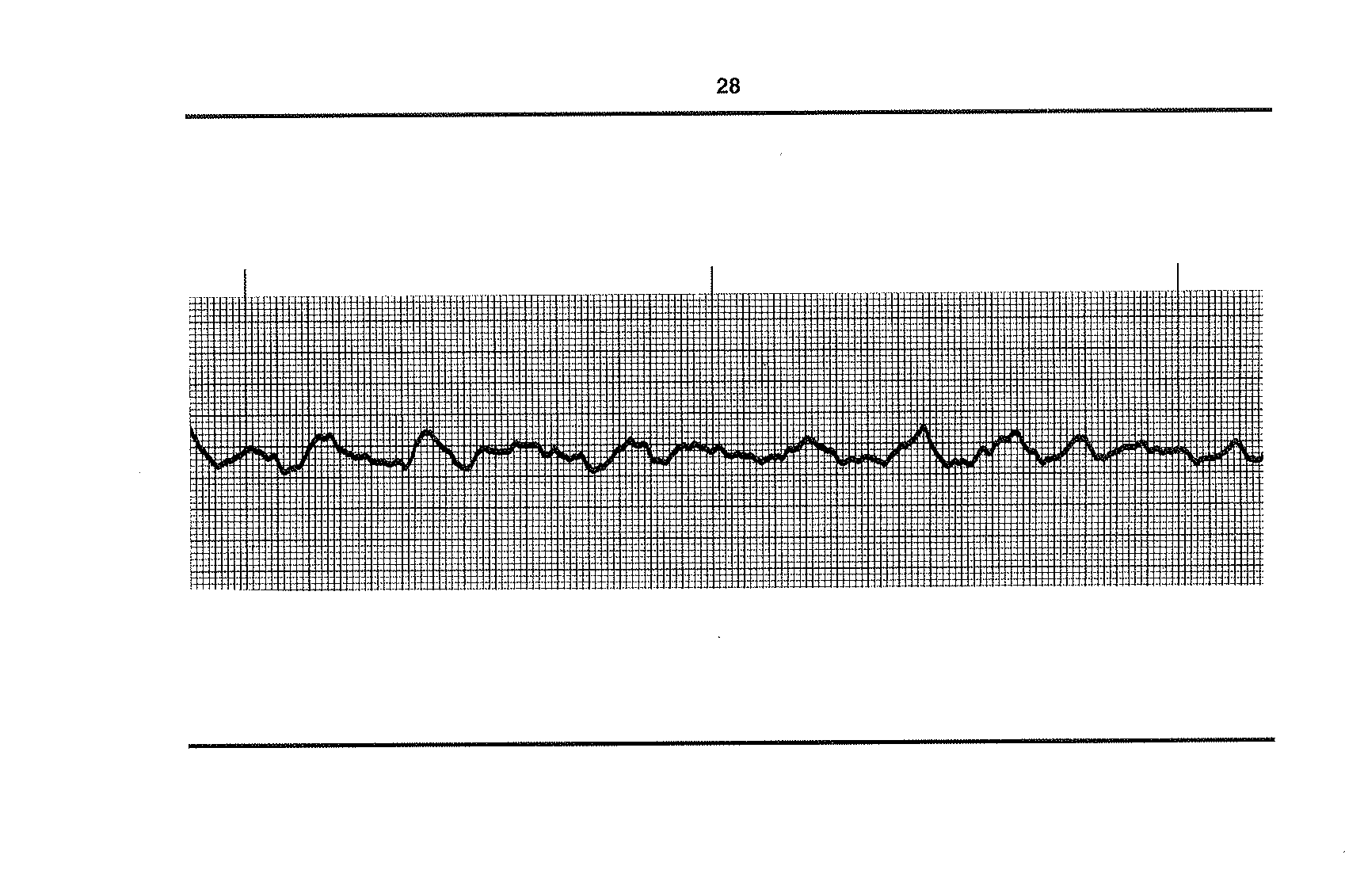

Slide 29
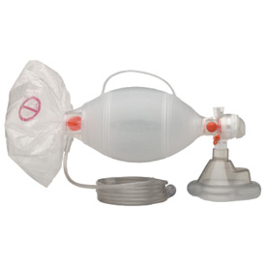
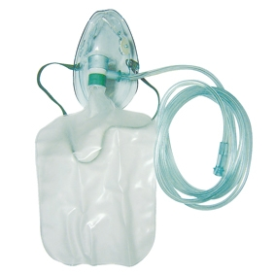
Ventilation
Half squeeze of resuscitation bag
Passive Flow O₂

Slide 30
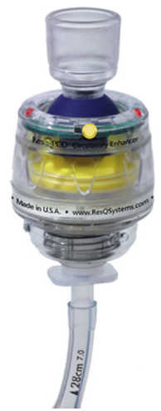
Impedance Threshold Device
More negative intrathoracic pressure,
more blood returns to heart.
ITD prevents influx of respiratory
gases into the chest during chest
wall recoil.
Ventilation timing light

Slide 31
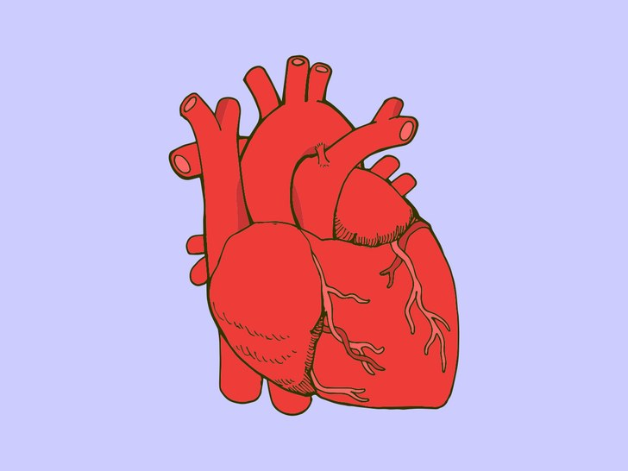
ITD with CPR
Increases ETCO₂
Decreases ICP
Increases blood flow to brain.¹
Increases blood flow to heart.²
Improve survival by ≥ 25%.³
Lurie et al, Chest, 1998
Langhelle et al, Resuscitation, 2002
Idris et al, Circulation, 2012

Slide 32
ITD - Contraindications
CHF
Pulmonary HTN
Aortic stenosis
Flail chest
Uncontrolled blood loss

Slide 33
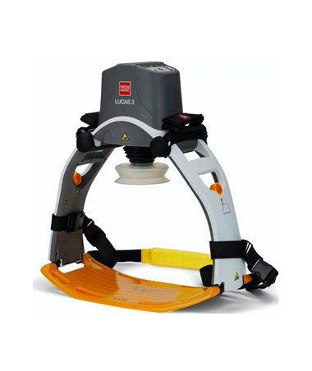
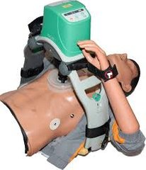
Chest Compression System

Slide 34
CPR Patient Position
South Korea – dense population.
Tall apartments, small elevators.
Patient diagonal – head up or down?
Frascone, J Emerg Med Serv, 2017

Slide 35
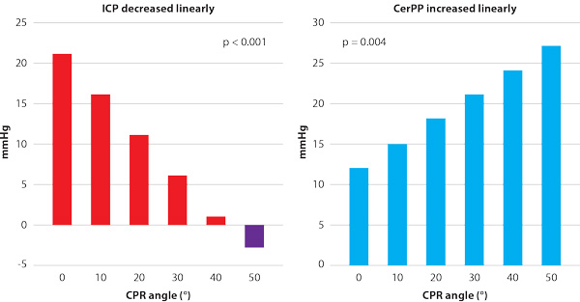
CPR Position
Frascone, J Emerg Med Serv, 2017

Slide 36
CPR in Pigs w/Head-Up 30º
Improved:
Coronary perfusion pressure
Cerebral perfusion pressure
Pigs began to gasp spontaneously
Frascone, J Emerg Med Serv, 2017

Slide 37
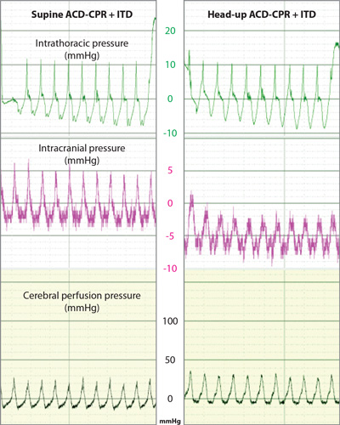
CPR in Cadavers
↓
↓
↑
Frascone, J Emerg Med Serv, 2017

Slide 38
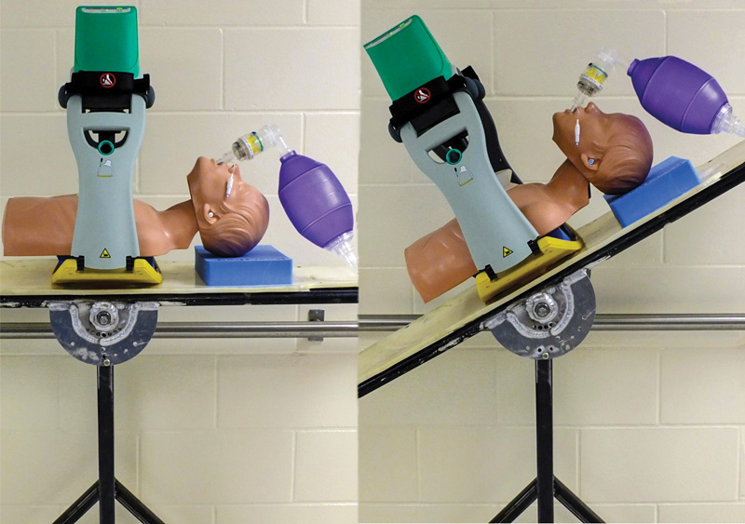
Head-Up CPR
Compared to normal, heart appeared to be:
3-4 cm superior
3-4 cm to the left
May need to change hand/plunger placement.
Frascone, J Emerg Med Serv, 2017

Slide 39
Head-Up CPR
Head-up position in C-CPR and ACD+ITD CPR significantly improved CerPP.
Potential to improve neurological outcomes after cardiac arrest.
Ryu et al, Resuscitation, 2016

Slide 40
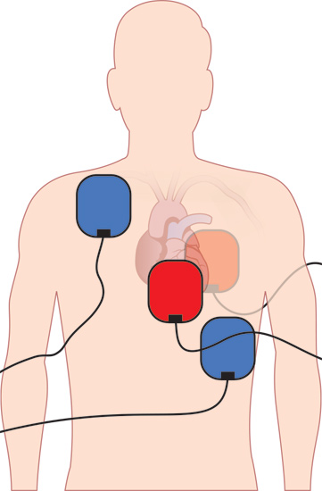
Double Sequential Defibrillation

Slide 41
Double Sequential Defibrillation
Case 1
Over 30 minutes of CPR, defibrillation (11x), meds
Case 2
CPR, defibrillation, meds, multiple rhythms (asystole, VF, sinus tach, NSR, torsades)
Lanan et al, J Emerg Med Serv, 2016
Neubert, J Emerg Med Serv, 2016

Slide 42
Double Sequential Defibrillation (DSD)
Refractory VF = VF persisted following:
≥5 unsuccessful single shocks
epi
antiarrhythmic
2-year period, 10 patients with DSD
7 successful cardioversion
3 ROSC
0 survived to hospital discharge
Neubert, J Emerg Med Serv, 2016

Slide 43
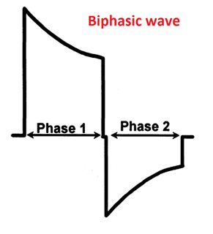
Sequential, NOT Simultaneous
How long between shocks?
Biphasic shock ~150 ms
Too short (simultaneous, overlapping)
Ineffective - positive and negative waves cancel (attenuate) each other
damage devices
Too long
increased energy threshold
2nd shock re-induces VF
Lanan et al, J Emerg Med Serv, 2016

Slide 44
CPR Induced Consciousness
52 yo male
Witnessed OHCA (v-fib)
During CPR
Severe agitation and thrashing (before defib)
Resuscitated
High quality CPR w/ advanced life support
2 double sequential external defib shocks
Need for sedation?
Pound et al, Prehosp Emerg Care, 2017

Slide 45
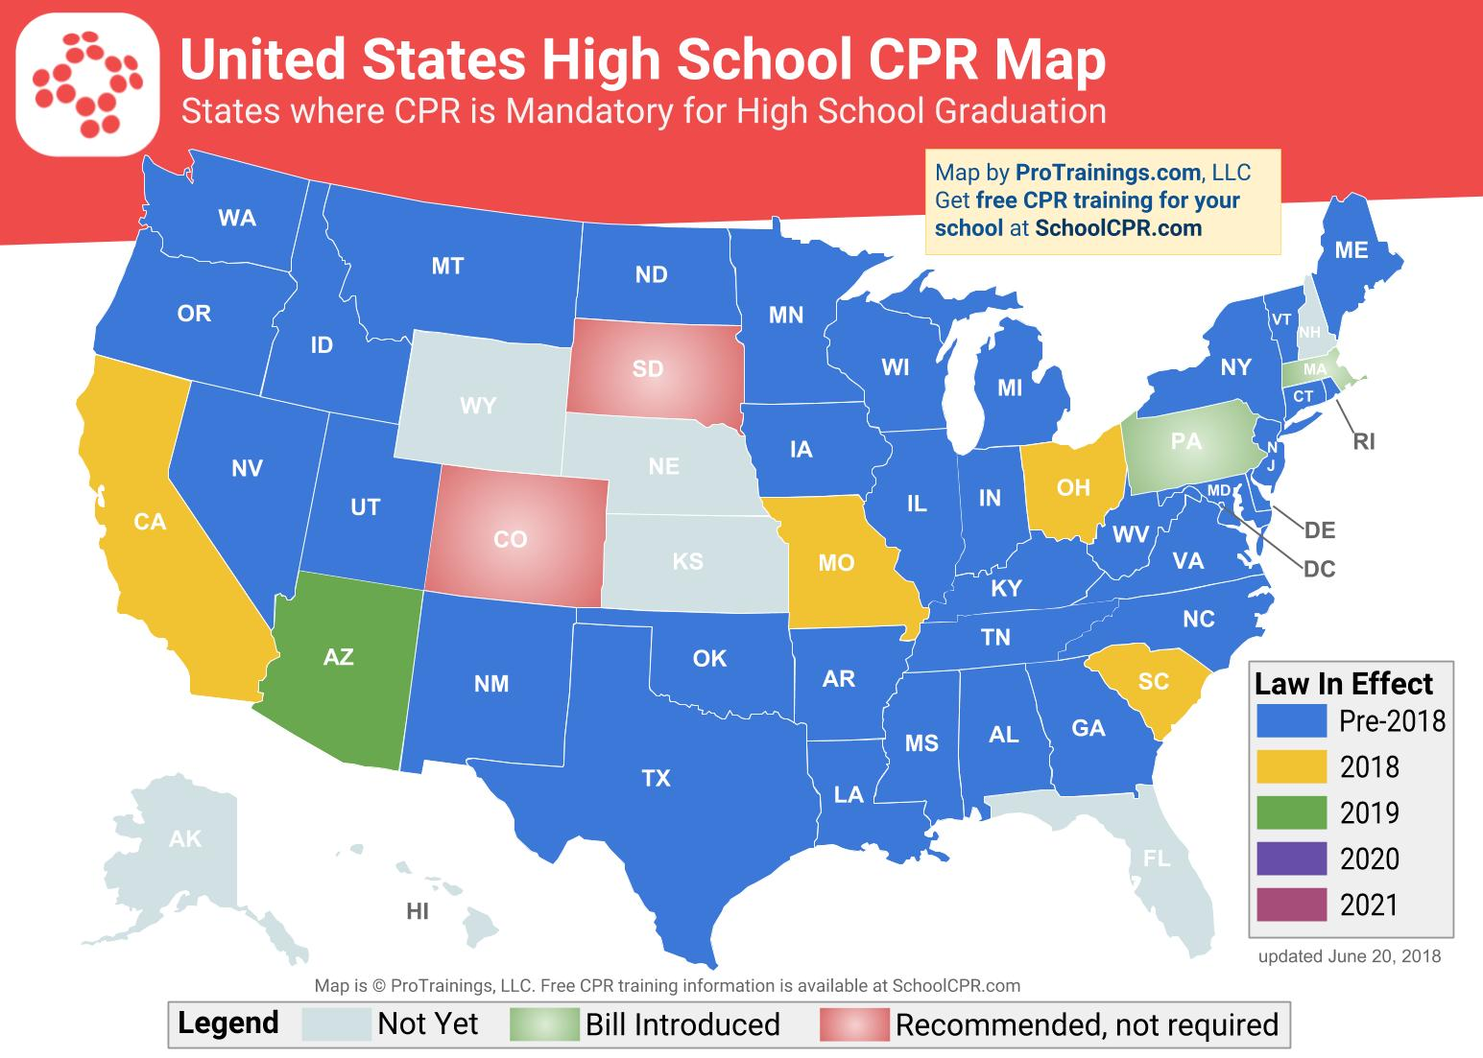

Slide 46
CPR Future
Updates as needed.
Phone app.
Increase bystander CPR.
Identify and start CPR earlier.

