Slide 1


Substance Use Disorder is a Brain Disease
The Family Solution Finder Learning Seminars

Slide 2
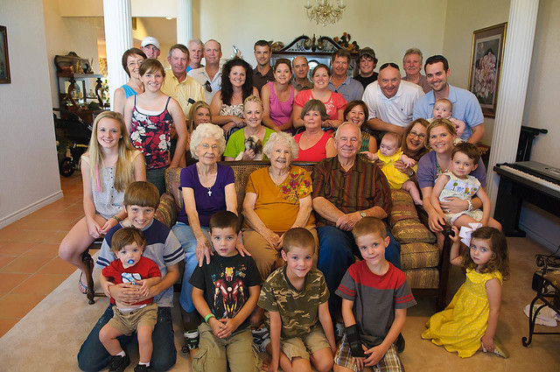
Substance use disorder is a brain disease
Being in Balance means Everyone contributes to support the family’s ability to function.
This is a difficult time of coming to the truth in what the fact this condition of our loved one is a disease of the brain.
What we want is for them to WILL their way out of this, and that is not happening.
Notes:
The family Solution Finder has 32 1.5hr seminars coving all the issues a family will likely face in their journey. The family can view these in the monthly meeting or at home. Each issues require a family plan of action

Slide 3
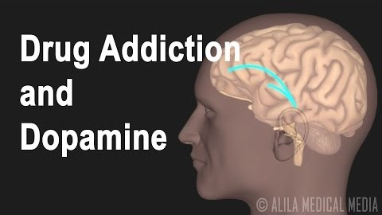

Slide 4

Program Overview
Dopamine overload
Reward System
Triggers Stimulate Memory
Practical Exercise
Other Comorbidities

Slide 5
Three Primary points in this brain disease which the Family needs to understand
1. Dopamine Overload
3. Triggers towards Memory
2. The Reward System
Notes:
The SP~ARK’s Program is a self-administered faith development program that has three steps.
Self evaluation
Scoring and identify faith practices strengths and weaknesses.
Plan of Action for self directed learning.

Slide 6
How to use this information ?
By completing the worksheets a family can better understand how Dopamine Overload occurs, what causes the reward system to enact behavior, the role triggers play in the reward system as a part of memory.
By taking this information and meeting with a family therapist or drug addiction counselor the family members can better understand how what they are doing in the family dynamic and with their relationships have a direct impact on the neuronal system of their loved one.
Using this information with others outside the family can also assist them in a more productive interaction and relationship with your loved one.
Notes:
We will first look at the structure of the entire workbook.
The go into the purposeful driven ministry, then all three programs.

Slide 7
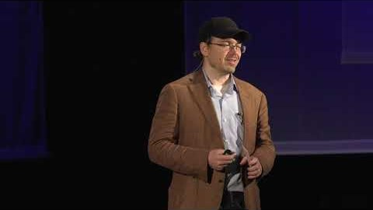

Slide 8

This Learning Sessions
What did you learn ?
How will you use it ?

Slide 9
Conclusion
Different Types of Family Therapy
Matching the family needs with the best fit for family therapy
Considering the top Choices for your family needs
Complete a “Responding to A Family Issue”

Slide 10
CONTACT US:
Roy Poillon Executive Director/Founder
  Office: 440.385.7605 Mobile: 814.722.8946
  Familiesimpactedbyopioids@gmail.com
  www.Familiesimpactedbyopioids.com
  LinkedIn Roy Poillon
  Facebook: Familiesimpactedbyopioids public group
  Instagram: Families Impacted by Opioids
  ALWAYS SEEK THE ADVICE OF A PROFESSIONAL THERAPIEST BEFORE ACTING ON ANY PART OF THE INFORAMTION PROVIDED IN THESE PROGRAMS.

