Slide 2
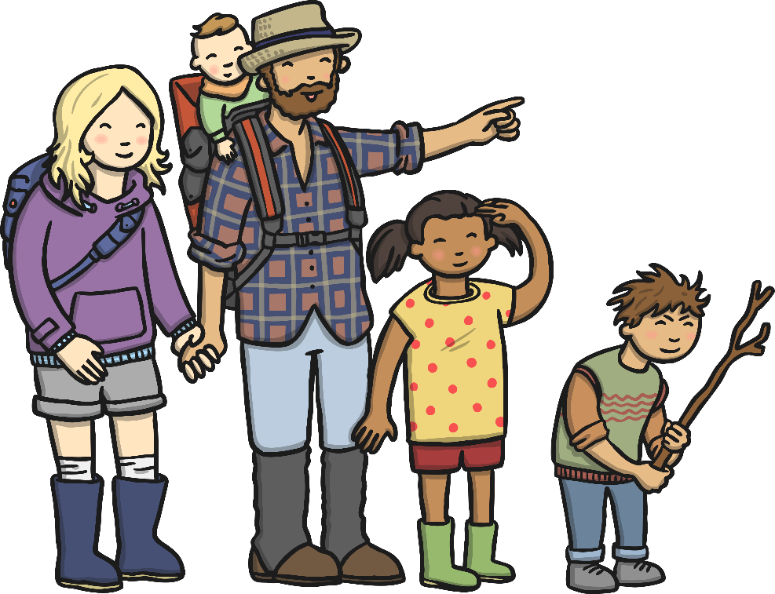
On a bear hunt today,
Through the long grass, hooray!
Swishy swashy, swishy swashy,
On a bear hunt today.

Slide 3
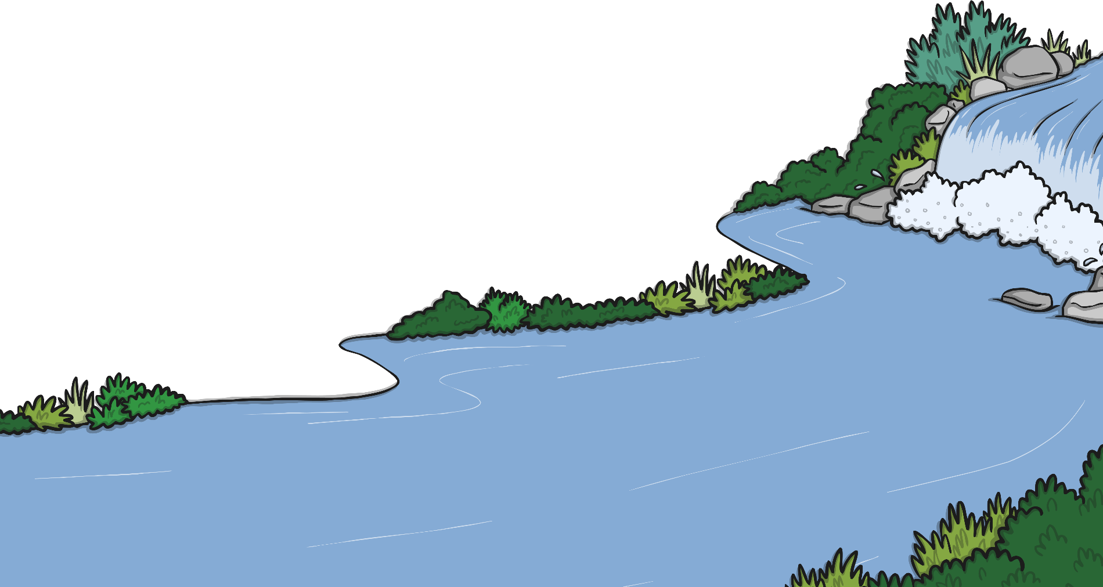
On a bear hunt today,
Through the river, hooray!
Splashy sploshy, splashy sploshy,
On a bear hunt today.

Slide 4
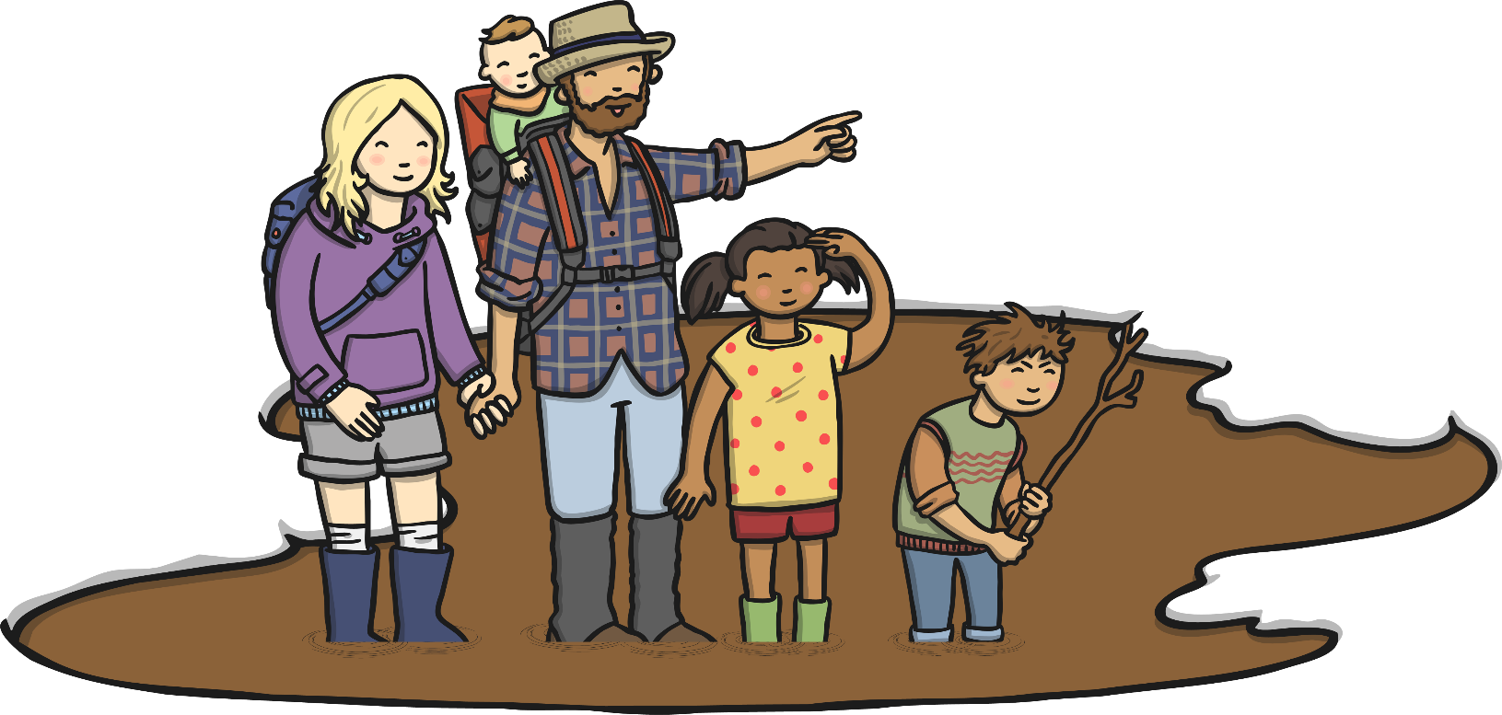
On a bear hunt today,
Through the wet mud, hooray!
Squelchy squerchy, squelchy squerchy,
On a bear hunt today.

Slide 5
On a bear hunt today,
Through the forest, hooray!
Stumble trippy, Stumble trippy,
On a bear hunt today.

Slide 6
On a bear hunt today,
Through the snowstorm, hooray!
Hooey wooey, hooey wooey,
On a bear hunt today.

Slide 7
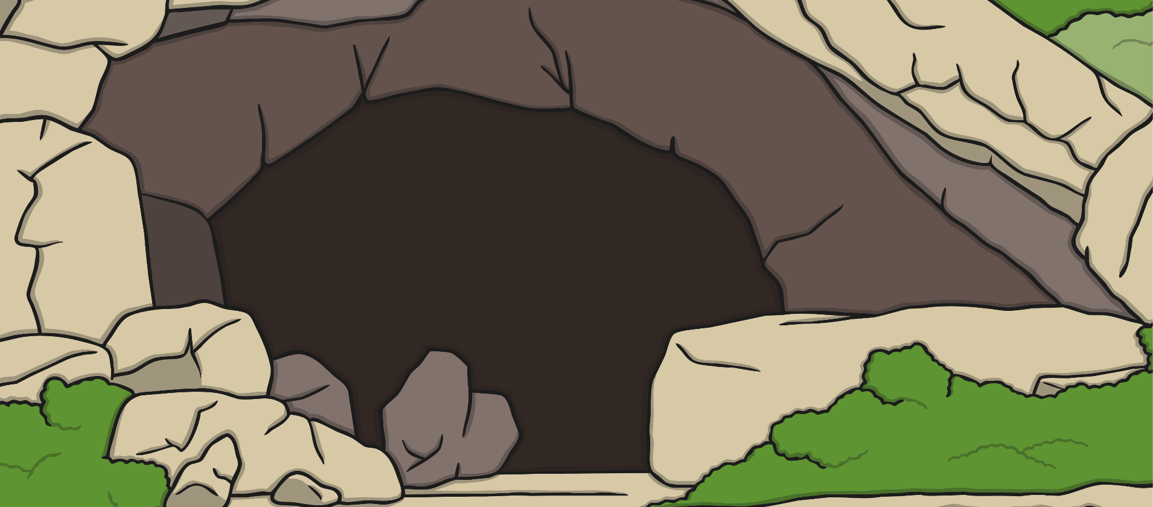
On a bear hunt today,
Through the dark cave, hooray!
Oh no! There's a bear!
No more bear hunt today!

