Slide 1
Welcome to
2013 VFW
Service Office Seminar

Slide 2
Duties & Responsibilities of Post & District Service Officers
Established by VFW National Veterans Service Policy & Procedures Manual.
P&P was amended March 2013 - Expanded the responsibilities of the District Service Officer to essentially be the same as those of the Post Service Officer in addition to those duties of promoting activities within the District and instruction of Post Service Officers.

Slide 3
New and Revised
VA Forms & Procedures
VA Form 21-0958
Notice of Disagreement
VA Form 21-526EZ
Application for Compensation
(Fully Developed Claim)
PL 112-154
Effective dates in FDCs

Slide 4
VA Form 21-0958, Notice of Disagreement

Slide 5
VA Form 21-526EZ
Fully Developed Claim Application

Slide 6
PL 112-154 FDC Effective Dates

Slide 7
Housebound
Aid and Attendance
Compensation vs Pension

Slide 8
COMPENSATION – SMC HB
38 CFR 3.350 (i) Total plus 60 percent, or housebound.
The special monthly compensation provided by 38 U.S.C. 1114(s) is
payable where the veteran has a single service-connected disability
rated as 100 percent and,
(1) Has additional service-connected disability or disabilities independently ratable at 60 percent, separate and distinct from the 100 percent service-connected disability and involving different anatomical segments or bodily systems, or
(2) Is permanently housebound by reason of service-connected disability or disabilities. This requirement is met when the veteran is substantially confined as a direct result of service-connected disabilities to his or her dwelling and the immediate premises or, if institutionalized, to the ward or clinical areas, and it is reasonably certain that the disability or disabilities and resultant confinement will continue throughout his or her lifetime.

Slide 9
COMPENSATION – SMC A&A

Slide 11
38 CFR 3.350 (h) Special aid and attendance benefit; 38 U.S.C. 1114(r)
(1) Maximum compensation cases. A veteran receiving the maximum rate under 38 U.S.C. 1114 (o) or (p) who is in need of regular aid and attendance or a higher level of care is entitled to an additional allowance during periods he or she is not hospitalized at United States Government expense. (See § 3.552(b)(2) as to continuance following admission for hospitalization.) Determination of this need is subject to the criteria of § 3.352. The regular or higher level aid and attendance allowance is payable whether or not the need for regular aid and attendance or a higher level of care was a partial basis for entitlement to the maximum rate under 38 U.S.C. 1114 (o) or (p), or was based on an independent factual determination.

Slide 12
38 CFR 3.352 (b) Basic criteria for the higher level aid and attendance allowance.
(1) A veteran is entitled to the higher level aid and attendance allowance authorized by § 3.350(h) in lieu of the regular aid and attendance allowance when all of the following conditions are met:
(i) The veteran is entitled to the compensation authorized under 38 U.S.C. 1114(o), or the maximum rate of compensation authorized under 38 U.S.C. 1114(p).
(ii) The veteran meets the requirements for entitlement to the regular aid and attendance allowance in paragraph (a) of this section.
(iii) The veteran needs a “higher level of care” (as defined in paragraph (b)(2) of this section) than is required to establish entitlement to the regular aid and attendance allowance, and in the absence of the provision of such higher level of care the veteran would require hospitalization, nursing home care, or other residential institutional care.

Slide 13
38 CFR 3.352 (b)
(2) Need for a higher level of care shall be considered to be need for personal health-care services provided on a daily basis in the veteran's home by a person who is licensed to provide such services or who provides such services under the regular supervision of a licensed health-care professional. Personal health-care services include (but are not limited to) such services as physical therapy, administration of injections, placement of indwelling catheters, and the changing of sterile dressings, or like functions which require professional health-care training or the regular supervision of a trained health-care professional to perform. A licensed health-care professional includes (but is not limited to) a doctor of medicine or osteopathy, a registered nurse, a licensed practical nurse, or a physical therapist licensed to practice by a State or political subdivision thereof.

Slide 14
38 CFR 3.352 (b)
(3) The term “under the regular supervision of a licensed health-care professional”, as used in paragraph (b)(2) of this section, means that an unlicensed person performing personal health-care services is following a regimen of personal health-care services prescribed by a health-care professional, and that the health-care professional consults with the unlicensed person providing the health-care services at least once each month to monitor the prescribed regimen. The consultation need not be in person; a telephone call will suffice.
(4) A person performing personal health-care services who is a relative or other member of the veteran's household is not exempted from the requirement that he or she be a licensed health-care professional or be providing such care under the regular supervision of a licensed health-care professional.

Slide 15
38 CFR 3.352 (b)
(5) The provisions of paragraph (b) of this section are to be strictly construed. The higher level aid-and-attendance allowance is to be granted only when the veteran's need is clearly established and the amount of services required by the veteran on a daily basis is substantial.

Slide 16
Monthly Compensation Rates
Total with SMC
100% HB Reg A&A Higher A&A
Veteran $2,816 3,152 3,504 7,026 / 8,059
Vet w/S $2,973 3,309 3,661 7,183 / 8,216

Slide 17
PENSION
Three levels of benefit:
Basic
Housebound
Aid & Attendance

Slide 18
Basic Level Pension
Live Pension
Wartime Veteran
Permanently & Totally Disabled (P&T) OR
Age 65 or over
Limited Income
Death Pension
Surviving spouse of Wartime Veteran
Any age
Limited Income

Slide 19
Eligibility to Pension Benefits
90 days active duty, other than active duty for training, one day of which must have been wartime
WWII 12-7-41 to 12-31-46
Korea 6-27-50 to 1-31-55
Vietnam 8-5-64 to 5-7-75*
Current War period 8-2-90 to unknown date
If service period is after 9-7-80, a continuous period of active duty of 24 months or the full period for which called to active duty

Slide 20
Veteran Disability Pension
P&T Criteria
Single disability rated 60% or higher
OR
Multiple disabilities combined at 70% or higher one of which must be a major disability rated 40% or higher

Slide 21
Housebound Level Pension
Veteran Disability Pension
38 CFR 3.351 (d) Housebound, or permanent and total plus 60 percent; disability pension.
The rate of pension payable to a veteran who is entitled to pension under 38 U.S.C. 1521 and who is not in need of regular aid and attendance shall be as prescribed in 38 U.S.C. 1521(e) if, in addition to having a single permanent disability rated 100 percent disabling under the Schedule for Rating Disabilities (not including ratings based upon unemployability under § 4.17 of this chapter) the veteran:

Slide 22
38 CFR 3.351 (d)
(1) Has additional disability or disabilities independently ratable at 60 percent or more, separate and distinct from the permanent disability rated as 100 percent disabling and involving different anatomical segments or bodily systems, or
(2) Is “permanently housebound” by reason of disability or disabilities. This requirement is met when the veteran is substantially confined to his or her dwelling and the immediate premises or, if institutionalized, to the ward or clinical area, and it is reasonably certain that the disability or disabilities and resultant confinement will continue throughout his or her lifetime.

Slide 23
Surviving Spouse Death Pension
38 CFR 3.351 (f) Housebound; improved pension; death.
The annual rate of death pension payable to a surviving spouse who does not qualify for an annual rate of death pension payable under § 3.23(a)(6) based on need for aid and attendance shall be as set forth in § 3.23(a)(7) if the surviving spouse is permanently housebound by reason of disability. The “permanently housebound” requirement is met when the surviving spouse is substantially confined to his or her home (ward or clinical areas, if institutionalized) or immediate premises by reason of disability or disabilities which it is reasonably certain will remain throughout the surviving spouse's lifetime.

Slide 24
Aid & Attendance Level Pension
Applies to both Live and Death Pension
38 CFR 3.351
(b) Aid and attendance; need. Need for aid and attendance means helplessness or being so nearly helpless as to require the regular aid and attendance of another person. The criteria set forth in paragraph (c) of this section will be applied in determining whether such need exists.
(c) Aid and attendance; criteria. The veteran, spouse, surviving spouse or parent will be considered in need of regular aid and attendance if he or she:
(1) Is blind or so nearly blind as to have corrected visual acuity of 5/200 or less, in both eyes, or concentric contraction of the visual field to 5 degrees or less; or
(2) Is a patient in a nursing home because of mental or physical incapacity; or
(3) Establishes a factual need for aid and attendance under the criteria set forth in § 3.352(a).

Slide 25
Asset Consideration in Pension Cases
The VA will consider pension entitlement based in part on household assets.
The consideration of assets is based on the question: Can the size of the asset provide for the veteran’s needs during his anticipated life expectancy?
In general the asset limit at which the VA will begin evaluating the question is $80,000 excluding the family home in most cases. Assets include all other real property and convertible financial instruments.

Slide 26
Pension Benefit Calculations
Terms:
IVAP: Income for VA Purposes
All household income is reportable
Not all income is countable
UMEs Unusual Medical Expenses - Paid and unreimbursed Medical Expenses for members of the veteran’s household for whom he is responsible.
IVAP = sum of all countable income – allowable UMEs
Max benefit – IVAP= annual benefit / 12=monthly benefit

Slide 27
In determining final income for VA purposes (IVAP), VA will take into consideration Unusual household Medical Expenses for those persons in the home that the veteran is responsible for.
Acceptable Medical Expenses are the total of countable UMEs which exceed 5% of the maximum pension benefit based on the number of claimable dependents.
Deductable = 5% of $12,465 = $623

Slide 28
The VA is very liberal in the consideration of countable Unusual Medical Expenses.
The VA will allow:
Doctor visit costs or co-pays
Prescription costs or co-pays
Health insurance premiums
Non prescription medicines and supplies
Mileage to doctor visits
In home medical care expenses
Nursing care expenses

Slide 29
Disability Pension Rates
Status Annual Benefit Monthly Benefit
Vet Basic $12,465 $ 1,038
Vet w/ one dep 16,324 1,360
Vet Housebound $15,233 $ 1,269
Vet w/ one dep 19,093 1,591
Vet A&A $20,795 $ 1,732
Vet w/ one dep 24,652 2,054
Medical Expense deductible = $623 / $816

Slide 30
Death Pension Rates
Status Annual Benefit Monthly Benefit
Spouse $ 8,359 $ 696
W/one dep 10,942 911
Housebound $10,217 $ 851
W/one dep 12,796 1,066
A&A $13,362 $ 1,113
W/one dep 15,940 1,328
Medical expense deductible = $417 / $547

Slide 31
Veteran Pension
Veteran Max benefit: $12,465
Social Security Disability $ 6,000
Retirement pension $ 3,600
Other, interest, etc $ 1,200
Total Income $10,800
Annual Benefit $ 1,665
Monthly Benefit $ 138

Slide 32
Unusual Medical Expenses
Month Annual
Medicare Premium $104.90 $1,258
Supplemental Ins Premium $140.00 $1,680
Doctor Co-pay $ 25.00 $ 300
Prescription Co-pay $ 15.00 $ 720
Total UMEs $3,958

Slide 33
Veteran Max benefit: $12,465
Social Security $ 6,000
Retirement pension $ 3,600
Other, interest, etc $ 1,200
Total Income $10,800
Unusual Medical Expenses $ 3,958
Deductible $ 623
Accepted Medical Expenses $ 3,335
Income for VA Purposes $ 7,465
Annual Benefit $ 5,000
Monthly Benefit $ 416

Slide 34
Special Monthly Pension (SMP) Benefits
Higher level of Maximum VA Benefit
Housebound benefits are granted when the claimant is determined to be essentially confined to his home except for with the assistance of another person.
Housebound status is a Rating Board decision and can only be granted when the qualifying disability is permanent.

Slide 35
Special Monthly Pension (SMP) Benefits
Aid & Attendance (A&A) benefits are granted by Rating Board decision when the claimant is determined to be in the need of aid & attendance of another person to protect themselves from the hazards of daily living and keep themselves clean.
A&A benefits may be conceded when the claimant is in the receipt of nursing care in a state licensed nursing care facility.

Slide 36
Certification from a State Licensed Nursing Care Facility that a claimant is receiving nursing services as a patient in that licensed facility other than for temporary rehabilitation will be accepted as evidence of the need for aid & attendance.
The full cost of nursing home care will be accepted as unusual medical expense for pension purposes.

Slide 37
Claimants entitled to Housebound or Aid & Attendance benefits by Rating Board decision based on medical report of disability and limitations, 21-2680, but not residing in a licensed nursing home such as living at home or as a resident in an Assisted Living Facility must document the services provided and the cost of those services by either a facility report, VA Form 21-0779, or in home attendant care giver affidavit.

Slide 38
“Custodial care” is the same as room and board. Because the individual needs to live in a protected environment, all unreimbursed fees paid to the institution for custodial care ('room and board') . . . are deductible expenses.
As defined in VA regulations, Activities of Daily Living, (ADLs) are “basic self-care and includes bathing or showering, dressing, eating, getting in or out of bed or a chair, and using the toilet.”
To preserve the integrity of the pension program, VA considers a facility to provide custodial care if it assists an individual with two or more ADLs. Accordingly, for pension purposes,

Slide 39
The cost of room and board at a residential facility is a UME if the facility provides custodial care to the individual, or the individual's physician states in writing that the claimant must reside in that facility to separately contract for custodial care with a third-party provider.
A facility provides custodial care if it assists the individual with two or more ADLs.
If the facility does not provide the claimant custodial care, or the claimant's physician does not prescribe care by a third-party provider in that facility, VA will not deduct room and board paid to the facility but will deduct the cost of any medical or nursing services obtained from a third-party provider.

Slide 40
Claims for room and board as a UME when a facility provides assistance with Instrumental Activities of Daily Living (IADLs).
VA regulations define IADLs as “activities other than self-care that are needed for independent living, such as meal preparation, doing housework and other chores, shopping, traveling, doing laundry, being responsible for one's own medications, and using a telephone.” As a general rule, charges for assistance with IADLs are not UMEs for pension purposes because such assistance is not a medical or nursing service.
However, VA will deduct the cost of assistance with IADLs from the individual's income when:
The individual is entitled to pension at the A&A or housebound rate (by rating decision), or a physician has certified that the claimant has a need to be in a protected environment, AND
The facility provides medical services or assistance with ADLs to the individual.

Slide 41
VA must have complete income, net worth and medical expense data.
Income: month annual
Vet Social Security $ 1,196.90 $14,362
Vet retirement 615.00 7,380
Spouse Social Security 876.40 10,516
Spouse retirement 443.00 5,316
Interest on investment 150.00 1,800
Total household income $39,374

Slide 42
Problem??
Maximum income limit for veteran in need of A&A with one dependent??
$24,652 annually
Vet’s household income is $39,374
Vet is $14,722 over income for pension.
What is the possibility?

Slide 43
Vet and his wife have in home medical expenses:
monthly annual
Vet Medicaid premium $ 104.90 $1,258.80
Wife Medicaid premium 104.90 1,258.80
Supplemental insurance policy premium
210.00 2,520.00
Vet prescriptions 310.00 3,720.00
Wife prescriptions 42.50 510.00
MD visit co-pays 50.00 600.00
Vet diapers 144.00 1,728.00
Non prescription needs 32.00 384.00
In Home Nursing Aid 2,160.00 25,920.00
Total $ 37,899

Slide 44
Reportable medical expenses $37,899
Deductable (vet w/one dep) - 816
Allowable medical expenses 37,083
Reported Household Income 39,374
Allowable Medical Expenses - 37,083
Income for VA Purposes 2,291
Max VA benefit (vet A&A w/one dep) 24,652
IVAP - 2,291
Annual Payable Benefit 22,361
Monthly Benefit $1,863

Slide 45
Vet and his wife have Assisted Living medical expenses:
monthly annual
Vet Medicaid premium $ 104.90 $1,258.80
Wife Medicaid premium 104.90 1,258.80
Supplemental insurance policy premium
210.00 2,520.00
Vet prescriptions 310.00 3,720.00
Wife prescriptions 42.50 510.00
MD visit co-pays 50.00 600.00
Vet diapers 144.00 1,728.00
Non prescription needs 32.00 384.00
Assisted Living Facility (Vet) 4,200.00 50,400.00
Total $ 62,378

Slide 46
Reportable medical expenses $62,378
Deductable (vet w/one dep) - 816
Allowable medical expenses 61,562
Reported Household Income 39,374
Allowable Medical Expenses - 61,562
Income for VA Purposes -0-
Max VA benefit (vet A&A w/one dep) 24,652
IVAP -0-
Annual Payable Benefit 24,652
Monthly Benefit $2,054

Slide 47
MEDICAID and VA Pension
Maximum benefit payable to either veteran on pension or surviving spouse on death pension in a MEDICAID nursing care bed is $90.00 monthly.

Slide 48
QUESTIONS ?

Slide 49
Rating Type II Diabetes Mellitus
May be service connected by:
Direct (diagnosed in service)
Presumption (within one year)
Presumption (at any time after service due to Herbicide Exposure)

Slide 50
Must be a confirmed diagnosis of Type II Diabetes Mellitus.
High Glucose or “borderline diabetes” are not service connectable.

Slide 51
Diagnostic Code 7913: Diabetes mellitus
10% Manageable by restricted diet only
20% Requiring insulin and restricted diet, or; oral hypoglycemic agent and restricted diet
40% Requiring insulin, restricted diet, and regulation of activities
60% Requiring insulin, restricted diet, and regulation of activities with episodes of ketoacidosis or hypoglycemic reactions requiring one or two hospitalizations per year or twice a month visits to a diabetic care provider, plus complications that would not be compensable if separately evaluated

Slide 52
100% Requiring more than one daily injection of insulin, restricted diet, and regulation of activities (avoidance of strenuous occupational and recreational activities) with episodes of ketoacidosis or hypoglycemic reactions requiring at least three hospitalizations per year or weekly visits to a diabetic care provider, plus either progressive loss of weight and strength or complications that would be compensable if separately evaluated

Slide 53
Regulation of activities:
Diabetics with good blood sugar control may participate in strenuous athletics and ordinary exercise which is a standard prescription for diabetics.
Others may be instructed to avoid strenuous occupational and recreational activities to keep blood sugar stable.
When present, restriction of activities will usually be mentioned in the medical treatment records and there will be other evidence such as frequent changes of doses of insulin and frequent episodes of hypoglycemia.

Slide 54
Long-term complications of diabetes include:
retinopathy with potential loss of vision;
nephropathy leading to renal failure;
peripheral neuropathy with risk of foot ulcers, amputations, and Charcot joints; (may include fingers)
autonomic neuropathy causing gastrointestinal, genitourinary, and cardiovascular symptoms and sexual dysfunction.

Slide 55
Complications of diabetes may result in “loss of use” ratings due to erectile dysfunction, due to vision loss, and multiple “loss of use” of extremities due to peripheral neuropathy.

Slide 56
QUESTIONS?

Slide 57
Rating Cancer
A 100 % rating for “cancer” shall continue beyond the cessation of any surgical, radiation, antineoplastic chemotherapy or other therapeutic procedures.
Six months after discontinuance of such treatment, the appropriate disability rating shall be determined by mandatory VA examination. Any change in evaluation based upon that or any subsequent examination shall be subject to the provisions of § 3.105(e) of this chapter. If there has been no recurrence, rate on residuals.

Slide 58
Primary Cancers Residuals:
Prostate: rated on bladder dysfunction
Lung: rated on respiratory impairment
Kidney: rated on either removal of kidney or renal function
Liver: rated on function
Hodgkin's / Non Hodgkin’s: rated on anemia
Leukemia: rated on anemia

Slide 59
Secondary Cancers
Tumors the result of metastasis from primary cancers will be service connected as secondary conditions. All rules for rating primary cancers apply to secondary cancers.
Secondary cancers are determined to be metastatic based on biopsy results.

Slide 60
Reoccurrence
The reoccurrence of a service connected cancer previously treated and in remission will be rated in the same manner as the original onset of the cancer regardless of the time period it was in remission.

Slide 61
QUESTIONS?

Slide 62
Service Connection for Hearing Loss
Conductive Hearing Loss?
Vs
Sensor-neural Hearing Loss?

Slide 63
Conductive hearing loss must be diagnosed in service for purposes of service connection.
Usually the result of disease or severe trauma.
Hearing loss is immediate.

Slide 64
Sensor-neural hearing loss is presumptive if diagnosed to a compensable degree within one year of discharge because it is considered to be the result of “nerve” damage , the result of acoustic trauma.
Hearing loss may have delayed onset.

Slide 65
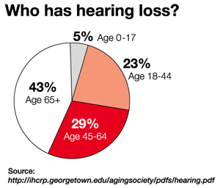

Slide 66
Service Connection for Hearing Loss
Service connection requires finding of hearing loss “for VA purposes”.
If diagnosed after discharge, requires medical opinion that hearing loss “is as likely as not” the result of conceded acoustic trauma in service.

Slide 67
A medical opinion may consider a shift in hearing loss during service between entrance and discharge as an indication of service incurred hearing loss even if the discharge exam did not diagnosis hearing loss for VA purposes.
A medical opinion must consider post discharge acoustic trauma in the same light as in service acoustic trauma.

Slide 68
38 CFR 3.385 Disability due to impaired hearing.
For the purposes of applying the laws administered by VA, impaired hearing will be considered to be a disability when the auditory threshold in any of the frequencies 500, 1000, 2000, 3000, 4000 Hertz is 40 decibels or greater; or when the auditory thresholds for at least three of the frequencies 500, 1000, 2000, 3000, or 4000 Hertz are 26 decibels or greater; or when speech recognition scores using the Maryland CNC Test are less than 94 percent.

Slide 69
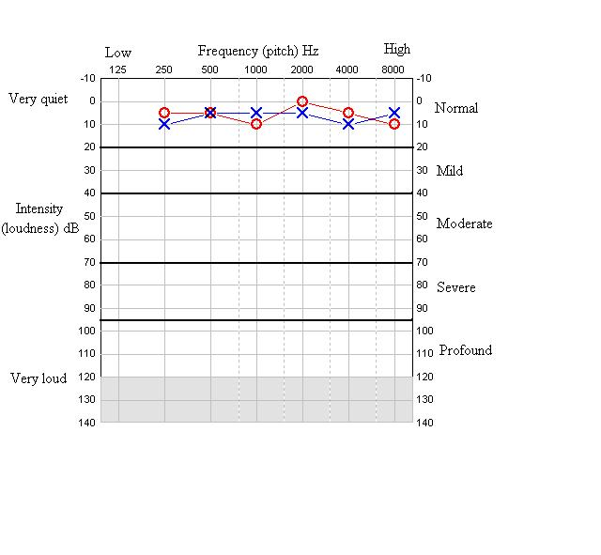

Slide 70
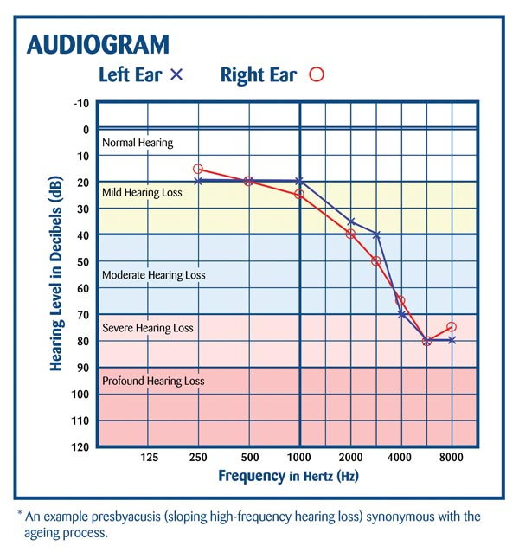

Slide 71
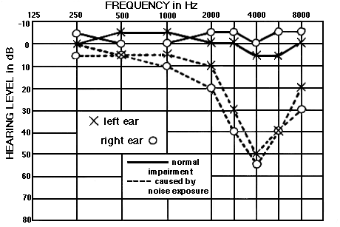

Slide 72
Test Results for 3.385
500 1K 2K 3K 4K Desr.
Left 15 20 25 25 30 97%
Right 20 25 25 30 40 95%
_____________________________________
Left 20 25 30 35 40 96%
Right 15 20 25 30 40 93%

Slide 73
Service Connection for Hearing Loss
Once hearing loss for purposes has been diagnosed and there is a positive medical opinion the Rating Board will make a decision: Service Connection, Yes or No.
If no, the process stops, regardless of how severe the hearing loss might be.
If yes, the process moves to the evaluation of the measured hearing loss.

Slide 74
Rating Hearing Loss
Hearing loss, once service connected, is evaluated using the instructions of 38 CFR 4.85.
Average the puretone thresholds measured at 1K, 2K, 3K and 4K Hertz.
Assign separate designations for each ear by combining the above average with the discrimination percentage.
Combine the two achieved designations to achieve a combined hearing loss evaluation.

Slide 75
500 1K 2K 3K 4K Des:
Left 20 25 30 35 40 96%
Right 15 20 25 30 40 93%
Left ear average: 33
Right ear average: 29

Slide 76
Left ear: Avg: 33 Des: 96% Designation: I
Right ear: Avg: 29 Des: 93% Designation: I
Left Designation “I” and Right Designation “I”
Combine to service connection at 0%

Slide 77
1K 2K 3K 4K Des:
Left 30 35 45 55 92%
Right 35 40 55 65 90%
Left ear average: 41
Right ear average: 49

Slide 78
Left ear: Avg: 41 Des: 92% Designation: “I”
Right ear: Avg: 49 Des: 90% Designation: “II”
Left Designation “I” and Right Designation “II”
Combine to service connection at 0%

Slide 79
1K 2K 3K 4K Des:
Left 45 55 65 75 92%
Right 50 55 65 75 88%
Left ear average: 60
Right ear average: 61

Slide 80
Left ear: Avg: 60 Des: 84% Designation: “III”
Right ear: Avg: 61 Des: 82% Designation: “IV”
Left Designation “III” and Right Designation “IV”
Combine to service connection at 10%

Slide 81
Tinnitus
Tinnitus, “ringing in the ears,” is not hearing loss and is not evidence of hearing loss even thou both may be the result of the same acoustic trauma. Tinnitus, if reported by the veteran, may be claimed as a separate disability from hearing loss and may be granted or denied service connection without regard to a rating board decision on the issue of service connection for hearing loss.

Slide 82
Tinnitus is classified either as subjective tinnitus (over 95% of cases) or objective tinnitus.
In subjective or “true” tinnitus, the sound is audible only to the patient.
In the much rarer objective tinnitus (sometimes called extrinsic tinnitus or “pseudo-tinnitus”), the sound is audible to other people, either simply by listening or with a stethoscope.

Slide 83
True (subjective) tinnitus does not originate in the inner ear, although damage to the inner ear may be a precursor of subjective tinnitus. It is theorized that in true tinnitus the brain creates phantom sensations to replace missing inputs from the damaged inner ear, similar to the brain’s creation of phantom pain in amputated limbs .
True tinnitus, is therefore, the perception of sound in the absence of an external stimulus, appears to arise from the brain rather than the ears.

Slide 84
Before 1999, the rating schedule authorized a 10% disability rating for tinnitus incurred as a result of trauma to the head, “Persistent as a symptom of head injury, concussion or acoustic trauma.”
The trauma must have been documented in service treatment records.
In 1999, the Rating Schedule was amended to provide service connection for “Tinnitus, recurrent,” regardless of its etiology, but still related to service.

Slide 85
The 1999 amendment to DC 6260 reflected an awareness that tinnitus need not be constant (persistent) to be disabling and that it can have causes other than head trauma.
The amendment addressed the need to accommodate tinnitus resulting from other causes.
Requires that tinnitus be described as recurrent from service. Need not be a subject of medical record.

Slide 86
Diagnostic Code 6260, as in effect prior to June 10, 1999, and as amended as of that date, authorizes a single 10% disability rating for tinnitus, regardless of whether tinnitus is perceived as unilateral, bilateral, or in the head.
Separate ratings for tinnitus for each ear may not be assigned under DC 6260 or any other diagnostic code.

Slide 87
QUESTIONS?

