Slide 1
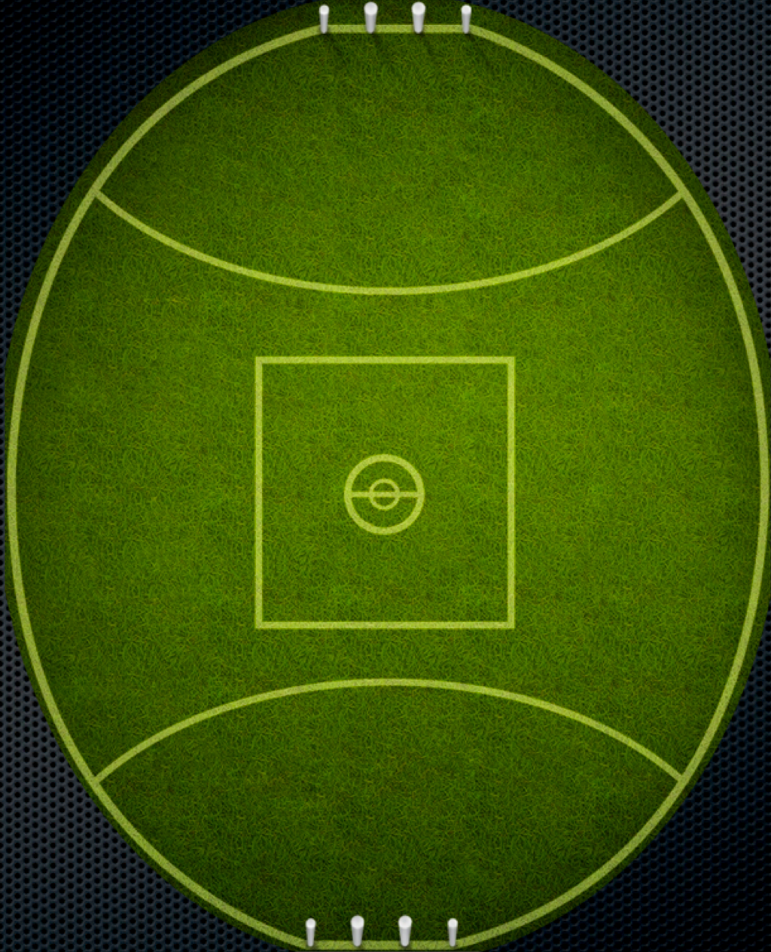
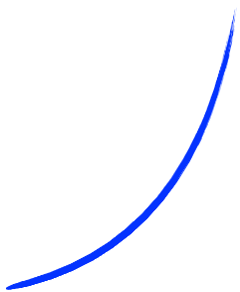
6 Laps of Death
10 Push ups
10 Sit ups
Running
Direction
Zig Zag through
Goal posts
Backwards
Running
20m Shuttle run
3 times
Repeat all this 6
times as fast
as you can

