Slide 1
AHIMA Commission on Certification for Health Informatics and Information Management (CCHIIM)
Linda Galocy, MS, RHIA, FAHIMA
CCHIIM Commissioner, 2020-2023

Slide 2
Agenda
CCHIIM mission, value, purpose, structure
Exam development process
Recertification guide changes
Candidate information update
Commissioner election, appointment, and eligibility
Notes:
In today’s session I will:
Articulate CCHIIM’s mission, value, purpose and structure
Outline the high level processes involved with certification exam development and initial eligibility criteria for various AHIMA certifications
Discuss the most important recertification policies, candidate guide changes, AND
Describe how commissioners are elected or appointed and what qualifications/requirements exist for seeking election or appointment

Slide 3
What Is CCHIIM?
The Commission on Certification for Health Informatics and Information Management
Is an integrated commission of AHIMA that exists to serve the public
Is comprised of dedicated volunteers who are committed to ensuring the competency of professionals practicing HIIM
Minimum of 15 commissioners
One public member
No more than 40% of the commission is composed of Representative Commissioners who are elected by the AHIMA membership
The remaining are At-large Commissioners appointed by CCHIIM
Notes:
CCHIIM is an integrated commission of AHIMA and as such is written into the AHIMA bylaws. It is not a separate organization, but does have some required firewalls that exist to ensure compliance with accreditation of certification requirements and industry best practice.
CCHIIM serves the public by establishing, implementing, and enforcing standards and procedures for certification and recertification of HIIM professionals.
This standing commission of AHIMA is empowered with the sole and independent authority in all matters pertaining to both the initial certification and ongoing recertification (certification maintenance) of HIIM professionals. Per its Memorandum of Understanding with AHIMA, CCHIIM makes recommendations regarding the development of new certifications or the sunsetting of existing certifications, with final approval by the AHIMA board.
CCHIIM is supported by staff of AHIMA, who assist with all functions of our commission.

Slide 4
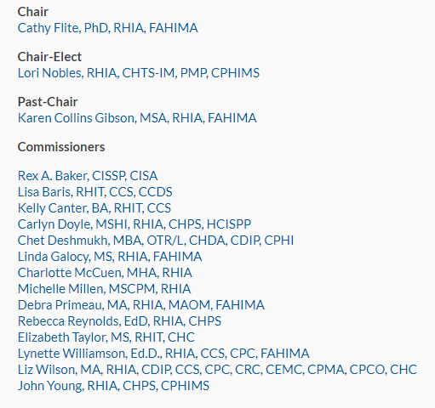
2020 CCHIIM

Slide 5
CCHIIM Mission, Values, and Purpose
Mission
Through certification, CCHIIM assures the competency of professionals practicing health informatics and information management worldwide
CCHIIM Values
The application of evidence-based best practices for certification
The validation of workforce competence through professional certification
The commitment to ongoing professional development, lifelong learning and workforce excellence, and
The recognition of CCHIIM-certified professionals' role in maintaining and enhancing quality health information for the safety of the public and the improvement of healthcare
Purpose
CCHIIM serves the public by establishing, implementing, and enforcing standards and procedures for certification and recertification of health informatics and information management (HIIM) professionals
Notes:
CCHIIM’s mission, values and purpose are as articulated here and focus on ensuring the availability of a strong HIM workforce.

Slide 6
CCHIIM Strategic Goals
Alignment to AHIMA Strategic Plan | 2020 CCHIIM Goals
Outcome #2: Shape the health information profession by growing the influence and competitiveness of health information skillsets | Identify market orientation for CDIP, CHDA, and CHPS
 | Develop a plan to enhance exam security (via technical capacity/ metrics/policy)
 | Determine the need for region-specific credentials outside the U.S.
 | Set forth a plan to evaluate and eliminate Beta Testing in the certification process
Outcome #3: Drive strategic transformation and renewed growth as a great partner and place to work | Market a communication cycle which will articulate policy setting

Slide 7
CCHIIM Structure
Executive Committee
Exam Development Committees
Appeals Committee
Nominating Committee
Exam Security Committee
Sub-committees and Work Groups:
Exam Development Sub-Committees for RHIA, RHIT, Coding, CDIP, CHDA, CHPS
Policy Development
Recertification
Job Analysis
Item Development
Notes:
CCHIIM Commissioners represent a broad spectrum of health informatics and information management professionals, including educators, and must be AHIMA-certified and meet certification, work experience, and leadership requirements in order to serve on the commission.
The commission is comprised of elected and At-Large or appointed Commissioners. AHIMA’s nominating committee places candidates for elected position on the annual AHIMA ballot for election. The number of elected commissioners may vary from year to year, but is generally 2-3 elected each year. The nominating committee of CCHIIM is charged with developing a slate of candidates to be considered for the appointed positions of at large Commissioner. Once elected or appointed, commissioners serve a three-year term unless they are elected to a leadership position during their tenure on the commission. Those who are elected by the commission to be the chair, ultimately serve 4-5 years on the commission as they go through the phases of chair-elect, chair, and past-chair and depending on at what point in their tenure they are elected to leadership.
The appeals committee is charged with reviewing appeals around certification and re-certification as specified in the CCHIIM appeal procedures and policies.
The exam security committee works to improve the protection policies of the exams and oversees any issues around breaches in any of our examinations.
Our current workgroups are focusing on Recertification and Policy Development. These may occasionally change depending on the focus of AHIMA.
The 2 boxes in green, Job Task Analyses and Item Development are currently managed by the internal AHIMA staff, and support CCHIIM’s efforts to assure our exams are current with today’s workforce needs, reflecting the current trends and important functions across the spectrum of HIIM.

Slide 8
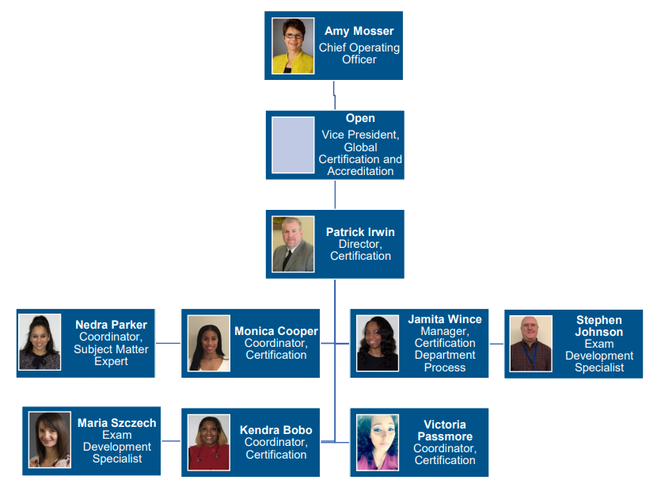
Certification Staff

Slide 9
Job Analysis
SMEs
Tasks and duties performed
Skills required
Credential/Certification
Update to ensure industry relevance
Map to competencies
Exam Preparation
Exam Development Committee
Item Writers
http://www.ahima.org/certification/RHIA
9
Notes:
A job analysis is done to assure continued relevancy in the industry. This pulls together industry subject matter experts (SMEs) actually working in the roles, with the particular certification/credential and breaks down their duties, and the skills required to help support the role.
This is generally performed on each credential/exam that AHIMA offers, about once every 3-5 years for each. In the instance of RHIA and RHIT job analysis, this may identify different opportunities to update/refocus curricula, as well as the examination and that information is important to the CEE, Council for Excellence in Education.
Exam prep – includes the exam development committee for each credential as well as multiple item writers for each credential AHIMA offers.

Slide 10
Exam Development Process
HIMM Practices/Roles
Body of Knowledge, Skills, Abilities
Potential/New
Existing Certifications
Exam Blueprint
&
Specifications
Item Writing & Development
Exam Assembly & Construction
Beta/Pre-Testing
Standard Setting
Exam Publishing/ Administrative Maintenance
Job/Needs Analysis
Notes:
AHIMA / CCHIIM certification exams are valid, reliable, and legally defensible assessment instruments which measure the competency of potential certificants against a codified and relevant body of health informatics and information management (HIIM) competencies (also referred to as knowledge, skills, and abilities). The subject matter (also referred to as a body of knowledge, or BOK for short) represented by these competencies is further segmented across specific roles and disciplines throughout the HIIM profession as a whole by the requisite levels of depth, breadth, and experiences necessary for successful job performance, as exemplified by each respective AHIMA certification.
This graphic shows the process for Exam Development.
AHIMA has traditionally used a “beta testing” process when a revised exam is introduced. Beta testing causes frustration for testers because it means they have to wait a period of time for their results and that time can be extensive because there have to be a significant number of people taking the test. The CCHIIM commissioners & AHIMA Certification, understand the need to increase customer satisfaction while ensuring the validity of the exam and scoring process, so we are eagerly working on the beta process.

Slide 11
Current Certifications
http://www.ahima.org/certification
HIM Certifications
RHIA
RHIT
Coding Certifications
CCA
CCS
CCS-P
Specialty Certifications
CDIP
CHDA
CHPS
11
Notes:
The RHIA and RHIT are the only certifications that are tied directly to educational requirements currently from AHIMA. Then of course we have the current coding credentials, (CCA, CCS, CCS-P).
Specialty certifications currently include (CDIP, CHDA, CHPS).
The RHIT, RHIA, CCS, and CCS-P are certifications that hold an accreditation by the National Commission on Certifying Agencies (NCCA). These 4 certifications require additional rigor in the test development and delivery process. Receiving NCCA accreditation is similar to accreditation by the Joint Commission and is a voluntary process.

Slide 12
Recertification Policy
Exists to ensure that credentialed individuals demonstrate ongoing competence in the domain areas in which they are certified
Policies and procedures are reviewed annually and published in the Recertification Guide
Contains Continuing education requirements by credential
Notes:
Recertification is the maintenance of your certification. It ensures that credentialed individuals demonstrate ongoing competence in the domain areas in which they are certified. This includes the completion of a specific number of educational program hours within a two year timeframe. The importance of lifelong learning is ever more apparent as the body of knowledge and the world in which we practice as HIM professionals is changing at an incredibly fast pace. What we learned in school 5, 10, 20 or more years ago may no longer be relevant. As new opportunities emerge, keeping current and learning new content and skills is critical to be considered for these new and emerging roles. While the CE requirements are currently not terribly prescriptive, for your own benefit remember to stay current in emerging areas of practice as well as the specific area of practice that you may be in today.
Recertification is separate from Reinstatement which is the return of a revoked credential to active upon completion of an Intent to Reinstate application and recertification requirements.
One change being planned is in names of the CEU reporting domains. Additional information will be published in advance of this change and the start date will depend on competition of system modifications necessary for this change.

Slide 13
Recertification Guide
To find and download the recertification guide:
Visit: https://www.ahima.org/certification/Recertification
Scroll down until you see “Recertification Resources” on the right-hand side
Click on “Recertification Guide”
Notes:
There are many rules and requirements around recertification and in some cases they can be complex, depending on the specific credential you hold as well as the number of credentials, when they were each earned, and a myriad of other considerations.
On occasion, AHIMA may “sunset” a certification meaning the exam will no longer be offered and no new certifications would be issued. However, when this happens, individuals generally have the option to maintain their certification. This means that individuals can continue to use the credential, but must report CE as required.
You can find a direct link to the Recertification Guide from your CEU Center.

Slide 14
Policy Overview
Effective 01/01/20 - HIIM Domain Name changes, also reflected in CEU Center
Effective 07/01/20
Transcript Submission Policy for Early Testers
Waiver/Hardship Policy
Voluntary relinquished
Retirement from HIIM Field
Appeals Policy
Effective 01/01/21 - Elimination of Grace Period
Notes:
CCHIIM reviewed all of its policies in 2019, this lists those areas where updates have been made or are planned to go into effect either later in 2020 or in 2021. I will go through each of these items on separate slides.

Slide 15
2020 HIIM Domain Updates – in effect
Informatics, Analytics and Data Use
Organizational Management and Leadership
Data Structure, Content and Information Governance
Revenue Cycle Management
Health Law and Compliance
Clinical Foundations
Information Protection: Access, Disclosure, Archival, Privacy and Security
Evolving Topics
Other
Notes:
CCHIIM's Recertification workgroup updated the HIIM domains to reflect current and future workforce competences.
A crosswalk that maps the 2019 Domains to the 2020 Recertification Guide and aids members in selecting the correct domain category within the CEU Center is available on the web site.

Slide 16
Policy Changes effective 7/1/20
Transcript Submission Policy for Early Testers
The recertification cycle is to start once one has met all eligibility requirements (completion of a program, approval of transcripts, passing of exam etc.)
Waiver/Hardship Policy
Policy title will change from “Waiver of CE Requirements” to “Recertification Requirements”
Credential must be in good standing when requesting for a waiver
Reason should be for extenuating circumstances
One hardship will be granted per credential
Each case will be individually evaluated on its merits and one will receive a response back within a specified number of days

Slide 17
Policy Changes effective 7/1/20
Appeals Policy Change
Once revoked, an individual will have 90 days to file an appeal and provide supporting documentation of the basis of the appeal
Letters of revocation will be sent via email with return receipt that the email was read; and via certified mail
Voluntary Relinquished clarification
If credential holder has voluntarily relinquished their credential and then later on changes their mind, the individual will need to take the exam again, no matter where they are in the recertification cycle.
Retirement from the HIIM Field
A fee will be assessed when changing to Retired and then back to Active status. NOTE – this change does not apply to individuals who have a current “Retired” status
Notes:
Given the job market

Slide 18
Policy Change effective 01/01/21: Elimination of Grace Period
Recertification status will be: Active, Inactive or Revoked
Active
Inactive Period
0-6 month period following recertification cycle end date
Revocation Period
7-12 month period following recertification cycle end date
Must earn remaining CEUs during revocation period to be reinstated
Must submit Intent to reinstate form and pay fee per credential
If reinstatement requirements not met during revocation period, credential is permanently revoked.
Extra time to record CEUs
Extra time to pay recertification fee
Must pay a late fee and satisfy recertification requirements
0-3 month period following recertification cycle end date
Grace Period
To reinstate, the certification examination must be passed again.
Notes:
2020 is the last time that a “Grace Period” will be used. Starting in January of 2021, there will no more use of a grace period.
Grace was the 0-3 month period following recertification cycle end date. It was intended to allow extra time for individuals to record earned CEUs, pay the recertification fee, etc. The use of a Grace Period was intended to be used occasionally and this has not been the case and as such as artificially elongated thousands of credential holders certification cycle. Moreover, this practice is not in keeping with industry best practice.
Best practice of professional associations follow a model of Active, Inactive and Revoked. AHIMA will be moving to this best practice starting January 1, 2021. AHIMA will be sending digital reminders over the course of the year.
Inactive Status has changed to be 0-6 months following recertification cycle end date.

Slide 19
Candidate Information Update
RHIA and RHIT Beta exam mistake Nov 15-20, 2019
96 individuals impacted
Given full refunds
Allowed to test at no charge
2020 Exam information:
CCS, CCS-P Beta starts May 1, 2020
RHIA new blueprint October 30, 2020
Candidate Score Report Change
Any individual who fails an exam will receive domain-level information, so they understand where they need to improve.
Notes:
A mis-communication between AHIMA and its testing partner, PearsonVue, resulted in a Beta exam being offered from November 15-20, 2019. Once discovered, PearsonVue took the exam down and replaced it with the previous exam. Unfortunately, 96 individuals took the exam. AHIMA contacted the individuals affected, provided full refunds and these individuals have or are testing again at no charge.
AS you saw from the 2020 CCHIIM Goals, moving away from the use of Beta exam periods is important. We thank those credential holders who have been helping as item writers, reviewers and the like for the past 6-9 months as we build up our item banks for each exam. To-date, we have focused on building up the CCS, CCA, CCS-P, RHIT and RHIA item banks so that we can begin pre-testing or seeding questions. This will allow us to eventually have a very strong item bank and eliminate the need for Beta exam periods.
We are not quite there yet, so CCS and CCS-P does have an upcoming Beta exam period starting 5/1/20. CCHIIM expects this to be the need for a beta period for these 2 exams.
RHIA has a new blueprint that does into effect October 30, 2020.
Lastly, regarding the candidate score report and the school report, we (CCHIIM and AHIMA) know how important this issue is and we are busy looking into the reports/issues surrounding reporting for both the candidate and school.

Slide 20
NCCA Accreditation Update
The National Commission for Certifying Agencies (NCCA) is the accrediting body of the Institute for Credentialing Excellence (ICE)
NCCA Standards were developed to help ensure the health, welfare, and safety of the public. They highlight the essential elements of a high-quality program.
Certification organizations that submit their programs for accreditation are evaluated based on the process and products and not the content; therefore, the Standards are applicable to all professions and industries.
Accreditations for RHIA, RHIT, CCS, CCS-P expire 4/30/20
4 reaccreditation applications were submitted 1/30/20. First phase of questions in process.
Notes:
ICE created the National Commission for Certifying Agencies (NCCA) in 1987.
NCCA’s Standards for the Accreditation of Certification Programs, which were created in the mid-1970s, were the first standards developed by the credentialing industry for professional certification programs.
NCCA standards are consistent with The Standards for Educational and Psychological Testing (AERA, APA, & NCME, 1999) and are applicable to all professions and industries.
AHIMA accreditations for RHIA, RHIT, CCS and CCS-P expire April 30, 2020
Organizations must submit and be approved PRIOR to their expiration date, which is why AHIMA submitted all 4 applications on 1/30/20.
AHIMA has had to make substantive policy and procedures changes in order to prepare for the application process

Slide 21
Exam Pass Rates

Slide 22
CCHIIM Needs You!
At-Large CCHIIM Commissioner (open until 8/14/20)
https://engage.ahima.org/volunteeropportunities/volunteer-opportunity-details?VolunteerOpportunityKey=81521563-1a30-4bf7-8b57-1c5a89d2c681&returnurl=https%3A%2F%2Fengage.ahima.org%2Fvolunteeropportunities%2Fopportunities-list-public
Elected CCHIIM Commissioner (open until 3/31/20)
3 open positions
https://engage.ahima.org/volunteeropportunities/volunteer-opportunity-details?VolunteerOpportunityKey=4568bc79-55ea-44b8-89ea-396fd35e60b7&returnurl=https%3A%2F%2Fengage.ahima.org%2Fvolunteeropportunities%2Fopportunities-list-public
Item Writers (always open)
If you have an interest in being an item writer, please send a message of interest along with your current CV (resume) to certification@ahima.org
Notes:
If you are interested in running or being considered for a CCHIIM volunteer position, please apply on the AHIMA Engage Volunteer Center. The close dates for these opportunities change annually, but for the At-large CCHIIM commissioners that are appointed by CCHIIM, applications are generally due in August each year. For elected commissioner positions, the due date is as announced on the Engage Volunteer Center and is at the end of MArch.
Please catch me while I am here at this meeting or feel free to email me with any other questions you may have about potentially serving on CCHIIM.
While item writer opportunities are not currently available directly through application on the volunteer center at this time (a project is currently underway to initiate this opportunity in the future), if you are interested in serving as an item writer, please send a message to certification@ahima.org and your name will be forwarded to the appropriate staff member for consideration. Item writing is a rigorous and time consuming volunteer activity and it is also very important to the HIM profession. Selection of item writers is based on knowledge of content, education, certifications held, and a variety of other factors.
The important work that is done by CCHIIM is foundational to the profession and how it is recognized in the healthcare industry. The many policy decisions reached by CCHIIM from the very beginning (eligibility for certifications) to the continued maintenance (recertification) must support the HIM profession today and in the future. If you are interested in making a difference to the profession, please consider running for an elected or appointed position as a CCHIIM commissioner or at-large commissioner.

Slide 23
Questions
Notes:
Happy to answer any questions at this point that the audience may have.

Slide 24
Notes:
Thank you for your time today.

