Slide 1
ICD-10-PCS Spinal Procedures
Presented by:
Shelly Callahan, RHIT, CCS

Slide 2
Learning Objectives
Review basic anatomy and physiology of the spine
Define common procedures of the spinal region
Learn pertinent Coding Clinic references specific to spine procedures
Apply coding tips necessary to obtain correct ICD-10-PCS codes

Slide 3
Spinal Column

Slide 4
Anatomy Review
The vertebral column, also known as the spine, consists of 33 vertebrae. The upper 24 are articulating vertebrae (separated by intervertebral discs) and the lower 9 are fused.
The vertebral column provides the spinal canal, which houses and protects the spinal cord.

Slide 5
Vertebral Regions
The articulating vertebra are grouped in their regions. They are:
7 Cervical vertebrae (called C1 to C7)
12 Thoracic vertebrae (called T1 to T12)
5 Lumbar vertebrae (called L1 to L5)
The fused vertebra are grouped in their regions. They are:
5 Sacrum vertebrae
4 Coccyx vertebrae

Slide 6
Orientation to Body

Slide 7
Physiology Review
When the vertebrae stack on top of each other, the holes (vertebral foramen) line up to form a long hollow tube that the spinal cord runs through. The spinal cord is a large bundle of millions of nerves that carries messages from your brain to the rest of your body, and from every part of your body back to your brain. The spine branches off into thirty-one pairs of nerve roots. These roots exit the spine on both sides through spaces called neural foramina between each vertebra.

Slide 8
Spinal Cord and Nerves

Slide 9
Physiology Review
All of the vertebral bodies act as a support column to hold up the spine. This column supports about half of the weight of the body, with the other half supported by the muscles. Like many other parts of the body, the spinal column also has joints. Spinal column joints are called facet joints. Facet joints link the vertebrae together and give them the flexibility to move against each other.

Slide 10
Facet Joints

Slide 11
Common Procedures of Spine
Spinal Fusions
ALIF
PLIF
TLIF
XLIF
360°
Diskectomy
Decompression

Slide 12
Spinal Fusions

Slide 13
Spinal Fusions
The Root Operation for Spinal Fusion is Fusion:
Fusion (G) – Joining together portions of an articular body part rendering the articular body part immobile.
The body part is joined together by fixation device, bone graft, or other means.
Fusion procedures are only performed on joints.

Slide 14
Spinal Fusions
Code Detail = Body System:
For joints above the level of lumbar vertebrae, Body System = Upper Joints.
For joints at the level of lumbar vertebrae and below, Body System = Lower Joints.

Slide 15
Spinal Fusions
Code Detail = Device:
If an interbody fusion device is used to render the joint immobile (alone or containing other material like bone graft), the procedure is coded with Device = Interbody Fusion Device
If bone graft is the only device used to render the joint immobile, the procedure is coded with Device = Nonautologous Tissue Substitute or Autologous Tissue Substitute
If a mixture of autologous and nonautologous bone graft (with or without biological or synthetic extenders or binders) is used to render the joint immobile, code the procedure with Device = Autologous Tissue Substitute

Slide 16
Spinal Fusions
Code Detail = Qualifier:
For access through the front of the body to perform a procedure in the body of the vertebrae or the disc, the Qualifier = Anterior Approach, Anterior Column.
For access through the back of the body to perform a procedure on the vertebral foramen, spinous processes, facets, and or lamina, the Qualifier = Posterior Approach, Posterior Column
For access through the back of the body to perform a procedure on the body of the vertebrae or the disc the Qualifier = Posterior Approach, Anterior Column

Slide 17
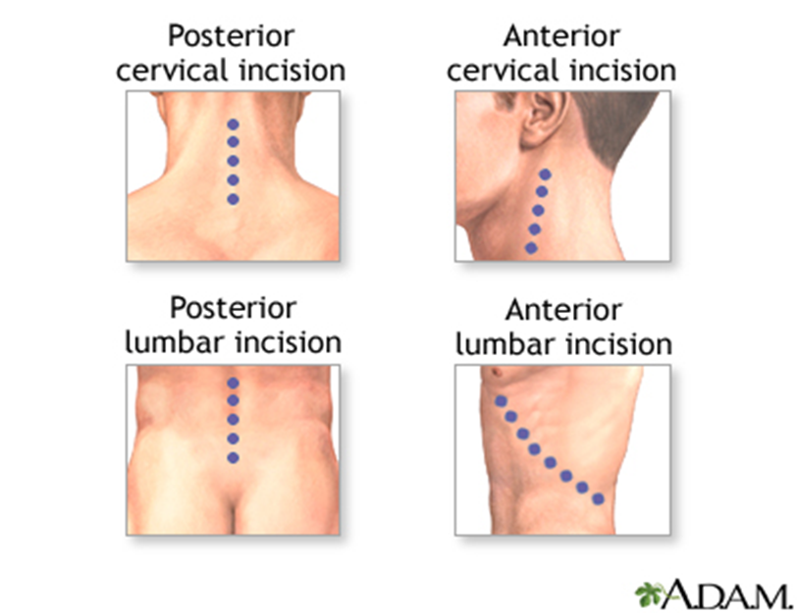
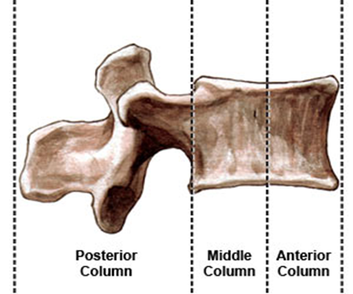
Spinal Fusions
Code Detail = Qualifier:

Slide 18
Spinal Fusions
Procedure Variations:
ALIF (anterior lumbar interbody fusion) – is an interbody fusion of the anterior and middle columns of the spine. The anterior approach allows the surgeon to remove the disc from the front and place the bone graft between the vertebrae. This is done by making an 3 to 5 inch incision in the abdomen. Since the anterior abdominal muscle in the midline (rectus abdominis) runs vertically, it does not need to be cut and easily retracts to the side. The organs in the abdomen, such as the intestines, kidneys, and blood vessels are moved to the side.

Slide 19
Spinal Fusions
Procedure Variations:
PLIF (posterior lumbar interbody fusion) – achieves spinal fusion of the anterior and middle column through a posterior approach. The spine is approached through a 3 to 6 inch incision in the midline of the back. The left and right lower back muscles are stripped off the lamina on both sides. The lamina is removed (laminectomy) which allows visualization of the nerve roots. The facet joints, which are directly over the nerve roots may then be trimmed to give the nerve roots more room. The nerve roots are then retracted to one side and the disc space is cleaned of the disc material. A cage made of allograft bone or synthetic material (PEEK or titanium) is then inserted into the disc space and the bone grows from vertebral body to vertebral body.

Slide 20
Spinal Fusions
Procedure Variations:
TLIF (transforaminal lumbar interbody fusion) – With this technique, the surgeon approaches the spine a little bit from the side. The TLIF is considered a more modern approach, and significant retraction of the dura and nerve roots is avoided. By removing one of the facet joints, a different trajectory is adopted to take out the disc and insert bone graft and a cage into the disc space. This exposes the nerves to a lower risk of injury, and also requires less muscle retraction (which may contribute to post-operative and long-term back pain).

Slide 21
Spinal Fusions
Procedure Variations:
XLIF (extreme lateral interbody fusion) – is an approach to spinal fusion in which the surgeon accesses the intervertebral disc space and fuses the spine using a surgical approach from the side (lateral) rather than from the front or the back. In some cases, an instrument called a tubular retractor is inserted through the skin and soft tissues down to the spinal column. The tubular retractor holds the muscles open and gives the surgeon a clear view of the spine. During the procedure, the disk is removed and a cage packed with bone graft is inserted between the vertebrae. Titanium screws are used to hold the cage in place. If needed, an additional incision is made on the back to insert the screws. This type of fusion is also called DLIF (direct lateral lumbar interbody fusion).

Slide 22
Spinal Fusions
Procedure | Approach | Qualifier
Anterior lumbar interbody fusion (ALIF) | Incision made in front of the spine through (mini)-laparotomy or laparoscopy | 0 = Anterior Approach, Anterior Column
Posterior lumbar interbody fusion (PLIF) | Incision made through a midline incision in the back | J = Posterior Approach, Anterior Column
Transforaminal lumbar interbody fusion (TLIF) | Incision made through a midline incision in the back | J = Posterior Approach, Anterior Column
Extreme lateral interbody fusion (XLIF) | Incision made in the patient’s side | 0 = Anterior Approach, Anterior Column

Slide 23
Spinal Fusions
Procedure Variations:
360-degree spinal fusion – a spinal surgery for low back pain or lumbar pain that requires the surgeon to stabilize both the front and back of the spine. Fusion surgery is only considered once all conservative measures have failed to provide significant back pain or neck pain relief. The front, or anterior, procedure is often performed first. This is the same as an anterior lumbar interbody fusion (ALIF). After this procedure is completed and bandages are placed over the operative area, the patient is gently rolled over for the second part of the surgery. This is the same as a posterior lumbar fusion (PLF). Pedicle screws and rods may be placed during the posterior portion of the surgery. Sometimes, this is procedure is done through a single incision.

Slide 24
Spinal Fusions
Procedure | Approach | Qualifier
360-degree spinal fusion | Incision made in front of spine through (mini)-laparotomy or laparoscopy. Patient is flipped over. Then, an incision made though the back | 0 = Anterior Approach, Anterior Column 1 = Posterior Approach, Posterior Column
360-degree spinal fusion | Incision is made only through the back | J = Posterior Approach, Anterior Column 1 = Posterior Approach, Posterior Column

Slide 25
Spinal Fusions
Coding Note:
Whether fusion requires one or two surgical incision(s), the Qualifier value will be dependent upon 2 things:
What direction is the actual spine approached?
From the front of spine = Anterior
From the back of spine = Posterior
Which portion of the vertebral column is addressed?
Vertebral body or disc = Anterior Column
Spinous processes, foramen, facets, or lamina = Posterior Column

Slide 26
Spinal Procedure Coding
Coding Practice – Code the following procedures!
Dx: Postlaminectomy syndrome and lumbar radiculopathy
Px: Translumbar interbody fusion L2-L5 with posterolateral fusion L2-L5 using local autograft

Slide 27
Answer!
Dx: Postlaminectomy syndrome and lumbar radiculopathy
Px: Translumbar interbody fusion L2-L5 with posterolateral fusion L2-L5 using local autograft
0SG10AJ = Fusion of 2 or more Lumbar Vertebral Joints with Interbody Fusion Device, Posterior Approach, Anterior Column, Open Approach
0SG1071 = Fusion of 2 or more Lumbar Vertebral Joints with Autologous Tissue Substitute, Posterior Approach, Posterior Column, Open Approach

Slide 28
Coding Clinic References
3rd Quarter 2013, pg 25-26
Similar to our practice example, two codes are required because the 360-degree fusion involves both a posterior column and an anterior column fusion and there are two different qualifiers to represent the procedure performed.

Slide 29
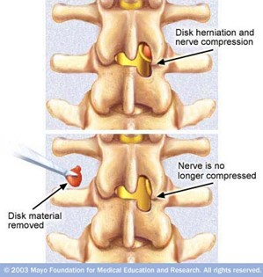
Diskectomy

Slide 30
Diskectomy
The Root Operation for Diskectomy is Excision or Resection:
Resection (T) – Cutting out or off, without replacement, all of a body part
Excision (B) – Cutting out or off, without replacement, a portion of a body part

Slide 31
Diskectomy
Code Detail = Body System:
For joints above the level of lumbar vertebrae, Body System = Upper Joints.
For joints at the level of lumbar vertebrae and below, Body System = Lower Joints.

Slide 32
Coding Clinic References
2nd Quarter 2014, pg 6-8
The advice taken from this is that diskectomy would be coded separately when done with spinal fusion.
If provider documents “total diskectomy”, it should be coded as a disc resection.

Slide 33
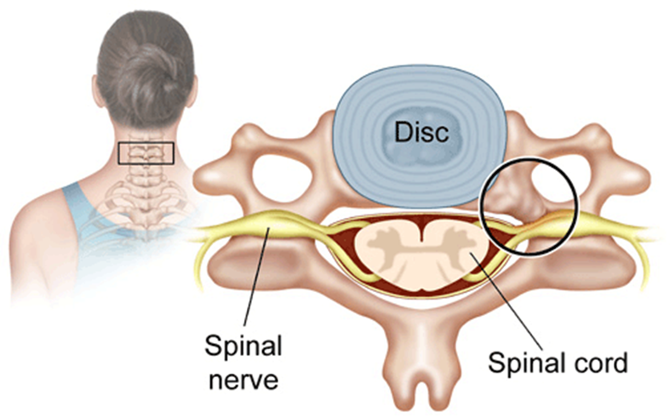
Decompression

Slide 34
Decompression
The Root Operation for Decompression is Release:
Release (N) – Freeing a body part from an abnormal physical constraint by cutting or by use of force

Slide 35
Decompression
Code Detail = Body System:
For decompression of spinal cord, Body System = Central Nervous System and Cranial Nerves.
For decompression of spinal nerves, Body System = Peripheral Nervous System.

Slide 36
Coding Clinic References
2nd Quarter 2015, pg 34
The advice taken from this is that “decompressive laminectomy” is done to release pressure and free up the spinal nerve root. This would be coded as a Release.
Previous Coding Clinic advised the assignment of Excision of Lamina. This was revisited and determined that Release is more appropriate.

Slide 37
Coding Clinic References
2nd Quarter 2016, pg 16
The advice taken from this is that when decompressive laminectomy/foraminotomy is performed with diskectomy, a code would be assigned for both procedures (Release and Excision).

Slide 38
Coding Clinic References
2nd Quarter 2016, pg 17
The advice taken from this is that when posterior longitudinal ligament is removed, this meets the objective of decompression of a nerve root. A additional code would be assigned for “Release”.

Slide 39
Decompression
Coding Note:
The provider must clearly document a disease process or symptom to support medical necessity and procedural intent that the laminotomy/laminectomy/foraminotomy is “decompressive”….not just the procedural approach.
NOTE: Laminotomies/Laminectomies/Foraminotomies that do not involve decompression are not coded!

Slide 40
Spinal Procedure Coding
Coding Practice – Code the following procedures!
2. Dx: Right L4-L5 lateral recess stenosis; herniated nucleus pulposus
Px: Right L4-L5 laminectomy, facetectomy, transforaminal diskectomy for decompression.

Slide 41
Answer!
2. Dx: Right L4-L5 lateral recess stenosis; herniated nucleus pulposus
Px: Right L4-L5 laminectomy, facetectomy, transforaminal diskectomy for decompression.
0SB20ZZ = Excision of Lumbar Vertebral Disc, Open Approach
01NB0ZZ = Release Lumbar Nerve, Open Approach

Slide 42
Associated Procedures
Some spinal surgeries have common associated procedures:
Bone Marrow Aspiration
Spinal Instrumentation

Slide 43
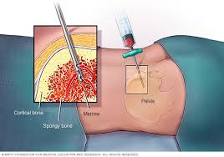
Bone Marrow Aspiration

Slide 44
Bone Marrow Aspiration
The Root Operation for BMA is Extraction:
Extraction (D) – Pulling or stripping out or off all or a portion of body part by the use of force

Slide 45
Bone Marrow Aspiration
Code Detail = Body System:
Bone Marrow is spongy tissue deep inside the bone, and the Body System = Lymphatic and Hemic Systems.

Slide 46
Bone Marrow Aspiration
Coding Note:
This procedure is done to harvest bone marrow for use in spinal fusions.
Coding Guideline B3.9:
If an autograft is obtained from a different procedure site in order to complete the objective of the procedure, a separate procedure is coded.

Slide 47
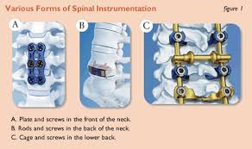
Spinal Instrumentation

Slide 48
Spinal Instrumentation
Coding Note:
Fixation instrumentation (rods, plates, screws) done along with fusion (interbody device, bone grafts) is included in the Fusion root operation and no additional code is assigned. This is to hold it in place while the fusion heals.
Fixation instrumentation done on other vertebral levels not fused, will be coded using the root operation of Insertion.

Slide 49
Coding Clinic References
2nd Quarter 2017, pg 23-24
The advice taken from this is that all spinal fusions involve the use of bone graft or bone graft substitute. If neither of these are used, it is not considered a spinal fusion.
NOTE: If instrumentation is applied (rods, screws, plates) without the use of bone grafting, this would be coded as an Insertion!

Slide 50
Spinal Procedure Coding
Coding Practice – Code the following procedures!
Dx: Degenerative disc disease with radiculopathy C5-C6, Spinal instability C4-C5
Px: Anterior cervical decompression, Fusion C5-C6 using PEEK interbody cage, Bone marrow aspiration from right iliac crest, and Instrumentation of C4-C5 with cervical plate

Slide 51
Spinal Procedure Coding
Operative Procedure: Patient was placed supine on the operative table, and all sites were prepped and draped. We made a stab incision to the right iliac crest, and aspirated 10 mL of bone marrow. This was soaked in allograft bone sponges. We approached the neck from the left side and dissected though the platysma and precervical fascia. We place Caspar pins in the C5-C6 level, identifying the correct level with C-arm fluoroscopy. We did a complete diskectomy at C5-C6. We released the posterior longitudinal ligament which made for nice foraminal decompression at this level. We prepared the PEEK interbody cage by filling it with local autograft and allograft bone sponges that had been soaked with bone marrow aspirate. This was then placed into C5-C6. Variable angle locking screws were placed at C5 and C6. A cervical plate was added to C4-C5 to provide stability. A drain was placed deep in the platysma. Layered closure was performed, followed by Mastisol and Steri-Strips for the skin. Sterile dressings and cervical collar was placed on the neck. Patient was awakened from anesthesia.

Slide 52
Spinal Procedure Coding
Operative Procedure: Patient was placed supine on the operative table, and all sites were prepped and draped. We made a stab incision to the right iliac crest, and aspirated 10 mL of bone marrow. This was soaked in allograft bone sponges. We approached the neck from the left side and dissected though the platysma and precervical fascia. We place Caspar pins in the C5-C6 level, identifying the correct level with C-arm fluoroscopy. We did a complete diskectomy at C5-C6. We released the posterior longitudinal ligament which made for nice foraminal decompression at this level. We prepared the PEEK interbody cage by filling it with local autograft and allograft bone sponges that had been soaked with bone marrow aspirate. This was then placed into C5-C6. Variable angle locking screws were placed at C5 and C6. A cervical plate was added to C4-C5 to provide stability. A drain was placed deep in the platysma. Layered closure was performed, followed by Mastisol and Steri-Strips for the skin. Sterile dressings and cervical collar was placed on the neck. Patient was awakened from anesthesia.

Slide 53
Answer!
Dx: Degenerative disc disease with radiculopathy C5-C6, Spinal instability C4-C5
Px: Anterior cervical decompression, Fusion C5-C6 using PEEK interbody cage, Bone marrow aspiration from right iliac crest, and Instrumentation of C4-C5 with cervical plate
0RG10A0 = Fusion of Cervical Vertebral Joint with Interbody Fusion Device, Anterior Approach, Anterior Column, Open Approach
0RT30ZZ = Resection of Cervical Vertebral Disc, Open Approach
01N10ZZ = Release Cervical Nerve, Open Approach
07DR3ZZ = Extraction of Iliac Bone Marrow, Percutaneous Approach
0RH104Z = Insertion of Internal Fixation Device into Cervical Vertebral Joint, Open Approach

Slide 54
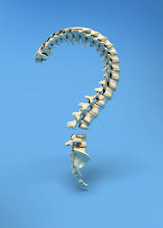
ANY QUESTIONS?

