Slide 1
MACHINE WAREWASHING PROCEDURES
DISHMACHINE SET-UP
FLATWARE
PRESOAK / WASH
DISHWASHING
CLEAN - UP
STORAGE

Slide 2
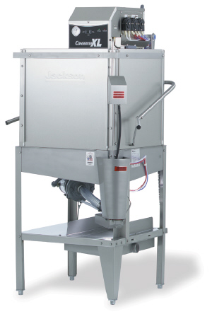
Dishmachine Wall Chart
Low Temp
SET-UP PROCEDURES
Check that machine is clean. Check wash arms, scrap trays, and pump intake screen to ensure good water pressure.
Revise Las paletas de lavado , la rejilla del accumulador de desperdicios y la de la bomba de toma a fin de asegurarse de gue esten limpias y debidamente colocadas para proporcionar una presion de lavado adecuada.
Check detergent, rinse and sanitizer pails. Replace any empty containers.
Verifiez le reservoir de detergent et le bol a additif. Remplacer les contentants vides et les remplir au besoin.
Clear dish table area and fill presoak tub, using liquid presoak.
Videz le panier a vaisselle et remplissez la cuve a countellerie soit de Liquid Presoak
Turn dishmachine on. Fill dishmachine with water.
Mettez la machine en marche. Elle se remplit d eau
WASHING PROCEDURES
After hand scraping, rack the dishes of the same size together in straight rows. Do not overlap causing poor cleaning action. Place cups and glasses upside down.
Apres avoir enleve le plus gros, Tasses et verres a l’envers.
Pre-rinse dishes.
Preenjuague los platos
Side dish rack into machine and close to door. Machine will automatically start to wash, wash and sanitizer each load.
When the cycle is complete, remove the rack and allow dishes to air dry. Lift rack up on to the lip of the clean dish table to allow air to flow under that rack to speed up drying.
Jackson Dishmachine
Cuando se haya completado el ciclo, saque le protlatos y deje que los platos se sequen al aire.
CLEAN-UP PROCEDURES
Unswcrew the was arms and end caps. Clean by flushing wash arms under a faucet. Reinstall end caps and wash arms .
Desatornille las paletas de lavado y las tapas de los extremos. Limpie las paletas de lavdo, enjuagandolas debajo de un grifo antas de reinstalarlos en el aparto.
Clean pump intake screen by flushing and scrubbing. Return screen to original position.
Lave la rejilla de la bomba de toma, enjuagandola y res pandola. Vuelva a ponerla en su posicion original.
Remove scrap accumulator screen. Remove food soil and flush the screen. Reinstall screen
Quite la rejilla del acumulador de desperdicious .remueva la mugre de los alimentos y lave la rejilla con agua. Vuelva a instalarla
24 Hour Service
Wipe the dishmachine with a clean towel. Be sure machine is clean and ready for the next shift.
Limpie el lavaplatos con una toalla limpia. Asegurese de que la maquina quede lista para el turno siguiente.

