Slide 1
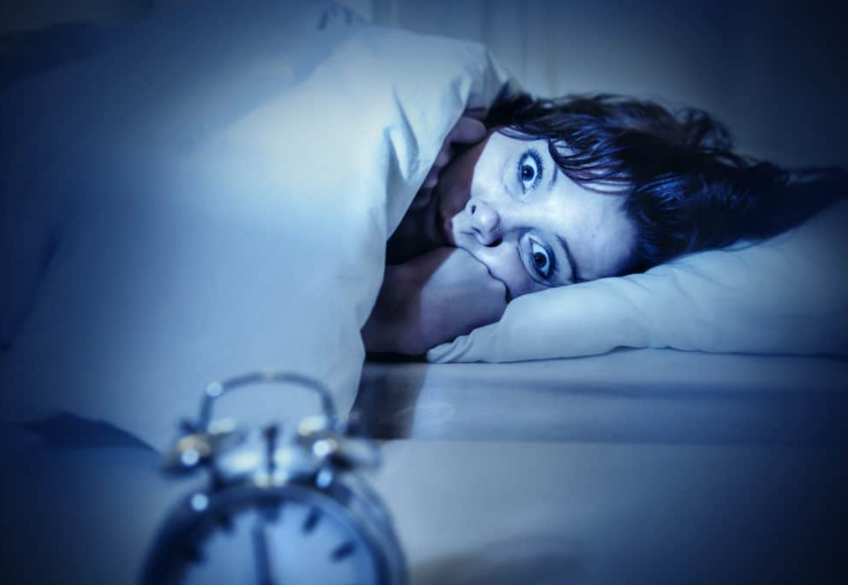
Cases in sleep medicine that keep you up at night
Lauren Tobias MD
Medical Director, Sleep Medicine Program
Veterans Affairs Connecticut Healthcare System
Assistant Professor of Medicine
Pulmonary, Critical Care & Sleep Medicine
Yale University School of Medicine
September 6, 2019
Notes:
Welcome everyone. I am delighted to be back here at NEPS. Today I’m going to discuss the relationship between Obesity & Sleep

Slide 2
Objective
To review some cases of common and not-so-common sleep disorders and their management

Slide 3
Case #1
47 yo male with depression, prior heroin use for which he now takes methadone presents for evaluation of daytime fatigue. He doesn’t snore but his girlfriend reports hearing him stop breathing frequently during the night.

Slide 4
Case #1 PSG
Notes:
5 min epoch
Example of periodic breathing, central apneas, and ataxic breathing pattern in a patient on chronic opioids

Slide 5
Central apneas in a patient on chronic opioids
Notes:
5 min epoch
Example of periodic breathing, central apneas, and ataxic breathing pattern in a patient on chronic opioids
SHOW OF HANDS IF YOU’VE SEEN THIS?

Slide 6
The opioid epidemic is a public health crisis
In the US, opioids are:
used by 92 million
misused by 12 million
opioid use disorder in 2 million
Overdose-related deaths >130 people/day in US
Economic burden $78.5 billion/year
Late 1990s: increased promotion of opioids by pharmaceuticals and dramatically higher prescribing rates by healthcare providers
Notes:
Economic burden: healthcare, lost productivity, addiction treatment, and criminal justice involvement

Slide 7
Opioid Prescription Rates
Notes:
- Recent FDA analysis of commercially available data showed steep drops in dispensing of opioid analgesics in retail outpatient settings. In the first six months of 201
- Quantities of opioid analgesics dispensed from retail pharmacies approach the lowest levels in 15 years, the volume of opioid analgesics dispensed down more than 16%from the first half of 2017,

Slide 8
Opioid Use Disrupts Sleep Architecture
Acute use:
More frequent shifts in sleep states
Increased arousals
↑N2, ↓N3, ↓ REM
Chronic Use
↓ TST, ↓ N3, ↓ sleep efficiency
Withdrawal may cause insomnia, increased arousals, REM rebound
Increased daytime sleepiness and fatigue
Notes:
- Recent FDA analysis of commercially available data showed steep drops in dispensing of opioid analgesics in retail outpatient settings. In the first six months of 201
- Quantities of opioid analgesics dispensed from retail pharmacies approach the lowest levels in 15 years, the volume of opioid analgesics dispensed down more than 16%from the first half of 2017,

Slide 9
Opioid use is associated with several types of abnormal breathing patterns
30-90% of patients on chronic opioids have some form of SDB (CSA most common)
Notes:
ATAXIC BREATHING: significant disorganization with irregular and varying depths of respiration BIOT RESPIRATION: irregularly interspersed periods of apnea in a disorganized sequence of breaths. (Of note, increased ICP or brain damage (eg. Medullary) can also result in this type of respiration)

Slide 10
Risk factors for SDB in chronic opioid users
Dose: daily doses greater than 200 mg morphine dose equivalents confer higher risk
BMI: low to low-normal body mass index
Type of opioid less important than morphine dose equivalent
Concomitant antidepressant and benzodiazepine use
200 morphine mg equivalents (MME)
Methadone 40mg
Oxycodone 120mg
Hydrocodone 200
Notes:
- Recent FDA analysis of commercially available data showed steep drops in dispensing of opioid analgesics in retail outpatient settings. In the first six months of 201
- Quantities of opioid analgesics dispensed from retail pharmacies approach the lowest levels in 15 years, the volume of opioid analgesics dispensed down more than 16%from the first half of 2017,

Slide 11
Opioid use affects respiratory control
Enhances relaxation of upper airway musculature
Altered hypoxic and hypercapnic ventilatory responses
Depression of respiratory rhythm generation (suppressed brainstem pacemaker)
Notes:
2 distinct respira-tory rhythm generators located in the ventrolateralmedullary portion of the neonatal rat brainstem,the pre-Bo ̈tzinger complex (pre-BotC) and the ret-rotrapezoid nucleus/parafacial respiratory group,which are normally coupled and generate normalrespiratory rhythm

Slide 12
Managing SDB caused by opioid use
Consider use of end-tidalCO2 (PETCO2) monitoring when ordering PSG -- we probably under-diagnose hypercapnia in these pts
Attempt dose reduction when possible
Substitute nonopioid & nonpharmacologic analgesics
Unclear whether to treat – lack of outcomes data
Consider ASV vs. bilevel ventilation
Counsel on avoiding drowsy driving
Notes:
2 distinct respira-tory rhythm generators located in the ventrolateralmedullary portion of the neonatal rat brainstem,the pre-Bo ̈tzinger complex (pre-BotC) and the ret-rotrapezoid nucleus/parafacial respiratory group,which are normally coupled and generate normalrespiratory rhythm
Best data for ASV but studies small – caution given SERVE-HF resuts – but increased mortality in HF pts should not be extrapolated to the opioid user population

Slide 13
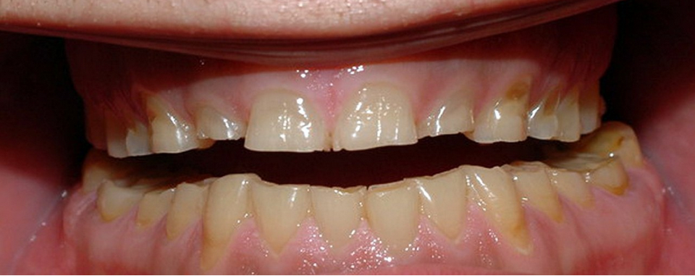
Case #2
53 year old male with a history of anxiety presents because his wife has been bothered by unbearable tooth grinding noises he makes during sleep. He also notices pain in his jaw upon awakening about 50% of nights. At his last dental visit, abnormal wear was noted on his teeth.

Slide 14
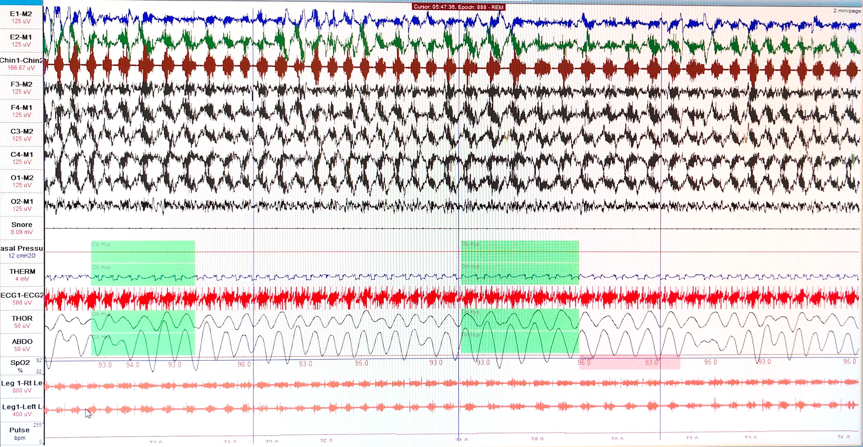
2 –minute epoch
Notes:
This is a clinical diagnosis – don’t need to get a PSG

Slide 15
Sleep Bruxism
Repetitive jaw-muscle activity characterized by clenching or grinding of the teeth and/or by bracing or thrusting of the mandible
Type of “Sleep-related movement disorder”
Usually seen in NREM stages 1 & 2
Up to 40% of children, 8% of adults, ♀ = ♂
May report jaw discomfort, morning headaches or tooth wear noted by dentist
Mayer P et al, CHEST 2016; 149(1):262-271

Slide 16
Diagnosing Sleep Bruxism
The presence of regular or frequent tooth-grinding sounds occurring during sleep
and
The presence of one or more of the following clinical signs:
Abnormal tooth wear consistent with above reports of tooth grinding during sleep
Transient morning jaw muscle pain or fatigue, and/or temporal headache, and/or jaw locking upon awakening consistent with above reports of tooth grinding during sleep
International Classification of Sleep Disorders, Third Edition (ICSD-3)
Notes:
Polysomnography is not required for the diagnosisv

Slide 17
Sleep bruxism on PSG
Repetitive and recurrent episodes of rhythmic masticatory muscle activity (RMMA)
Usually associated with sleep arousals
Definition: at least 3 consecutive EMG bursts (frequency 1 Hz) lasting ≥0.25 seconds on the masseter and temporalis channels
Notes:
Additional surface electromyography (EMG) electrodes can be placed over the masseter and temporal muscles to increase the sensitivity of detecting bruxism episodes on polysomnograph

Slide 18
Another example of sleep bruxism
Mayer P et al, CHEST 2016; 149(1):262-271
Notes:
Additional surface electromyography (EMG) electrodes can be placed over the masseter and temporal muscles to increase the sensitivity of detecting bruxism episodes on polysomnograph

Slide 19
Genesis of an RMMA episode
Dent Clin N Am 56 (2012) 387–413
Notes:
**SLEEP BRUXISM IS most likely a centrally-mediated phenomenon related to micro-arousals from sleep and activation of the autonomic nervous system. **
It has been well demonstrated that RMMA onset is associated with a sequence of physiologic events that occur within a sleep arousal.
Genesis of most RMMA episodes is preceded by the following cascade of events:
1. increase in the autonomic sympathetic-cardiac activity with a concomitant withdrawal of parasympathetic influences
2. Appearance of rapid-frequency EEG cortical activity (sleep arousal)
3. Approximately 25% increase of heart rate concomitant with increase in EMG activity of the jaw opener muscle concomitant
with an increase in the airflow amplitude visible as two big breaths preceding or concomitant with an increase in diastolic and systolic blood pressure
4. An observable EMG incident in the jaw-closing muscles (masseter and temporalis), scored as RMMA with or without tooth-grinding sounds
5. Almost 60% of RMMA episodes are followed in the 5 to 15 seconds after onset by swallowing

Slide 20
Risk factors for bruxism
Certain medications/substances
amphetamines, antipsychotics, antidepressants
Neurologic/psychiatric disorders (ADHD, Down syndrome)
Nothing to do with anatomical factors like dental occlusion!
Risk Factor | Odds Ratio
OSA | 1.8
Smoking | 1.8
Caffeine intake | 1.4
Smoking | 1.4
Anxiety | 1.3
Highly stressful life circumstances | 1.3
Ohayon MM et al, CHEST 2001; 119:53– 61

Slide 21
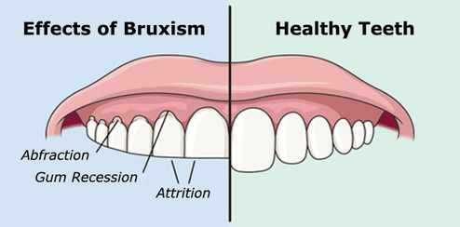
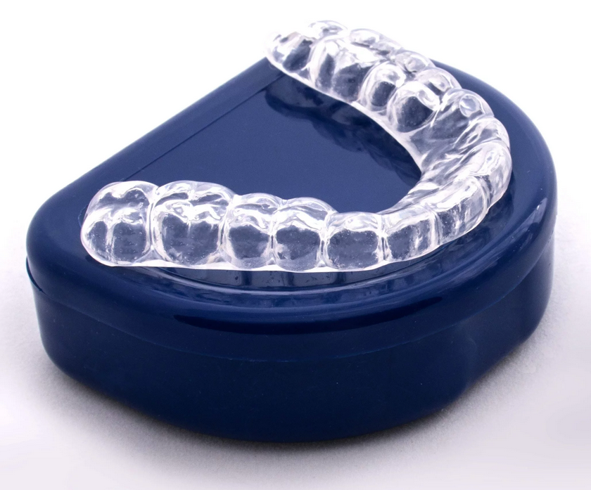
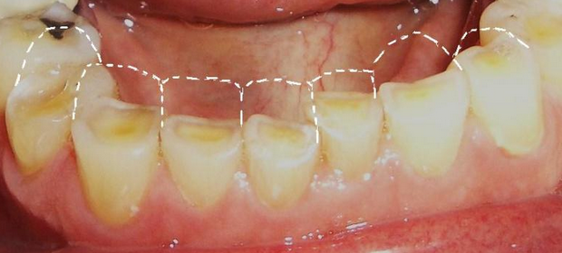
Treating Bruxism
Goal to reduce the tooth grinding sound & tooth destruction, prevent/alleviate temporomandibular disorder discomfort/headache
Evidence for behavioral strategies is mixed (avoiding triggers, relaxation techniques, biofeedback)
Occlusal splints to protect dental surfaces
Several medications have been tried, none consistently improve symptoms or bruxism on EMG
Notes:
most management strategies are not yet fully evidence-based; most are derived from mechanistic studies, case reports, or small sample size studies assessing treatment efficacy on the short-term only
- occlusal splints tend to reduce RMMA in the short term only, with a return to baseline within 7 to 10 days -- use is justified by the fact that they prevent tooth damage. upper maxillary splint appears to be contraindicated when SDB is suspected because of the risk of apnea-hypopnea aggravation.
-Best evidence for clonidine & clonazepam but even that is MIXED

Slide 22
Treating Bruxism
CPAP for patients with OSA in addition to bruxism
When sleep bruxism is related to OSA, successful treatment of breathing abnormalities may eliminate bruxism during sleep
Oksenberg A et al, Sleep Medicine 3 (2002) 513–515
Notes:
Initially it was thought that SDB is a cause of bruxism, but this hasn’t been borne out by recent studies. Most studies have found NO INCREASED PREVALENCE of sleep bruxism in SDB pts compared with controls.

Slide 23
Case #3
Rachel L. Smith is a 32 yo woman with unrefreshing sleep for the past 5 years, worsened during her recent pregnancy. She describes feeling “like ants are crawling up my legs” prior to falling asleep. Symptoms worsened during her recent pregnancy. She notices that symptoms are worse when she doesn’t get enough sleep. Her symptoms were also worse when she took Benadryl for a stuffy nose last week.

Slide 24
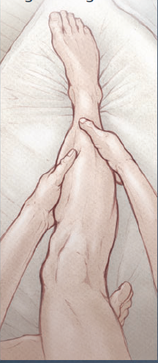
Restless Legs Syndrome (RLS)
Unpleasant, uncomfortable urge to move the legs
Worst when inactive & in evening
Relieved with movement
May affect upper extremities as well

Slide 25
RLS: Background
~7% of US adults; clinically significant in 2-3%
Most prevalent in Northern European countries
Can start at any age from childhood into late adult life
Strong genetic component (+ Family Hx in 50%)
Significant impact on quality of life and possible risk factor for cardiovascular disease

Slide 26
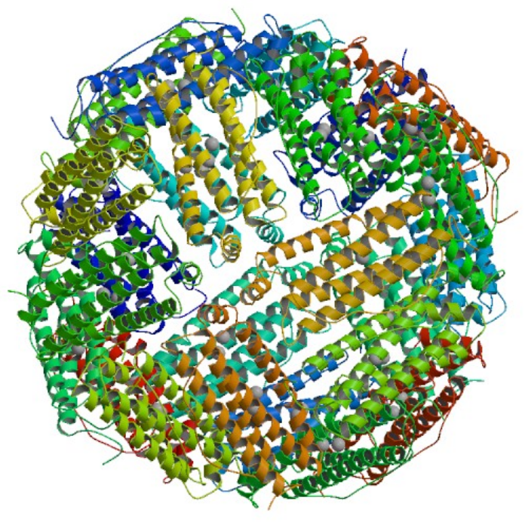
RLS: Etiology
Reduced central iron stores
Lower ferritin in cerebrospinal fluid
Reduced iron stores on brain MRI
Altered dopamine signaling
RLS Sx improve with dopaminergic therapy
Notes:
Pics: Ferritin on top, dopamine on bottom
MRI shows reduced iron stores in striatum & thalamus

Slide 27
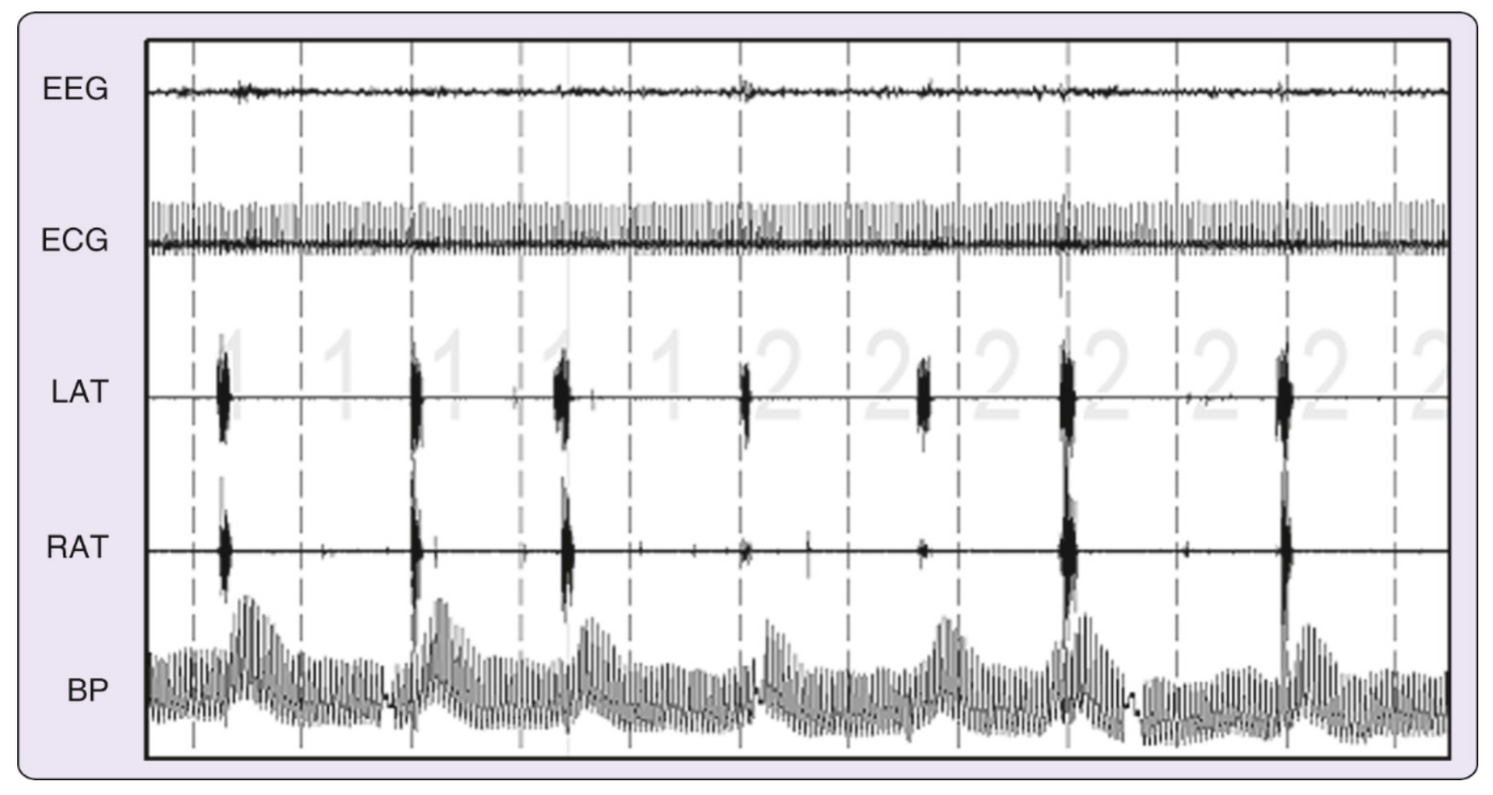
RLS: Evaluation
Diagnosis based on symptoms, not PSG
>80% of RLS pts will have PLMs on PSG
RLS ≠ PLMD (mutually exclusive)

Slide 28
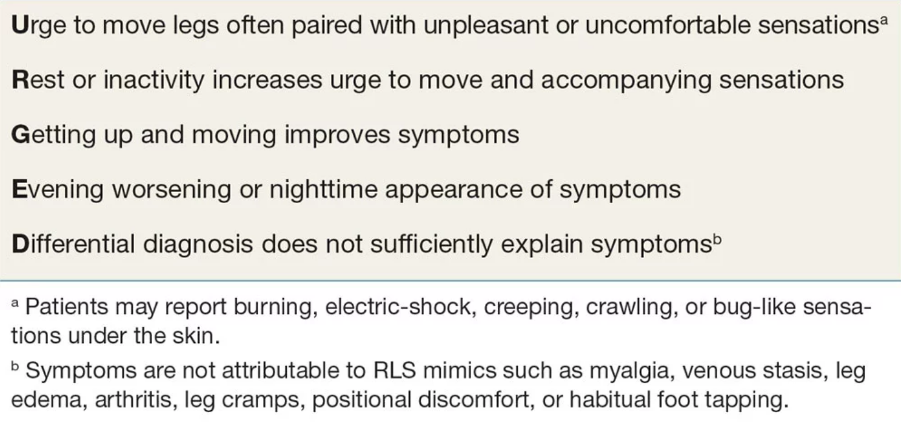
RLS Diagnostic Criteria
2012 Revised International Restless Legs Syndrome Study Group Diagnostic Criteria for RLS
Notes:
Patient descriptions: pulling, jittering, worms or insects moving, tingling, itching, aching, bubbling, fidgeting, electric current sensations, tightness, throbbing

Slide 29
RLS Diagnostic Criteria
2012 Revised International Restless Legs Syndrome Study Group Diagnostic Criteria for RLS

Slide 30
RLS Diagnostic Criteria
2012 Revised International Restless Legs Syndrome Study Group Diagnostic Criteria for RLS

Slide 31
RLS Diagnostic Criteria
2012 Revised International Restless Legs Syndrome Study Group Diagnostic Criteria for RLS

Slide 32
RLS Diagnostic Criteria
2012 Revised International Restless Legs Syndrome Study Group Diagnostic Criteria for RLS

Slide 33
RLS Mimics
peripheral neuropathy
nocturnal leg cramps
akathisia
parkinsonism with sensory symptoms
drug-induced dyskinesias
arthritis
hypnic jerks/sleep starts
peripheral vascular disease
varicose veins

Slide 34
RLS: Comorbid conditions
Uremia (up to 65% of pts w/CKD)
Iron deficiency anemia
Pregnancy (15-30%)
Notes:
RLS may be primary/idiopathic or secondary to another condition
Anemia and compromised iron regulation in pts w/CKD can predispose to RLS

Slide 35
RLS: Exacerbating factors
Medications
Antidepressants (mirtazapine, SSRIs, SNRIs, possibly TCAs, not bupropion)
Antihistamines
Dopaminergic antagonists (antipsychotics, antiemetics)
Caffeine
Alcohol
Smoking
Sleep deprivation
Notes:
Antiemetics such as reglan

Slide 36
RLS: Treatment options
Decide whether treatment is even necessary
often not if mild, only ~20% require meds
Check ferritin level and if under 75 ng/mL, consider iron supplementation
Usually oral iron + vitamin C
IV iron in severe cases
Behavioral strategies
Get sufficient sleep
Reduce caffeine
Moderate regular exercise
Stop aggravating meds
Notes:
A serum ferritin concentration lower than 45 to 50 mcg/L (ng/mL) has been associated with an increased severity of restless legs syndrome (RLS), and oral iron replacement is suggested if the fasting serum ferritin level ≤75 mcg/L

Slide 37
RLS: Pharmacologic treatment options
alpha-2-delta calcium channel ligands usually 1st line
especially if comorbid insomnia or anxiety is present
may cause weight gain, somnolence, unsteadiness
eg. gabapentin, pregabalin
dopamine agonists 2nd line
eg. ropinarole, pramipexole
opioids
benzodiazepines

Slide 38
2 major problems associated with dopamine agonists
Impulse control disorders
pathologic gambling, compulsive eating and shopping, and compulsive inappropriate hypersexuality
Associated with higher dose, history of experimental drug use, female sex
May affect up to 20% of patients
Augmentation
worsening of RLS symptoms with increasing doses of medication
earlier Sx onset, increased intensity, shorter duration of drug action, Sx spread to involve arms

Slide 39
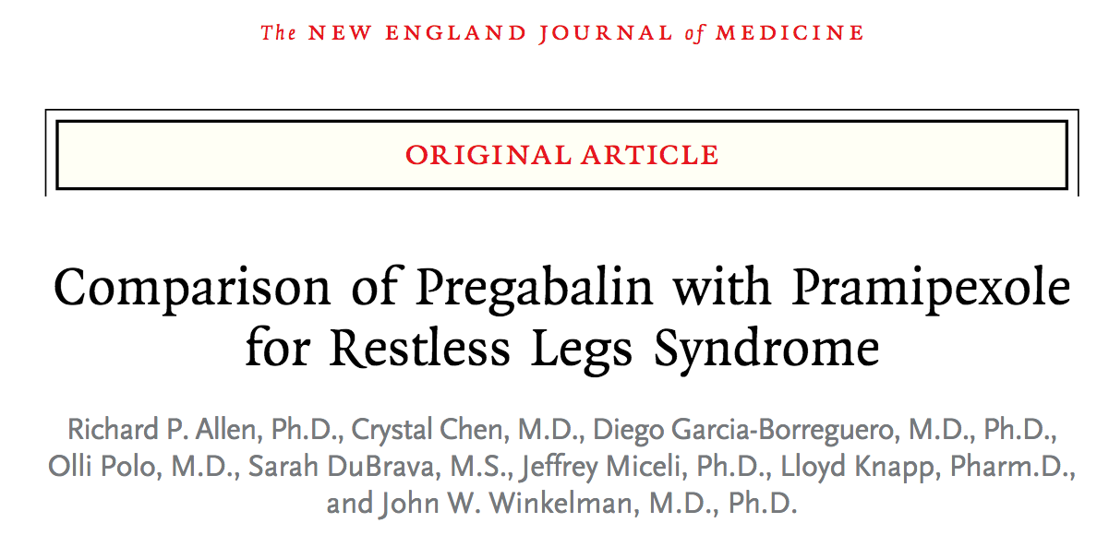
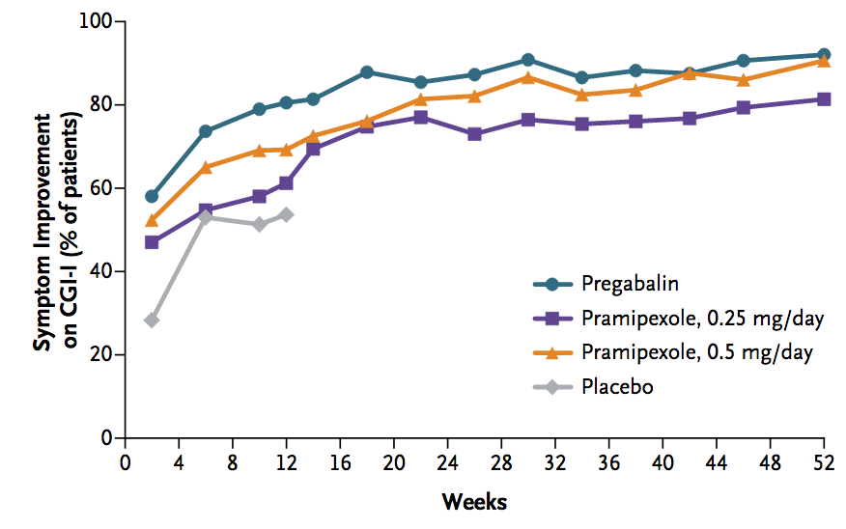
52-weeks, >700 pts
Both pregabalin & pramipexole improved Sx
Lower rates of augmentation with pregabalin than pramipexole (2% vs. 7-9%)
Notes:
Practice-changing article
Figure on upper right shows participants with clinically significant Sx improvement as measured by the Clinical Global Impression of Improvement (CGI-I). At 52 wks, proportion of pts w/clinically signif improved Sx were 72% with pregabalin, 57% and 68% w/pramipexole 0.25 and 0.5 mg respectively

Slide 40
Case #3 Conclusion
Serum ferritin level was measured and found to be low at 24 ng/mL. Oral iron supplementation was started.
She was advised to discuss switching fluoxetine (Prozac) to bupropion (Wellbutrin) with her psychiatrist.
RLS triggers including antihistamines and insufficient sleep were reviewed.
Although her ferritin level increased, RLS symptoms continued after so she was started on gabapentin and symptoms improved.

Slide 41
Case #4
A healthy 25 yo female graduate student presents in late January due to concerns that the FitBit she received for Christmas shows a high percentage of “light” sleep. She is committed to a healthy lifestyle with good eating habits and regular physical activity. She has no specific sleep complaints but wants to ensure she is maximizing her sleep quality to facilitate optimal daytime functioning and productivity.
Collen JF et al. J Clin Sleep Med. 2019;15(8):1077–1078.

Slide 42
Case #4
Wearable sleep trackers are big business: global revenues over $2 billion in 2018
Success of devices depends on the market, not clinical evidence
Collen JF et al. J Clin Sleep Med. 2019;15(8):1077–1078.

Slide 43
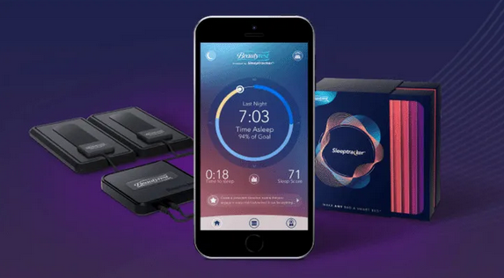
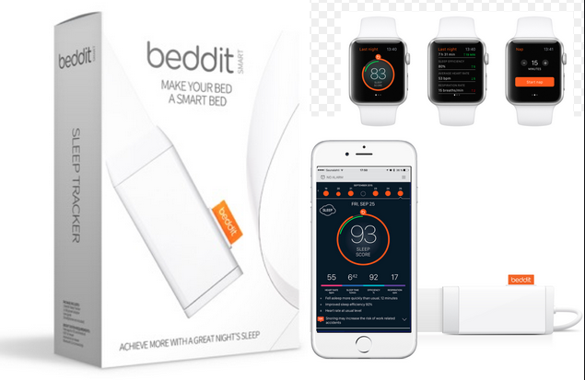
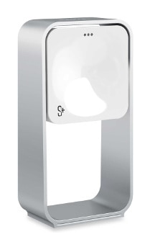
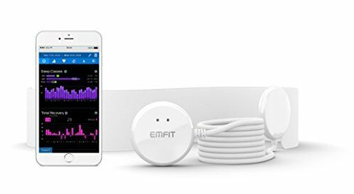
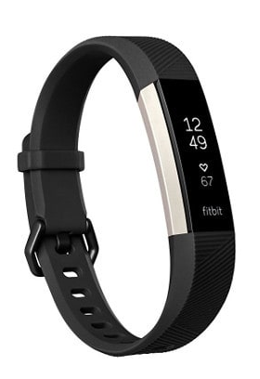
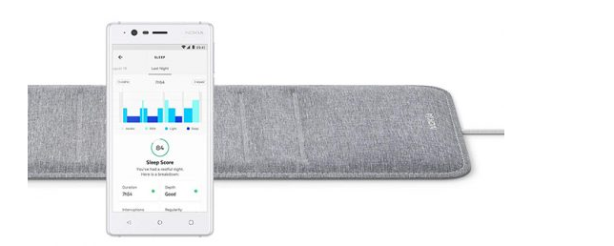
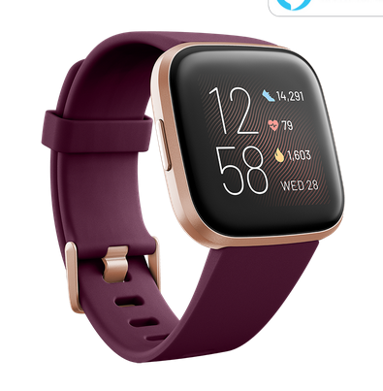
Many consumer sleep tracking devices available
Notes:
Many pair a smartphone with other sensors (e.g., micro-phone) or external sensors (oximeter).

Slide 44
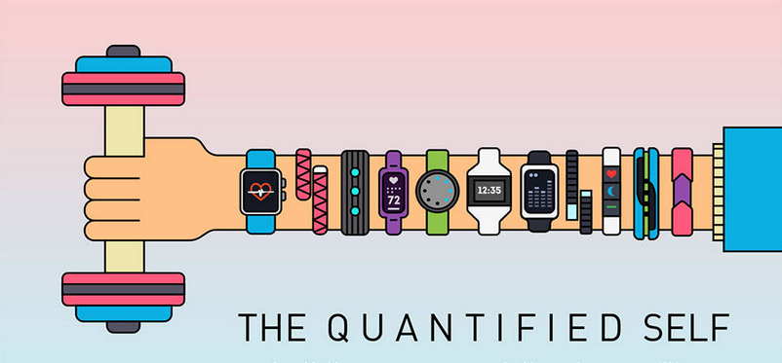
What do sleep trackers claim to measure?
Sleep duration: tracking time you’re inactive
Sleep quality: detecting “interrupted sleep”
Sleep phases: track “phases” of sleep and time alarm to go off during lighter sleep
Environmental factors: Some record environmental eg. amount of light or temperature in bedroom
Lifestyle factors: Some trackers prompt you to enter information about activities that can affect sleep, such as caffeine intake, meal times and stress level

Slide 45
What do sleep trackers actually measure?
Data depends on sensor type (accelerometer vs. noise)
Proprietary/undisclosed definition of how “sleep” is determined
Mostly validated in healthy sleepers (not always representative of our patients)
Lack of evidence-based guidance on how to use the data

Slide 46
Wearable sleep trackers: What we know
Among healthy sleepers, devices appear comparable to actigraphy
Generally high agreement between the different wrist worn devices and moderate to poor agreement between sleep measured these devices compared to PSG
Among pts w/insomnia, devices tend to:
overestimate TST (by ~20-60 min)
overestimate sleep efficiency
underestimate sleep onset latency
underestimate WASO
Net effect is that wrist actigraphy overestimates sleep problems in pts with insomnia
Jumabhoy R et al 2017 Sleep suppl A288-289.
Notes:
Pts with insomnia have POOR sleep and LOW activity levels

Slide 47
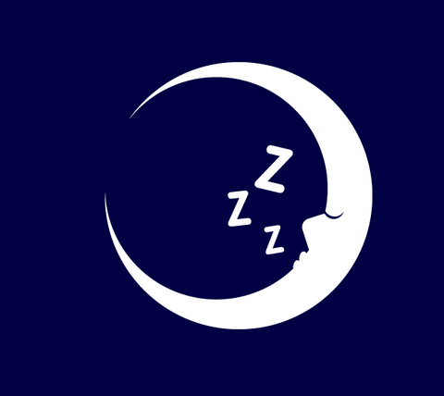
Potential benefits of sleep trackers
Self-monitoring may promote patient involvement and encourage healthy behaviors
Appeal of a cost-effective, portable and reliable measuring device to study sleep in home settings
Potential to improve the current mismatch between supply and demand for CBTi, by connecting pts to internet-based Tx for insomnia
Might improve communication between patients and providers by stimulating conversation about device output

Slide 48
Potential problems with sleep trackers
Studies show that people who used iPads instead of reading print before bedtime go to bed later
Light at night suppresses melatonin → delayed melatonin production
Health apps don’t necessarily make people healthier
Need to consider the specific population
eg. perhaps most useful in encouraging longer sleep opportunity but less useful for those who already allow for adequate sleep opportunity, but unable to achieve sufficient sleep duration due to the presence of insomnia or OSA

Slide 49
Case #5
A 50 yo woman complained of severe difficulty sleeping for over a decade. She felt she hardly ever sleep, and was never being able to sleep more than 3 hours each night. She stated that she remained in bed awake for the majority of each night. She felt fatigued upon awakening but denied daytime sleepiness or unintentional dozing. She had tried several different sleep aids in the past without benefit.

Slide 50
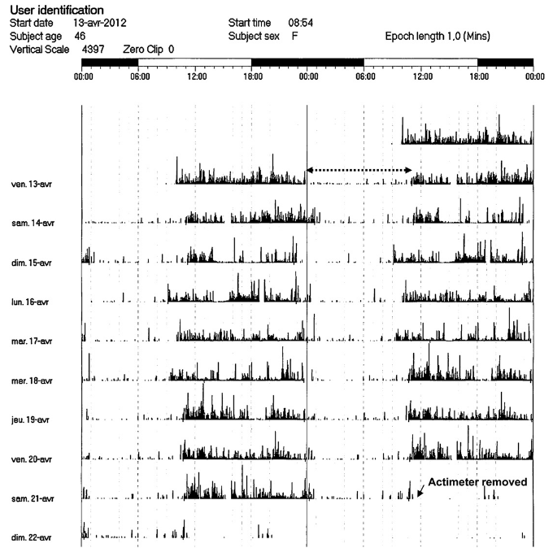
Case #5 Sleep Log
Notes:
Patient’s double plot actogram recorded during a 1-week vacation. Recordings were made at 1-minute intervals. The second cycle on a line isthe same as the first cycle on the following line. Home polysomnography was performed on the night of April 13 (dotted arrow

Slide 51
Paradoxical Insomnia
Discrepancy between estimated and objective sleep time calculated on PSG
Previously called “sleep state misperception”
Patients report severe sleep disturbance (little or no sleep on many nights) BUT only mild daytime impairment inconsistent with degree of sleep deprivation reported

Slide 52
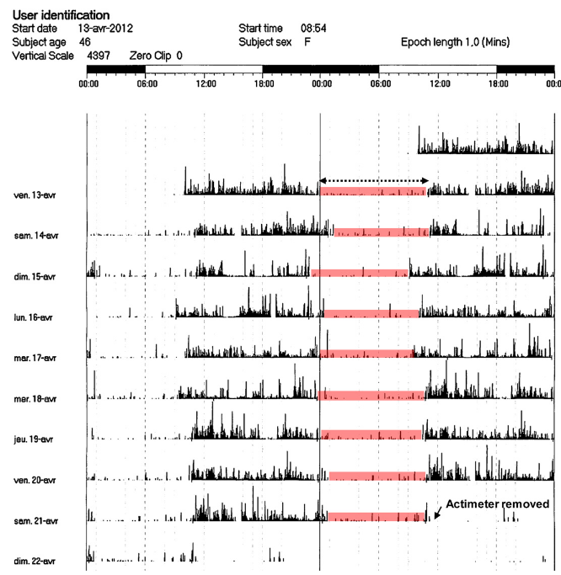
Actogram consistently showed nocturnal sleep periods of 8 hours or more
Notes:
Patient’s double plot actogram recorded during a 1-week vacation. Recordings were made at 1-minute intervals. The second cycle on a line isthe same as the first cycle on the following line. Home polysomnography was performed on the night of April 13 (dotted arrow

Slide 53
Paradoxical Insomnia
Sleep diary usually consistent with pt’s symptoms but objective evidence (PSG) indicates lack of severe sleep disturbance and no significant deficits in TST
Patients may have difficulty believing the diagnosis and blame PSG results on faulty sensors or measurement techniques.
Treatment is cognitive behavioral therapy for insomnia (CBTi)
review of PSG with video, exploration of the discrepancy between their reported and observed sleep experience

Slide 54
Take-home points
Opioid use is common and often associated with sleep-disordered breathing
Bruxism is characterized by recurrent episodes of rhythmic masticatory muscle activity (RMMA)
RLS is a clinical diagnosis distinct from PLMD
Consumer sleep trackers are becoming increasingly common and their appropriate use remains to be clarified
Paradoxical insomnia may be suspected when a patient reports severe insomnia without significant daytime impairment
Notes:
But need larger & more robust studies to confirm maternal & fetal benefit

Slide 55
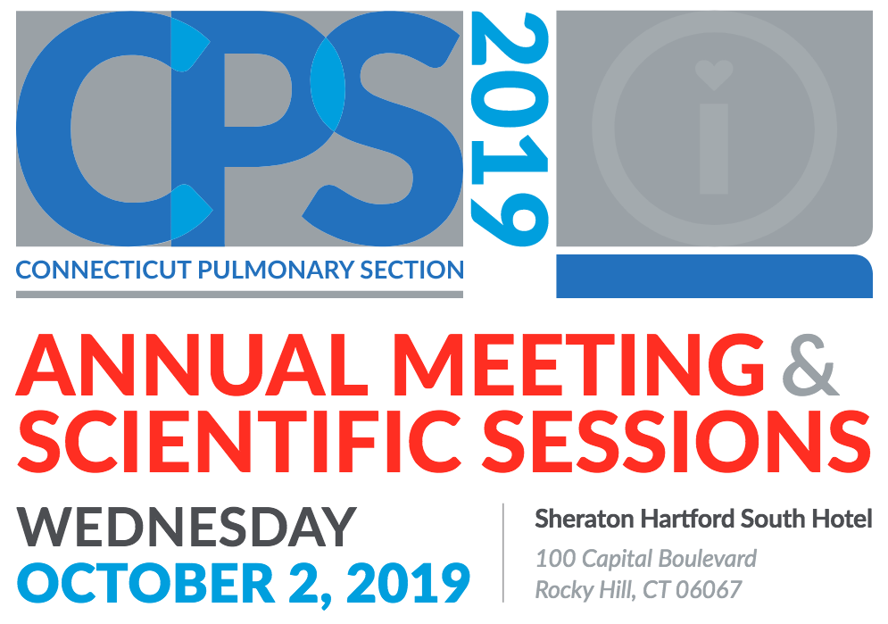
Does Peak Inspiratory Flow Rate Matter in Patients with COPD?: Curtis Mello, MD, MPH, FCCP, Southcoast Health Medicine Care Center
Electronic Cigarettes from the Pulmonologist Perspective: Mario F. Perez, MD, MPH, UConn Health
Sleep Science and Wearable Devices: Ana C. Krieger, MD, MPH, Weill Cornell Medicine
Critical Care Ultrasound Cases: Moderated by Ian Weir, DO, Norwalk Hospital
Notes:
But need larger & more robust studies to confirm maternal & fetal benefit

Slide 56
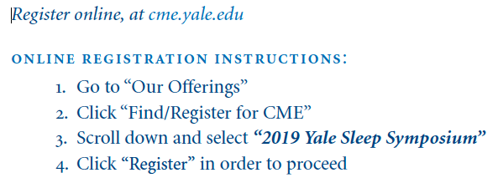
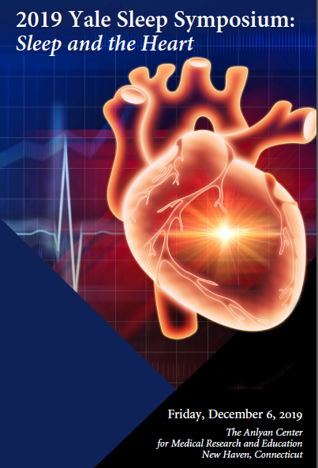
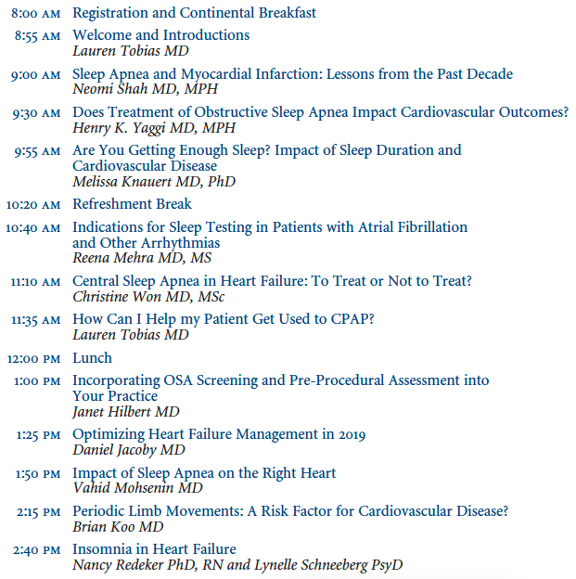
Notes:
But need larger & more robust studies to confirm maternal & fetal benefit

Slide 57
Thank you! Questions
Lauren.Tobias@yale.edu

