Slide 1
LEARNING DIFFERENCES: Multiple Intelligences (Dr. Howard Gardner theory) Learning Styles
Dr. Mary Custureri
Notes:
Although many studies have been conducted to reveal different learning style patterns, perhaps the easiest to understand is that of Dr. Howard Gardner, who wrote a number of books about his theory of multiple intelligences.

Slide 2
Who are we? Where do we fit?
We were created equal
Yet, each of us is unique
We have multiple intelligences, different abilities, different backgrounds.
Yet, we affect one another as we live in a world that is constantly changing.
Notes:
In Custureri, Mary. Strategies: Helping all Students Succeed. Washington, D.C.: NCTE, 2004)

Slide 3
8 Multiple Intelligences
Linguistic intelligence: writers (Byron)
Logical mathematical: scientists (Einstein)
Spatial/visual: architects, painters, physicists
Musical/rhythmic: musicians, singers, composers
Kinesthetic: athletes, dancers, actors, surgeons
Interpersonal intelligence: Oprah Winfrey, psychologists
Intrapersonal intelligence: to know oneself: philosophers, counselors, Teresa of Avila
Naturalist: environmentalist, gardner, biologist
Notes:
These are some of the main intelligences referred to by Gardner. Note how each intelligence has manifested itself in many ways.
Can you think of any other people in the news today who seem to possess these intelligences strongly?

Slide 4
Two major academic intelligences
LINGUISTIC
Verbal fluency
Authors
Teachers
Speakers
Writers
Public relations
Talk show hosts
MATHEMATICAL
Logical mathematical
Mathematicians
Scientists
Math teachers
Researchers
statisticians

Slide 5
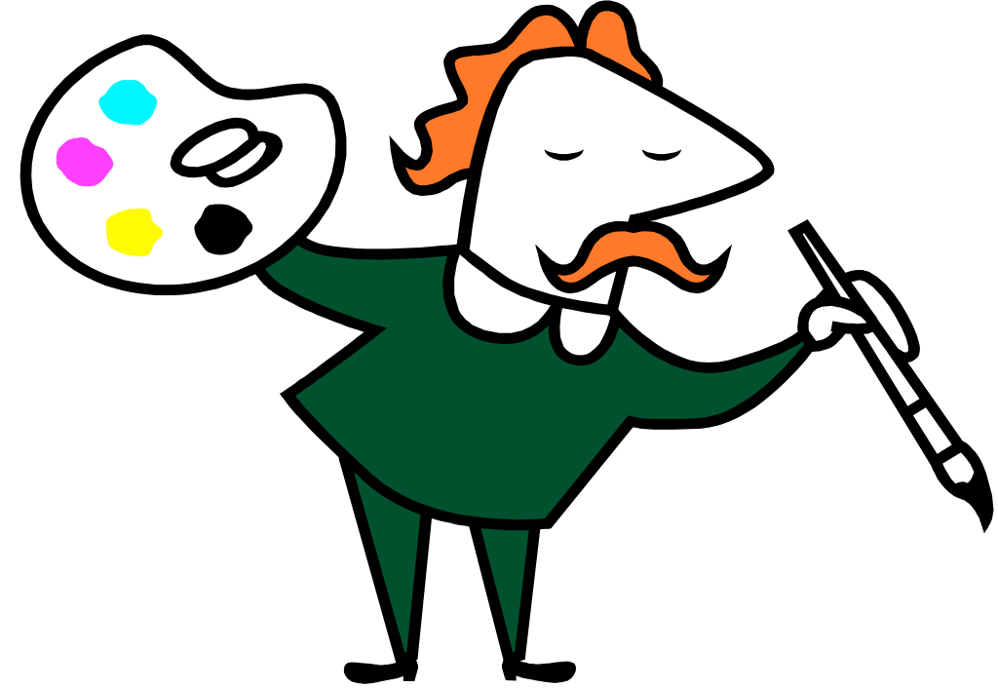
Spatial intelligence
Visualize and manipulate patterns
Artists
Architects
Surgeons
Sculptors
Navigators
pilots
Notes:
People possessing spatial intelligence seem better able to visualize patterns. They make good artists, architects, surgeons, sculptors, navigators and pilots.

Slide 6
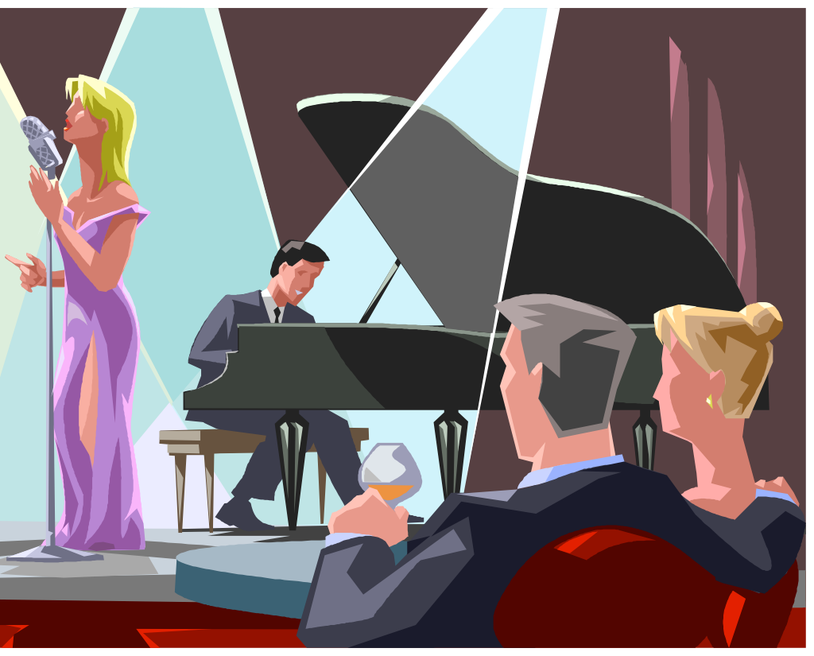
MUSICAL
COMPOSERS
SINGERS
MUSICIANS
(ALL
INSTRUMENTS)
MUSIC
APPRECIATION
Notes:
People with musical intelligence can be found in musical fields as composers, singers, musicians and as critics who appreciate music.

Slide 7
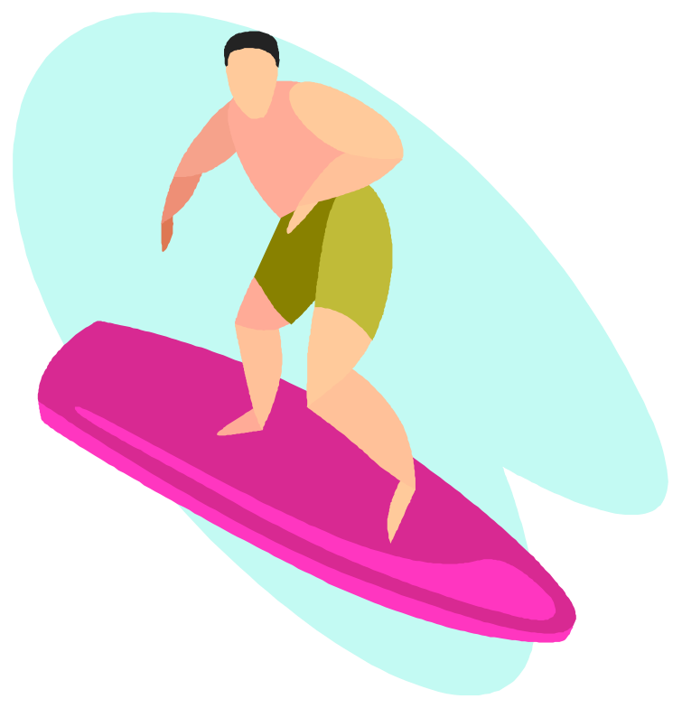
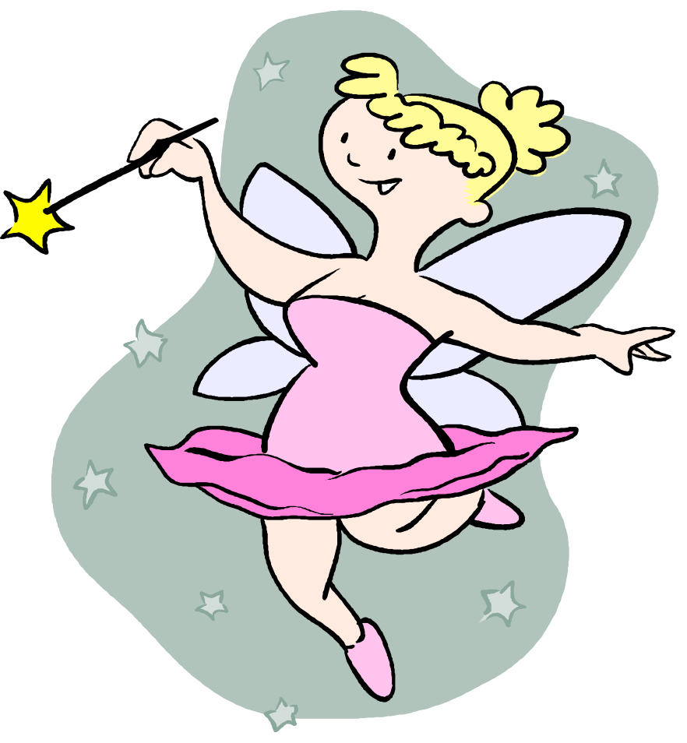
Bodily kinesthetic intelligence
Using one’s whole body
Sports
Dancing
Acting
Technical people
Craftspeople
Notes:
Everyone possesses some kinesthetic intelligence. However, people in sports, dancing, acting, technology and crafts possess this to a strong degree.

Slide 8
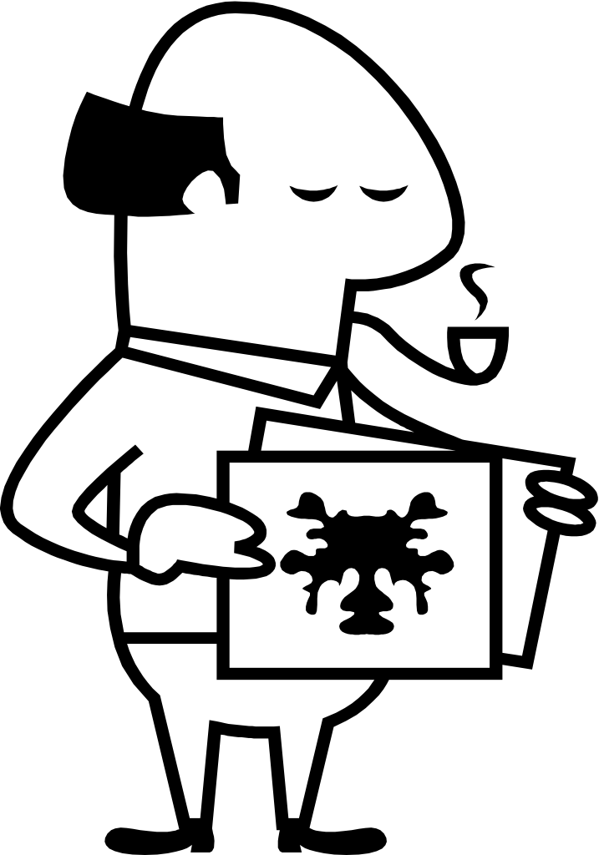
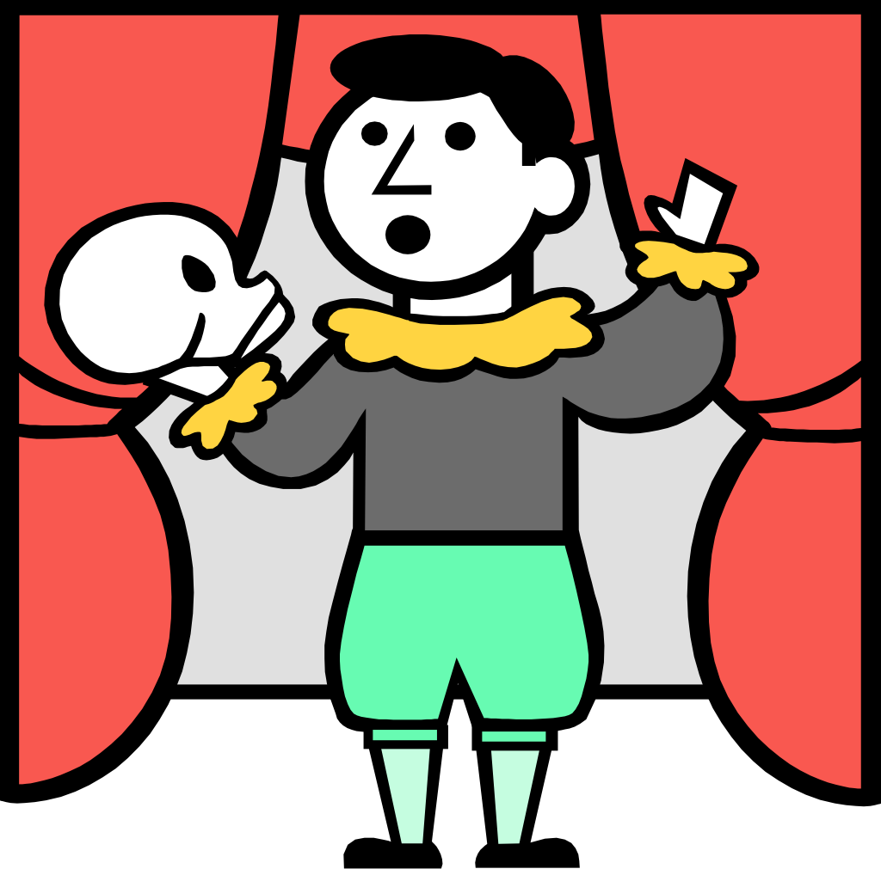
INTERPERSONAL INTELLIGENCE
Understands people and how to work with them
Teachers
Clinicians
Politicians
Leaders
Actors
psychologists

Slide 9
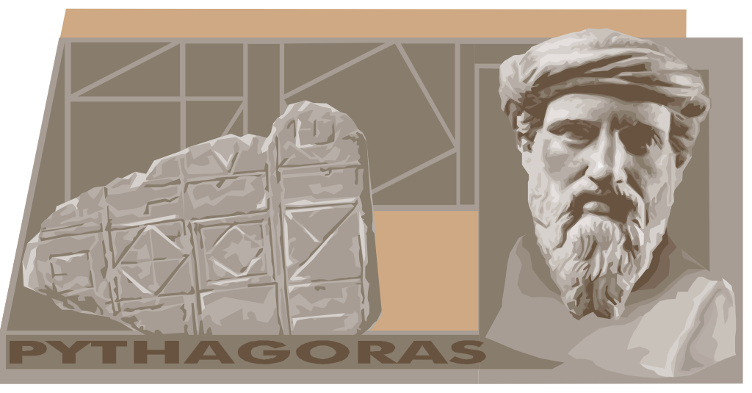
INTRAPERSONAL INTELLIGENCE
Understanding the SELF and being able to self-discipline to reach goals and sometimes to act as models for others
Philosophers
Counselors
Winners
Mother Teresa

Slide 10
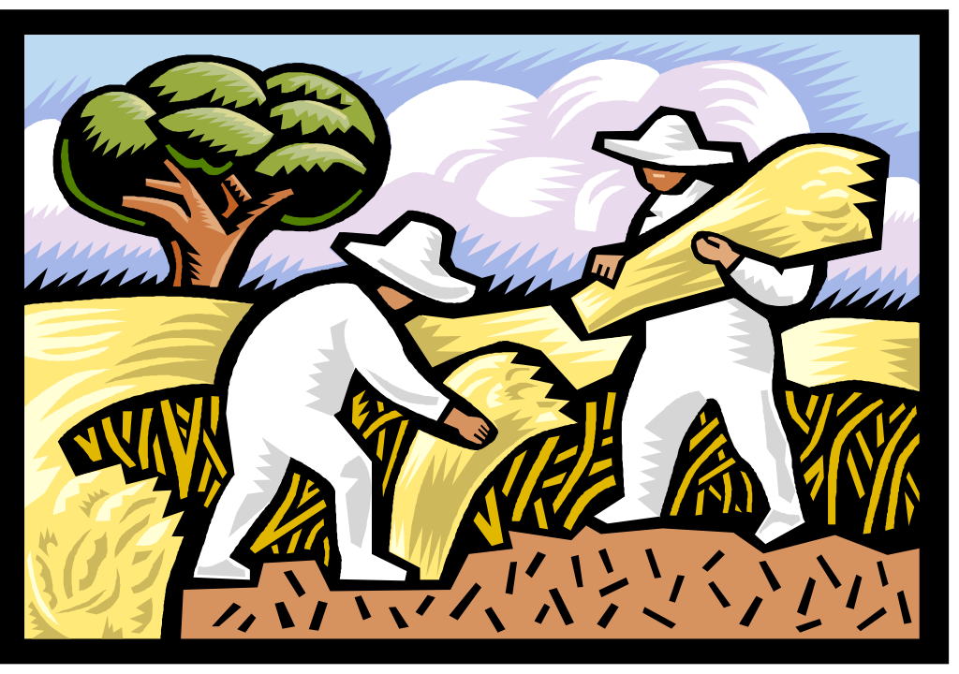
NATURALIST
Environmentalist
Biologist
Gardner
Landscape artist
Conservationist

Slide 11
Value of each intelligence:
All intelligences equal
We have different kinds of smart
We can develop other intelligences
If one is not appreciated for his intelligence, what happens?
If one does not develop his intelligence, what happens?
What happens if only a few kinds of intelligence are predominant in the population?
Notes:
What about these intelligences? What does this all mean?
First of all, no one intelligence is more important than the others.
Although the academic field usually places strong emphasis on mathematical and linguistic intelligence, there are different kinds of “smart” that are equally important.
What would happen in the world if we emphasized only two kinds of intelligence? We would be much poorer: no musicians, architects, sports people, technology…
We need to know that all intelligences should be appreciated. Also, we all possess each intelligence to some degree, and we can increase each intelligence somewhat with exposure and practice; otherwise we might not develop the intelligence strengths that we have.

Slide 12
Interaction with learning
Thinking
Doing
Seeing
Listening
CD roms, computers, movies, maps
Notes:
We should use our intelligences and appreciate them to strengthen them when we think, act, see, listen.
We should use our strengths by utilizing any media that we have to strengthen our learning in our own style. If we are kinesthetic, we could use this strength to learn by doing. If we possess linguistic intelligence and learn also through hearing, we could utilize strategies and technology to help us learn.

Slide 13
Capitalizing on one’s intelligence
An intelligence is a strength.
Use it as an approach to learning.
Use it for projects.
Notes:
Students can use movies to reinforce learning if they are visual/auditory.
Students can use computers to reinforce memory (kinesthetic)

Slide 14
ENHANCE YOUR LEARNING
Use technology to enhance learning
Use learning style theory to enhance learning
KNOW YOURSELF:
NOT, HOW SMART ARE YOU.
THINK: HOW ARE YOU SMART?

Slide 15
COMBINE ALL YOUR INTELLIGENCES. WIN!

