Slide 1



we can use in
SB4

Slide 2
As we are aware that there are a few features that are not on SB4 that would make the customer designing process much easier.
Hence, I have compile some examples of what we can do to assist or recommend to customers as a workaround.
Along with some general servicing tips.

Slide 3

We will be reviewing:
1. Blog
2. Manage Forms
3. Banners (Like SB3 Banner Carousel)
4. Shopping Cart
5. Uploading Document
6. DIFYA Process
7. Change Template design
8. Reviewing SB3-SB4

Slide 4

I know we do not have a blog for SB4. In the meantime we can give them the option to add a contact form/s after each blog.
If they have multiple blogs they can generate email accounts ( from their website package) to organize the feedbacks. Then add the different email address on the contact form settings or using the same email address on each form settings they can use the contact form field to separate the blog form submissions.
Example: in the field to add the comment for the blog they could add message for " the blog title"
They would be able to add the feedback manually and they can monitor more what they want to approve on their blog comments.

Slide 5


Although we do not have a tab of such in SB4.
You can download all the contacts and information a customer sent via the contact forms by using the “download” option in the contact form settings.

Slide 6

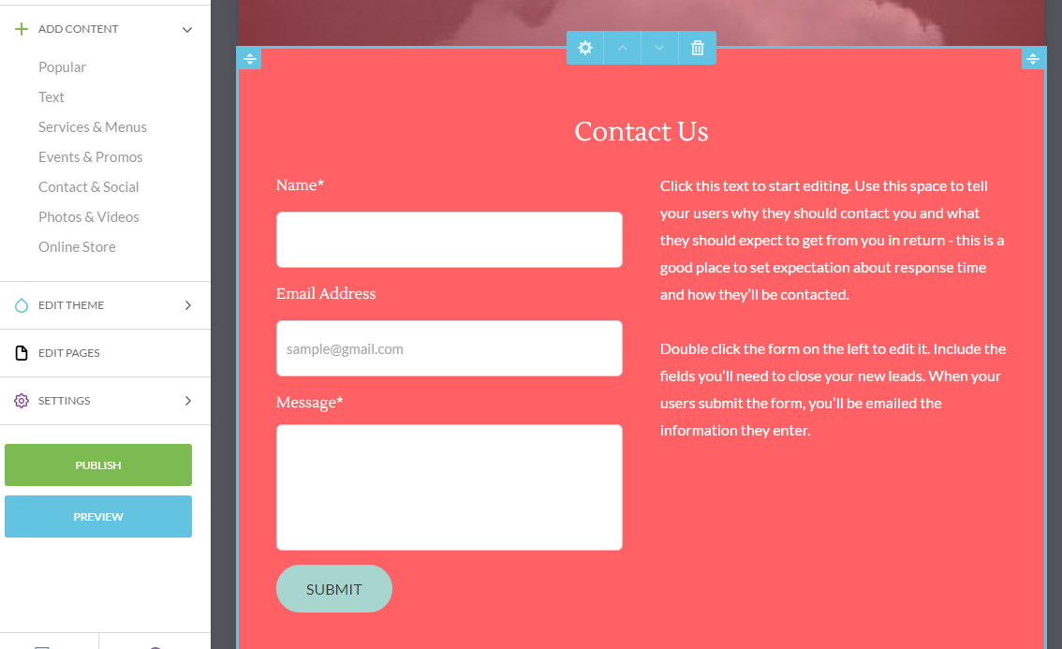

Slide 7

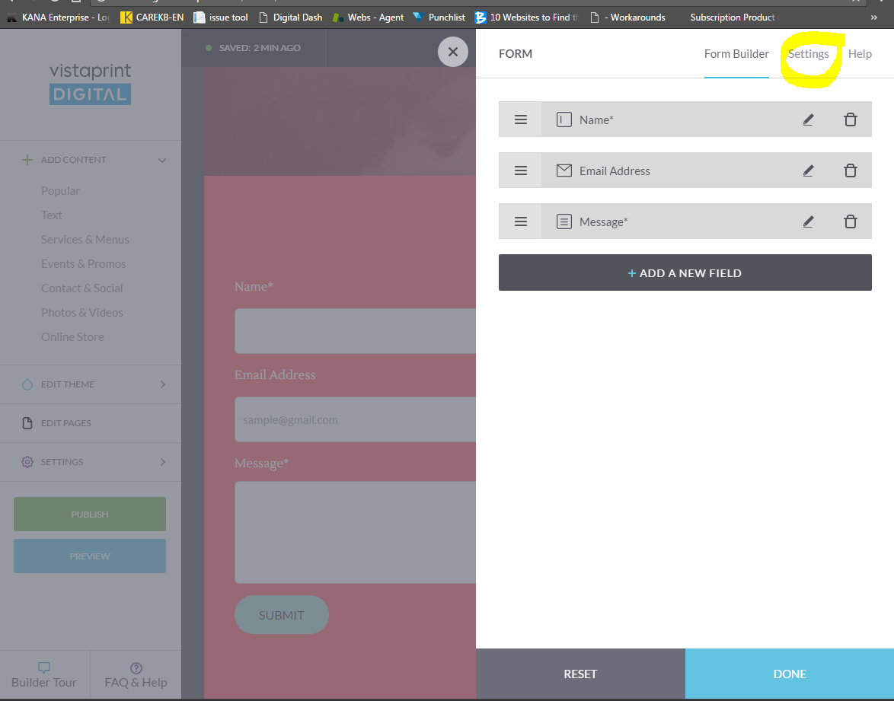

Slide 8

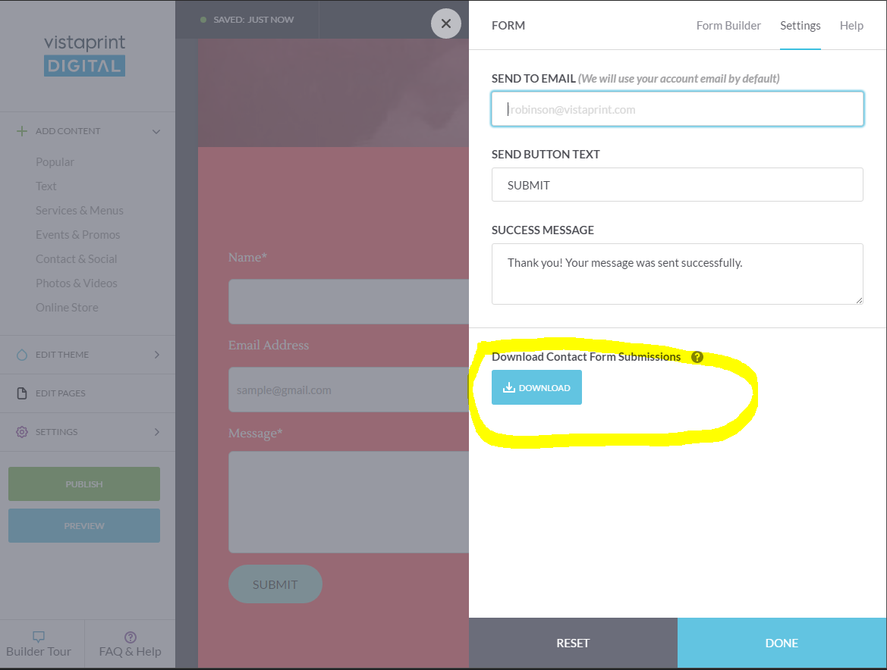

Slide 9
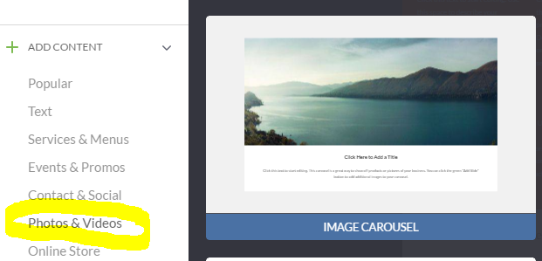
NO BANNER CAROUSEL
You can use the image Carousel option

Slide 10
Product Options in the shopping cart
I know our shopping cart does not have all the functions that shopping cart should
have. However, we can try to see how best we can help our customers while our
Engineers work to have these features added. These features include size and color
options and cases where the prizes maybe different.
They can add the products multiple times
They can have in the description of the product to send an email with the specifications of the order.( color, customizations)
They can add the products and get the HTML from PayPal with the drop down options of the products
4. If they have the shopping cart with another provider, they can link the cart to the website.

Slide 11
LINKING A FILE IN SB4
Customers can add files to their google drive and then generate a link for that file.
The link can be linked to image, text or external page in SB4.
As we are aware that there are a few features that are not on SB4 that would make
the customer designing process much easier. Hence, I have compile some examples
of what we can do to assist or recommend to customers as a workaround.
On your computer, go to drive.google.com.
Go to “New” at the top right
Then Select “File Upload”
Select the file on your computer
Click on the file you want the link for
Select the share icon at the top right
Then change the setting for the link to “Anyone with the link can view”
OR

Slide 12
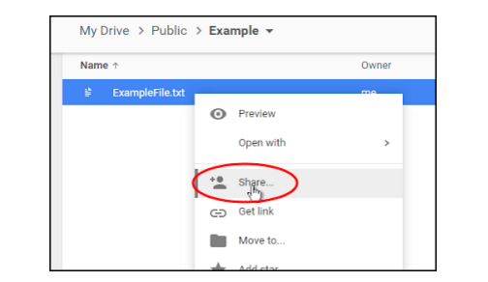
From step 4. You can
Right click on the file and select “share”
Then you will be able to change the settings to “Anyone with the link can view” and copy the link.

Slide 13
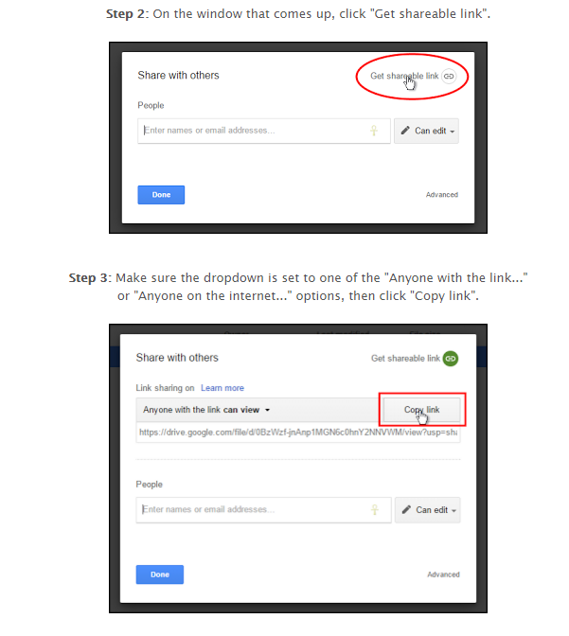

Slide 14
DIFYA Process
The new process is :
1. Customer places the website Design Services
The customer do the “Design Brief”
After they submit the brief they will get a Schedule an appointment on
the screen.
4. Then the MC will contact the customer base on the schedule time selected
5. The other steps would follow for the designer to be assigned

Slide 15
Change Template Design
Remember if the customer calls to get this done. Do not just show the customer
How to do it? But inform customer if they have information on the website already
That it will be lost.
We can probe customer to understand what they are looking for and advise
customer how they can use the features to the left to get the results they want.
Example using the “Change Header” , "Footer" and other blocks to recommend
to customer how they can use it to get their desired website.

Slide 16

Reviewing SB3 to SB4
Before we let a customer order a SB4 website, I would recommend that you review the customer’s website to see what features they have and to let them, know what would be available on the new platform. Examples Blog, layout of images, icons in footer.

Slide 17
References:
How to Import and Export Documents in Google Drive
https://sites.google.com/site/gdocs2direct/
https://business.tutsplus.com/articles/how-to-import-and-export-documents-in-google-drive--cms-20930
https://www.vistaprintdigitalsupport.com/hc/en-us/articles/115002826848-Create-File-Download

Slide 18

I hope this
was helpful

Slide 19


