Slide 1
IDEAL WRITING PROCESS
Barbara J. Smith, PhD

Slide 2
IDEAL Writing PRACTICES
I = Illustrate
D – Draft
E = Edit
A = Advise & Revise
L = Lure

Slide 3
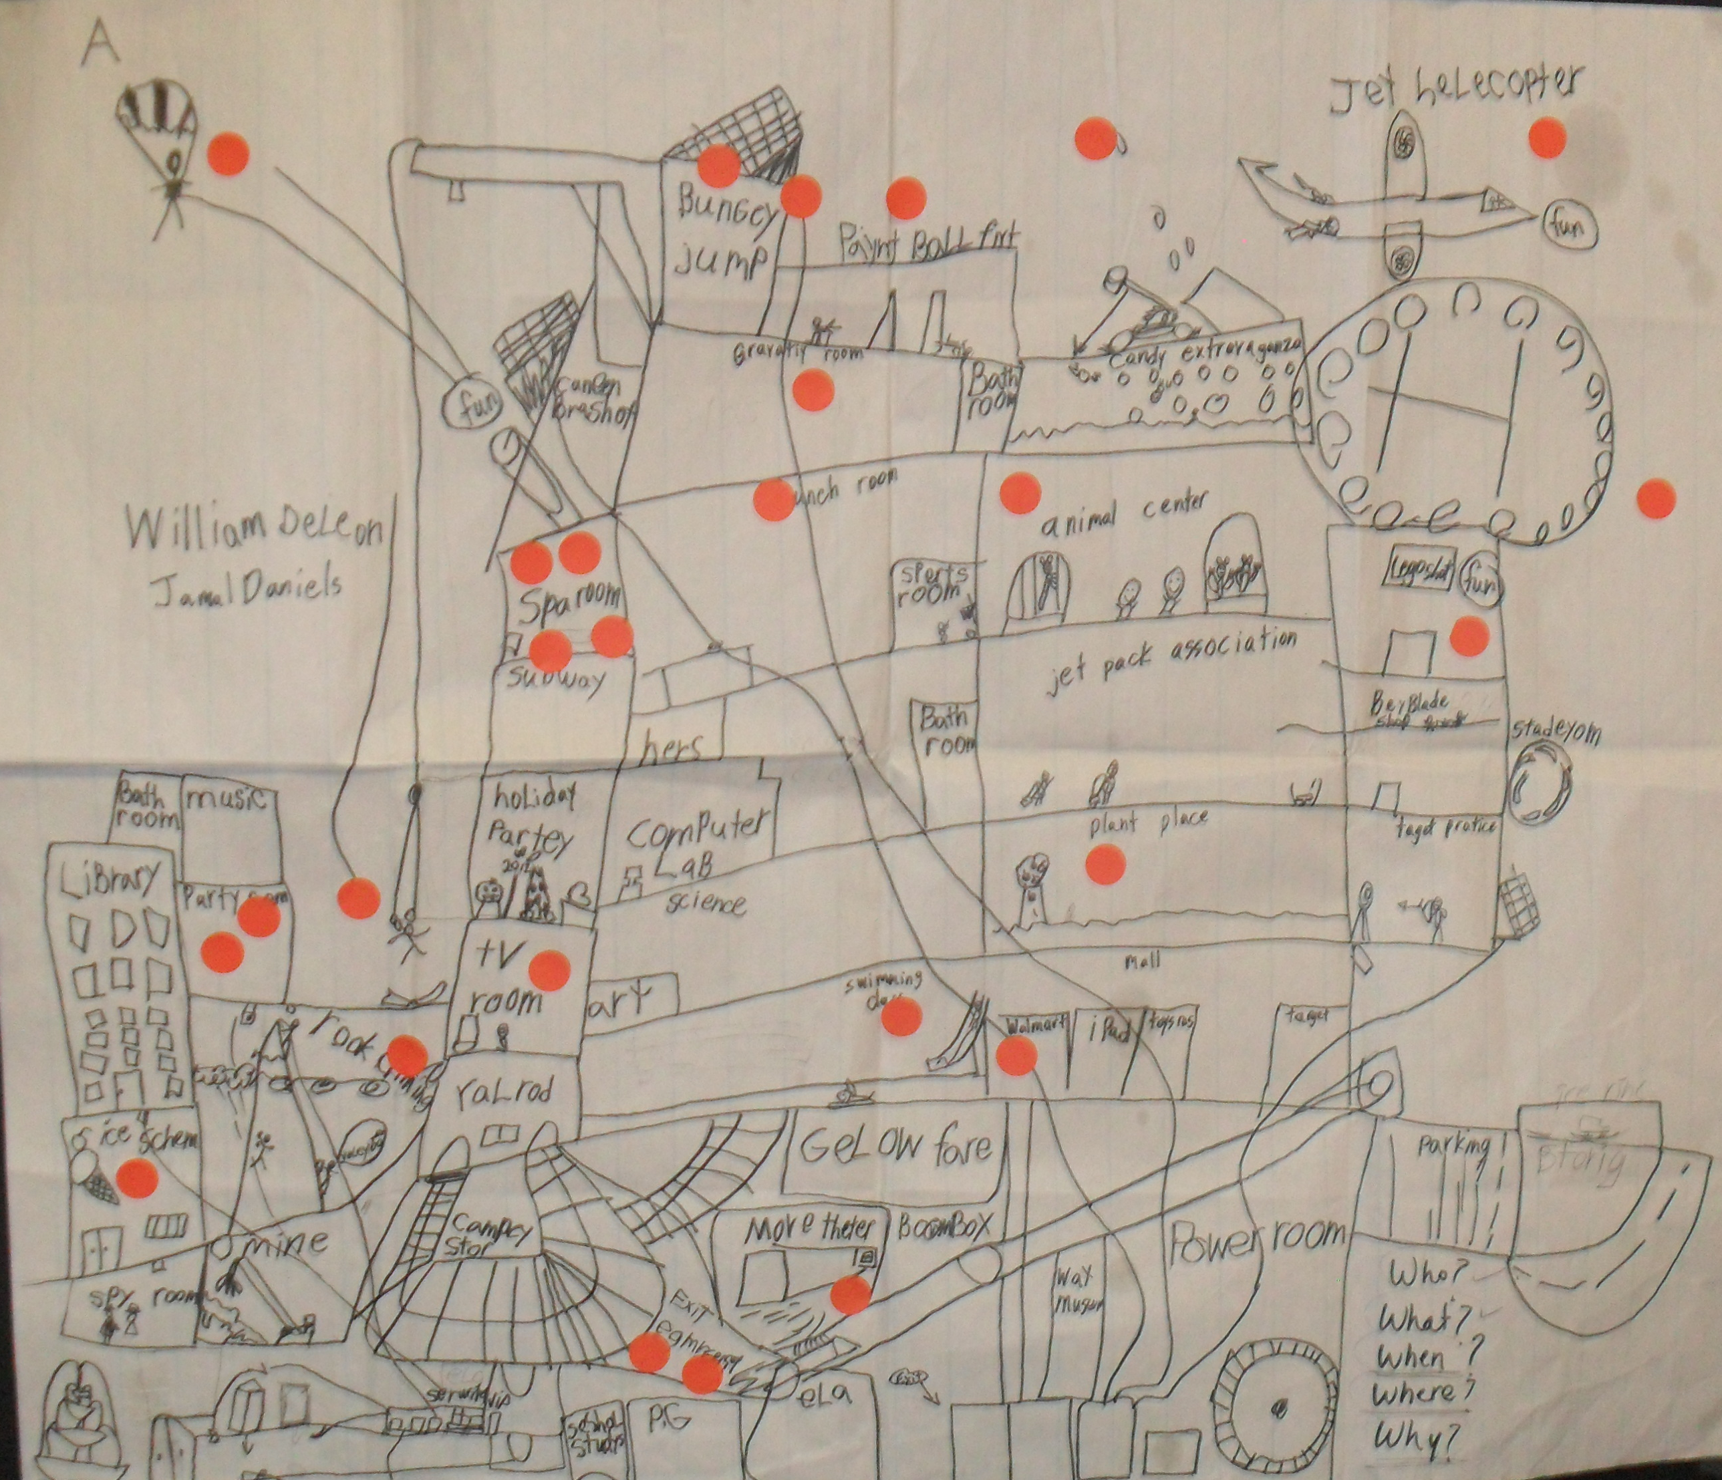
1. Illustrate
Illustrate/sketch and label an image to use as an outline (on large poster paper) in place of a graphic organizer (more space to brainstorm)
Example

Slide 4
2. Draft
Review writing rubric for directions.
First sentences formed from expanding labels from illustration.
Use every other line (to make room and promote future edits)

Slide 5
3. Edit
IDEAL Language Chart
3 Powerful Nouns: - opportunities - survival - expert | 3 Powerful Verbs: committed designed impressed
3 Powerful Adjectives expressive clever shimmering | 2 Powerful Adverbs: smoothly finally
Figurative Language (alliteration) shiny, shimmering stone Paddle, packs and patience | Figurative Language (simile) Exploded Like a rocket Light as a feather
Score: 15/15
Edit illustration on more than one occasion
Review rubric to check word choice expectations
Edit draft for word choice changes (improve parts of speech; figurative language)
Use Language Chart to track strong word choices

Slide 6
4. Advise & Revise
In pairs…
Read aloud piece of writing to partner. Pause to make revisions.
Listen to partner read aloud your piece of writing. Pause to make revisions.
Review ‘Common Mistakes in Writing’ and ’Polishing Tips’ (see next 2 slides)
Edit for spelling and punctuation before completing polished draft.

Slide 7
Common Mistakes in Writing
Missing a subject before a verb
Using fragments
Wacky use of “this” or “that”
Using “that” as a subject
Lack of first or third person agreement
Using proper past tense words
Leaving out words
Use of excess or extraneous words
Use of absolutes (best – safe –only – always, every)
Repeating words
Use of too many simple words
Use of slang or awkward use of clichés
Careless about word endings “ed” and “ing”
Misuse of contractions and apostrophes

Slide 8
Polishing Tips….
proper use of homonyms (there, they’re, their; to, too, two; our, are; your, you’re). STOP every time you see one and MAKE sure you have it right, NOT write ☺)
word endings (“s”, “es”, “ed” and “ing”…). Racing minds can lead to careless errors. An extra ‘read aloud’ can usually catch these typos.
NOTE: Canadian, American and British versions of spelling

Slide 9
5. Lure
Lure readers to your polished piece of writing (“secret sauce”)
Check directions for instructions re: audience
Options may include:
  Illustrations/posters/graphic artwork/bulletin board posting
  Web page/blog/Twitter/other social media
  Writing a review /asking for endorsements
  PowerPoint presentations/video /dramatic performance
  Submit for publication (magazine, journal, newspaper…)

Slide 10
According to Graham, McKeown, Kiuhara, and Harris (2012):
“When students receive instruction designed to enhance their strategic prowess as writers (i.e., strategy instruction, adding self-regulation to strategy instruction, creativity/imagery instruction), they become better overall writers. Likewise, when students are taught specific knowledge about how to write (i.e. text structure instruction), the overall quality of their writing improves” (p. 891).

Slide 11
Think about Writing as a Cycle
Illustration
Draft
Edit
Advise & Revise
Lure

Slide 12
From Making Room for Writing…
“While the avid readers tend to be strong writers through osmosis, they may not understand what makes a good piece of writing great. Many teachers might skip the teaching of a writing process if they have a group of strong readers who seem to automatically write well. I would argue that without exposing students to a writing process, where they deliberately re-think their work, teachers are limiting the writing potential of both weaker and stronger students. (Smith, 2018).

