Slide 1
Understanding Addiction
Dr. Ron Mottern

Slide 2
Understanding Addiction
What It Is

Slide 3
Drugs of Abuse
Hard Drugs
Soft Drugs

Slide 4
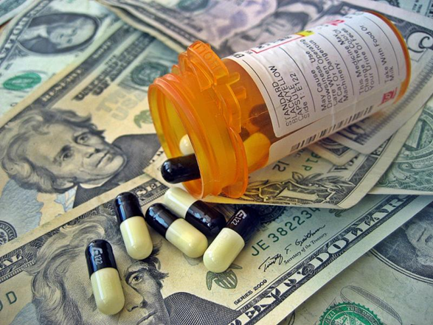
Understanding Addiction
If you listed ANY difference in “hard” and “soft” drugs – you’re wrong.
“Hard” and “soft” are subjective, sociological concepts.
ALL DRUGS - regardless of the manner in which they enter the bloodstream - eventually end up affecting the brain.

Slide 5
Understanding Addiction
Every new drug is “the world’s most dangerous drug.”

Slide 6
Understanding Addiction
List three drugs in order of their addiction potential:
1.
2.
3.

Slide 7
Understanding Addiction
If you listed ANY drugs – you’re wrong.
Addiction IS NOT a PHYSICAL concept.
Addiction is a PSYCHOLOGICAL concept.
This DOES NOT mean that the mind (psychology) and body (physiology) are separate and do not influence one another.
The mind-body is one holistic system.
The body influences the mind (the brain is a part of the body) and the mind influences the body.

Slide 8
Substance Dependence v. Addiction
Substance dependence
A maladaptive pattern of substance use, leading to clinically significant impairment or distress, as manifested by three (or more) or the following, occurring at any time in the same 12-month period:
*Tolerance (using more and more to get the same effect)
*Withdrawal (physiological symptoms)
Taking larger amounts or longer than intended
Persistent desire or unsuccessful efforts to cut down or control substance use
Time spent in obtaining, using or recovering from effects
Important social, occupational, or recreational activities are given up or reduced because of substance use
Use continues despite knowledge of persistent physical or psychological problems
Diagnostic and Statistical Manual of Mental Disorders, 4th ed., Text Revision (DSM-IV-TR)

Slide 9
Substance Dependence v. Addiction
Substance dependence is a list of characteristic BEHAVIORS with the physiological indicators of tolerance and withdrawal.
Substance dependence is continuing to use despite harmful effects.

Slide 10
Understanding Addiction
The difference between PHYSICAL DEPENDENCE and PSYCHOLOGICAL ADDICTION:
Physical Dependence
Tolerance - Can I develop a tolerance to it?
Withdrawal - Will I experience withdrawal if I stop using it?
Psychological Addiction
Making choices to do something over and over again
Addiction is a CHOICE

Slide 11
Understanding Addiction
Why do they do that?

Slide 12
Understanding Addiction A New (Old) Theory

Slide 13
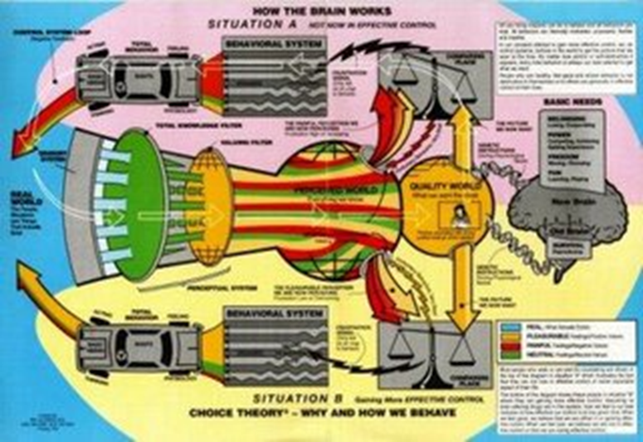
Understanding Behavior: Why We Do Everything We Do
Choice Theory Psychology

Slide 14
Axioms of Choice Theory
The only persons whose behavior we can control is our own.
All we can give another person is information.
All long-lasting psychological problems are relationship problems.
The problem relationship is always a part of our present life.
What happened in the past has everything to do with what we are today, but we can only satisfy our basic needs right now and plan to continue satisfying them in the future.
We can only satisfy our needs by satisfying the pictures in our Quality World.
All we do is behave.
All behavior is Total Behavior and is made up of four components: thinking, doing, emotions and physiology.
All Total Behavior is chosen, but we only have direct control over the acting and thinking components. We can only control our feeling and physiology indirectly through how we choose to act and think.
All Total behavior is designated by verbs and named by the part that is most recognizable.

Slide 15
The Brain as a Control System
5 Basic Needs
Needs Profiles
Wants
Quality World
Comparing Place
Creating Place
Total Behaviors
Perceptual Filters

Slide 16
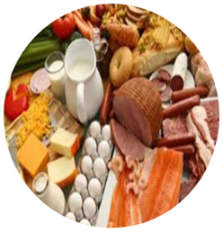
The 5 Basic Needs

Slide 17
Needs Profile

Slide 18
Needs are Motivators
The Basic Needs are first and foremost motivators.
They motivate us to do everything that we do.
Everything we do in this life is an attempt to meet our Basic Needs.

Slide 19
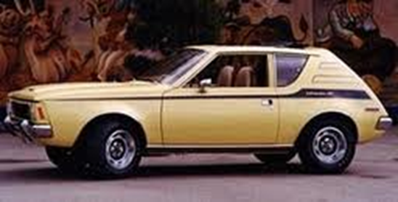
Wants

Slide 20
Everything I Know World
The everything I know (EIK) world is just that – it contains everything we know.
It is the sum total of our knowledge.

Slide 21
Filters
Sensory filter
How we know the world
Hearing, seeing, feeling, smelling, tasting
Perceptual filter
How we understand the world
Paradigms, beliefs, points of view
Our perceptions determine our reality
Reflexive loop between the EIK world and the Quality World

Slide 22
Perceptual Filter
The Business of Paradigms video – Joel A. Barker
Kuhn, T. (1962). The structure of scientific revolutions. Chicago, IL: University of Chicago.

Slide 23
Quality World
The QW is a very small part of the EIK world.
The QW is a long-term store for internal referents that satisfy Basic Needs.
The QW is like a picture album
It contains pictures of those things we want (that we think will fulfill our Needs) and those things that fulfill our Needs.

Slide 28
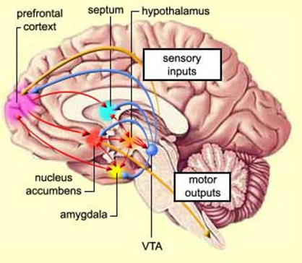
Pics in the Quality World
Takes away misery (the affective indicator that Needs are not being met) and cause euphoria (fool the brain into thinking that the Needs are being met – pleasure is the accumulation of dopamine in the nucleus acumbens of the brain)
The behavior of using helps fulfill Basic Needs.
Because AOD take away the misery of not having the Needs met and help fulfill the Basic Needs, they get to be pics in Quality World.

Slide 29
Once something gets in the QW through Need fulfillment IT NEVER GOES AWAY
We will continue to return to the pics in our QW to relieve misery and to experience pleasure.
If the Needs are no longer being met then the pics may fade over time.
We know, however, that memories (thinking) can perpetuate the retention of pics that are, themselves, no longer Need fulfilling.

Slide 30
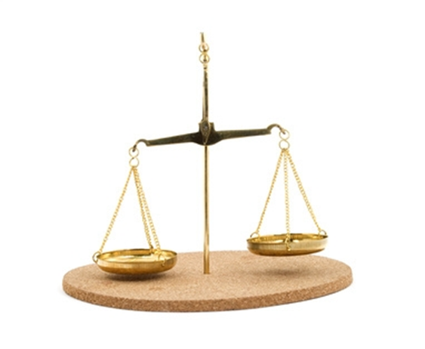
Comparing Place
One scale represents what we want (the pic in the QW).
The other scale represents what we’ve got (in reality)
The difference between what I want and what I’ve got is my PROBLEM.

Slide 31
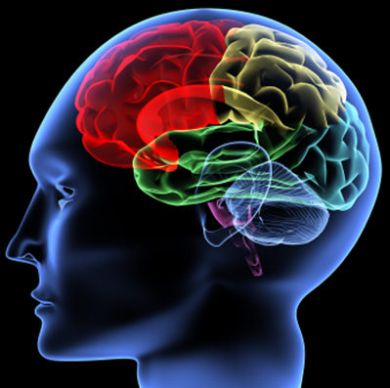
Creating Place
Anytime we have a problem, we have a feeling of frustration.
This feeling of frustration causes the Creating Place to kick in.
The Creating Place is the black box of the mind.
It is responsible for creating all behavior.
It is intimately connected to the frontal cortex.

Slide 32
Total Behavior
Emotions Thinking
Physiology Doing

Slide 33
How Thinking Affects Emotions and Physiology
Have you ever been angry with someone because you thought s/he did something to you and then found out s/he didn’t do it?
Did you stay angry at them? (Thinking affects emotions)
The Lemon Exercise (Thinking affects physiology)
The Arm Bar Exercise (Thinking affects physiology)
Lazar, S. W., et al. (2005, November). Meditation experience is associated with increased cortical thickness. Neuroreport, 16(17), 1893-1897. (Thinking affects physiology)

Slide 34
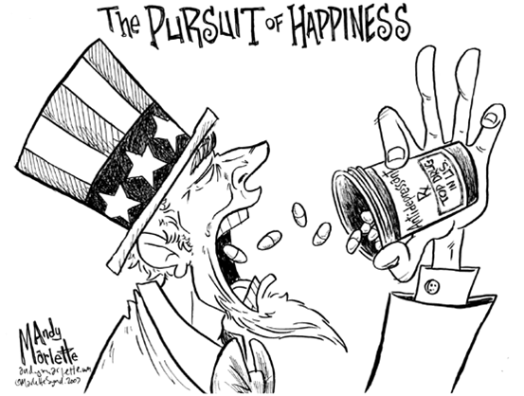
Total Behavior
We never develop any pattern of behavior that does not meet our Needs.
There is nothing that says our behavior has to be good for us. Survival is just one of five Needs.
We continue to engage in any behavior (even destructive behavior) because the it meets our Needs.
We know our needs are being met by the presence of pleasure/euphoria and the absence of pain/misery.

Slide 36
Addiction
Addiction is a pattern of repetitive Total Behavior designed to meet Basic Needs (through maximization of pleasure/euphoria and minimization of pain/misery)
There are negative addictions (patterns of Total Behavior that cause harm to self and others).
There are positive addictions (patterns of Total Behavior that either cause no harm to self and others or/and promote health and well-being).

Slide 37
Goal of Addiction Treatment
The goal of addiction tx is to assist clients in developing new Total Behaviors that get them closer to what they want and that fulfill their Basic Needs in ways that either cause no harm to self and others or promote health and well-being .

Slide 38
What This Means
New behaviors that fulfill Basic Needs must placed in the QW so there is a choice between behaviors.
The new behavior must meet the Needs as well or better than using.
New behaviors must be experienced to become pictures in the Quality World.
You have to do something different.

Slide 39
What This Means

Slide 40
Understanding Addiction
What It Isn’t

Slide 41
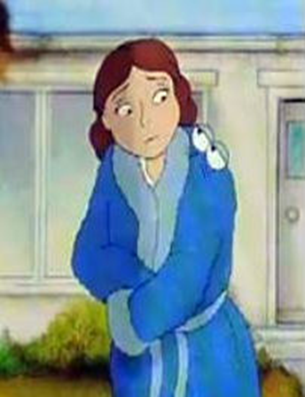
Understanding Addiction
Classical definition of addiction –
A compulsive, unmanageable behavior characterized by tolerance and withdrawal.

Slide 42
The Broken Brain Theory
Some suggest that the addict’s brain is somehow broken and must be repaired.
There is nothing wrong with the addict’s brain.
It works exactly like it is supposed to work.
It works exactly like your brain and my brain.

Slide 43
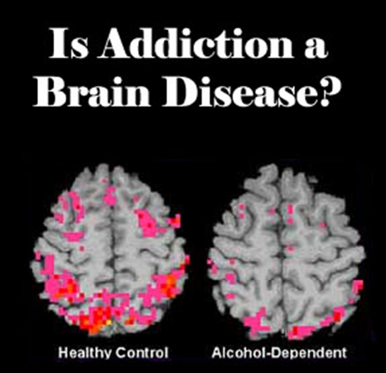
The Brain Disease Theory
Addiction is defined as a chronic, relapsing brain disease that is characterized by compulsive drug seeking and use, despite harmful consequences. It is considered a brain disease because drugs change the brain – they change its structure and how it works. These brain changes can be long lasting, and can lead to the harmful behaviors seen in people who abuse drugs.
National Institute of Drug Abuse

Slide 44
Problems with these Ideas 1
The brain is not abnormally functioning. The brain is neuroplastic.
Brain imaging shows the normal neuroplastic functioning of the human brain, not an abnormal brain disease

Slide 45
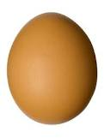
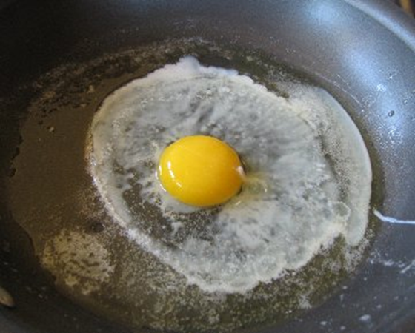
Do not confuse cause and effect.
Substance abuse (behavior) causes physiological changes .

Slide 46
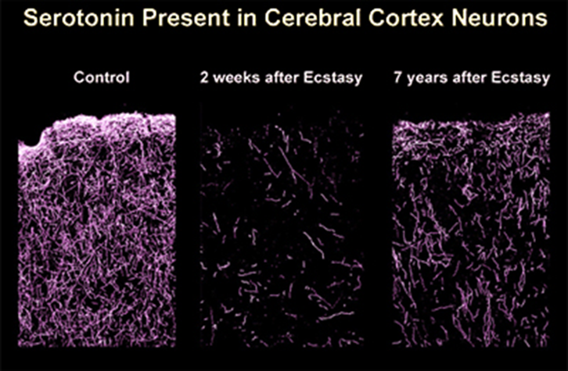
Thinking, doing and drugs ALL cause changes in the brain.
These changes are subject to free will.
I can change what I’m thinking (which causes the brain to change).
I can change what I’m doing (which causes the brain to change).
In the absence of drugs, my brain heals (changes).
Neuroplasticity of the brain works BOTH WAYS.

Slide 47
Problems with these Ideas 2
There is no evidence that the behavior of addicts is compulsive – meaning I have no control over what I’m doing, which means I have no control over what I’m thinking.

Slide 48
Compulsion v. Demon Possession

Slide 49
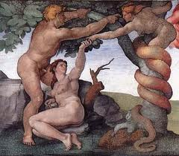
Understanding Addiction
There is no place in the current, medical model of addiction for incipiency of the will – free will

Slide 50
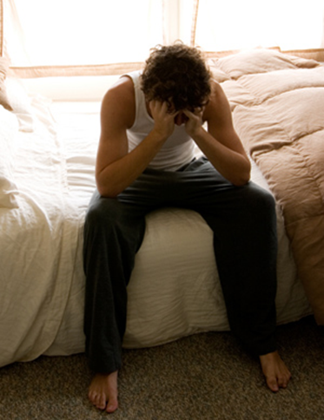
Why do they do that?
People choose destructive behaviors because:
1) the behaviors either take away the misery of not having Basic Needs met, or,
2) the behaviors fulfill basic Needs
I am almost always in direct control of what I choose to think and what I choose to do.

Slide 51
Why do they make these choices?
Thinking determines behavior.
So, what’s wrong with their thinking?

Slide 52
Thinking Errors
Thinking errors include:
Closed Thinking
Victim Role
Superior Self-Image
Reckless Attitude
Instant Gratification
Fear of Losing Face
Power Control
Possessive Attitude
Uniqueness

Slide 53
Continuum of Thinking/Behavior
Responsible
Irresponsible
Arrestable
Extreme

Slide 54
Change the Thinking

Slide 55
Understanding Addiction
What I Can Do About It

Slide 56
Community Level
Demand from local, state and federal officials that offenders receive MANDATORY TREATMENT (in jail and on probation/parole) that is supported by evidence-based research
Cognitive-behavioral programs
High-risk offenders
Cognitive restructuring (How to change the thinking)
Social skills
Problem solving

Slide 57
Personal Level
7 Caring Habits
(Help Relationships)
Listening
Supporting
Encouraging
Respecting
Trusting
Accepting
Negotiating Differences
7 Deadly Habits
(Hurt Relationships)
Blaming
Complaining
Criticizing
Nagging
Threatening
Punishing
Bribing

Slide 58
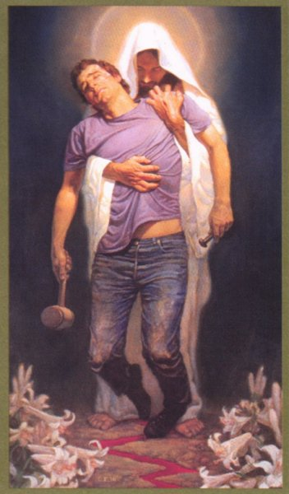
Personal Level
Educate yourself about addiction.
Don’t become an enabler. Get help for YOURSELF.
Know that treatment works.
PRAY.

Slide 59
Dr. Ron Mottern
ron.mottern@gmail.com

