Slide 1
That I May Dwell Among Them God’s Tent of Meeting
Exodus 26:19
38:15-30

Slide 2
Exodus 26:19 (NKJV)
You shall make forty sockets of silver under the twenty boards: two sockets under each of the boards for its two tenons.

Slide 3
Exodus 38:15 (NKJV)
and the same for the other side of the court gate; on this side and that were hangings of fifteen cubits, with their three pillars and their three sockets.

Slide 4
Exodus 38:16 (NKJV)
All the hangings of the court all around were of fine woven linen.

Slide 5
Exodus 38:17 (NKJV)
The sockets for the pillars were bronze, the hooks of the pillars and their bands were silver, and the overlay of their capitals was silver; and all the pillars of the court had bands of silver.

Slide 6
Exodus 38:18 (NKJV)
The screen for the gate of the court was woven of blue, purple, and scarlet thread, and of fine woven linen. The length was twenty cubits, and the height along its width was five cubits, corresponding to the hangings of the court.

Slide 7
Exodus 38:19 (NKJV)
And there were four pillars with their four sockets of bronze; their hooks were silver, and the overlay of their capitals and their bands was silver.

Slide 8
Exodus 38:20 (NKJV)
All the pegs of the tabernacle, and of the court all around, were bronze.

Slide 9
Exodus 38:21 (NKJV)
This is the inventory of the tabernacle, the tabernacle of the Testimony, which was counted according to the commandment of Moses, for the service of the Levites, by the hand of Ithamar, son of Aaron the priest.

Slide 10
Exodus 38:22 (NKJV)
Bezalel the son of Uri, the son of Hur, of the tribe of Judah, made all that the Lord had commanded Moses.

Slide 11
Exodus 38:23 (NKJV)
And with him was Aholiab the son of Ahisamach, of the tribe of Dan, an engraver and designer, a weaver of blue, purple, and scarlet thread, and of fine linen.

Slide 12
Exodus 38:24 (NKJV)
All the gold that was used in all the work of the holy place, that is, the gold of the offering, was twenty-nine talents and seven hundred and thirty shekels, according to the shekel of the sanctuary.

Slide 13
Exodus 38:25 (NKJV)
And the silver from those who were numbered of the congregation was one hundred talents and one thousand seven hundred and seventy-five shekels, according to the shekel of the sanctuary:

Slide 14
Exodus 38:26 (NKJV)
a bekah for each man (that is, half a shekel, according to the shekel of the sanctuary), for everyone included in the numbering from twenty years old and above, for six hundred and three thousand, five hundred and fifty men.

Slide 15
Exodus 38:27 (NKJV)
And from the hundred talents of silver were cast the sockets of the sanctuary and the bases of the veil: one hundred sockets from the hundred talents, one talent for each socket.

Slide 16
Exodus 38:28 (NKJV)
Then from the one thousand seven hundred and seventy-five shekels he made hooks for the pillars, overlaid their capitals, and made bands for them.

Slide 17
Exodus 38:29 (NKJV)
The offering of bronze was seventy talents and two thousand four hundred shekels.

Slide 18
Exodus 38:30 (NKJV)
And with it he made the sockets for the door of the tabernacle of meeting, the bronze altar, the bronze grating for it, and all the utensils for the altar,

Slide 19
The Foundation
The Source 30:11-15
The Symbolism vs. 15
The Significance

Slide 20
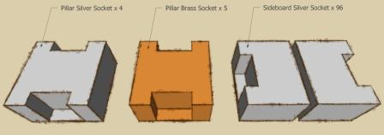

Slide 21
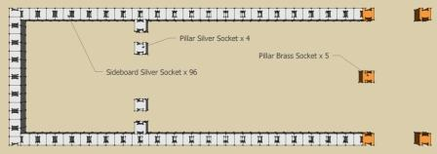

Slide 22
The Boards vs. 15-30
The Cutting of the Boards Matthew 3:10
The Coverings of the Boards
vs. 29
The Configuration of the Boards
vs. 19

Slide 23
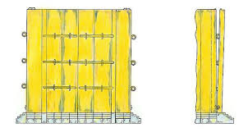

Slide 25
The Curtains
The Colors
White = Purity
Blue = Heaven
Purple = Sovereignty
Scarlett = Blood or Suffering

Slide 26
The Cherubim
The Coverings
The Linen vs. 1
The Goat’s Hair vs. 7
The Ram’s Skin vs. 14a
The Badger’s Skin vs. 14b

Slide 27
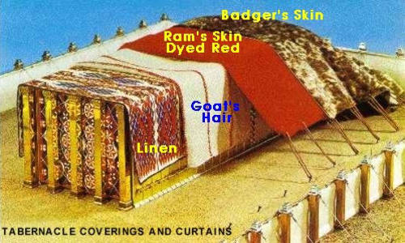

Slide 28
