Slide 1
BICYCLE SAFETY AND HELMET USE

Slide 2
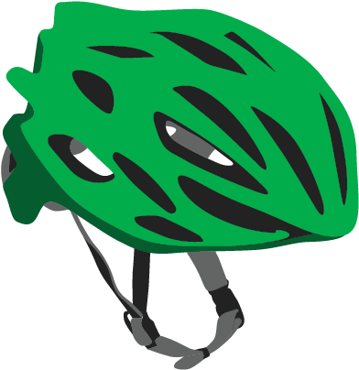
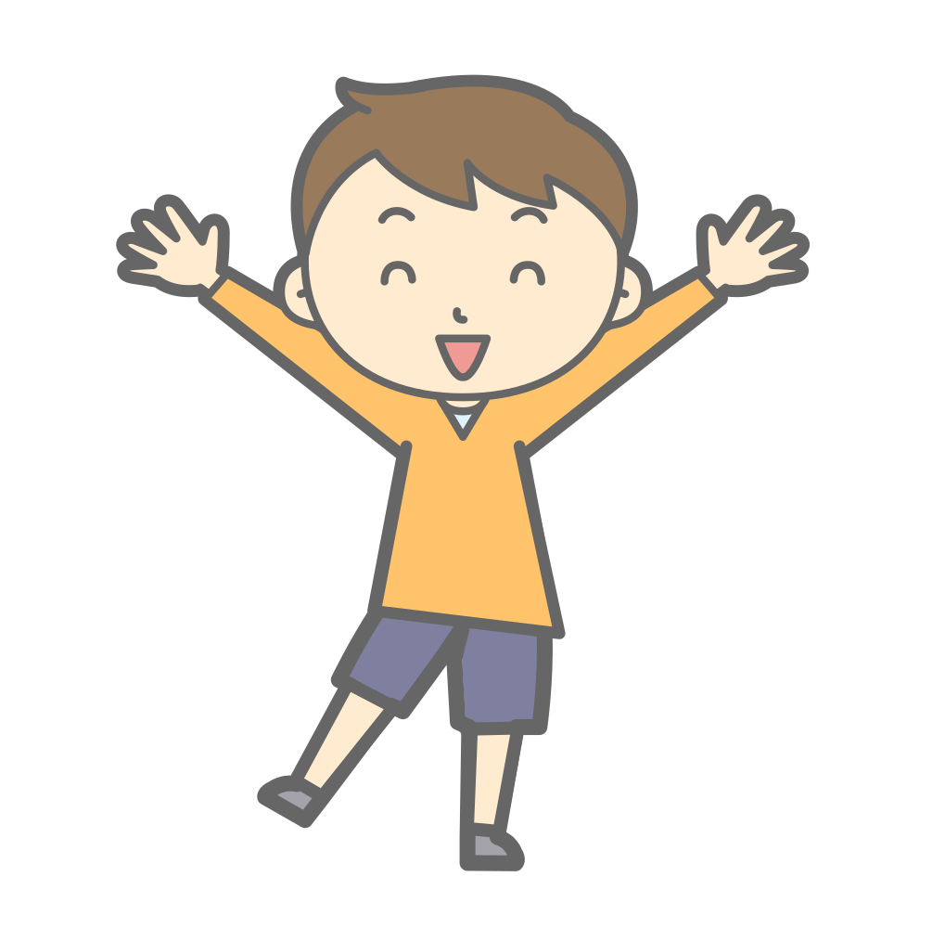
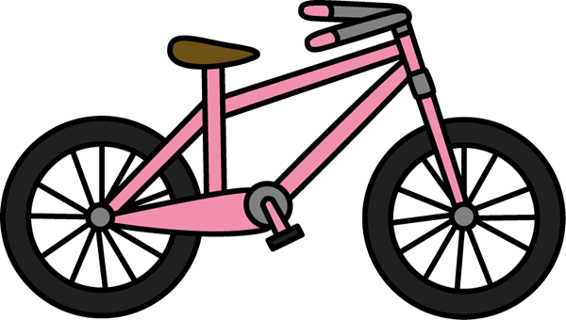
Getting on a bicycle?
First step, pick up your helmet.

Slide 3
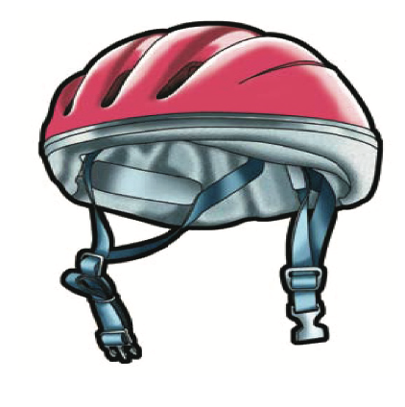
WHAT IS A HELMET ?
A helmet is more
than just a cool
hat! It’s a piece of
protective gear
worn to keep your head safe
while biking.

Slide 5
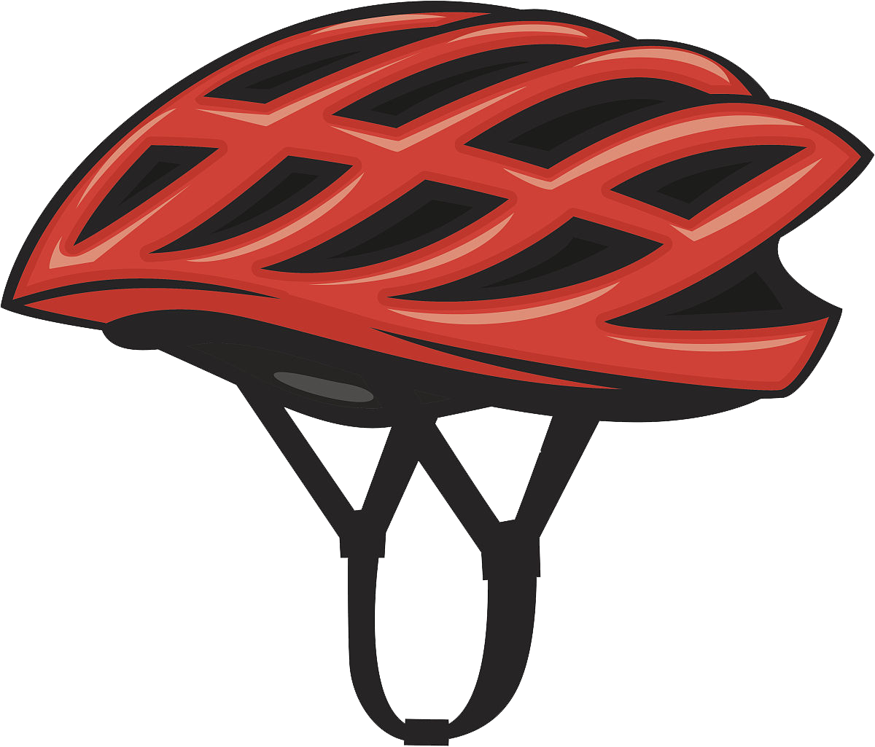
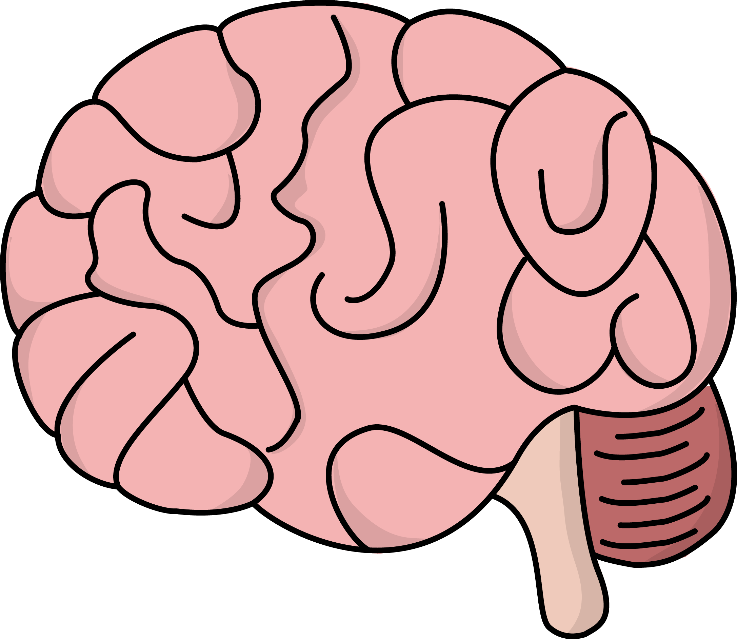
A helmets purpose is to protect your brain and it can't do that if it's not on right

Slide 6
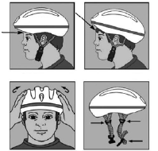
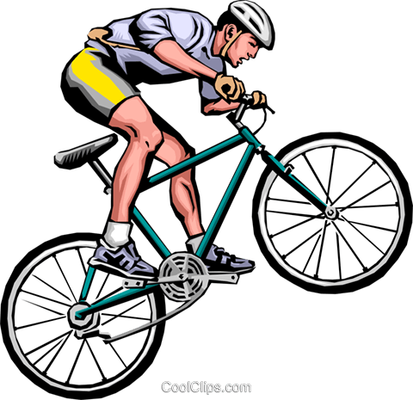
How to properly wear a Helmet
Correct Incorrect

Slide 7
Rule #1
Eyes: Put the helmet on your head. Look up. You should see the bottom rim of the helmet.

Slide 8
Rule #2
Ears: Make sure the straps form a ‘V’ under your ears when buckled. The straps should be a little tight but comfortable.

Slide 9
Rule #3
Mouth: Open your mouth as wide as you can. Does the helmet hug your head? If not. tighten the straps. Your chin strap should hug your chin.

Slide 10
Helmet Rules
1. Always wear a properly fitted bicycle helmet to protect your head – every time you ride.
2.Helmets should sit comfortably on your head all the way around, follow the eyes, ears, mouth rules!
3.Always replace a helmet after a crash. Damages may not be visible, but the foam can lose its integrity.

Slide 11
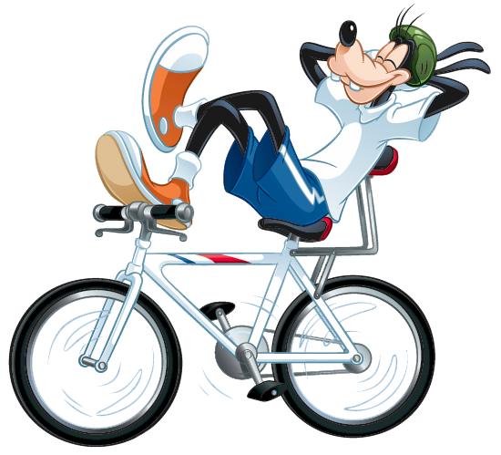
Other Safety Tips to follow
One rider per seat
Ride on the sidewalk
Wear bright colors when riding
Always ride with an adult

Slide 12
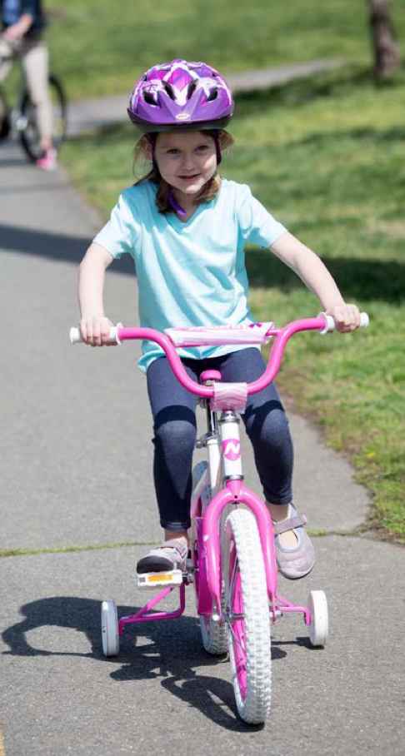
Tip
#1
Only One rider per seat

Slide 13
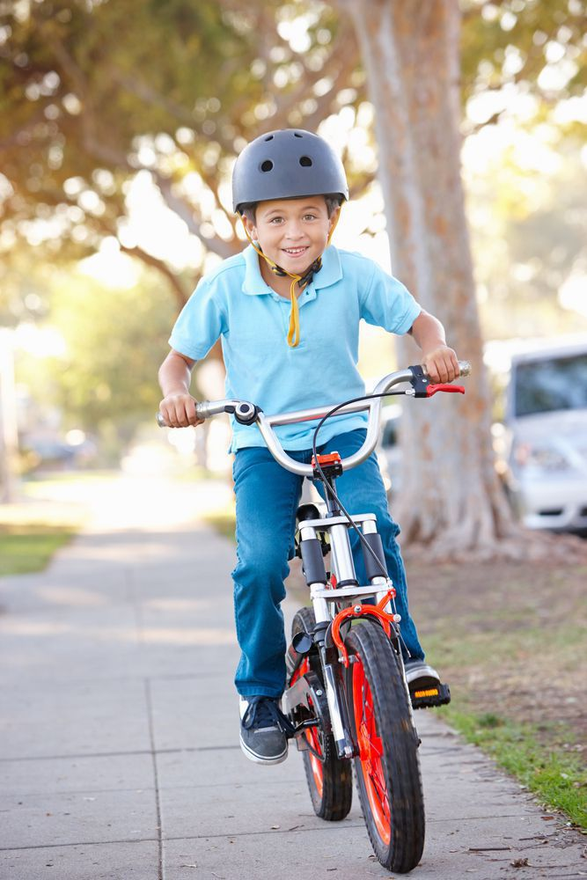
#2
Tip
Ride on the Sidewalk

Slide 14
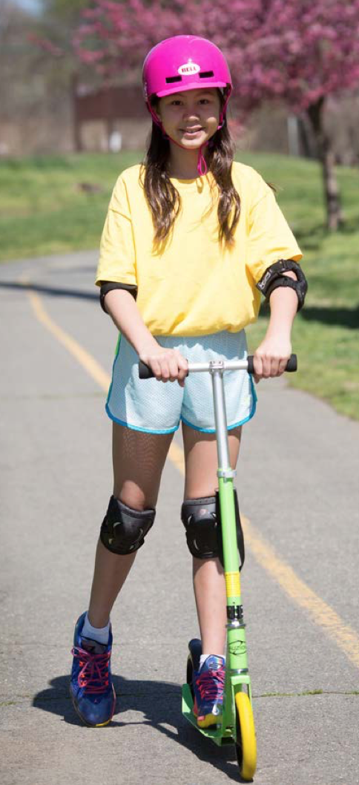
#3
Tip
Wear Bright colors when riding

Slide 15
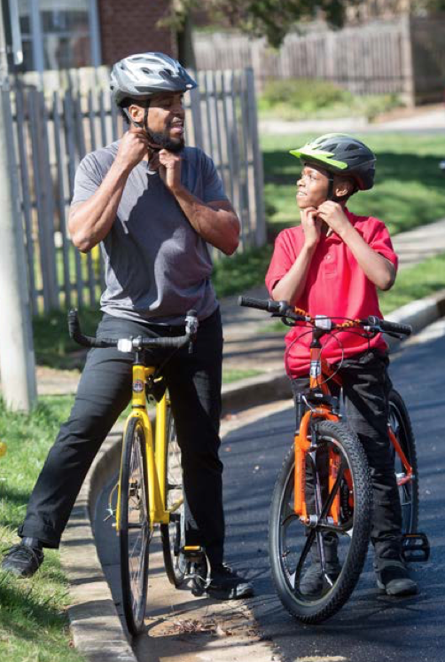
#4
Tip
Always ride
with an adult

Slide 16
Your brain is like this egg.
Watch how the helmet keeps it safe.
Click here!

Slide 17
Quiz time

