Slide 1
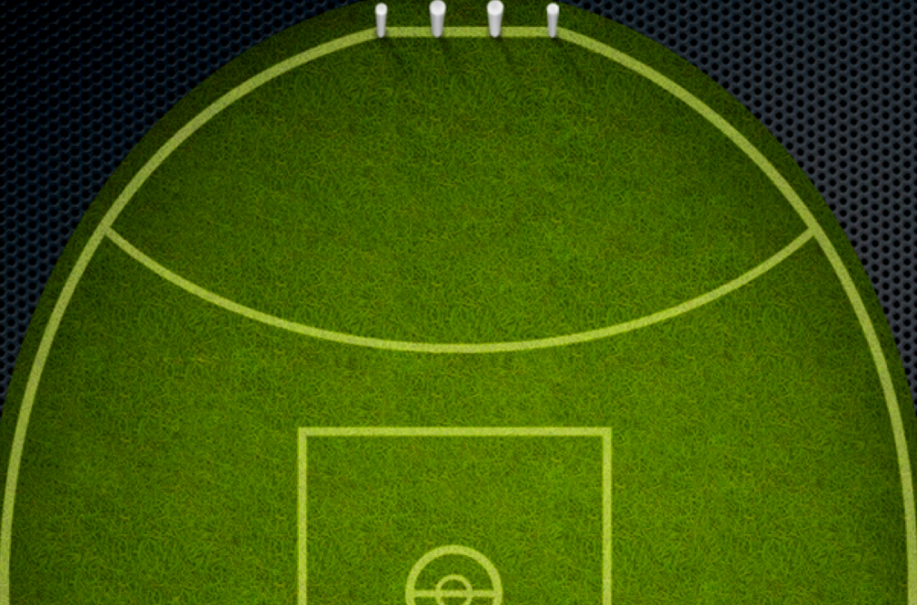
Shuttle
Start in one lane, then run to 20m, pivot turn back to start, then run to 40m, pivot turn back to start, then run to 60m, pivot turn back to start then change lanes. Complete all five lanes as fast as you can. Full running distance 1.2km
20m
40m
60m

