Slide 1
DIFY Website Recreation

Slide 2
Steps to Save SB2/SB3 Customer with SB4
With hundreds of thousands of customers on our legacy platforms, there is ample opportunity to save customers with a fresh, modern, re-created site on Tower if they’re looking to cancel or in need of a fresh look for their sites.
Admittedly, this process will not be 100% clean to start, but we want to start funneling these requests to Affinity.
We want your feedback on what works/doesn’t work with this pilot.
Here are the steps for the MVP of Internal Saves with SB4.

Slide 3
Examples: when to offer SB4 to Customer
If a customer calls to and mentioned that their sites aren’t mobile friendly and or optimized.
They don’t see any templates that they like.
They feel like their site is outdated.
There are too many bugs.
Etc. (Use your best judgement!)

Slide 4
How to Save an SB2/SB3 Customer with SB4
Customer calls in to cancel:
Determine the reason for customer’s cancellation. If reasons are their current builder doesn’t suit their needs, they’re encountering bugs, or want an updated site (among others) then saving them with SiteBuilder4 makes sense. You can prod a bit if they’re cancelling for other reasons to see if a re-create makes sense, but I suspect those that are closing their business won’t want another website ☺
Here is the link to Sample sites that can be used to get the customer’s buy in for the recreation http://www.mbywebsiterecreation.com
Key selling point can include but not limited to:
Amazing Mobile features & aesthetics
Modern Look
Ease of maintenance
Cancel my @#$*
Website

Slide 5
Customer Opts in
With your amazing ability to get the customers to be interested in the offer, here are the steps needed to ensure the order is placed successfully.
Access the Subscription Product Orderer in production: Click here for screenshot www.vpcustomercare.com/vp/manager/digital/SubscriptionProductOrderer.aspx
In the “Products on PAID” grouping add either to the customer’s cart:
DIFY Standard Recreation Monthly ($15/month with Free Trial)
Or -
DIFY Standard Recreation Annual ($135/ month with Free Trial)
Note: if price is an issue, once they order, you can use the PAID CCT tooling to reconcile the price
Prompt customer to check out, and notify them that after checkout, they will be able to provide some information about their current site.

Slide 6
Customer Opts in cont.
Check Out Process
After CC goes through, the brief will be accessible through the digital order confirmation tile immediately after checkout. They will also be able to access if from their dashboard, but immediately after order would be preferred.
The first email they will receive is an “order confirmation” email. The email to review their site will be sent when the site is ready to review (which should be around 2 business days).
Use the brief reference to walk customers through. Once they submit, an agent would be able to edit the brief on behalf of the customer.PS – Agents are expected to assist the customers with filling out the design briefs
If the CC does not go through successfully then the agent is expected to connect the customer to CSS so they can take the CC info over the phone
PS – Agents are expected to advise CSS to assist the customer with editing the design briefs
CSS should assist the customer with completing the questions in the design briefs
See preview of questions in the brief
Domain name
What they like currently
What they want changed, different, or don’t like
As reference, here is the brief that they will submit: https://vistaprint.co1.qualtrics.com/jfe/form/SV_6Rm9WsZls20nfUN

Slide 7
Customer Opts in cont.
Check Out Process
The customer will receive status notifications via email -or- go to their dashboard to get the most up to date information
Let the customer know that they will be receiving email notification to review their website from their dashboard (it may be marked as spam, so they’ll have to monitor their inbox or return to their dashboard to see the status).
Update: We are currently spinning up a team in Tunis to help reconcile their domain name after they accept their re-created site, as well as walk them through a tutorial of the new builder.

Slide 8
Steps to Access Dify Tower (SB4)
DIFY using SB4 will have 2 different flavors: Normal DIFY and Re-Creations. In addition to DIFY SB3 sites, all 3 types of jobs will be displayed in the Job Board. As part of the work to get on to SB4, we developed a new “Admin Board” (replacing the current job board) that will display SB3, SB4 (Tower), and Re-Creation DIFY jobs.
Below are the steps to access the new tool.
Once a job is created, the VP and Affinity systems (DIFY and Idea/JobTraq) will still function the same way:
DIFY w/ SB3: state will be defaulted to pending brief
DIFY w/ Tower (SB4): state will be defaulted to pending brief
Re-Creations w/ Tower (SB4): state will begin at “In Design” – customer will also submit a condensed brief, included here:
Access Admin Board - These new DIFY jobs (SB3, Tower (SB4), Re-Creations) will be displayed in the new Admin Board. To access the board, follow these steps:
Navigate to https://admin.designservices.digital.vistaprint.com
On the first screen, type in your VP email address
Click “Log In”
Click continue
You should now be single signed on to the Admin Board and see all the jobs

Slide 9
Steps to Access Dify tower (SB4) cont.
All information here should be the same as the previous job board. If you click on the blue box in the details column, you will see all the relevant information for the customer’s request. In the product column, this will denote if it’s SB3 (BHG, BRL, BDB, BDV), DIFY w/ Tower, or DIFY Tower-Recreate.
*We will add additional filtering depending on usability requests
Agents from the admin board, clicking the “view brief” button will allow agents to edit the brief on behalf of the customer. Please be mindful of the status of the job – if design has started, updated information may not be used during design.
If the case, Tunis will help when the customer is under review
Click here for screenshot for brief. Scroll down on the page for more info
You can also access the customer’s builder here as well

Slide 10
Steps to access customer builder
Click on the blue square in the “Details” column for the appropriate job
Note: in actions group, you can view the customer’s brief as well
Click “Open SiteBuilder” button
This will log you in to the appropriate builder assigned to the job
There will be instances where the customer calls in after to add information and or an image. Agents are expected to add the info for the customer by entering the builder DO NOT PUBLISH

Slide 11
Completing Design Work (and subsequent revisions)
Click on the blue square in the “Details” column for the appropriate job
Note: in actions group, you can view the customer’s brief as well
Click “Open SiteBuilder” button
This will log you in to the appropriate builder assigned to the job
There will be instances where the customer calls in after to add information and or an image. Agents are expected to add the info for the customer by entering the builder DO NOT PUBLISH
Notes:
Only use the admin tool for status updates. In addition, when we walk customers through the brief and they submit, but realize they missed something, immediately use the admin board to update the brief they just submitted.

Slide 12
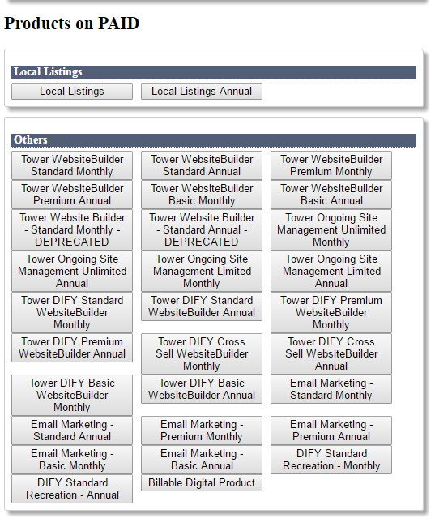

Slide 13
