Slide 1
Jesus Cleanses A Leper

Slide 2
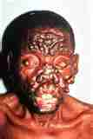
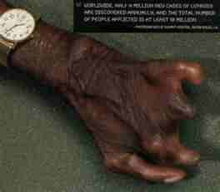
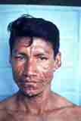
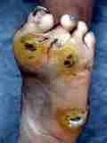

Slide 3
Luke 5:12-14 And it happened when He was in a certain city, that behold, a man who was full of leprosy saw Jesus; and he fell on his face and implored Him, saying, "Lord, if You are willing, You can make me clean."
13 Then He put out His hand and touched him, saying, "I am willing; be cleansed." Immediately the leprosy left him. 14 And He charged him to tell no one, "But go and show yourself to the priest, and make an offering for your cleansing, as a testimony to them, just as Moses commanded."

Slide 4
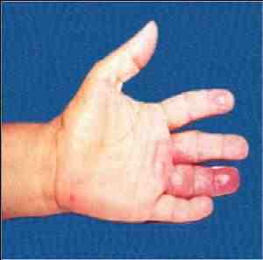
What do we know about this dreaded disease?
Leprosy or Hansen's disease , chronic, mildly infectious malady capable of producing, when untreated, various deformities and disfigurements. It is caused by the rod-shaped bacterium Mycobacterium leprae, first described by G. Armauer Hansen, a Norwegian physician, in 1874. The mode of transmission is not fully understood. It is thought to be transmitted by nasal discharges and skin sores, possibly also by contaminated objects and arthropods. Only 5% of those exposed acquire the disease. The onset is intermittent and gradual; symptoms may not appear until years after exposure. It is seldom fatal, but its involvement of the peripheral nerves destroys sensation and makes the patient prone to inadvertent injury.

Slide 5
Leprosy has affected humanity for over 4,000 years, and was well-recognized in the civilizations of ancient China, Egypt, and India. DNA taken from the shrouded remains of a man discovered in a tomb next to the Old City of Jerusalem shows him to be the earliest human proven to have suffered from leprosy. In 1995, the World Health Organization (WHO) estimated that between 2 and 3 million people were permanently disabled because of leprosy at that time. In the past 20 years, 15 million people worldwide have been cured of leprosy. Although the forced quarantine or segregation of patients is unnecessary in places where adequate treatments are available, many leper colonies still remain around the world in countries such as India (where there are still more than 1,000 leper colonies), China, Romania, Egypt, Nepal, Somalia, Liberia, Vietnam, and Japan. Leprosy was once believed to be highly contagious and sexually transmitted, and was treated with mercury—all of which applied to syphilis which was first described in 1530. It is now thought that many early cases of leprosy could have been syphilis.

Slide 6
Japan had enacted the Leprosy Prevention Law in 1953, which prescribed segregation and isolation of leprosy patients as part of their treatment. This Act was repealed in 1996. But the damage had been done. Those who had been suffering from leprosy were ostracized by the society and they found it extremely difficult to integrate into the society again.
NEW DELHI, India, April 11 -- DEPUTY DIRECTOR general (leprosy), Government of India, PL Joshi said the leprosy patients who were below poverty line (BPL) would get Rs 5000, if they were selected for corrective surgery, to restore their limbs.
"The amount will be given to them to compensate for the loss of wages due to hospitalisation for 10-15 days, after the surgery," said Joshi, while reviewing the leprosy control programme of 28 districts in UP, at Leprosy Mission Hospital, Naini, on Friday. Presiding over the meeting, Joshi laid stress on the need of early detection of leprosy patients, so that they could be saved from permanent disability

Slide 7

Why even discuss this today, no problem with it here in U.S. ?
This looks The Way Sin Looks To God!

Slide 8
MAN OFTEN HAS A HARD TIME REALIZING THAT HE SHOULD VIEW THINGS AS GOD VIEWS THEM !
Luke 5:12-16
This narrative, both in Matthew and Mark. It is said to have been in a certain city (v. 12); it was in Capernaum, but the evangelist would not name it, perhaps because it was a reflection upon the government of the city that a leper was suffered to be in it. This man is said to be full of leprosy; he had that distemper in a high degree, which the more fitly represents our natural pollution by sin; we are full of that leprosy, from the crown of the head to the sole of the foot there is no soundness in us.
(

Slide 9
What we must do with spiritual leprosy !
We must seek Jesus!
We must humble ourselves before him!
We must earnestly desire to be cleansed from the defilement!
We must firmly believe Christ has the ability to cleanse us!
We must be active in prayer for forgiveness!
We must surrender to the will of Christ!

Slide 10
What can we expect to see from Christ?
Condescending
Compassionate
All Sufficient

Slide 11
What Christ Expects From Those Being Cleansed?
Humility
Thankfulness
To Maintain our Duty

