Slide 1
THE APPEAL PROCESS
Barry Walter
VFW Service Office

Slide 2
Topics
Notice of Disagreement
Time limits
Substantive Appeal (VA Form 9)
VA Form 646
Advancement on the Docket
Substitution Cases at the Board
Hearings
BVA Decisions/Remands
What Next?
Important Links/info

Slide 3
The words most feared:
“I want to appeal!”

Slide 4
What Constitutes an Appeal?
A timely Notice of Disagreement.
VA issued a Statement of the Case.
A timely filed Substantive Appeal
(VA Form 9).
38 CFR 20.200

Slide 5
The Notice of Disagreement (NOD)
  Must be a written communication.
    (Appellant or their accredited representative)
  Must be filed with the office that made the decision.
  Must be filed within one year of when the RO’s decision letter was mailed. (38 CFR 20.302(a))
  (The date of letter is considered the date mailed)
  Must express disagreement and a desire for appellate review.
  Should say with what part of the decision and why the appellant disagrees.
  Can be filed on a VA form 21-4138 or just a piece of paper.

Slide 6
Sample Wording
Please accept this statement as a Notice of Disagreement and request for appellate review of the rating decision dated _________, which denied my claim for service connection for ___________,
my claim for an increased rating for _________,
the evaluation assigned to my ______ disability,
the effective date of _______ established for my ________disability.
The reason I disagree is because ___________.
I request a De novo review by a DRO.
I request a personal hearing before the DRO.

Slide 7
De novo Review
A review by a Decision Review Officer (DRO)
starting at the original rating decision for the
issue(s) on appeal. It should be a thorough
review of all the evidence and decisions up to the
last decision making sure the decisions were
correct.
Any additional evidence sent with the NOD will
also be taken into consideration when the DRO
makes a decision after the De novo review.
38 CFR 3.2600 (a)

Slide 8
Traditional Review
A review by someone in the Appeals Team at
the regional office, but it is not a De-novo
review. The reviewer, sometimes a Rating
Specialist, reviews any additional evidence
received with the NOD and either grants the
benefit sought or if any issues(s) continues to be
denied, prepares a Statement of the Case.
38 CFR 3.2600(f)

Slide 9
No Selection on the NOD?
If the Notice of Disagreement does not request a De novo or Traditional review, the VA will send a letter to the appellant, explain both reviews, and give them 60 days to make a selection.
If the appellant fails to make a selection within 60 days from the date of the letter, VA will proceed with the Traditional Review. 38 CFR 3.2600(b)
Q: So what’s the difference and why would you chose one
over the other?
A: A De novo review is much more thorough and a DRO could use Difference of Opinion to change the rating.

Slide 10
Difference of Opinion
The DRO can change the decision based on the record if he/she believes that the better rating practice would be to grant. The DRO cannot reverse a decision with which he/she just disagrees. 38 CFR 3.2600 (a)
  Difference of opinion does not require new medical evidence to change the previous decision.
  The Decision Review Officer is the only person in the Regional Office who can change a rating based on difference of opinion.

Slide 11
What Happens to the NOD?
  The file is reviewed along with any additional arguments or evidence included with the NOD.
  The DRO or Appeals Team member will then either grant the benefit sought or if any issue(s) continues to be denied, prepare a Statement of the Case.

Slide 12
What’s a Statement of the Case (SOC)?
  It’s a detailed description of the facts, laws, regulations, and reasons used by the RO in reaching their decision.
  It’s intended to help the appellant understand the laws and regulations for the RO decision.
  It’s also intended to help the appellant with their appeal.
  38 CFR 19.29

Slide 13
VA Form 9
Included with the SOC is a VA Form 9, “Appeal to Board of Veterans’ Appeals”. It’s also called a Substantive Appeal.
  Once the appellant has reviewed the SOC, the VA Form 9 must be completed and returned to the VA timely so that BVA will review the issues being appealed. The appellant should make a comment on each issue on appeal.
  38 CFR 19.30

Slide 14
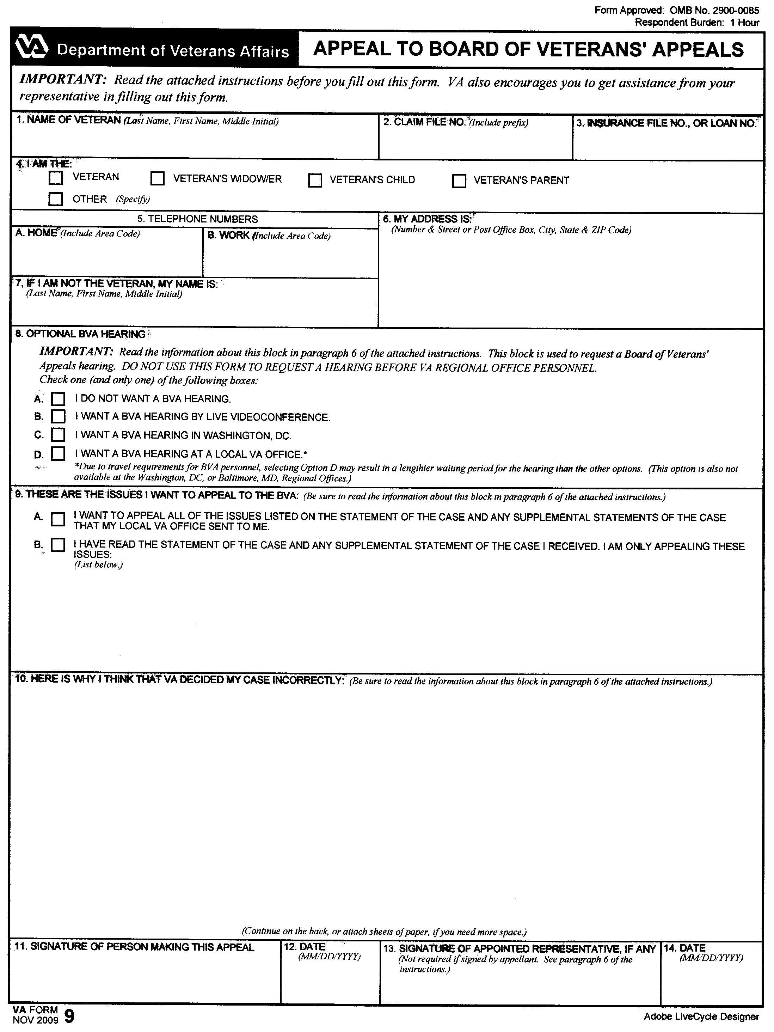

Slide 15
Form 9
Must include a selection of personal hearing versus no hearing request
Must identify the issues being pursued on appeal
Must include some discussion of the each issue

Slide 16
HEARINGS
If the appeal has not yet been certified to the Board, a hearing may be held before a Decision Review Officer at the RO.
Once the appeal has been certified to the Board, any hearing requested on the appealed issues will be held before a BVA Judge .

Slide 17
BVA Hearings can be Conducted Different Ways:
  1. In person at the Board in Washington, D.C.
  2. Locally before a Travel Board of the BVA.
  3. Video teleconference hearing before a BVA Board member.
  Q: Which is the quickest way to get a hearing?
  A: Probably a video hearing

Slide 18
Time Limits for Filing VA Form 9
#1 – 60 days from the date the SOC is mailed or the remainder of the one year period following the date of the original decision whichever is greater.
38 CFR 20.302 (b)
#2 – 60 days from the date the SSOC is mailed or the remainder of the one year period whichever is greater. 38 CFR 20.302 (b)(2)

Slide 19
Time Limits, Form 9
Remember, the time is measured from the day
the VA mailed the notice of the decision being
appealed. The date of the letter is considered
the date it’s mailed.
  However, the law does guarantee an appellant not less than 60 days to review a SOC or SSOC.

Slide 20
Appeal Example #1
May 13, 2010 – Date of VA letter notifying the claimant of the decision.
June 15, 2010 – Notice of Disagreement received at the VA
November 2, 2010 – Date of VA letter with attached Statement of the Case.
December 18, 2010 – Additional information submitted.
March 18, 2011 – Date of VA letter with attached Supplemental Statement of the Case.
May 4, 2011 – Additional information submitted.
October 3, 2011 – Date of VA letter with attached Supplemental Statement of the Case.

Slide 21
Appeal Example #1
Q: What is the last day to submit VA Form 9?
A: May 16, 2011
Q: What is the earliest date to submit VA Form 9?
A: November 3, 2010

Slide 22
Appeal Example #2
May 13, 2010 – Date of VA letter notifying the claimant of the decision.
June 15, 2010 – Notice of Disagreement received at the VA
November 2, 2010 – Date of VA letter with attached Statement of the Case.
December 18, 2010 – Additional information submitted.
March 11, 2011 – Date of VA letter with attached Supplemental Statement of the Case.
Q: What is the last day to file VA Form 9?
A: May 12, 2011

Slide 23
The BVA Docket
  Except as otherwise provided, the Board will consider
  and decide appeals in date order according to each
  appeal’s place upon the docket. – 38 CFR §20.900
  The docket number is assigned based on the date the
  Substantive Appeal (VA Form 9) is received at the
  regional office.
Q: When should you submit a VA Form 9?
A: As early as possible after the SOC is issued, to lock in the earliest docket date possible.

Slide 24
VA Form 646
Once the VAF 9 has been filed with the VA, the veteran’s accredited representative at the regional office will be given the opportunity to make any final arguments prior to the case being sent to the Board.
VA Form 646, Statement of Accredited Representative is used for this purpose. Additional information is not submitted with this form.

Slide 25
Informal Hearing Presentation
Once at the Board, the case will be provided to a VSO appeal consultant to prepare a brief called an Informal Hearing Presentation (IHP). This is the Board VSO’s equivalent of a 646. The IHP will discuss the merits of the appeal.
An IHP is not prepared when the appellant has a Board hearing. The hearing is considered an IHP.

Slide 26
90 DAY RULE
The appellant has 90 days after the appeal is received at the Board to:
Request a change in representation.
Request a personal hearing.
Submit additional evidence.
The appellant will receive a letter from the Board explaining this regulation when the appeal is received at the Board.
38 CFR 20.1304

Slide 27
After 90 Days….
After 90 days, the appellant must demonstrate good cause for the delay such as:
Discovery of evidence after the 90 day period.
Illness.
Death of an individual representative.
Prepare a motion based on 38 CFR 1304(b), explain the change and the reason for the change.
Note: Anytime evidence is sent to the Board, make sure you prepare a letter stating you want to waive regional office jurisdiction. Otherwise, the case will have to go back to the regional office for consideration.

Slide 28
Advancement on the Docket
The Board may grant a motion to advance an appeal on the docket for the following reasons:
The claimant is seriously ill.
The claimant is under severe financial hardship.
The claimant is of an advanced age (75 years or older).
There is other sufficient cause, to include administrative error that has resulted in a significant delay in docketing the case.
See 38 CFR 20.900 for guidance in motion filing.

Slide 29
Substitution Cases at the Board
When a claimant dies on or after October 10, 2008, an eligible survivor must file a request within one year to be “substituted” as the claimant for purpose of processing the claim to completion. VA Form 534 meets that requirement.
Substitution means new additional information can be submitted for the appeal, unlike the old law where only the “evidence of record” was used to decide the appeal.
The Board does not have jurisdiction to make the substitution decision. The appeal will be dismissed and returned to the regional office.
Once the substitution decision has been granted, the appeal will be returned to BVA and keep the SAME docket number.
VBA Fast Letter 10-30

Slide 30
BVA Decisions
When a BVA Judge decides the case, he/she can do several things:
Grant the issue(s).
Deny the issue(s).
Remand the issue(s).
The decision may include all three.
The Board will send the appellant and the VSO a copy of the decision. If the issue is granted or denied, the Board’s decision is final and will include appeal rights to the Court of Appeals for Veterans Claims (CAVC) on the denied issues. Any issue that is remanded is not a final decision.

Slide 31
REMANDS
If the Board finds that it does not have enough information to make a decision on a specific issue, the Remand Decision will instruct the regional office or the Appeals Management Center (AMC) what it needs to make a decision.
Or, if there is something that has happened, such as a change in law, request for a hearing, etc. that the appeal requires re-adjudication, the appeal is remanded.
Court of Appeals for Veterans Claims: Stegall vs. West (6/98) held that all remand orders must be complied with before the case is returned to the BVA. If remand orders cannot be complied with for reasons such as the whereabouts of the appellant are not known or that, after development, the requested evidence cannot be obtained, then the folder must document the reason(s) for noncompliance.

Slide 32
Remands
Once the information has been received (or an unsuccessful attempt has been made), the regional office or AMC will make another decision and grant the benefit sought or continue the denial and issue a SSOC.
The appellant should review the decision, and return the attachment which states whether or not he has or does not have additional evidence to submit. It is also his chance to tell the Board why he does not agree with the decision.

Slide 33
BVA FINAL DECISIONS – What Next?
Denials:
File a motion asking the Board to reconsider the claim or review the case because there was a clear and unmistakable error (CUE) in the Board’s decision. The motion must discuss the reason for the request.
File an appeal with the US Court of Appeals for Veterans Claims. There is a time limit of 120 days from the date of the decision, so pay attention to the date of BVA’s decision.
Go back to the local VA and reopen the claim.
Do nothing.

Slide 34
BVA FINAL DECISIONS – What Next?
Grants:
Sometimes the BVA decision will include the percentage and effective date; however, most of the time it doesn’t.
When the RO does the rating implementing the BVA decision check for percentage and effective dates on grants/and increases. You can appeal that decision on percentage and/or effective date.

Slide 35
Court of Appeals for Veterans Claims
If the appellant continues to disagree with BVA’s decision, he can file an appeal with the Court.
VFW does not represent, nor recommend an attorney or law firm. We will refer them to the Pro Bono Consortium at the Court.
There is a 120 day time limit to file and a $50 filing fee that can be waived. (hardship).
http://www.uscourts.cavc.gov/

Slide 36
Opportunity:
Request for Reconsideration by Rating Board?
There is no such provision in regulation, however:
Submission of new evidence
Identification of evidence of record not considered
Does not extend appeal period unless evidence is in timely response to DTA letter

Slide 37
Opportunity:
Clear & Unmistakable Error (CUE)?
No Time Limit for Request!
38 CFR 3.104(b)
38 CFR 3.105(a)
38 CFR 20.1403
An unappealed RO decision, the elements of a CUE, as outlined in Russell v. Principi,
3 Vet.App. 310(1992).

Slide 38
CUE
Review of evidence of record is so compelling that reasonable minds would not differ, undebatable.
Under laws which existed at the time.
A different decision on the evidence would have manifestly changed the outcome.

Slide 39
Opportunity:
Administrative Review Request?
Request by VSO prior to SOC for review by VA Central Office.
Very unique circumstances.
Not every VSO has established procedures for AR requests.

Slide 40
Important Links/Info
The Department of Veterans Affairs – Information about VA, pamphlets and online forms, How Do I Appeal pamphlet. www.va.gov
Veterans Benefits Administration (VBA) – Benefits information, links to VA Forms, regulations. www.vba.va.gov/vba
Department of Veterans Affairs – Electronic FOIA reading room – Links, answers to a number of VA issues. www.foia.va.gov
United States Court of Appeals for Veterans Claims – Court cases, information on how to appeal a BVA decision and filing with the Court. www.uscourts.cavc.gov
National Archives and Records Administration Code of Federal Regulations – Published federal regulations, including 38 CFR. http://www.gpoaccess.gov/cfr/index.html

Slide 41

QUESTIONS ?

