Slide 1
The Key to Financial
Security
UNDERSTANDING
THE IMPORTANCE
OF
INCOME
DIVERSIFICATION
By:
John K. Doherty
July 2009 - 2019

Slide 2
Welcome Message – The Problem
Dear Friend,
Are you making the kind of money you want?
Are you happy with your financial picture?
The fact is, adults today are at a huge disadvantage when it comes to their financial future.
The statistics are staggering; we are faced with:
Lower incomes when compared to inflation
Higher cost of living; especially in education and housing
Major debt due to college loans and credit cards, and
The inability to save and accumulate wealth for the future.
Documentary: Millennials & Debt | No Room to Maneuver – 21:44 min
www.youtube.com/watch?v=53GiUoEeIvA
A real education: The plight of teachers– 8:13 min
www.youtube.com/watch?v=JbqbxtUQYnQ

Slide 3
The Income Crisis of the American Middle Class
The videos below reflect the uncertainties Americans are facing as it relates to their income, job security, and their ability to save for retirement. The total time for ALL videos is about 45 minutes.
In today’s economy, even two-income families struggle to make ends meet – 7:25 min www.youtube.com/watch?v=qyPW9Z5_jsk
20/20 Diane Sawyer My Reality: A Hidden America (The impact of high housing costs) – 16:06 min www.youtube.com/watch?v=Hhh0Qcl_yMA
Why so many Americans in the middle class have no savings – 11:59 min
www.youtube.com/watch?v=tamC-M8TxtY
Student Loans: More Debt, More Defaults, More Problems – 8:27 min
www.youtube.com/watch?v=6p0HyjtfaMg

Slide 4
The Workforce of the Future
The workforce of the future is changing – are you financially prepared for this economic shift? The videos below explore how automation is (and will) change the landscape of our workforce. The total time for ALL four videos is about 50 minutes.
Robots and AI: The Future Is Automated and Every Job Is At Risk – 15:11 min www.youtube.com/watch?v=rnBAdnNIIXk
Do labor-saving robots spell doom for American workers? – 8:42 min
www.youtube.com/watch?v=zwwPtKiIn4M
How we'll earn money in a future without jobs | Martin Ford – 14:37 min
www.youtube.com/watch?v=swB7Ivct8d8
Are we on the brink of a jobless future? – 9:13 min
www.youtube.com/watch?v=dNhBfvOQ_RY

Slide 5
THE FACTS OF LIFE
In the United States today, the top 1% of the money earners (the
millionaires and billionaires) control roughly 67 % of this country’s
wealth. That leaves only 33% of this country’s wealth for the remaining
99% of us.
So Where Do YOU Stand?
1) Do YOU have a game-plan to control debt in your life?
2) Do YOU have a program in place to fund your children’s education?
3) Are YOU saving enough to provide for retirement security?
4) Are YOU happy with your overall financial picture?
Do YOU control your life or are you controlled by other forces?

Slide 6
OTHER FORCES
FACT:
Most people are controlled by outside forces, such as;
- creditors, the government, financial institutions, and employers
SOLUTION:
YOU take control and begin solving your own financial problems.
There are three questions you should be asking yourself:
1) Am I truly getting the most out of my efforts?
2) Am I really spending my money wisely?
3) Am I realizing my dreams?
How Cash Changes The Way You Look At Money - Dave Ramsey – 7:49 min
www.youtube.com/watch?v=1liYvgX799Y

Slide 7
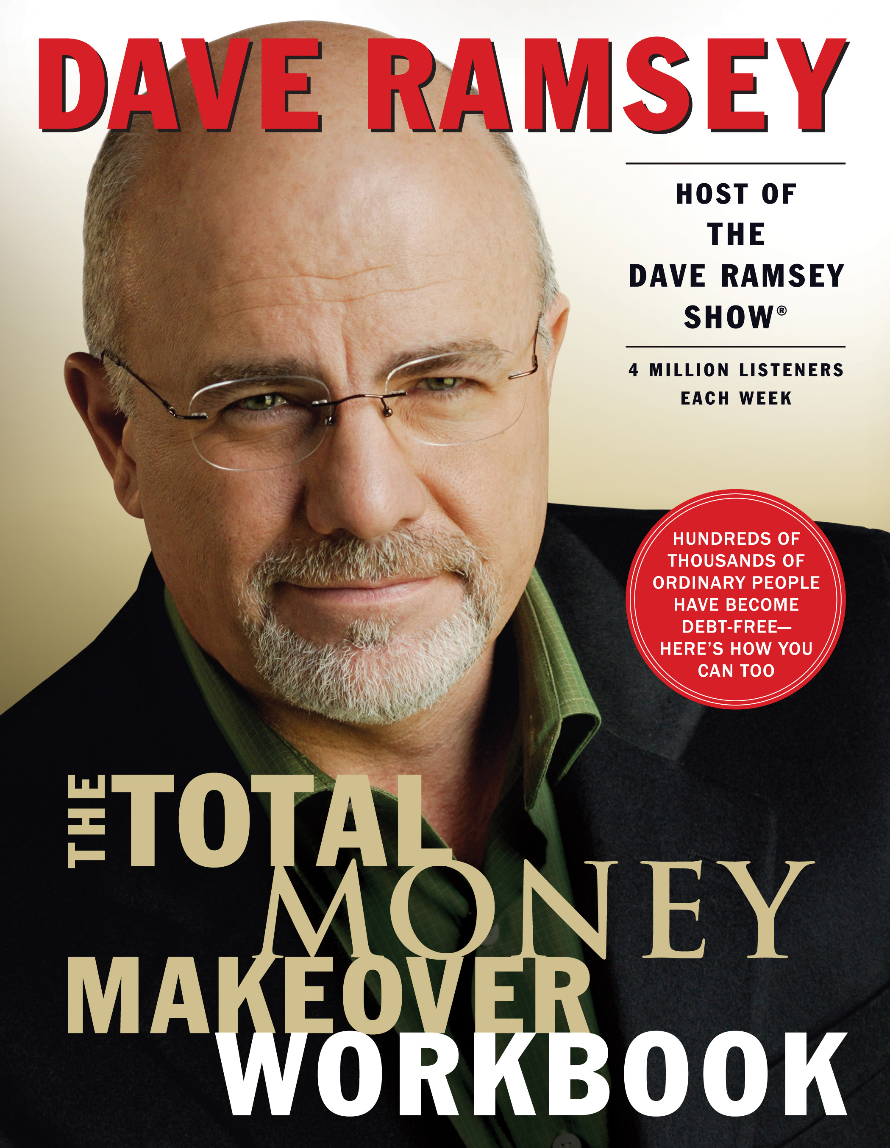
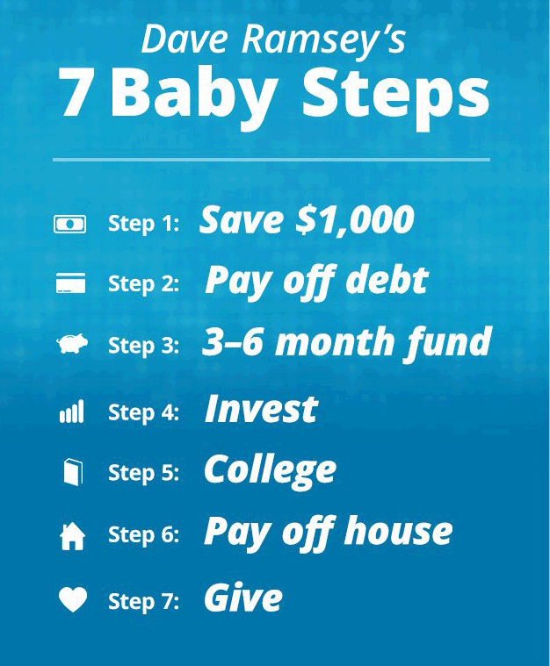
Learn From a Financial Expert
Dave Ramsey is a personal money-management expert, author and popular national radio personality.
Dave Ramsey: How to Get Out of Debt
www.youtube.com/watch?v=i2Xx3mN5XSU
How To Be Good With Money – 7:49 min
www.youtube.com/watch?v=0wi6b3wWwnw

Slide 8


Dream BIG and Have a Financial Goal!
Dave Ramsey’s brutally honest advice to making money & getting out of debt. The total time for ALL videos is about 54 minutes.
Live Like No One Else - Dave Ramsey's Story – 18:15 min
www.youtube.com/watch?v=r1NJzEYARlM
Start With A Dream, End With a Goal | Dave Ramsey – 11:19 min
www.youtube.com/watch?v=P6BJdfIWITo
You Become What You Think About | Dave Ramsey – 7:48 min
www.youtube.com/watch?v=wkyCIoH10Uo
Now Is The Time To Make A Change - Dave Ramsey Rant – 8:08 min
www.youtube.com/watch?v=ae-SAXb5yMU
YOU Can Be A Millionaire - Dave Rant– 8:16 min
www.youtube.com/watch?v=XCT7Qbc9lRA

Slide 9
WHY THE RICH GET RICHER
.... A man had to go away for two weeks on business. He went to a Manhattan bank and told the teller he needed a $5,000 loan. The bank teller said fine, but that he would need to see some collateral.
The man said sure and handed him the keys to his Rolls Royce. The bank teller gave the keys to one of the clerks and instructed him to drive the car to the parking garage underneath the bank for safe keeping. The man thanked them and left.
He returned two weeks later, as planned, to pay off the loan. The bank teller said sure, that will be $5,000 for the principal and $15.82 for the interest. The man said no problem and paid off the loan. The clerk then went to retrieve the man’s car.
Before the man could leave though, the bank teller stopped him. He told him that while he was away they found out that he was a millionaire. They were curious to find out why a millionaire would need to take out a $5,000 loan.
The man replied, with a smile, where else could I park my Rolls Royce in Manhattan for two weeks and pay only $15.82? ....
Now, doesn’t that make YOU think?

Slide 10
Here is something to think about:
Ever wonder how millionaires make their money? What do they know that we don’t?
The answer is quite simple… it’s not what they know, it’s what they DO.
If money is power,
AND there is power in numbers,
AND money equals independence;
THEN…
there is money in numbers AND
numbers equals independence.
THEREFORE…
“Financial Independence” must be
related to the number of people
on your money making team.”

Slide 11
Welcome Message – The Solution
Did you know that it actually takes just as much effort to create wealth as it does to “earn a living”?
The key is recognizing top trends and utilizing business systems that are currently in place.
I am on a mission to educate people on the importance of "Income Diversification” and the benefits of residual (passive) income.
If you ever thought about starting a home-based ecommerce business, then this is definitely the time.
Stop living paycheck-to-paycheck and let me show you how to achieve your financial goals.
Together We Can Achieve Greatness!
John K. Doherty
Ecommerce Business Consultant
239-770-6847
Jdoherty239@aol.com
The Characteristics of an Entrepreneur | Dave Ramsey – 5:20 min
www.youtube.com/watch?v=_H9KnNi38Zw

Slide 12
WHAT IS WEALTH?
The educational videos below explain how thoughts and mind set can determine your financial future. The videos are very informative and are definitely worth watching. The total time for all four videos is about 35 minutes.
Why The Rich End up Poor But The Wealthy Enjoy Life – 7:49 min
www.youtube.com/watch?v=MK688vY8ouA
Rich Dad Poor Dad Summary (Animated) – 8:51 min
www.youtube.com/watch?v=TcNpoc-lF0M
Business of the 21st Century by Robert Kiyosaki (Animated) – 7:35 min
www.youtube.com/watch?v=l5s6uzM6SNo
Think and Grow Rich by Napoleon Hill (Animated) – 8:57 min
www.youtube.com/watch?v=K2CDU1AeAj0

Slide 13

Be a Part of the Next
$ Trillion Dollar Industry $
The Health & Wellness industry is on track to becoming the next trillion dollar industry.
It is projected that
this industry will create
10 million millionaires
over the next 10 years.
Many of these new millionaires will achieve this milestone through the Direct Selling and Network Marketing industry.
The reason why? – Trends!.

Slide 14
The Business of the 21st Century!
When you consider our current economy and the impact of these popular trends…
Demand for Health & Beauty products
Online Purchasing (E-commerce)
Sharing & Networking (social media)
Home-based Business Opportunities
“Timing Really IS Everything”

Slide 15

Making Money in the 21st Century
The Internet and websites have made it
so ANYBODY can become wealthy - regardless
of their education or background.
People don't realize how easy
making money is today...
It's no longer about "Job Security" (Paychecks & Pensions)… it's now about “Financial Security" (Residual or Passive Income).
    Jobs = Paycheck
    Residual Income = Wealth $$

Slide 16
Change Your 20th Century Thinking
Into 21st Century $uccess!
The Internet business trend and e-commerce (online sales) is the new way people are making money in the 21st century.
“The Internet is to the 21st century, as
the automobile was to the 20th century -
it changed how things got done.”
Invest in people, not companies

Slide 17

The Key to Wealth – Teamwork
Most people don’t realize that making money is a team effort – nobody can be successful by themselves.
True success can only happen when
a group of people work together to achieve a common goal.
Who is on YOUR “money-making” team?

Slide 18
So Why Start a Home-Based Business?
Will a $50,000 a year income provide enough financial security for this current generation?
In today's economy, having a secondary source of income is not just a good idea, it is almost a necessity.
A home-based business can allow individuals, and families, the flexibility
to supplement their income - on their own time, at their own pace - while regaining control of their finances.
Whether you are a single parent, a college student, or just someone looking
to supplement your income - starting a home-based business can be a fun and effective way to generate residual income.
By generating a secondary source of income, it can act
          as insurance if your primary source of income is lost.

Slide 19
The Benefits of a Direct Selling Business
  Flexible hours (Part-time or Full-time)
  Low investment vs. high returns
  No overhead, inventory, employees, or boss
  Make money shopping and referring products
“A direct selling / network marketing business
is one of the best investments I ever made.”
– Warren Buffett
Why NOW is The PRIME TIME For Network Marketing – 4:32 min
What financial experts think about this business model. (2011)
www.youtube.com/watch?time_continue=257&v=e3J6YisuPW4

Slide 20
Three Easy Steps to Achieve Wealth in the 21st Century
Step 1: E-Commerce
Make purchases online
Step 2: Duplication
Refer others to make purchases
from the same online company
Step 3: Residual Income... aka wealth
Earn a percentage based on the total purchases made by your "network of shoppers"
It's THAT $imple!

Slide 21
TOP BUSINESS TRENDS TODAY
This business just makes sense… it can’t get any easier!
Health & Beauty
With the Baby Boomers at or on the verge of retirement, the desire for staying fit and youthful is at an all time high.
Online Purchasing
With the ease and convenience of shopping online, more consumers are shifting their purchasing power to the internet.
Home-Based Businesses
With their financial security in doubt, many people are looking for other ways to generate income. (Income Diversification)

Slide 22
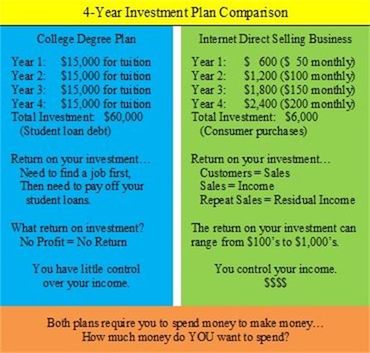

Slide 23
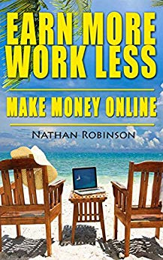
The New Retirement Plan
Many people today are struggling to pay their bills and are living paycheck-to-paycheck.
Home-based businesses have become a viable option for many to supplement their income and achieve their financial goals.
The direct selling (e-commerce) business model has become - in essence - the new retirement plan.
Burned-out millennials take on alternative work lifestyles – 7:46 min
www.youtube.com/watch?v=-nAco9ZGiAE

Slide 24

Your Financial Future Starts with Making a Choice
Once you begin thinking about
income diversification, planning and controlling your financial future can be easy.
Understanding the concept of Income Diversification is the key to generating great wealth and realizing the AMERICAN DREAM.
The Power Of Choice - Dave Ramsey
www.youtube.com/watch?v=VK2Z9Z8aXow
THINK America! - Dave Ramsey Rant
www.youtube.com/watch?v=K1usdOW4RyI
It’s never too early, or late, to start saving for retirement.

Slide 25

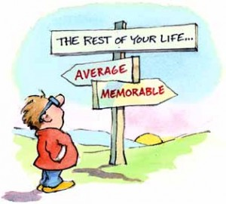



Slide 26
My 20 Reasons (Why’s) for Investing in a Direct Selling Business!
Getting out of debt.
Building residual income.
Stop living paycheck-to-paycheck.
Being my own boss.
Determining my own income and wealth.
Save more towards retirement.
Creating income diversity.
Reduce stress due to lack of finances.
Having the money and freedom to travel.
Living in a nice house with many rooms and a pool.
Driving a nice car.
Buying what I want, NOT what I can afford.
Having more fun doing what makes me happy.
Spend more time with family and friends.
Generating capital for other investments.
Philanthropy… giving back to society.
Meeting new people and making new friends.
Help others achieve financial freedom.
Living an above average lifestyle.
Achieving the American Dream!
What are YOUR reasons (WHY’s)?

Slide 27
SOME INSPIRATIONAL QUOTES
“Timing is everything.”
“Work smart, not just hard.”
“Success is not a one person job.”
“If you always do what you have always done, you will always get what you have always got.”
“I chose the path less traveled, and that has made all the difference."
-- Robert Frost, Poet
“You can’t stop people from thinking, but you can start them.”
-- Eleanor Roosevelt, First Lady
“Two men working as a team will produce more than three men working as individuals.”
-- President William McKinley
“Don’t ask what your country can do for you, ask what you can do for your country.”
-- President John F. Kennedy
“There are those who look at things the way they are, and ask why. I dream of things that never were, and ask why not.”
-- Senator Robert F. Kennedy
“You can play now and pay later, or you can pay now and play later. And the later is always greater.”
-- John K. Doherty

Slide 28
IS THIS OPPORTUNITY FOR YOU?
If you answer “YES” to many of the questions below, then this business might just be the perfect fit for you. Contact me today for more information.
Are you concerned about your financial future?
Do your expenses EXCEED your income?
Would you like to save more towards your retirement?
Do you like trying new things, meeting new people, and helping others?
Is eating healthy and staying active important to you?
Have you ever purchased anything online?
Do you know people who have purchased items online?
Do you think the popularity of online purchasing is a trend that will continue?
Have you ever thought about starting your own business?
Do you like the idea of being your own boss, controlling when and where you work, and how much money you make?

Slide 29
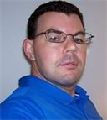
Contact Information
Johnny D’s Health Zone Plus
“The Healthy Choice for Healthy Lifestyles”
John K. Doherty
Ecommerce Business Consultant
Fort Myers, Florida
239-770-6847
Jdoherty239@aol.com
Facebook.com/johnkdoherty
Websites:
Business/Informational - www.healthzoneplus.com
Online Store - www.amway.com/jkdohertyhealthzone

