Slide 1
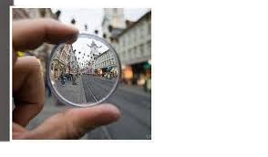
Can You Spy What is Happening in Plain Sight?
Human Trafficking: A COMMUNITY Conversation
Michelle Resendez, RN, SANE-A
Pediatric SANE
Franciscan Health Regional Center of Hope Coordinator
Co –Chair Indiana Protection for Abused and Trafficked Humans Task Force

Slide 2
OBJECTIVES:
Define Human Trafficking
Identify risk factors that increase incidence
Define role of healthcare professionals in addressing Human Trafficking
Be able to identify victims in unit/department setting
Identify barriers to disclosure by victims
Learn the importance of protocol development and coordinated response in your setting

Slide 3
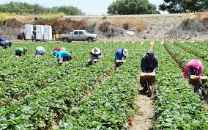
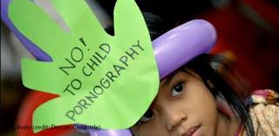
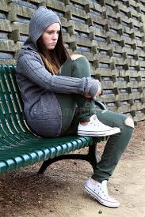
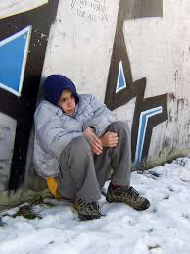
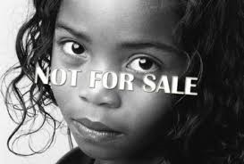
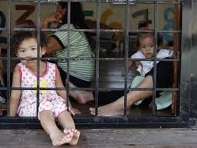
What is Human Trafficking?

Slide 4
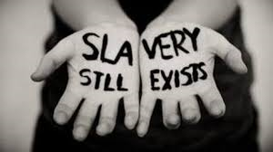
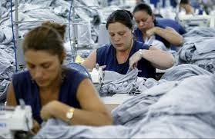
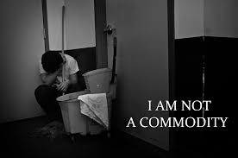
Human Trafficking:
“ Maintaining or obtaining the services of another through threats of violence…”

Slide 5
Human Trafficking:
Considered modern day slavery
Victims of trafficking exploited for commercial sex or labor purposes
Traffickers use force, fraud or coercion to achieve exploitation.

Slide 6
If you think SLAVERY ended in the United States in 1865…… think again.
Human Trafficking is tied as the 2nd LARGEST and FASTEST growing criminal industry in the world, averaging $150 BILLION per year
This is a global epidemic
Between 14,500 to 17,500 men, women and children are trafficked in the US each year
83% were US Citizens that were trafficked
1 Million children exploited in commercial sex every year

Slide 7
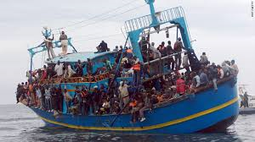
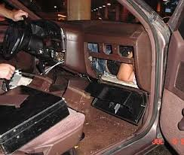
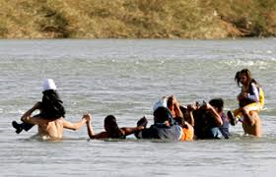
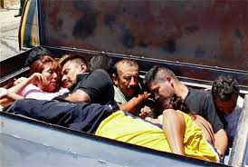
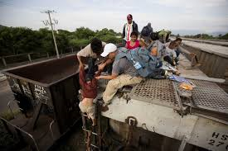
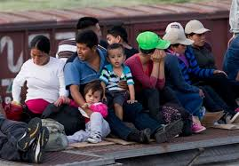
Human Trafficking is not Human smuggling
Examples:

Slide 8
DIFFERENCES BETWEEN TRAFFICKING AND
SMUGGLING
TRAFFICKING:
Victims do NOT consent or consent is rendered useless by traffickers
Ongoing exploitation of victims to generate illicit profits for traffickers
Trafficking do NOT require movement
Trafficking is a CRIME against a PERSON
SMUGGLING:
Smuggling includes those who consent to being smuggled
Usually ends when subject(s) reach new destination
Smuggling is always transitional
Smuggling is a CRIME against the STATE

Slide 9
Who is involved in Trafficking?
Recruiter: Gains the victims trust, grooms them and then sells them for labor or to a pimp. Sometimes this is a “boyfriend,” neighbor or family member.
In stables, the bottom bitch may also be the recruiter
Trafficker: is the one who controls the victims making them fearful through abuse, threats and lies. This is how power is gained
Victim: ANYONE
Consumer: Funds the trafficking industry by purchasing good and services. -Supply and demand

Slide 10
Who are the victims?
Approximately 800,000 to 900,000 victims are annually trafficked across international borders
Between 18,000-20,000 victims are trafficked into the United States annually
More than half of victims trafficked into the United States are children
ONLY 1-2% of victims are ever rescued

Slide 11
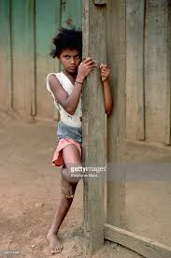
Types of human trafficking:
DEFINED: Any commercial sex act induced by force, fraud or coercion, OR in which the person performing the act is under age 18.
Victims can be found working in massage parlors, brothels, strip clubs, escort services
SEX TRAFFICKING

Slide 12
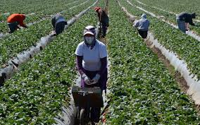
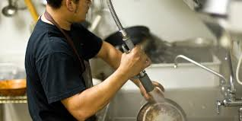
Types of human trafficking:
DEFINED: Using force, fraud or coercion to recruit, harbor, transport obtain or employ a person for labor or services in involuntary servitude, peonage, debt bondage or slavery
Victims can be found in domestic situations as nannies or maids, sweatshop, factories, janitorial jobs, construction sites, farm work, restaurants, panhandling, etc.
LABOR TRAFFICKING

Slide 13
Myths:
All prostitutes are willing participants
All immigrants smuggled into the United States enter willingly
All participants involved in Human Trafficking are Criminals

Slide 14
High risk factors for victims:
YOUTH
Poverty
Unemployment
Desperation- abuse at home
Natural disasters, political upheaval areas, corruption
Homelessness
Need or desire to be loved
Immigration status
Persons with disabilities
Parental substance abuse
Physical maltreatment
Exposure to DV in home
Incarcerated parents.

Slide 15
Vulnerable populations:
Youth male and females recruited into the commercial sex industry found that:
12-14 is the average age that U.S. kids are first pulled into commercial sex.
57% had been sexually abused as children
49% had been physically assaulted
85% were victims of incest as girls
61.5% were frequently hit, slapped, pushed or grabbed or had objects thrown at them by a member of their household
40% of the above were kicked, hit, beaten, raped, or threated and/or attached with a weapon by a member of their household
Nearly half of the participants in one study had been ‘molested or raped as children/teenagers’

Slide 16
What does this mean for health care……Why are we talking about this?
Childhood experiences, both positive and negative, have a tremendous impact on future violence victimization and perpetration, and lifelong health and opportunity. As such, early experiences are an important public health issue. Much of the foundational research in this area has been referred to as Adverse Childhood Experiences (ACEs).
Adverse Childhood Experiences have been linked to
risky health behaviors,
chronic health conditions,
low life potential, and
early death. (www.cdc.gov/violence)

Slide 18
Foster Care…… recruiting grounds for vulnerable populations
1/3 of kids that run away are at risk of trafficking within 48 hours

Slide 20
Trafficking knows NO boundaries……
Supply and Demand

Slide 21
Identifying human Trafficking
NON VERBAL CUES:
Behavior indicators of sever dependency
One person insistent in proving information or TRANSLATING- always use language line/facility interpreters
Living conditions of potential victims
Possession of other’s legal documentation
Possession of false or fraudulent documentation
Restriction of movement indicators
Signs of physical abuse

Slide 22
Identifying human Trafficking
Is potential victim accompanied by another person who seems controlling?
Does person accompanying potential victims insist on giving you the information-speaking for the patient
Did you hear threats during conversation in passing
Does potential victim seem submissive/fearful

Slide 23
Identifying human Trafficking
Does victim have difficulty communicating because of language / cultural barriers
Does victim have own identification- driver’s license
How did you get here?
At registration, asking for address and they say they are staying at a hotel, “in between houses, moving” -Red flag
Cell phone use- anxious to leave and grasping onto phone and continually checking it-continually going off-backpage.

Slide 24
Assessment findings:
Signs of physical abuse- old/new injuries
Injury presentation- does the reported mechanism of injury match the presentation of pt.?
Tattoos
Malnourished
Poor dentation
Disease/illness gone untreated for extended time
Self mutilation
Branding
Drug use
Avoid eye contact - sometimes

Slide 25
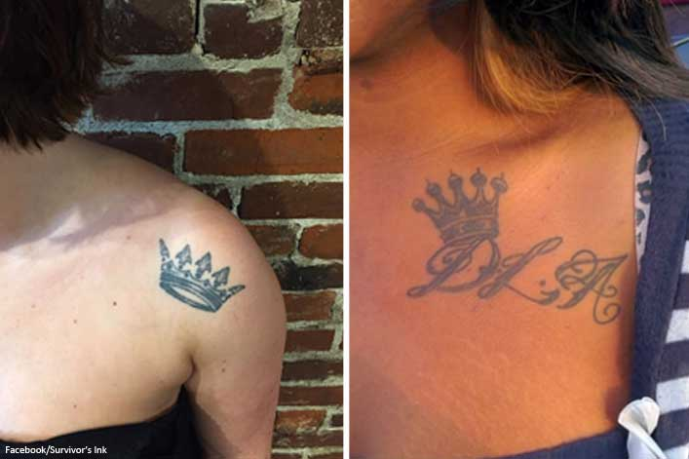
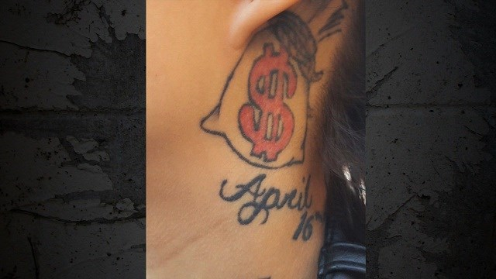
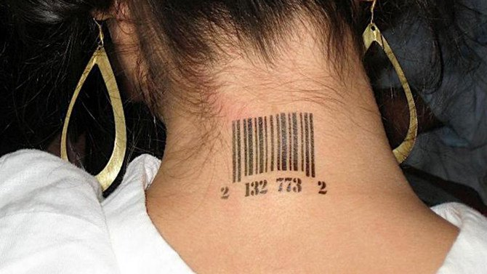
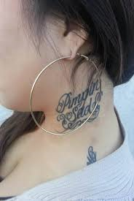
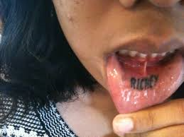
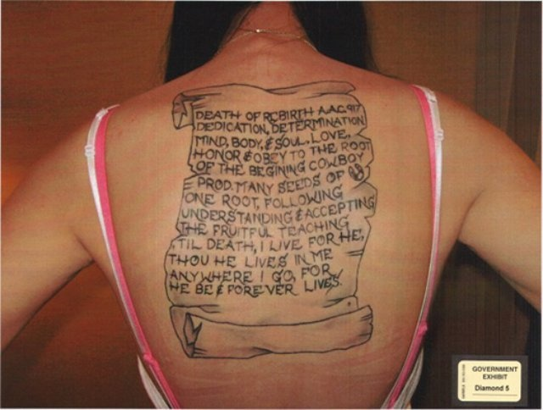
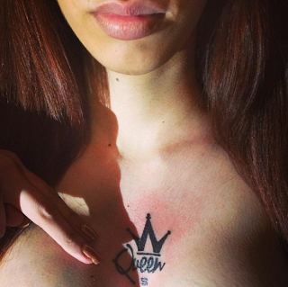
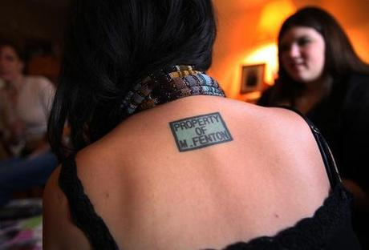

Slide 26
The mind doesn’t see what the mind doesn’t know.
You don’t always know what you are seeing
As when patients/victims do present, they are in the latent stages of disease process.

Slide 27
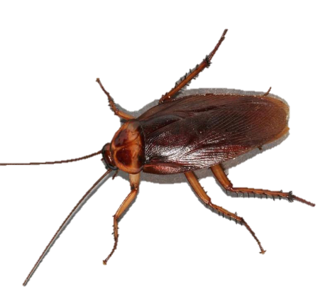
Challenges:
When we try to account for these traffickers, morph and disappear like
They live among us….. who are they?
Perception is that this is what happens in “other countries”
We encounter trafficked individuals AND traffickers here in Indiana
How do we get victims to recognize they are being trafficked
How do we meet their needs?

Slide 28
Biggest obstacle…..

Slide 29
What we need to do as an organization:
Provide trauma informed care
Avoid re-victimization
Appreciate many behaviors/language –attempt to cope
Strive to maximize their choices over our processes
That moment you encounter them may be the only control they have had
BE SENSITIVE TO CULTURE- where they came from and their life experiences
Inherent lack of trust

Slide 30
Trauma informed care cont.….
Be cognizant of bias
They NEED to know what is going on
Step by step provide options and engage them in treatment
GIVE them CONTROL over their care and their bodies.
Be mindful verbiage- don’t talk over them

Slide 31
Be prepared:
SECURITY: Work with staffing and develop process when situation presents we have action plan
Mandatory Reporting: Encourage and educate staff
Adults 18yrs older….. Required to provide information
Minors, we are mandatory reporters
Remember it is not for us to determine if crime is committed.
WE just ensure safety and well being of those we care for.
Do NOT hesitate to report- go with your gut feeling

Slide 34
Video
www.mylifestory/medical
Playersball

Slide 35
DO
DON’T
Tell them we are going to care for them the best we can
Tell them they are safe now- because we cannot guarantee that they are

Slide 36
Information disclosure related to their care is limited
They do not TRUST
Fear retaliation
Harm to them, family, children, etc… that is their reality
Limited on time spent at facility for care– time is money and may see increase in anxiety/anxiousness
This is their reality

Slide 37
What to do
Keep them informed
Involve a SANE nurse when possible- one on one care and experienced with trauma informed/victim centered care
Keep in low traffic areas- inform security and staff of any safety concerns if verbalized
Typically do NOT see themselves as trafficked- takes years

Slide 38
Understanding situation
Background- how did they get to where they are?
Safety concerns for our community- who is at risk
Understanding recruitment and grooming process which entrapped victim

Slide 39
It takes a team…..A community
We have to act- only one opportunity as they change demographic areas
Our most vulnerable are our children:
We have a responsibility to protect them
System has failed them at some point- hard to reach

Slide 40
Check your normal at the door:
When they choose what they will disclose to you….. Watch your non- verbal's
They are GROOMED
They are conditioned to think that sex/rape is play
That is their ‘normal’ blow jobs, bum bum, suck suck….

Slide 41
They will NOT trust you
First… they will ignore you
Then… they will laugh at you
Then…. they will fight you
Finally….. You will win
Ghandi

Slide 42
Never give up…..
Only 1-2 % of victims are EVER rescued
But making a difference and even saving one life is a success

Slide 43
Promoter/pimp has a team….
Those in stable work/earn their place and strive to be “bottom bitch”
Right hand person
Usually been there the longest
Start recruitment/grooming
Target vulnerable
Know what to look for because that was them at one point
Look lost/alone
Counting money before buying food at the mall/fast food

Slide 44
Even Bigger problem…..
Internet is a gateway- like opening the front door to your home.
Pimp/promoter lifestyle glamorized in media
Socially acceptable- but there is a cruel reality

Slide 45
Demand for this crime exists because we tolerate it.
Prostitutes and strippers are portrayed in movies and song lyrics
Internet- desensitized due continual visualization – dehumanizing

Slide 46
Internet:
Blackmail cyber/social media networking
Sextortion- grooming
Glamour is now the naked pictures kids send- its acceptable
Epidemic on the computer
Conversations need to occur at an earlier age at home and education to parents
It is in our back yards folks

Slide 47
Society asks…. Why do victims stay?
Trauma bond – how body processes and becomes conditioned/addicted to hormonal rollercoaster
Begins with brief intense positive attention that leads to prolonged intensive experiences of negative attention
Works on the amygdala –the Brain wants to be happy
Trained to tolerate negative attention for short periods
Over extended period of time, becomes desensitized, leads to identity loss – de humanized and ultimately slave
Traffickers target primed victims to be abused
Grooming
Actively listen/chat/txt
Learns to accept certain kinds of love

Slide 48
Trauma Bond
Extreme affection leading to extreme emotional and physical cruelty
Provides FALSE sense of safety
If you listen and follow the rules- life is good
If not…. You are beaten
They fear being replaced
Understand this is deep programing over period of time

Slide 49
Trauma Bond
Be careful about what you say about promoter/pimp/trafficker
They gave value to this person
They don’t believe this person would/could do this to them
That is why many don’t recognize they are trafficked for years…..

Slide 50
Different Stages of Rescue
You cannot force someone to be rescued
Take next step- what happens next with this person/
Law Enforcement, what do we do?
Resources: No food, no shelters, not sleeping and not engaged
Remember this is a TEAM effort: Our community partners are key players in the success/recovery of victims of trafficking

Slide 51
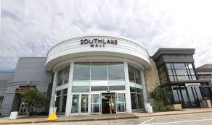
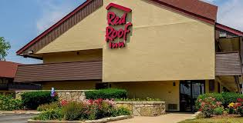
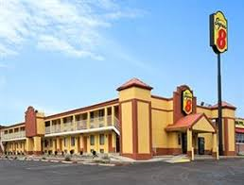
Always be aware….
…You could save a life or prevent one from being destroyed.

Slide 52
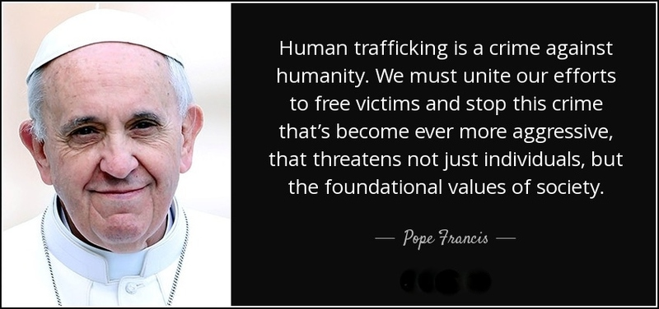
Remember
They have been striped of their humanity

Slide 55
If you believe someone is a victim of Human Trafficking:
Call 911 if there is an emergency or crime occurring currently.
Then…
National Human Trafficking Resource Center Hotline Number 1-888-3737-888 or send a text to BeFree (233733)
Indiana Child Abuse and Neglect Hotline Number 1-800-800-5556
humantraffickingtip@atg.in.gov

