Slide 1
2019 Medicare Prescription Drug Extra Help Program

Slide 2
Who We Are
Dayton
Kettering
Cincinnati
Columbus

Slide 3
Medicare Part D
Extra Help Program 2019
Open Discussion

Slide 4
Offered through private insurance companies
Penalties for not enrolling
Should not be bought based on premium
Changes significantly every year
Prices range from $13 - $90 monthly

Slide 6
GETTING EXTRA HELP WITH PRESCRIPTION MEDICATIONS

Slide 7
What is Extra Help?
An entitlement administered by Social Security worth about $4900 to help offset the costs of prescription medications for people on Medicare
Helps with the Part D premiums
Helps with Part D deductibles
Helps with medication copayments
Can eliminate RX donut hole
Can eliminate the late enrollment penalty

Slide 8
Who Qualifies?
Your annual income must be limited to $18,735 for an individual or $25,365 for a married couple living together. Even if your annual income is higher, you still may be able to get some help.
Single: $1561.25 / Month
Married: $2113.75 / Month
If the applicant has dependents, they can make more than the maximum amount of income

Slide 9
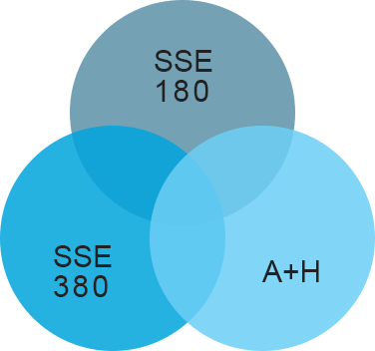
Who Qualifies?
Resources: must be limited to $14,390 for an individual or $28,720 for a married couple living together.
Bank Account
Stocks & Bonds
Cash
Investments
Home You Live In
Personal Vehicle
Life Insurance

Slide 10
How do I apply?
Applying for Extra Help is easy. Just complete Social Security’s Application for Extra Help with Medicare Prescription Drug Plan Costs (SSA-1020).
• Apply online at www.socialsecurity.gov/extrahelp
• Call Social Security at 1-800-772-1213 (TTY 1-800-325-0778)
• Apply at your local Social Security office
Visit your local Medicare Resource Center
www.resourcemedicare.com

Slide 11
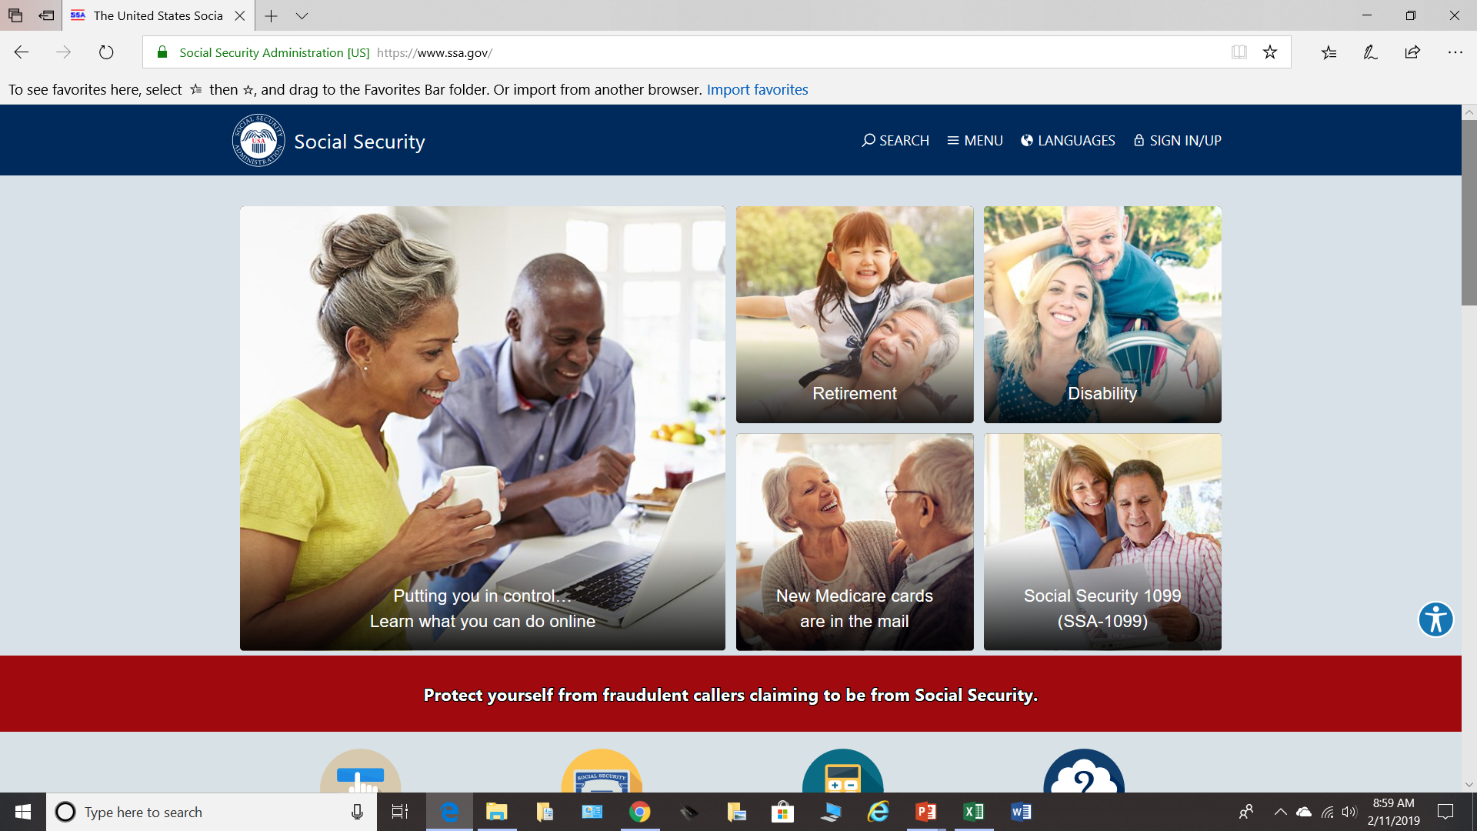

Slide 12
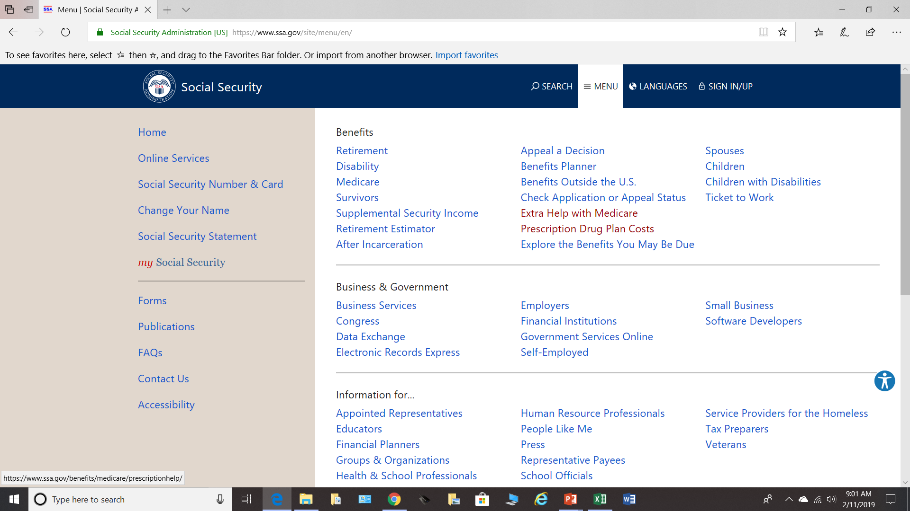

Slide 13
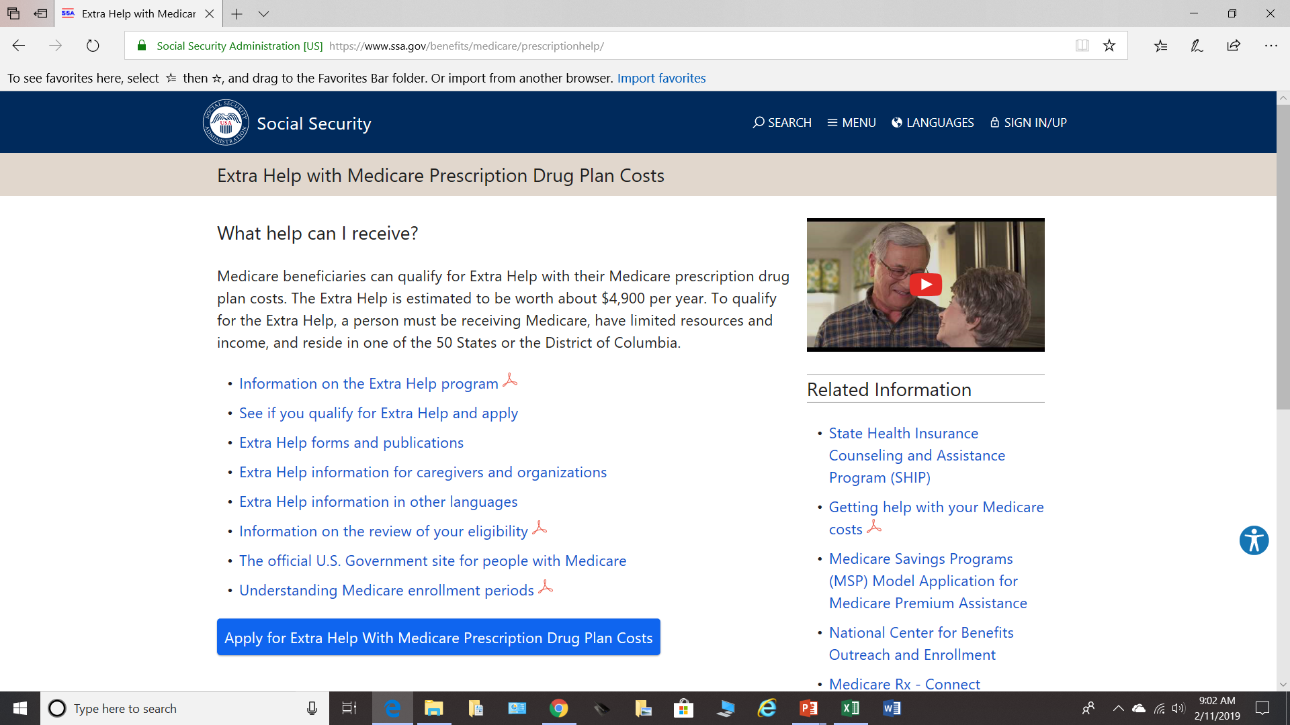
Information on Extra Help

Slide 14
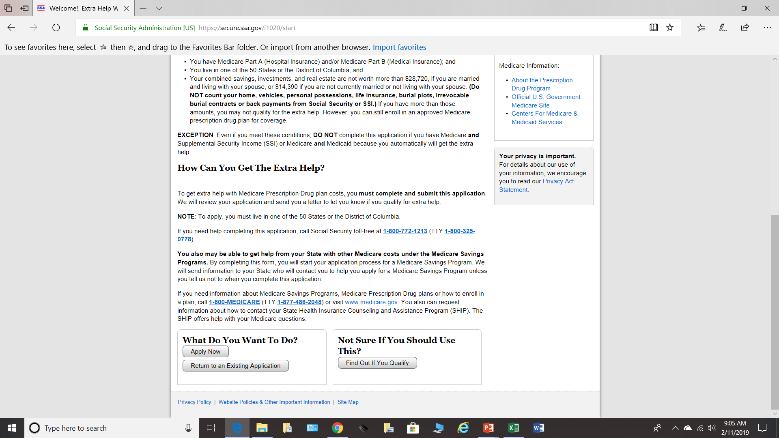
Re-Entry Number
10 Minutes

Slide 15
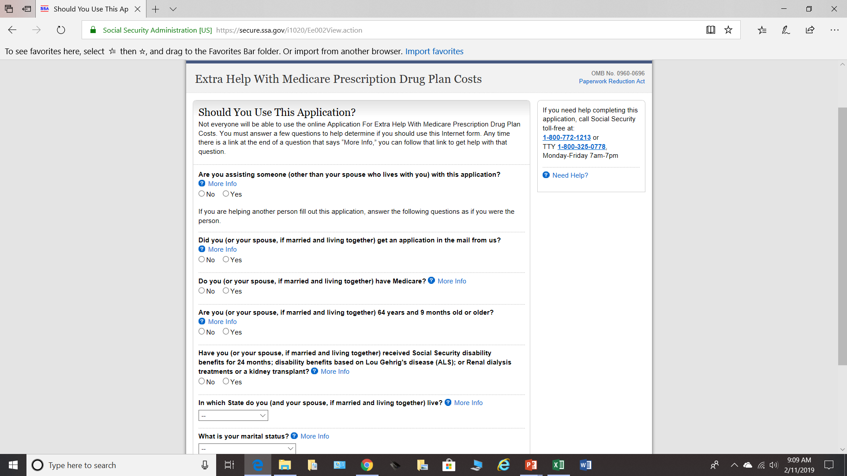
I am assisting with this application
You can also request assistance for MSP at the same time

Slide 16
Applying for Extra Help
When will I be notified?
10 Working Days
Notified by mail
Opens a Special Election Period to change plans

Slide 17
Complimentary Service
Schedule a free strategy session with a Medicare Plan Navigator
Review your medications
Apply for Extra Help
www.resourcemedicare.com

