Slide 1
Clean Water

Slide 2
Filtration Project (Clean Water Science Kit)
Allows the removal of foreign contaminants in water
Removes harsh or lethal pathogens that may detrimental to health
*Not to drink – depends on water quality*

Slide 3
Background of Filters
Removes 99.99% of pathogenic bacteria, disease-causing cysts such as Cryptosporidium and Giardia, and particles.
On average, filter will remain effective for at least 12 months of continuous usage (depending on water quality). The filter has a cleanable surface for longer life.
No Power Required

Slide 4
How Our Project Works
3 Different Layers of Granules
- Gravel
- Sand (Sand must be wet to trap and not seep through other layers)
- Live Carbon
-Filter Paper
Each layer traps different size particles, from largest size, to smallest size

Slide 5
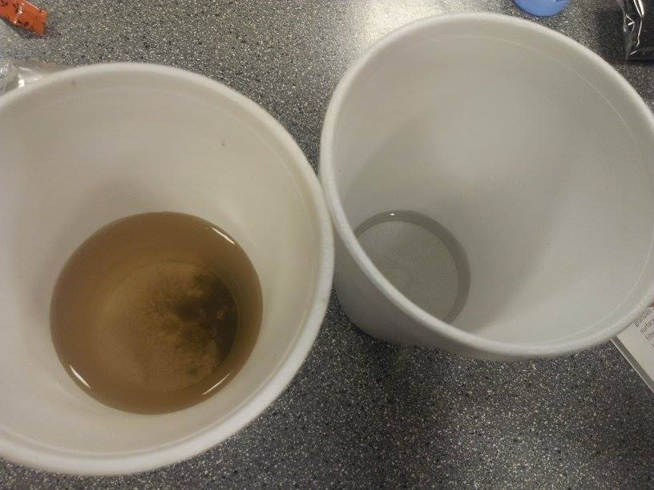
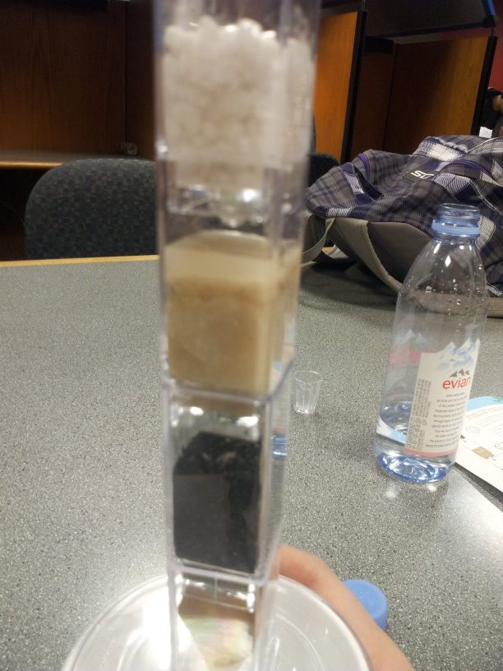
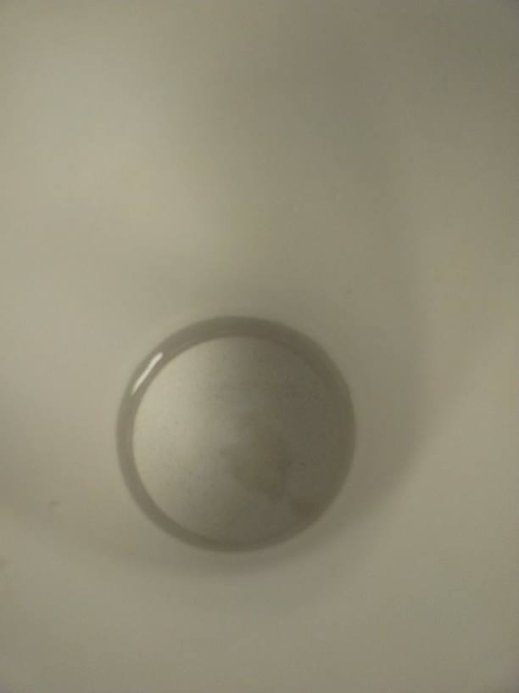
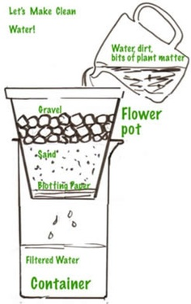
The Process
gravel
Before: dirty water after: filtered water
sand
live carbon
Water after being filtered
Photo from http://www.kindergarten-lessons.com/nature_education.html

Slide 6
How to Explain to Kids
Simplify wording
“The layers with bigger rocks will catch the big things, while the layers with the little rocks will catch the small things”
Worksheets with activities on it

Slide 7
Real World Setting
DISCLAIMER: not for drinking
Good for Hand washing
Good for Showering
Washing clothes
Clean water filters have been tried and tested in various third-world situations changing the quality of life for many thousands of adults and children.

Slide 8
Health Benefits
Prevents diseases inborn in skin
Keeps out pathogens that can get into the skin

Slide 9
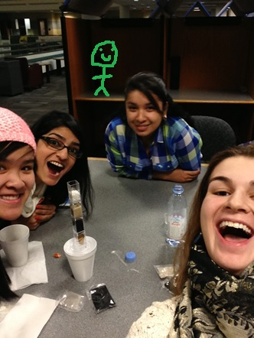
HOPE YOU ENJOYED OUR PROJECT!

