Slide 1

PEP FOR Angels
STORYTELLING SERIES
AND
Cultural Arts Festival
2017-2019

Slide 2
Sponsored by:
Life Care Wellness PEP For Angels, Inc. and the Mississippi Arts Commission
Hosted by:
UMMC Batson Children’s Hospital
Child Life Department

Slide 3
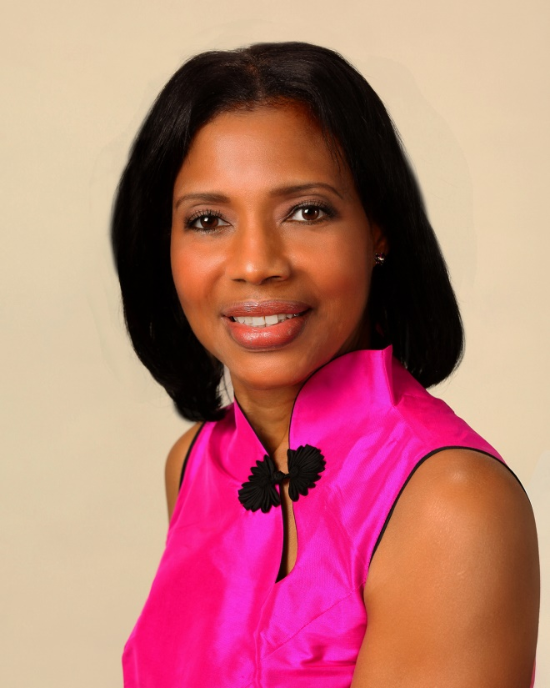

Founder and CEO, Life Care Wellness PEP For Angels, Inc., Author, Educator and Life Care Coach

Slide 4
“Laughter Is Healing”
Prime Time Family Time and
Prime Time Show Time

Slide 5
Videotaped Archive of Dorian LaChance
Compliments of Rob Jay

Slide 6
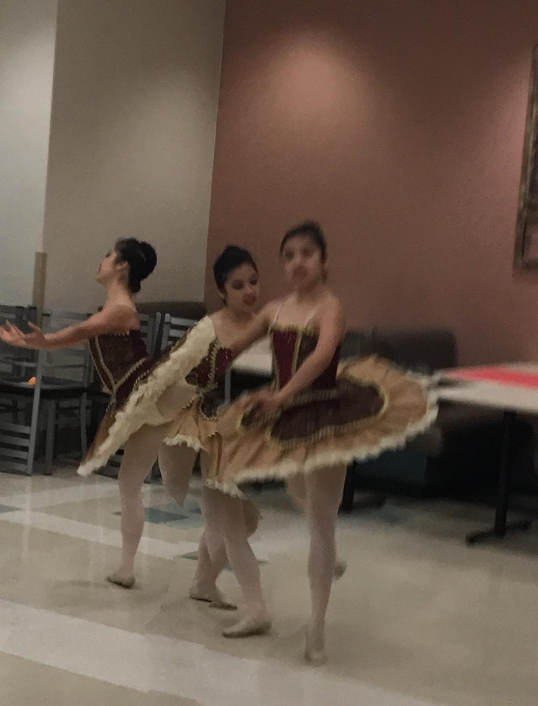
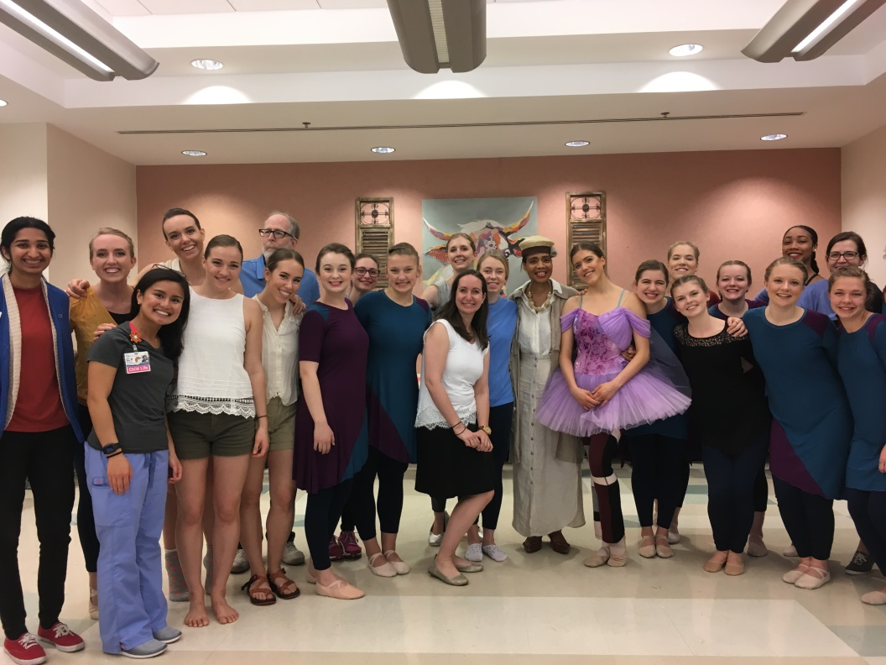
Krista Bower and Belhaven Dance Ministry

Slide 7
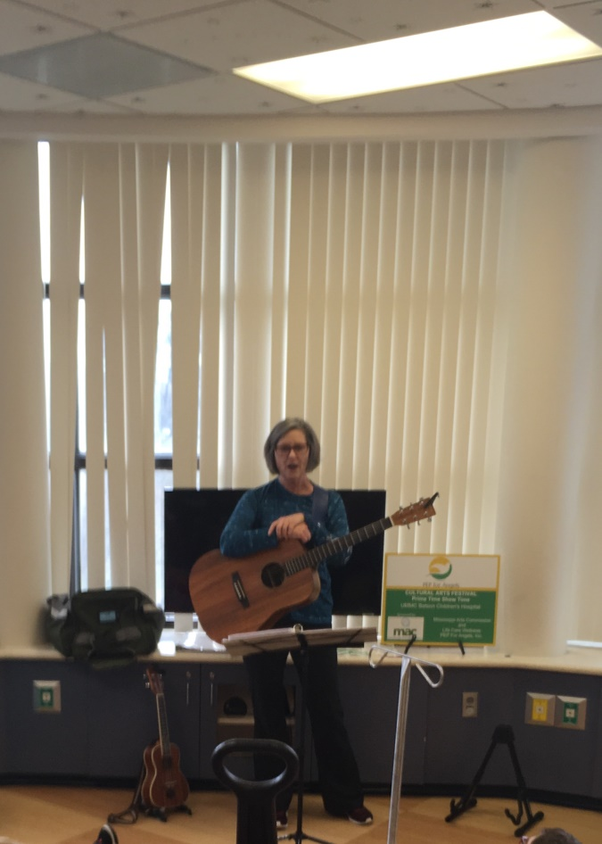
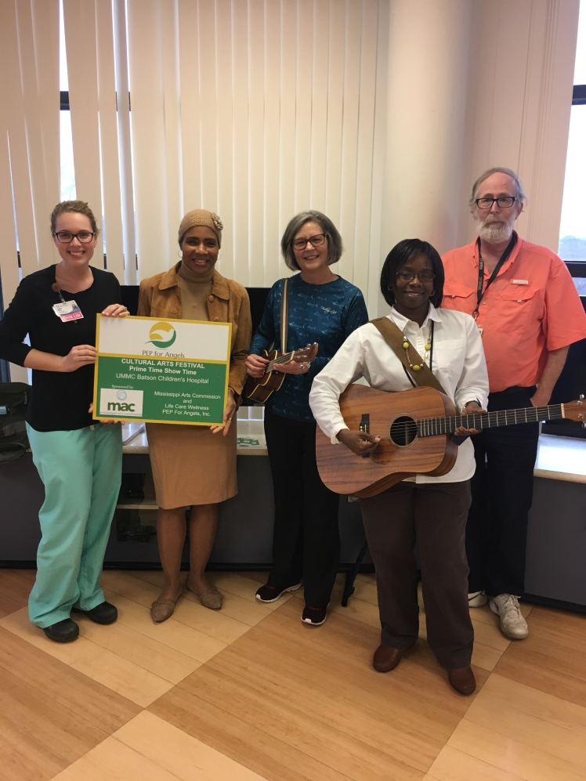
Richelle Putnam, Literary Drama Artist and Guitarist

Slide 8
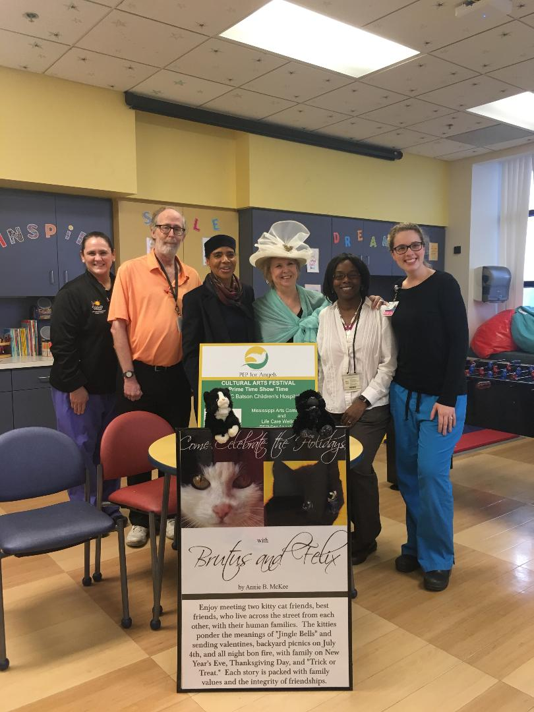
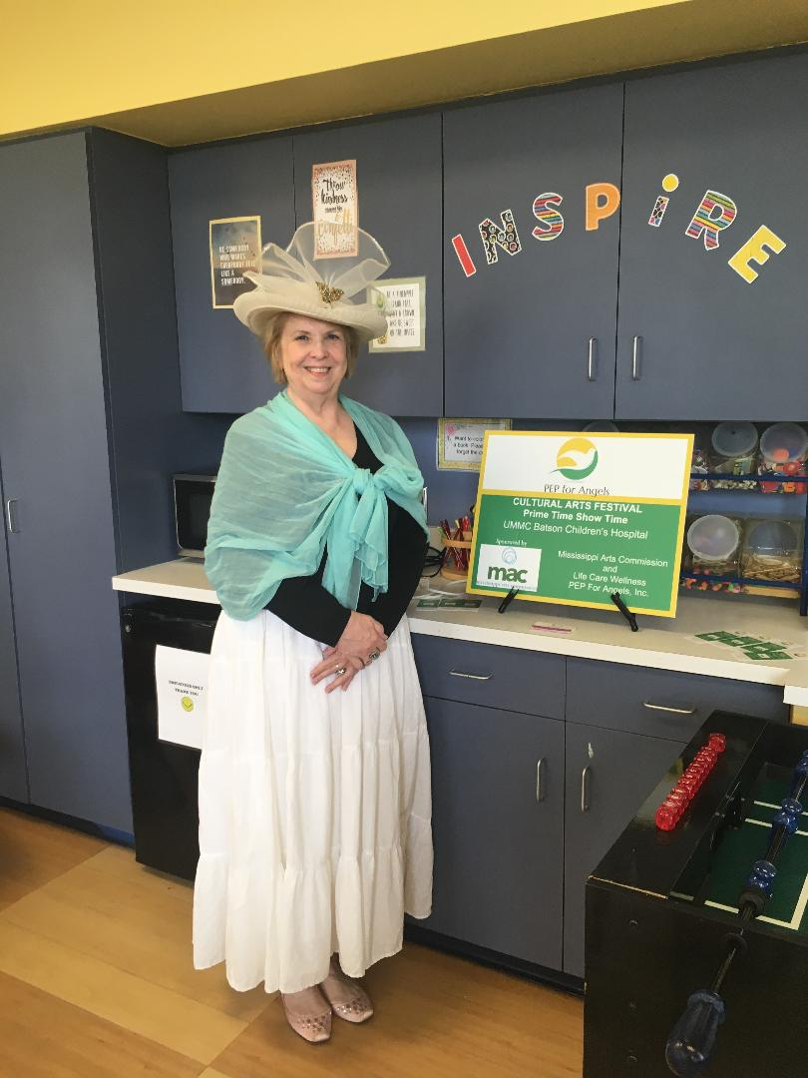
Anne McKee, Literary Drama Artist with Special Valentine’s Day’s Card Creation and Treats

Slide 9
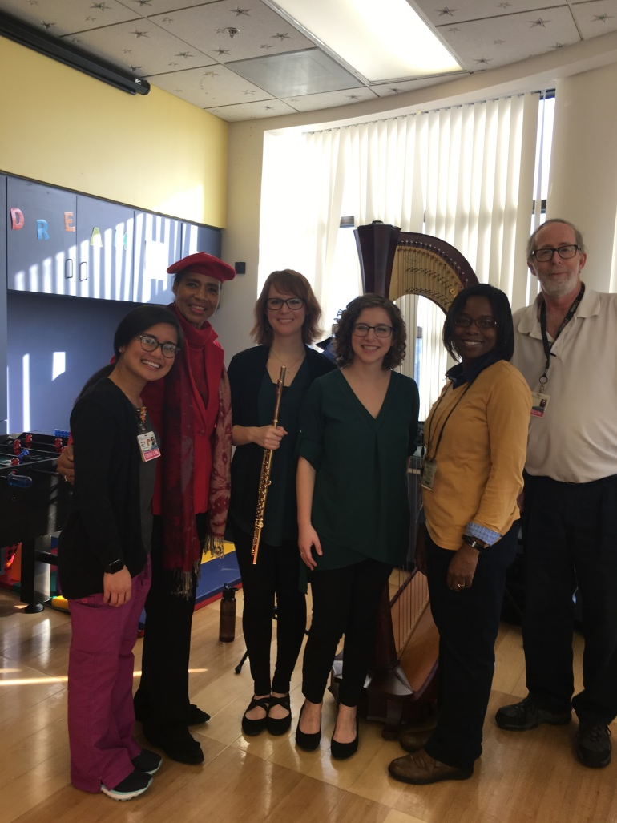
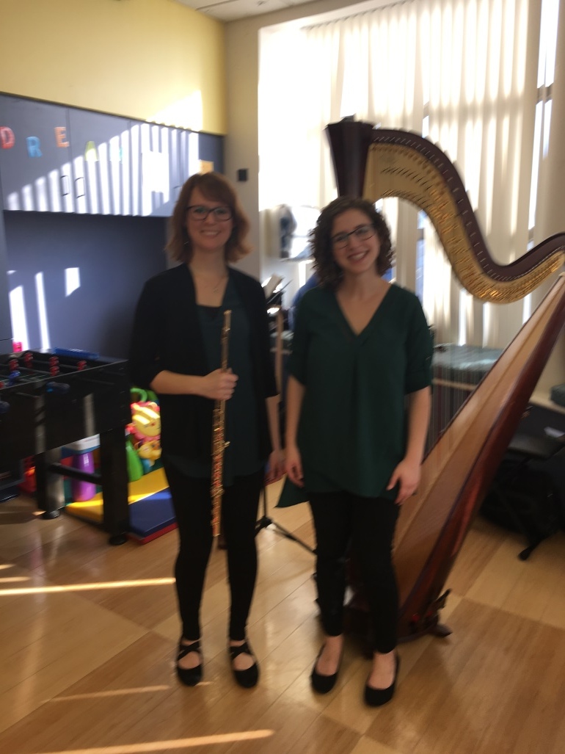
Amulet Strange and Hope Cowan, Harp and Flute Program

Slide 10
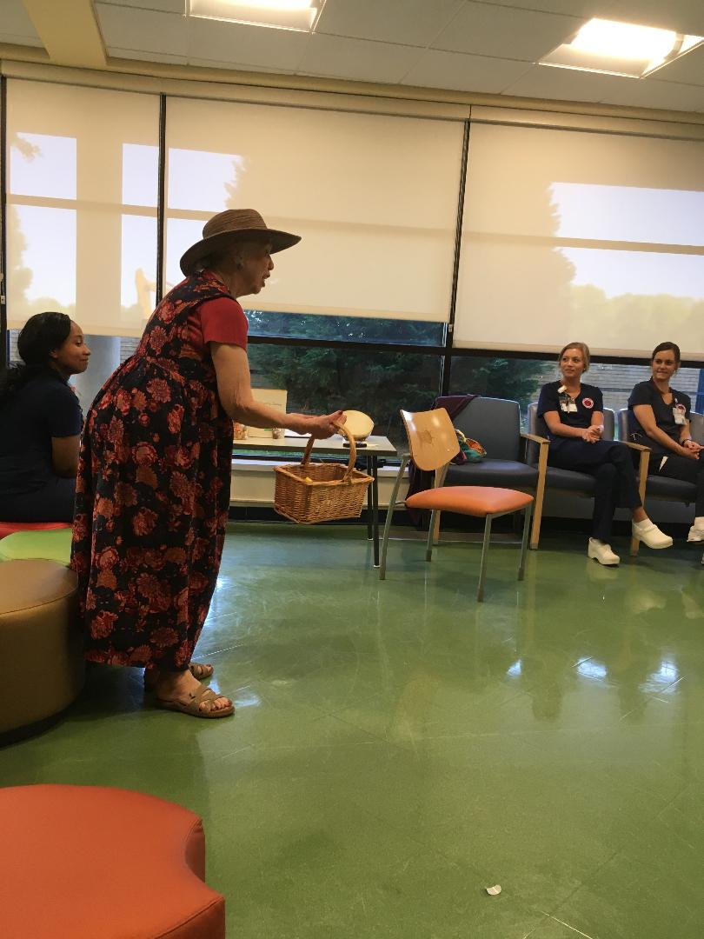
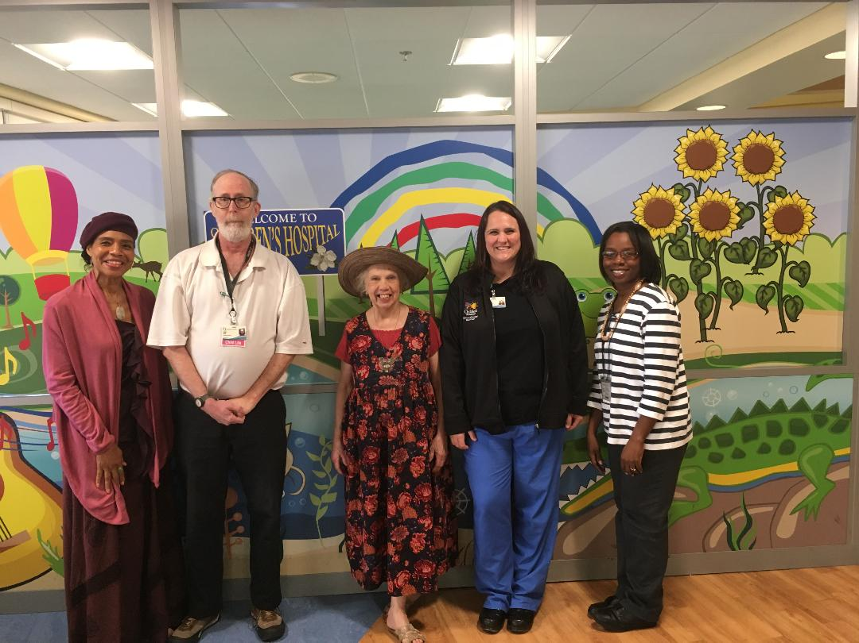
Rebecca Jernigan, Actress and Literary Drama Artist

Slide 11
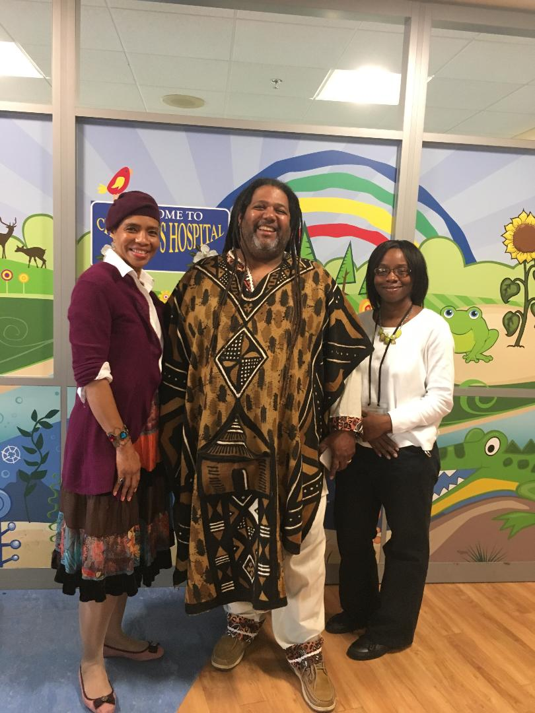
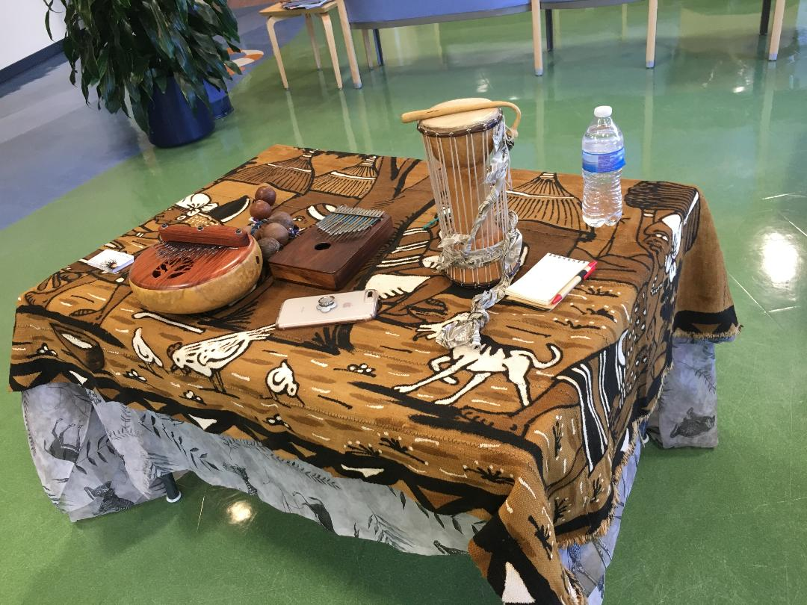
Terrence Roberts, “Da Story Weaver”, Ethnic Literary Drama Artist with a Collection of Exotic Instruments

Slide 12
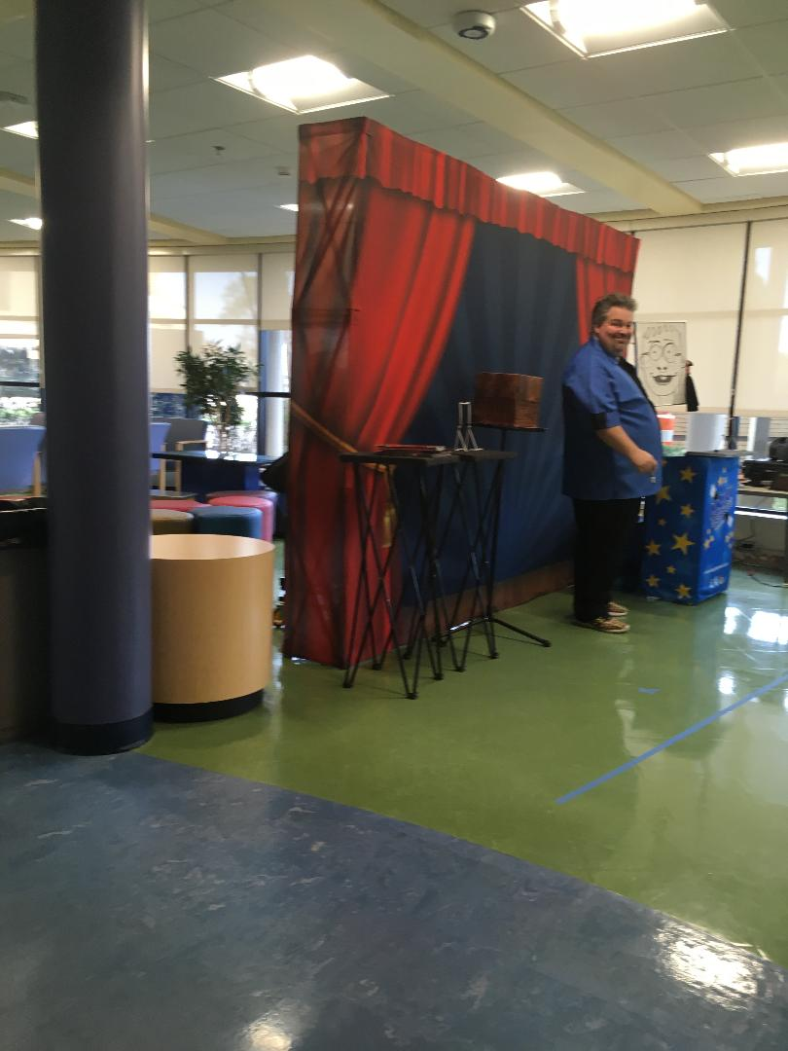

Dorian LaChance, Comedian, Magician and Literary Drama Artist

Slide 13
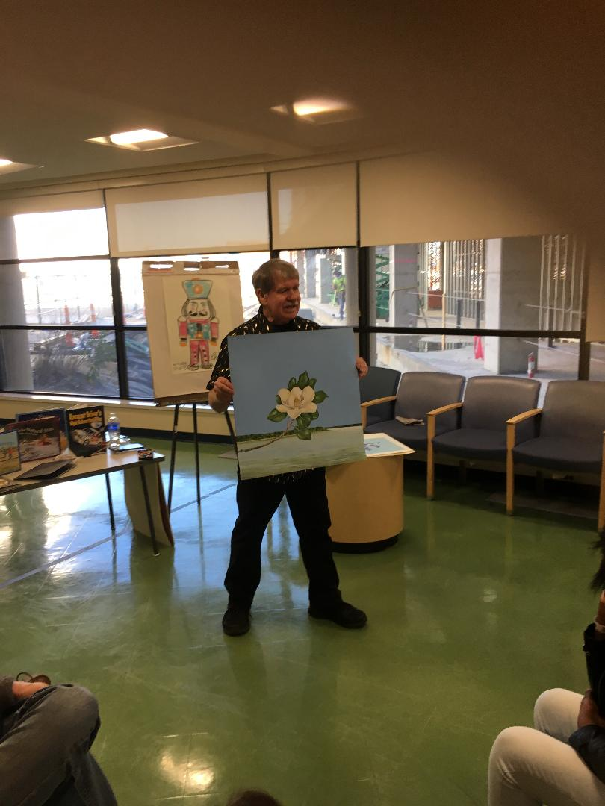
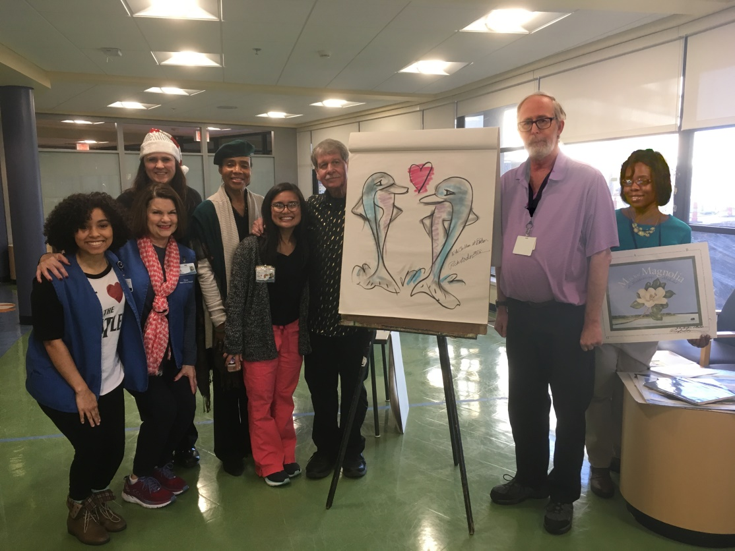
Rick Anderson, Artist, Author and Illustrator

Slide 14
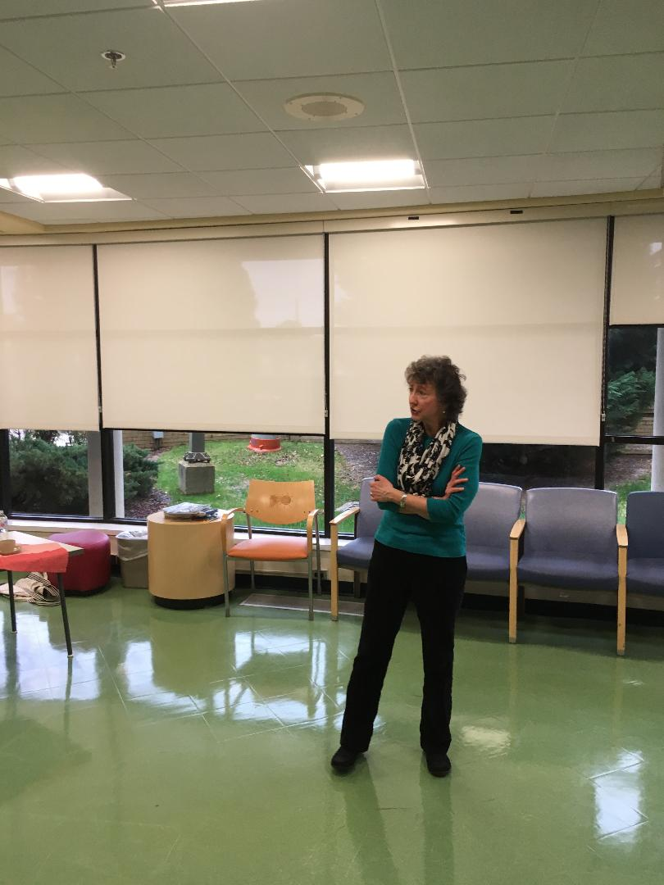
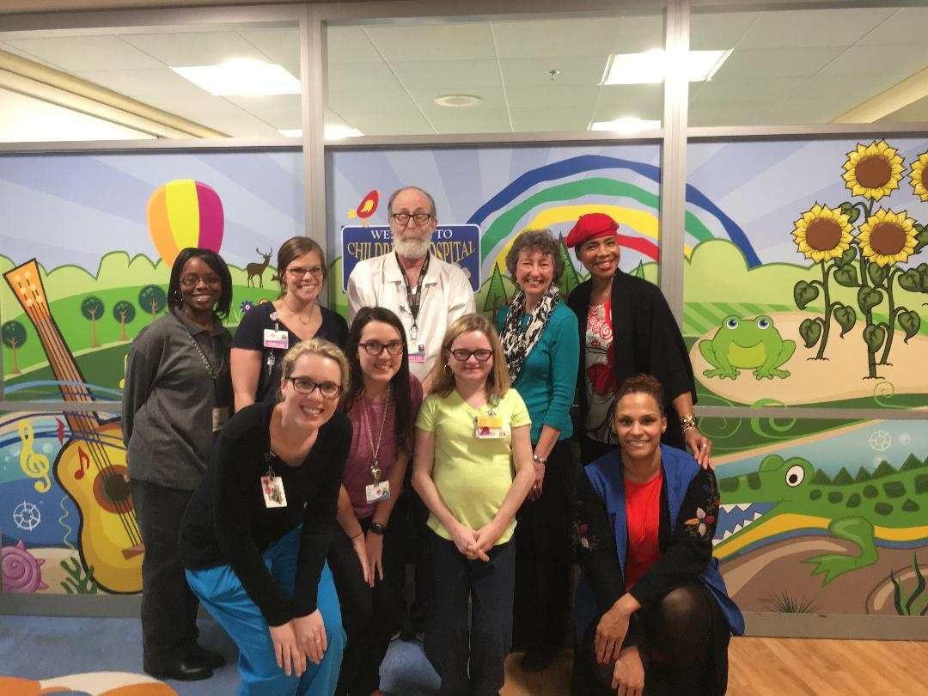
Doris Jones, Literary Drama Artist

Slide 15
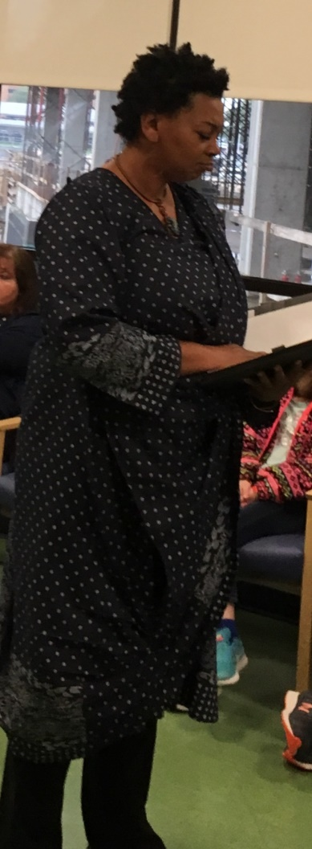
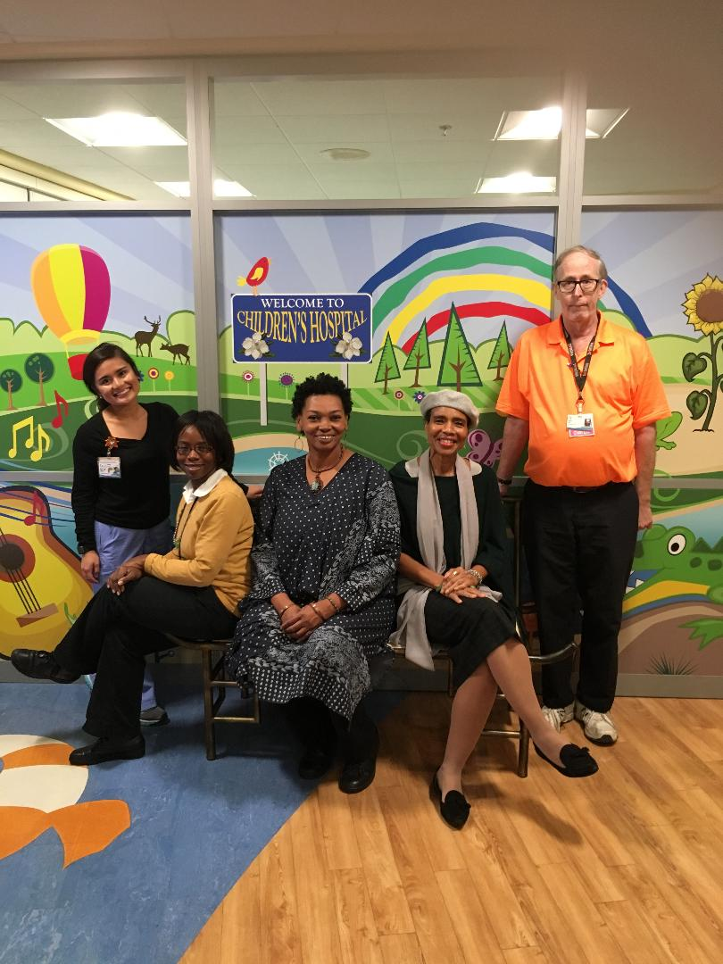
Asia Rainey, Literary Drama Artist,
New Orleans

Slide 16
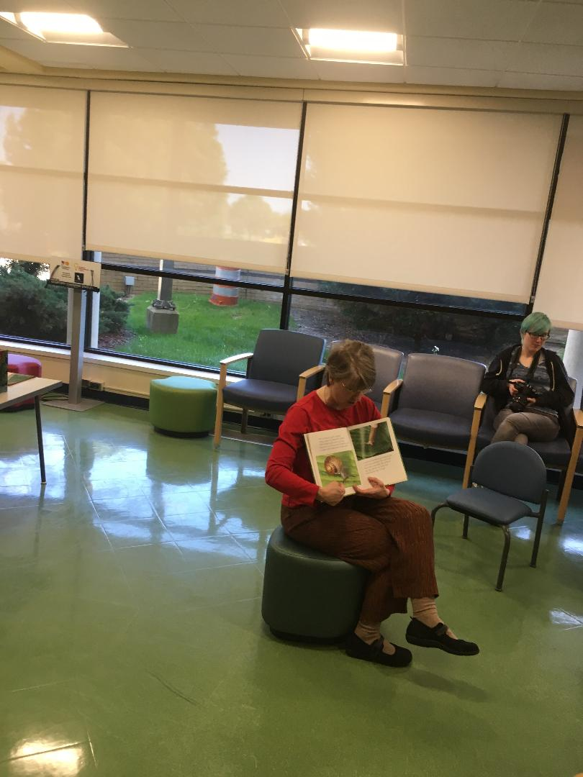
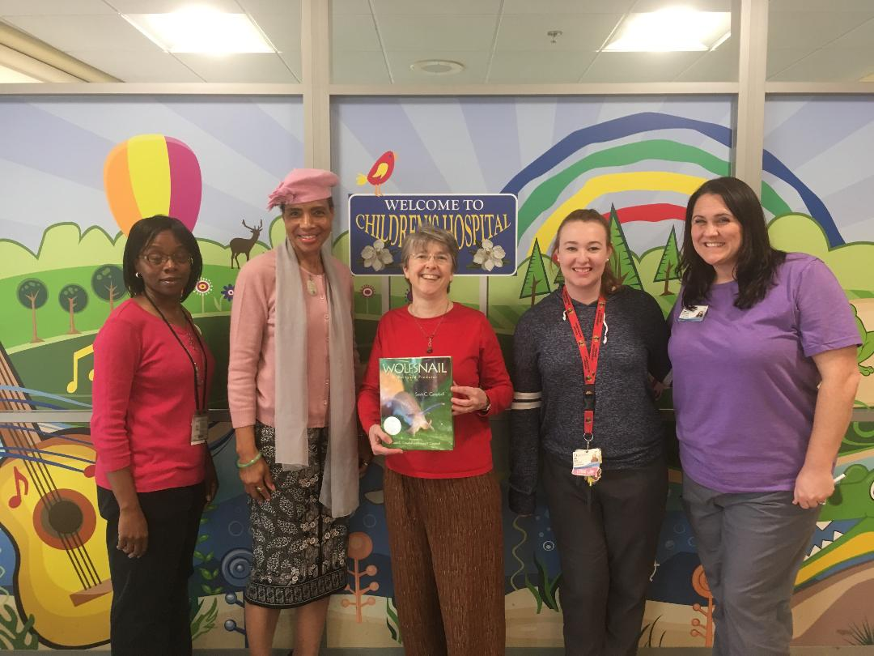
Sarah Campbell, Literary Drama Artist and Author

Slide 17
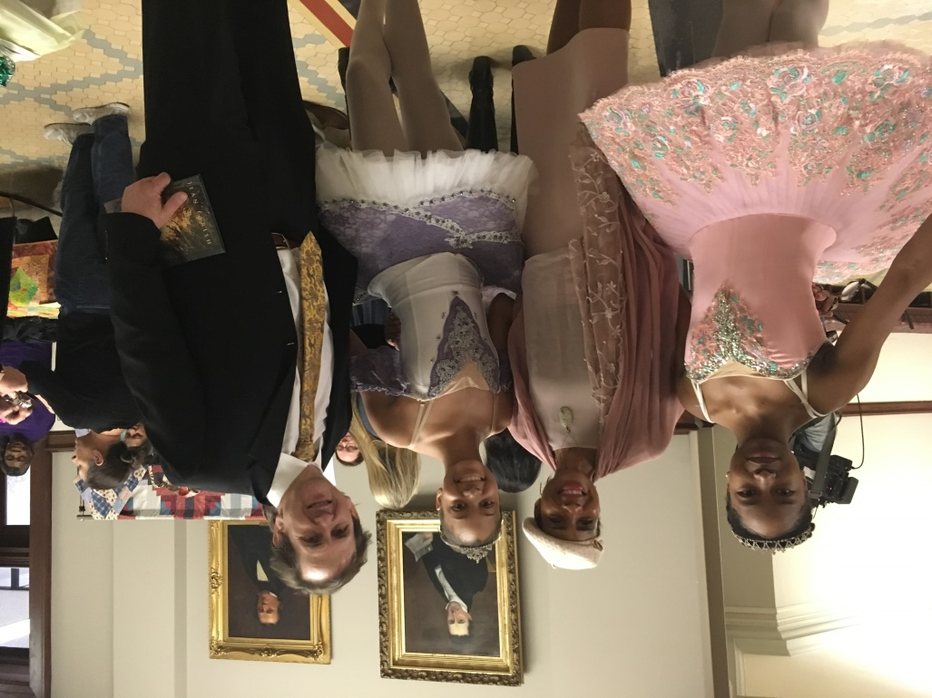
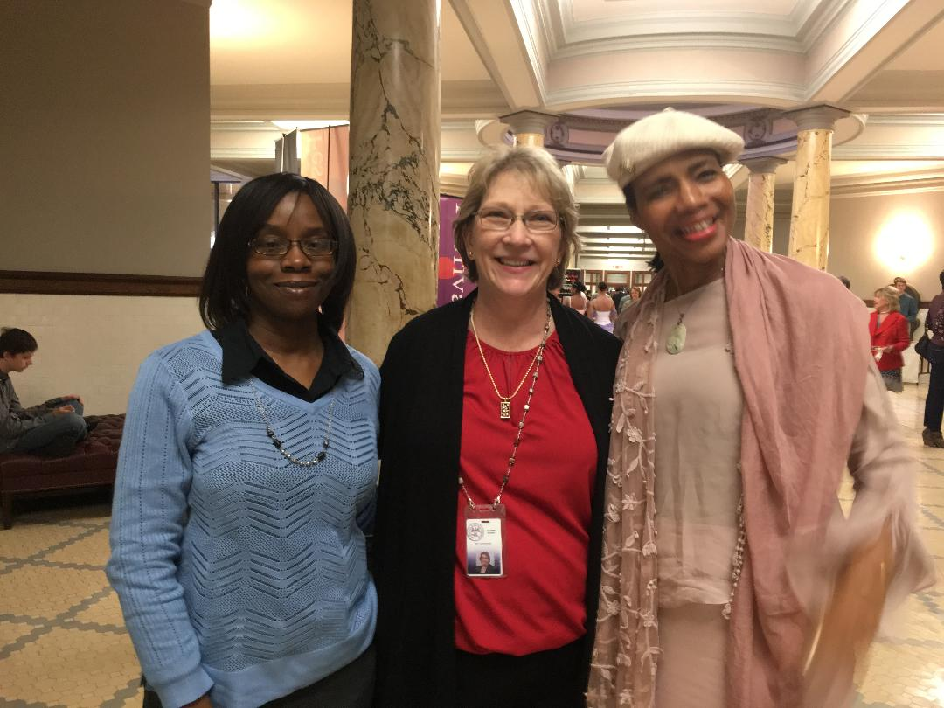
Ms. Michelle Chambers joins us at Arts Day at the Capitol

Slide 18
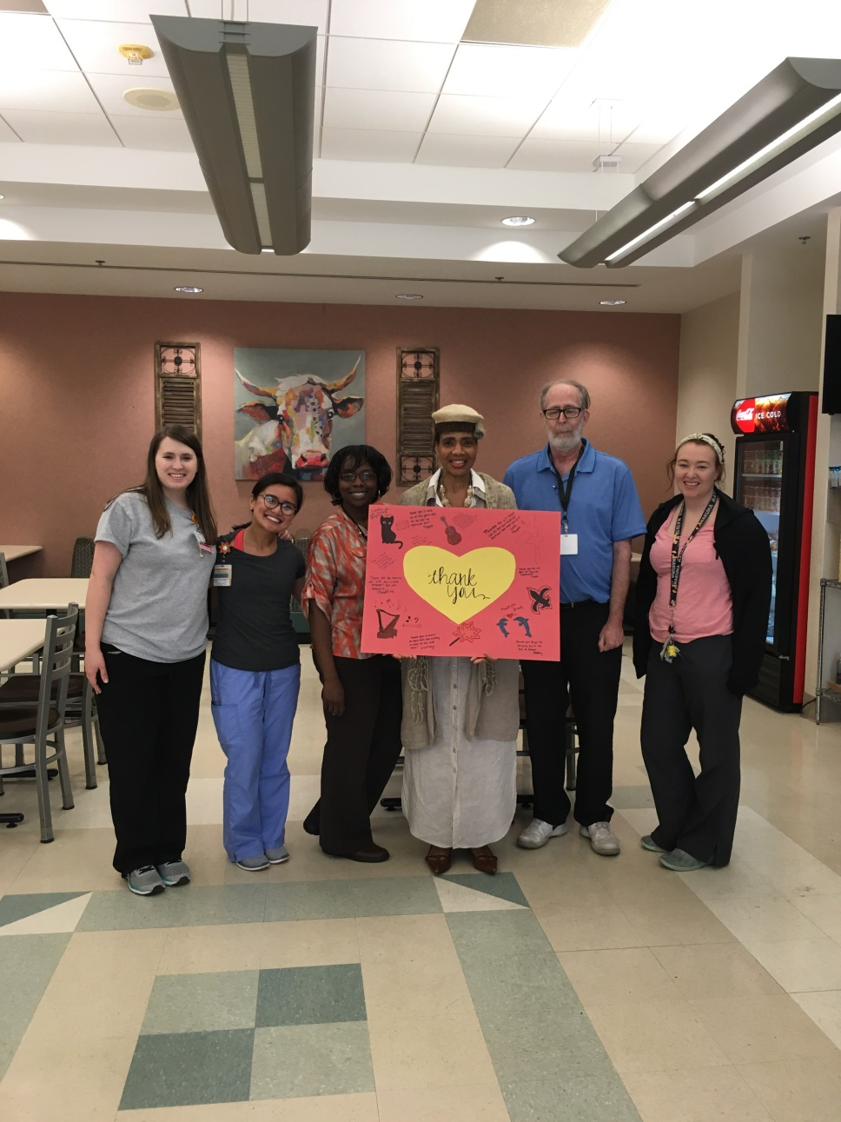
Grand Finale

Slide 19

Thanks to the Child Life Department, Children, Family, Staff and Caregivers

