Slide 1
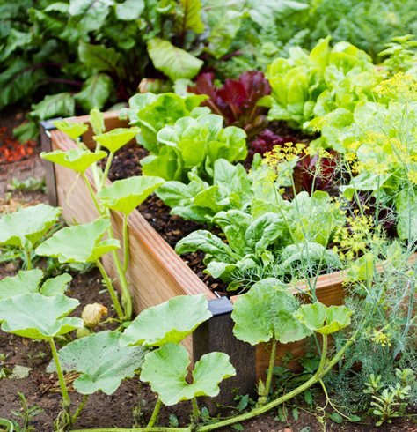
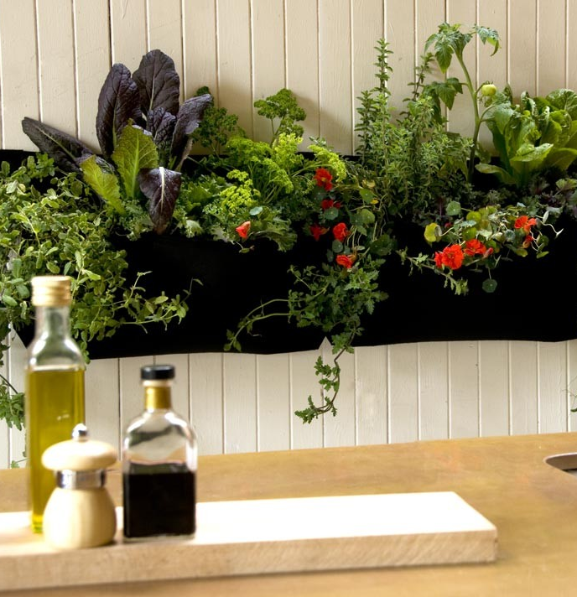
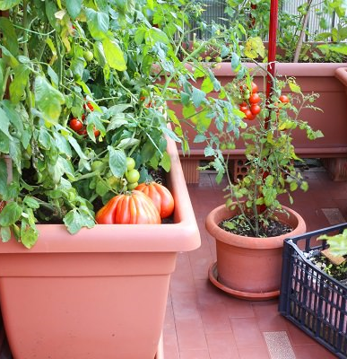
Gardening 101
The Revolution is Green

Slide 2
First Considerations

Slide 3
First considerations
A hardiness zone is a geographically-defined zone in which a specific category of plant life is capable of growing, as defined by temperature hardiness, or ability to withstand the minimum temperatures of the zone.
Find your hardiness zone | https://garden.org/nga/zipzone/
Deciding on "Indoor or Outdoor" is all about knowing where your sun is coming from. Sun is everything when it comes to growing a healthy garden so knowing if you are doing it indoor or outdoor is a crucial first step.
In pots or in ground is all about preparation for the plants. How you will prep the ground or a garden bed is totally different from how you will prep the pots.
Having some familiarity with the insects, small animals and birds helps you know how tyo protect your garden or how to prepare to share your garden, making some things easily and peacfully accessable to wild life.
Location means where you are in regards to the sun and where the south facing side of your property is no matter how small. This does not mean that if you have no access to south sun that you cannot garden it just means that you will have to be mindful of what you grow.
Hardiness Zone
Indoor or Outdoor
In pots or In ground
IPM insect and pest management
Location

Slide 4
Hardiness Zone Resources

Slide 5
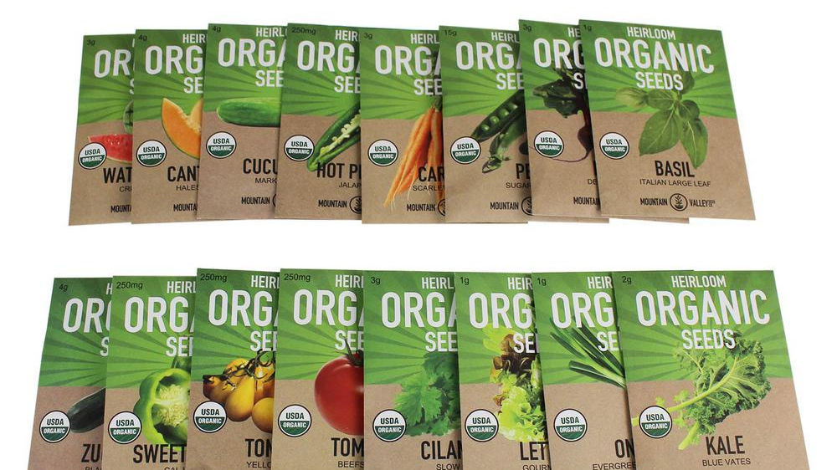
Seeds

Slide 6
Reading Seed Packets
Days to germinate| this is the amount of time it take for your seed to emerge from the soil as a seedling
Depth to Sow| this is how deep you place your seed in the soil
Seed spacing| how far apart the seeds are placed
Row spacing| how far apart each row of seeds are
Days to harvest| amount f days till maturity
Full/ Partial sun| full sun means 6 hours or more partial sun means 5 hours or less
Starting Seeds Tips
Be sure the plant can handle being transplanted, some plants like to be sowed directly where they will grow. Apple Trees are an example.
Use a nice nutrient starter soil it can be a blend of potting mix and compost for seed starting.
Seeds do not need light per say so starting seeds indoors before you transplant them outside is a great is a great idea.
Some seeds require hardening off before transplanting which is placing them outside for a few hours a day bfore their transplant day.

Slide 7
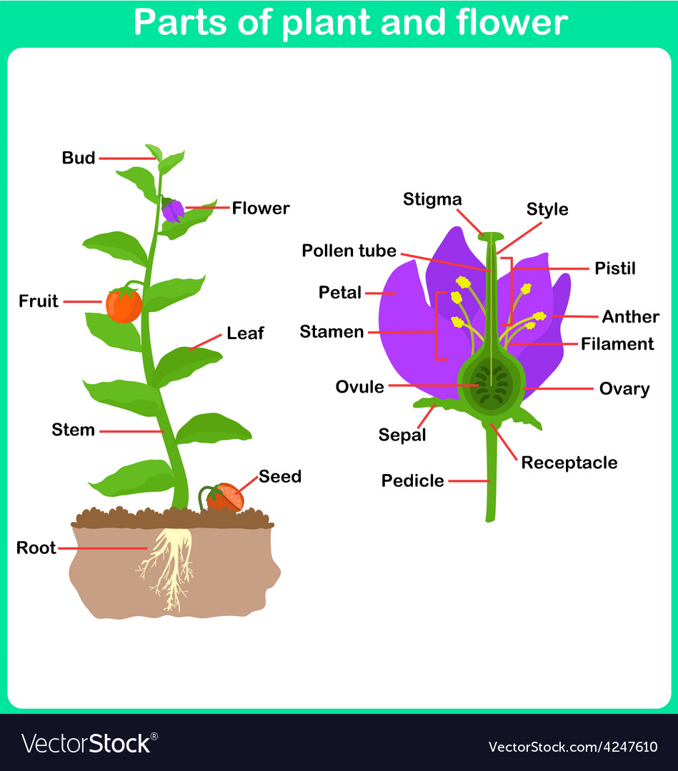
Parts of a Plant

Slide 8
Parts of a Plant
Anthers| contain pollen sacs
Petals| attracts insects and hold scent
Filament| stalk of the stamen, supports the anther
Stamen| male part that makes pollen
Stigma| collects pollen
Style| supports stigma
Sepal| protects the flower till it blooms
Ovary| protect ovule while it becomes fruit
Ovule| The egg and seed

Slide 9
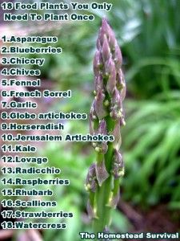
Perennial & Annual Plants
Annual plants| must be replanted each year.
Perennial plants| return each year sometimes several years.

Slide 10
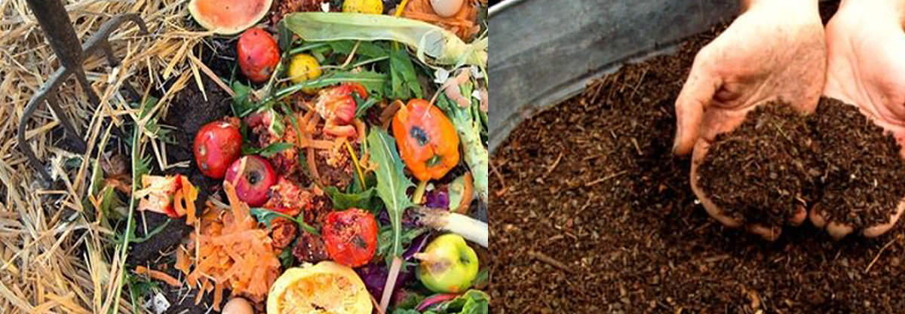
Composting

Slide 11
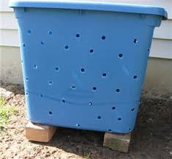
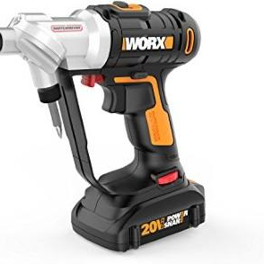
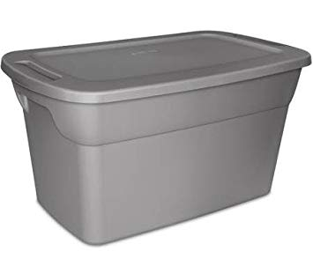
Making your bin
Get an opaque tote with a lid, a drill gun and something to elevate the tote; safely drill holes in the sides and bottom of your tote.
Place your tote in a safe space preferably elevated over grass as to feed it the compost tea that drips from the holes in the bin. Raised bins keep rodents out.
Be sure to periodically stir your bins content to keep air circulating.

Slide 12
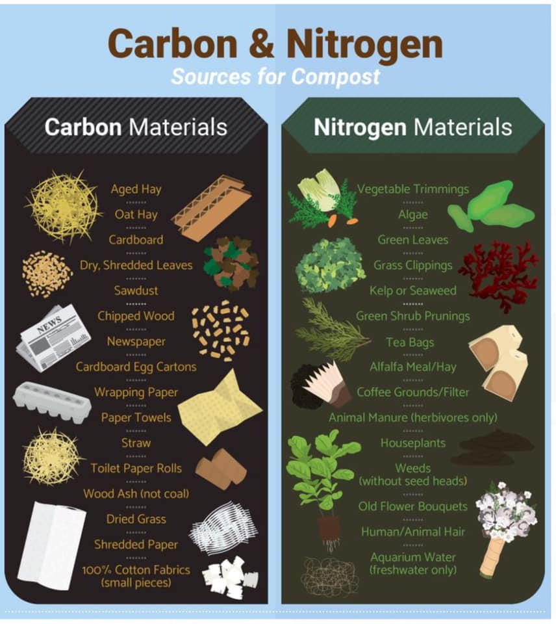
Compost layering
You need 2 ingredients to create compost and they are carbon and nitrogen.
These 2 ingredients can be found in things all around you; paper and dry natural items like leaves add carbon while fresh leaves and produce scraps add nitrogen.
If you get a stinky smell from your compost that could mean that you need more carbon items so just add some paper or cardboard but not laminated or glazed paper.
Keep it simple and turn your compost once a week.
If you see flies in your bin pour some boiling hot water into it and place the lid on and the steam will kill flies and larvae and eggs repeat if needed.
Worms and maggots help to break down the contents of the bin so if you see maggots don't panic. Just don't use it in the garden while it has maggots in it they will eat the roots of your plants.

Slide 13
Lasagna Gardening

Slide 14
Lasagna Gardening
Is one method of no till gardening where you build on top of the soil much in the fashion that nature does.
This method keeps one from disturbing the beneficial microbes that live in the soil and add to the soils health.
It reduces the unwelcomed flowers in the garden also known as "weeds"
Using this method lessons the amount of woodchips you need in the garden.
Nutrients become available to the plants as the breakdown process is completed.

Slide 15
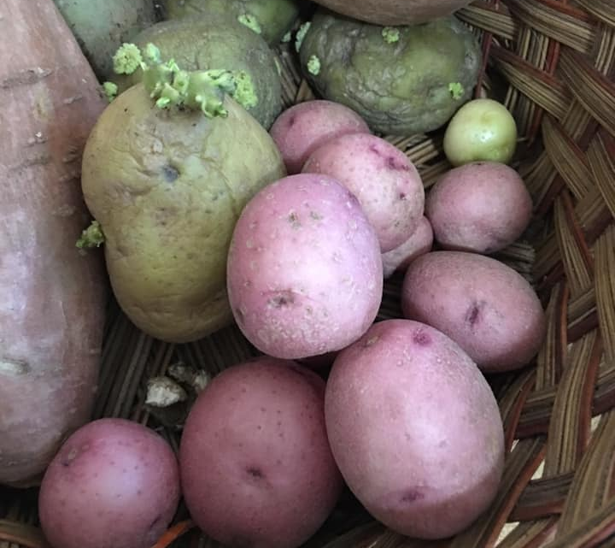
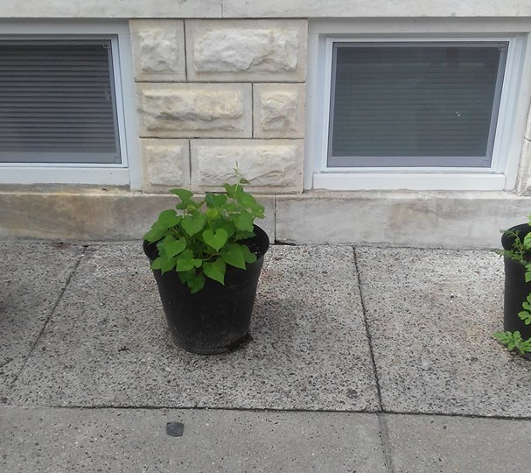
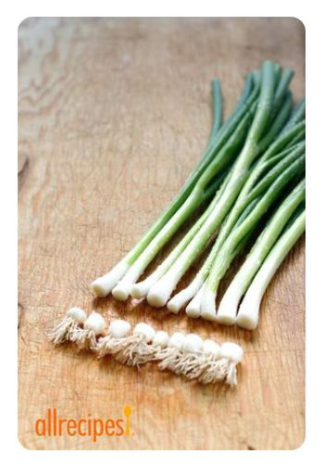
Growing food from Food
Foods to regrow
Potato
Cut off spuds place in water once rooted place in soil and allow to grow until the leaves turn brown then harvest.
Carrots
Cut off the tops with a quarter inch of orange skin left sow water and enjoy carrot greens. Galic and onion can work the same way.
Lettuce
Cut the greens of off a head of romaine lettuce and plant the base without covering water regularly and you will get about 3 inches of baby leaves perfect for side salads and sandwiches.
What is better than buy one get one? Can you imagine going to the store taking your food home and growing more? Well that's exactly what you can do, trust what I am telling you. I've done it and so can you, just look the pictures above as evidence

Slide 16
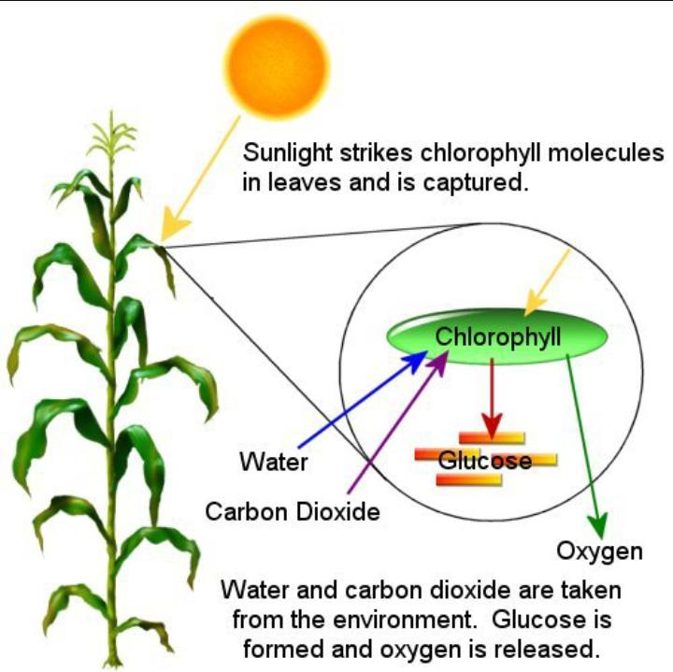
Sun Soil & Water
Soil also helps a plant to grow by giving it water and nutrients. Plants use the rays from the sun to keep them warm and to supply them with energy. Plants need just the right amount of sunshine. Too much can dry the soil and prevent them from surviving.

Slide 17
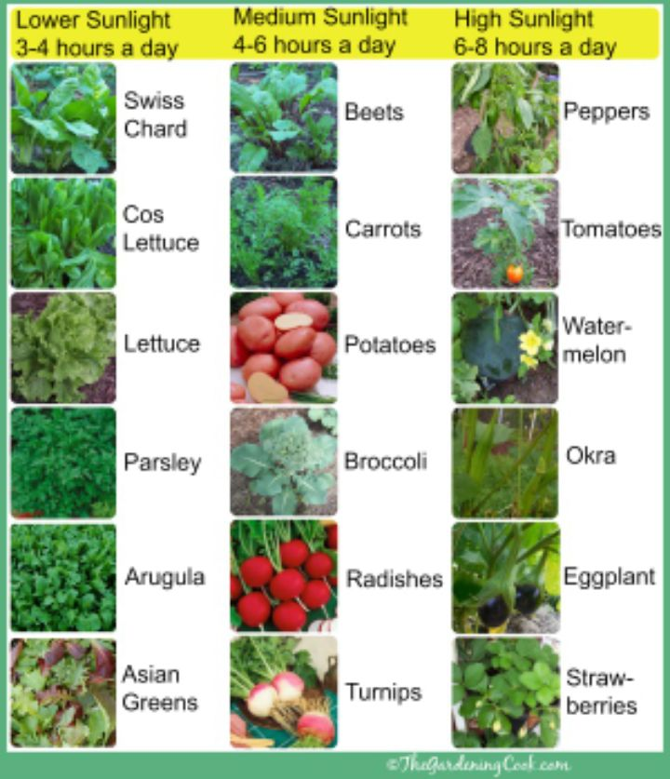
Sun
The sun provides energy for plants
The molecules of chlorophyll contained in the chloroplasts absorb energy in the form of light from the sun
Energy from the sun splits the water molecules into hydrogen and oxygen.
The oxygen molecules are given off by the plant and emitted into the atmosphere.
Molecules of ATP are created within the plant cell.
These reactions are called photochemical or light reactions because they require light to occur.

Slide 18
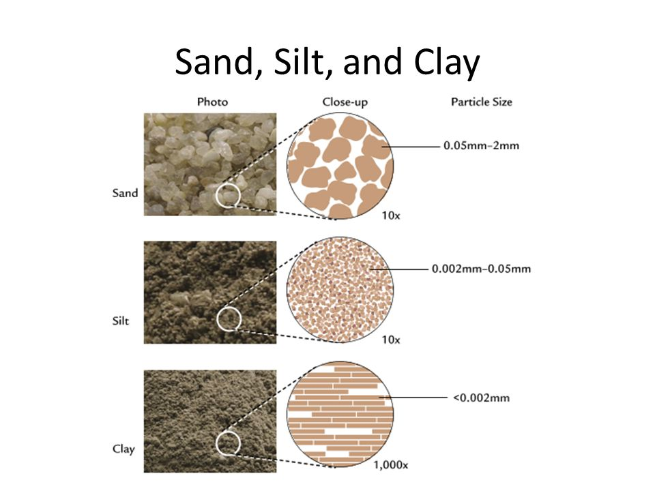
Soil
It's all about the molecules baby The bigger the molecule the easier roots, air and water can pass through.
The smaller the molecule the harder it is for roots, air and water to pass through.
Sand has large molecules so water passes through quickly and clay is compact so it is hard for water or air to move through.
This is why Loam is preferred, it has just enough of each soil type to create an even flow of water and air to nourish the roots as they grow.
This is also why you MUST be sure to use potting soil when using pots unless the plant you are growing says differently.
Garden soil is closer to clay and will compact and be too heavy for your plants roots to grow in.

Slide 19
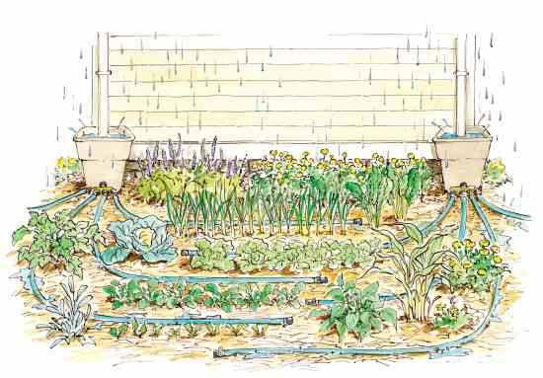
Water
The unique function of plants in making their own food depends upon regular access to water. The very structure of the plant from root to leaf allows for the entry, movement, and processing of water.
https://www.pbslearningmedia.org/resource/thnkgard.sci.ess.water/think-garden-the-importance-of-water/
Rain Water
Rain gardens are effective in removing up to 90% of nutrients and chemicals and up to 80% of sediments from the rainwater runoff. Compared to a conventional lawn, rain gardens allow for 30% more water to soak into the ground. A rain garden is not a water garden. ... Conversely, a rain garden is dry most of the time.
~ https://www.groundwater.org/action/home/raingardens.html

Slide 20
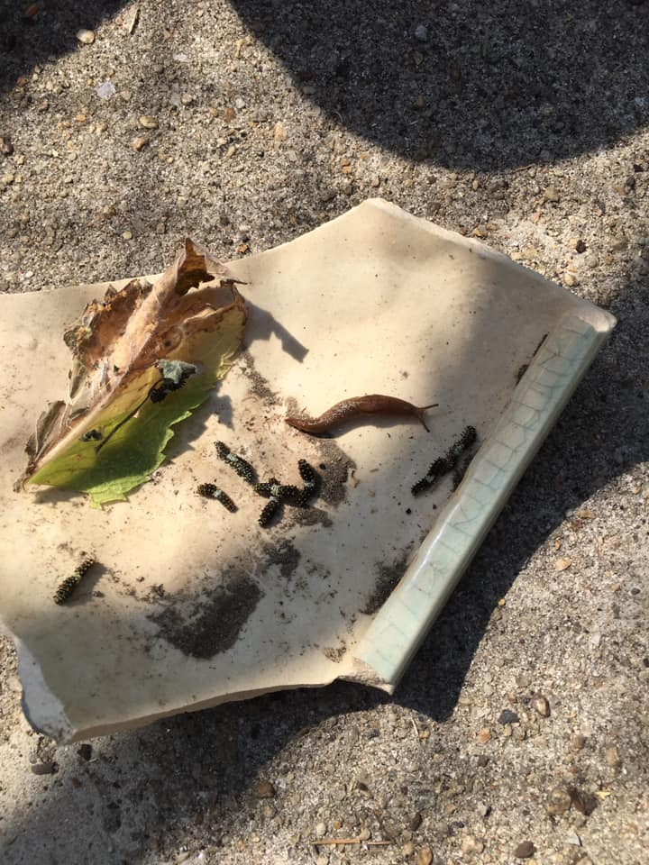
IPM Insect and Pest Management
Pest Party
Certain infections, insects and pest can cause a great amount of damage to plants, fruits, compost, beds. Being able to identify the IPM needs for your garden are crucisal to preventative measures. In the following slides I will show you a few "good" guys and "bad" guys of the garden.
Biodiversity
The variety of life in the world or in a particular habitat or ecosystem.
With biodiversity you can create a natural defense and lessen the amount of work you have to do in protecting you garden from uninvuted lunch guest. YOu can do this by adding bird feeders and baths as well as planting pollinator plants that will attract predator insects that will have the invasive insects for nourishment.

Slide 21
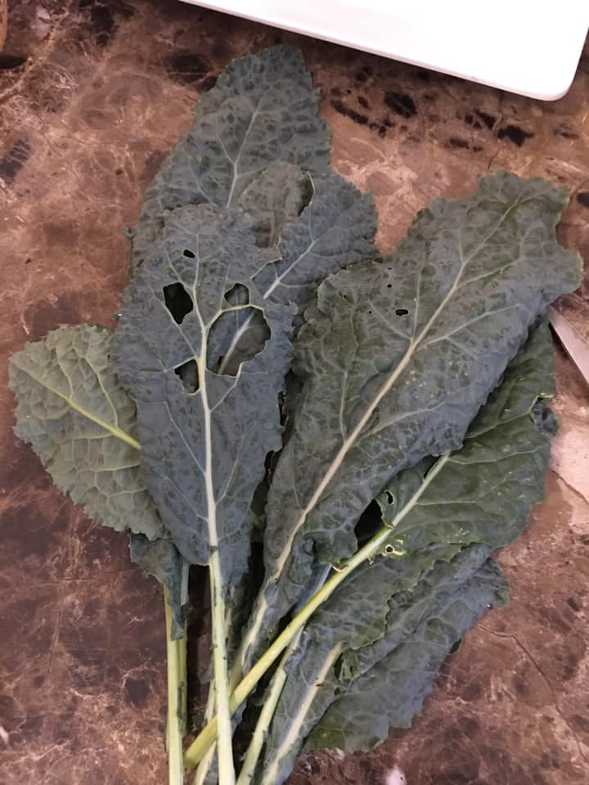
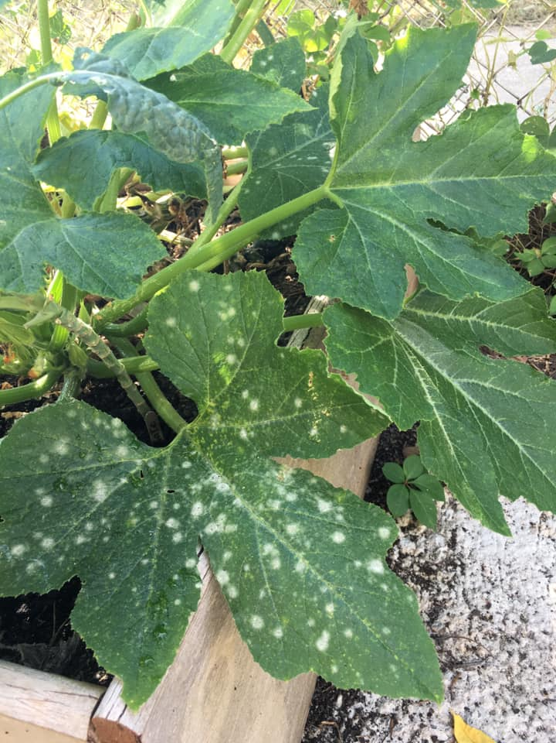
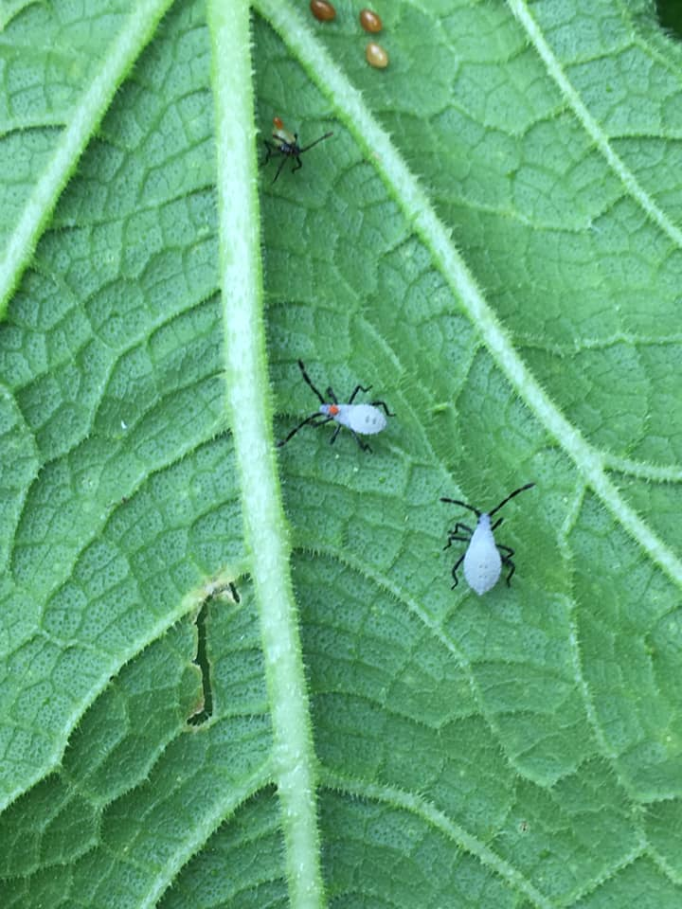
IPM Insect & Pest Management| Bad Guys
Blossom end rot prevents the fruit from growing. It is a calcium deficiency.
Catepillars will eat entire leaves in a day.
They come from butterflies laying tehir eggs on the under side of leaves
Powdery mildew means that there is too much water in the soil and it loves cooler temperatures. To manage you can purchase copper treatments other wise try removing the damaged leaves and allowing the soil to dry out between waterings, this may help. Do not compost these leaves burn them or throw them away.
Squash bugs will literally suck the life out of your plants. Get some soapy water and drop the bugd in, they will drown.

Slide 22
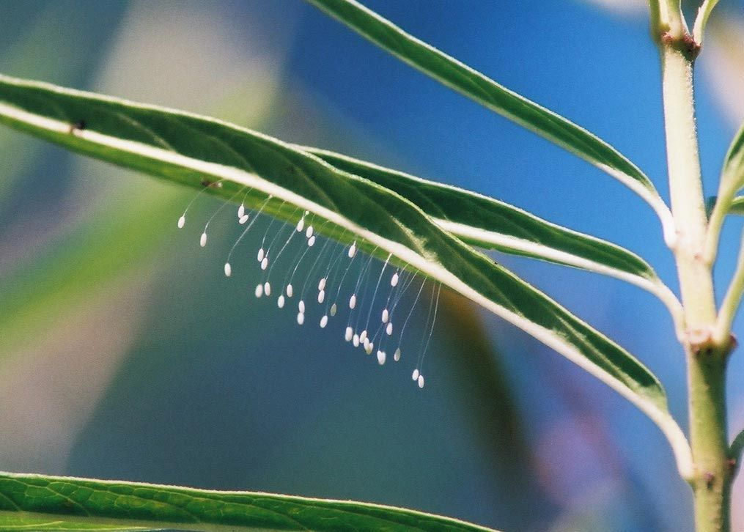
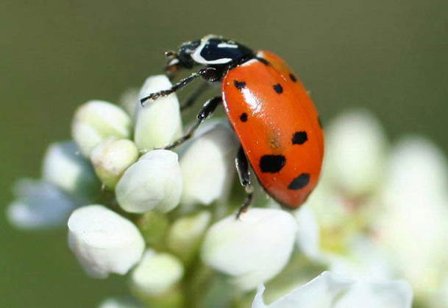
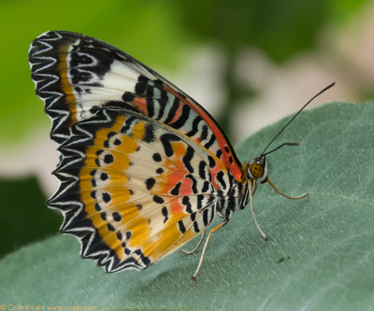
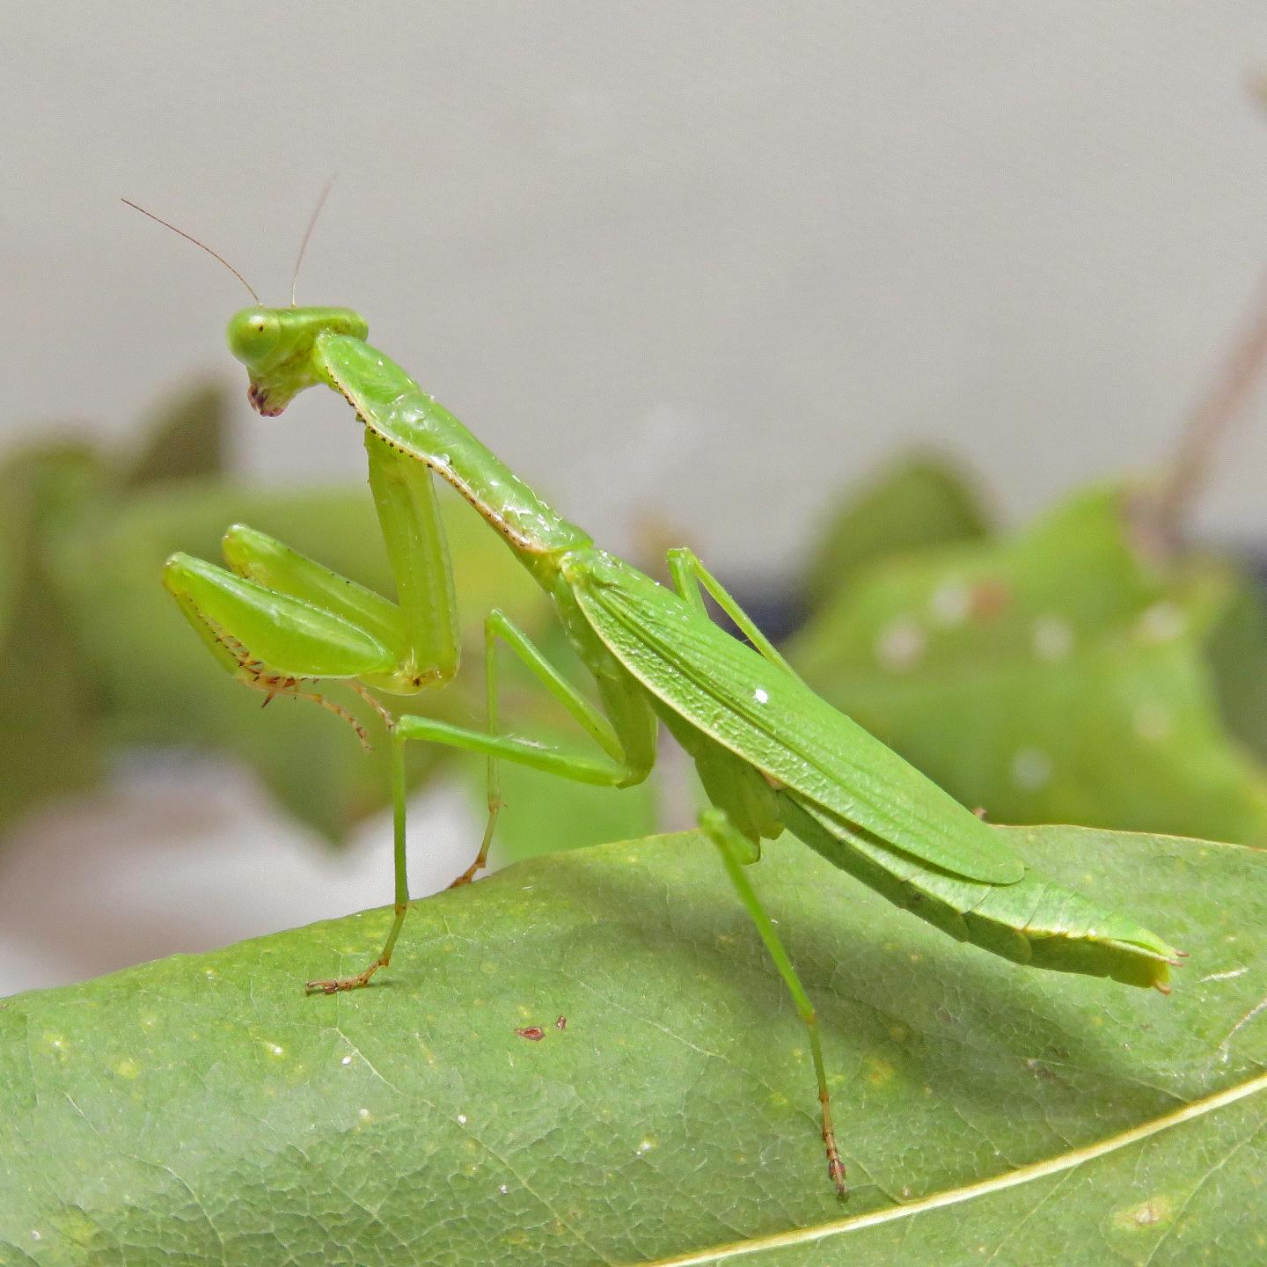
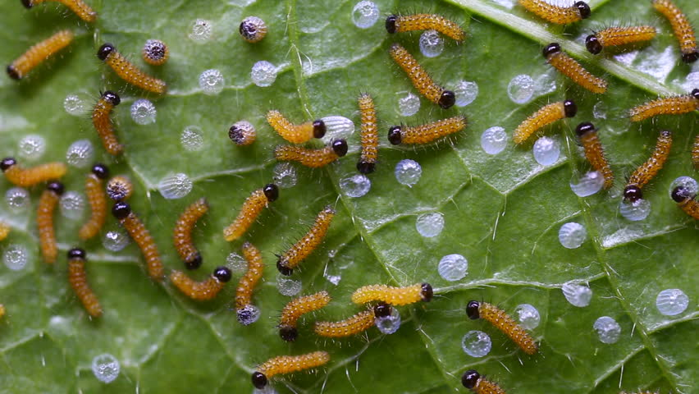
IPM Insect and Pest Management | Good Guys
The green lacewing larvae are a voracious feeder and can consume up to 200 aphids or other prey per week. In addition to aphids, it will eat mites and a wide variety of soft-bodied insects, including insect eggs, thrips, mealybugs, immature whiteflies, and small caterpillars.
Lady bug larvae eat aphids; they also eat other insects that have soft bodies, like mites, white flies, and scale insects – all of which are pests of plants. Ladybugs mainly eat aphids, so farmers and gardeners love ladybugs.
Mantis have enormous appetites, eating various aphids, leafhoppers, mosquitoes, caterpillars and other soft-bodied insects when young. Later they will eat larger insects, beetles, grasshoppers, crickets, and other pest insects. These ferocious-looking praying mantises actually make great pets.
Lady Bug
Mantis
Lacewing Butterfly

Slide 23
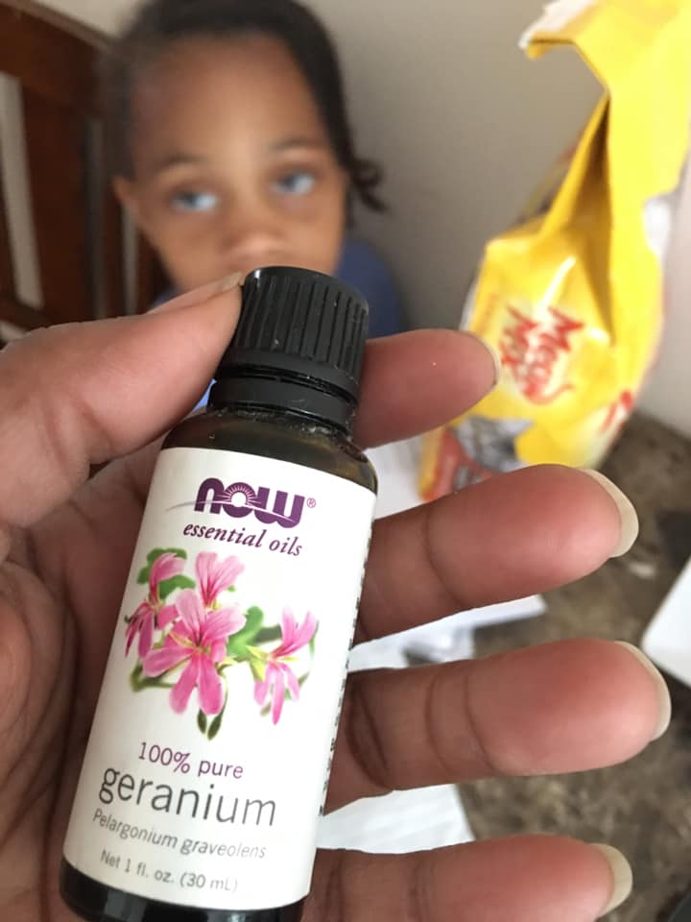
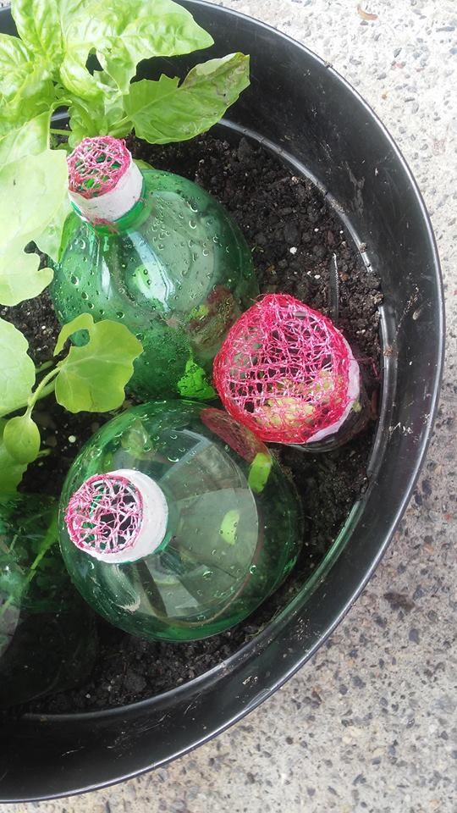
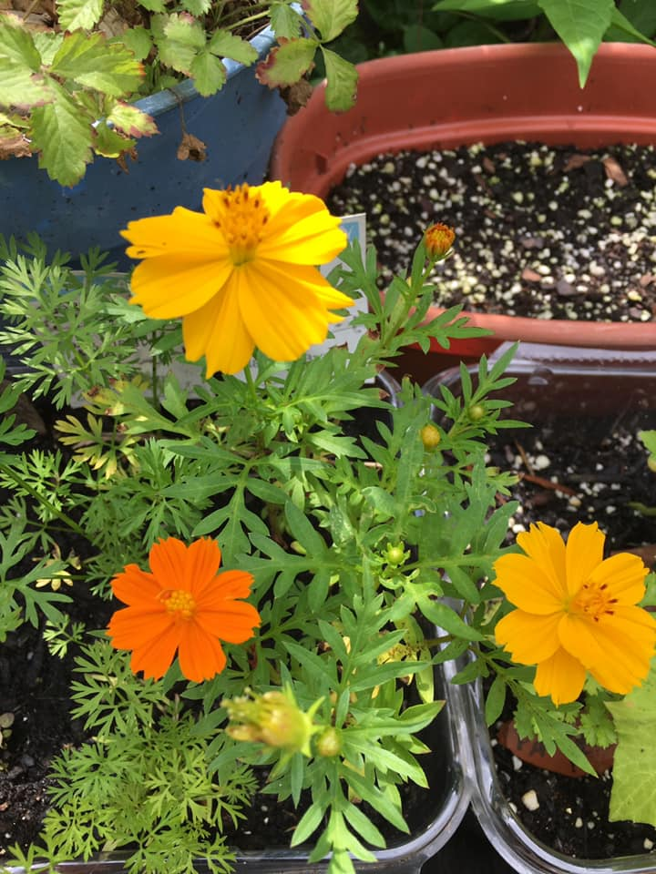
IPM | Tips
Aphids love nitrogen rich plants, and will attack plants that are nitrogen loving like tomatoes.
Plant beneficial flowers and herbs like cilantro, dill, fennel, geraniums, cosmos to attract beneficial bugs or good guys.
Cracked nut shells sprinkled across soil will deter snails and slugs because they do not like the sharp edges.
Mantis will eat other good bugs too.
Essential oils help a great deal with repelling insects: geranium, citronella, peppermint, cedar, and lemongrass.
Basil repels aphids and does especially well with tomato.
Use old orange bags or tulle to create coverings for your plants. Cut a soda bottle in half cover the top with the mesh and then cover your seedling to protect it while it is young.
You can also use fake lady bugs and butterflies to scare off bad bugs.
If you find that you have lots of flies around your compost boil some water and pour it in your bin then cover it. The heat will kill flies eggs and larvae.

Slide 24
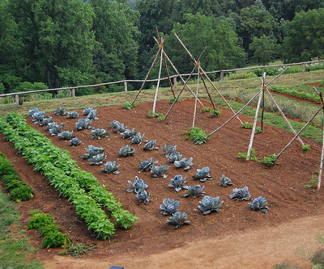
Gardening is the most therapeutic and defiant act you can do. Plus you get strawberries. ~ Ron Finely
ONE LAST THING………
In a society where there are so many concerns about food safety the only way to ensure the quality of your food is to grow it yourself or at least know and visit your grower. When living consciously you cannot ignore the self reliance side of sovereignty it and nothing shows the sovereignty of conscious living like gardening.
Before using any essential oils always be sure to get educated especially on the precautions as to avoid any accidents.
Thank you for viewing this power point be sure to check out the video too; and continue to grow in conscious living.
If you have any questions feel free to email me or fill out the contact form on the contact us page.

