Slide 1
Chapter 1: The science of psychology
Psychology
By Cicarelli and Meyer

Slide 2
What is Psychology?
Definition of psychology
The scientific study of behavior and mental processes
Four primary goals of psychology
Description
Explanation
Prediction
Control

Slide 3
Description
What is happening
Where does it happen
To whom does it happen
Under what circumstances does it seem to happen
Description is observing a behavior or mental process and noting everything about it
Goal of description= observation
return

Slide 4
Explanation
Why is it happening
Explanations lead to theories
Goal of Explanation= theory
Experiment by Sapa Cheryan et al.
return

Slide 5
Prediction
Prediction: determining what will happen in the future
Goal of prediction= understand the behavior in the future
return

Slide 6
Control
Goal of control is to change or modify the behavior, specifically from undesirable behavior to desirable behavior
Control is not brainwashing

Slide 7
Four Goals
Not all psychological investigations try to meet all four goals
Personality theorist
Experimental psychologists
therapists
Goals have not changed but methods to achieve goals have changed

Slide 8
Psychology Then: The history of Psychology
A young field 130 years
Developed from the fields of philosophy, physiology, and medicine
Two greek words
Psyche-mind
Logos-study or knowledge
Most is known about white male pioneers

Slide 9
Early Roots of Psychology
Philosophers
Hippocrates
Aristotle
Plato
Descartes
Physiologists
Fechner
Von Helmholtz
Johannes Muller

Slide 10
Hippocrates
Lived 460-370 B.C.
Believed the brain was the seat of thought and emotions

Slide 11
Aristotle
Lived from 384-322 B.C.
Believed the brain served to cool the passion of the heart
Viewed the heart as the seat of thought and emotion.
Believed the soul and the body were two parts of the same underlying structure
Wrote De Anima (On the Soul)

Slide 12
Plato
Aristotle’s teacher
Lived 427-347 B.C.
Believed the soul could exist separately from the body
Dualism: a belief that human beings consist of two distinct but intimately conjoined entities, a material body and an immaterial soul.

Slide 13
Rene Descartes
French philosopher and mathematician
1596-1650
Agreed with Plato (and dualism) that the brain was the seat of the soul
Specifically believed the pineal gland was the seat of the soul

Slide 14
Pineal Gland

Slide 15
Pineal Gland 2

Slide 16
Descartes’ Dualism
Prior view that the soul was source of heat, life, and movement
Animal dissections
Reflex arc
Continued belief in a soul
“any human activity that is qualitatively no different from that of nonhuman animals can, in theory, occur without the soul. If my dog (who can do some wondrous things) is just a machine, then a good deal of what I do might occur purely mechanically as well” (Gray, 1999, p.4)

Slide 17
Descartes Reflex Arc

Slide 18
Descartes Dualism: Soul Receiving Information from the eyes
Soul’s function was conscious deliberation and judgment
Theory was well received
Major flaw: Casper’s Dilemma

Slide 19
Materialism
Thomas Hobbes
1599-1679
Englishman
Tutor to King Charles II
Wrote Leviathan
Believed all human behavior were mechanical
Believed conscious thought was product of brain’s machinery
return

Slide 20
Physiologists
Fechner
Herman Von Helmholtz
Johannes Muller

Slide 21
Gustav Fechner
1801-1887
German
Credited with performing the first scientific experiments in his studies of perception
One of the founders of experimental psychology

Slide 22
Empiricism
Theory: all knowledge derives from sensory experience
Human mind consists of elementary ideas that originate from sensory experiences
Ideas link together to form thoughts
Contrasted with nativism

Slide 23
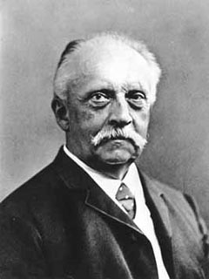
Hermon Von Helmholtz
1821-1894
German
Groundbreaking experiments in visual and auditory perception

Slide 24
Johannes Muller
1801-1858
German
Strong advocate of application of experimental techniques
Most important contribution was the doctrine of specific nerve energies
Doctrine of specific nerve energies: because all nerve fibers carry the same type of message, sensory information must be specified by the particular nerve fibers that are active.
The brain is therefore functionally divided.

Slide 25
Wilhelm Wundt
Laboratory in Leipzig Germany 1879
Wundt lived from 1832-1920
Physiologist who applied scientific principles to human mind
Believed mind was made up of thoughts, experiences, emotions, and other basic elements
Objective introspection
Father of psychology

Slide 26
The Answer is!
Empiricism or nativism because of the belief in elementary units
It is specifically empiricism because Wundt would use the senses to access the information
return

Slide 27
Objective introspection

Slide 28
Edward Titchener and Structuralism
Student of Wundt
1867-1927
Born an Englishman but brought Wundt’s ideas to Cornell University in Ithaca, New York
Expanded on Wund’ts ideas to form structuralism
Expanded introspection to thoughts

Slide 29
Titchener’s Introspection

Slide 30
Structuralism
Established as a theory of psychology in America by Edward Titchener
Died out in early 1900s due to infighting over the key elements of experience that were most important
Titchener believed there were four dimensions (quality, intensity, duration, clarity) to every sensation but others trained differently disagreed and may only have three
Fatal flaw: private technique but science requires public techiques

Slide 31
Margaret F. Washburn

Slide 32
Margaret F. Washburn
1871-1939
Originally a student at Columbia University
Student of Titchener at Cornell University
First woman to receive her Ph.D. in psychology in 1894
1908 Published The Animal Mind
1921 Became the second female president of the American Psychological Association

Slide 33
Christine Ladd- Franklin

Slide 34
Christine Ladd-Franklin
1847-1930
Completed all the requirements at Johns Hopkins University for a Ph.D. in 1882
University refused to give her the degree as they did not issue doctoral degrees to women
Distinguished research career in psychology
Developed a new theory of color vision
Finally received her Ph.D. in 1926

Slide 35
Functionalism
In response to Structuralism
Functionalism: focus is on how the mind works (what is the function)
Influenced by the work of Darwin and theory of natural selection
Still used today by evolutionary psychologists

Slide 36
William James
1842-1910
Contemporary of Titchener
Taught philosophy and psychology at Harvard beginning 1889
Found laboratory work boring
Opposed structuralism

Slide 37
Mary Whiton Calkins

Slide 38
Mary Whiton Calkins
1863-1930
Student of William James
Completed her Ph.D. requirements at Harvard University but was denied a doctorate
Established a psychology lab at Wellesley College
Research on learning, short term memory, and psychology of the self
1905 First female president of American Psychological Association
Was never awarded her Ph.D.

Slide 39
Francis Cecil Sumner

Slide 40
Francis Cecil Sumner
1895-1954
1920 First African American to earn a Ph.D. in psychology at Clark University
Became chair of psychology department at Howard University
Father of African American Psychology

Slide 41
Albert Sidney Beckham

Slide 42
Albert Sidney Beckham
1897-1964
Received Ph.D. from New York University in 1930
Specialized in Educational Psychology
Senior Assistant Psychologist at the National Committee for Mental Hygiene
Researched racial disparity in intelligence testing and intellectual disabilities

Slide 43
Kenneth and Mamie Clark

Slide 44
Mamie Clark
Mamie Clark (1917-1983)
1943 Mamie Clark became second African American to earn a doctorate from Columbia.
Research on formation of racial identity and self-esteem.
Had two children while completing a doctoral degree.
Difficulty finding a job
1946 opened Northside Center for Child Development

Slide 45
Kenneth Clark
Kenneth Clark (1914-2005)
1971 Kenneth Clark elected first African American president of American Psychological Association
Worked with his wife to show the negative effects of segregation on school children

Slide 46
J. Henry Alston

Slide 47
J. Henry Alston
1920 became the first African American to publish research findings in a U.S. psychology journal
Research was on the perception of warmth and cold

Slide 48
Gilbert Haven Jones

Slide 49
Gilbert Haven Jones
1883-1966
1909 Received a doctorate in psychology from a university in Germany
First African American with a Ph.D. to teach psychology in the U.S.

Slide 50
Richard Suinn

Slide 51
Richard Suinn
1999 First Asian American president of American Psychological Association
One of first members of the APA Committee on Ethnic Minority Affairs in 1979
Research in sport psychology and ethnic minority issues
First psychologists to serve on U.S. Olympic sports medicine team 1972

Slide 52
Jorge Sanchez
Hispanic psychologist who conducts research in intelligence testing and cultural bias in these tests

Slide 53
Pioneer Paper
5 points for including a pioneer not mentioned in this lecture
Brief biography of the person, no more than ½ page (major contributions, birth, death)
Discuss their struggles (bias in society, university, field of psychology, on an individual level)
Discuss what barriers you would experience today if you were a pioneer in the field
If you feel you would face no barriers discuss the privilege you gain as related to your pioneer.

Slide 54
Pioneer Paper
http://psychology.okstate.edu/museum/afroam/bio.html (African American Pioneers in Psychology)
Google some of the pioneers already listed in this chapter and find similar people
Other people may include:
-Sabina Spielrein
Melanie Klein
Jorge Sanchez (due to limited information)

Slide 55
Where we are today

Slide 56
Gestalt Psychology
Another response against structuralism like functionalism
Major figure was Max Wertheimer
Wertheimer believed that psychological events such as perceiving and sensing could not be broken down into smaller elements
Slogan “the whole is greater than the sum of its parts”
Gestalt psychologists believe that people naturally seek out patterns (wholes)

Slide 57
Gestalt Psychology
Studied sensation and perception
Gestalt is a German word meaning “good form” or “good figure”
Gestalt Psychology is found in cognitive psychology today focusing on perception, learning, memory, thought process, and problem solving
Also a founding principle for Gestalt therapy

Slide 58
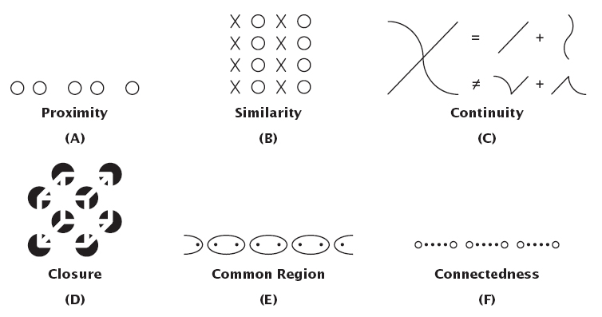
Gestalt Principles of Perceptual Grouping

Slide 59
Max Wertheimer

Slide 60
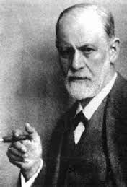
Sigmund Freud and Psychoanalysis
Freud was a medical doctor from Austria
Freud 1856-1939

Slide 61
Sigmund Freud and Psychoanalysis
Theory created during the Victorian age
Many of Freud’s clients were woman
Patients suffered from nervous disorders without any known physical causes
Freud proposed that the unconscious of the patients was causing the symptoms

Slide 62
Freud and Psychoanalysis
He stressed the importance of childhood experiences as the source of personality and problems
Followers included Adler, Jung, and his daughter Anna Freud.
His ideas are found today in modified forms
His theory is the source of modern day therapy model.
Psychoanalysis is still practiced today.

Slide 63
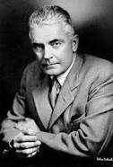
John B. Watson and Behaviorism
1878-1958

Slide 64
John B. Watson and Behaviorism
Challenged Structuralists , Functionalists, and psychoanalysis
Created behaviorism to bring psychology back to a “scientific” injury
Decided to ignore consciousness and focus on observable behavior
Based a lot of his ideas on Ivan Pavlov

Slide 65
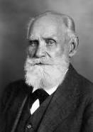
Pavlov’s Conditioned Response
Ivan Pavlov 1849-1936
Pavlov Video

Slide 66
Pavlov’s Conditioned Response

Slide 67
Of Babies and Rats
Phobias-irrational fear
Freud-repressed conflict
Watson-learned behavior
Little Albert
Everyone born Tabla Rasa (Blank Slate)
Trained the child to become afraid

Slide 68
Little Albert

Slide 69
Mary Cover Jones
1897-1987
Attended one of Watson’s weekend lectures
1920 earned Master’s degree under Watson
Little Peter (counterconditioning)
Became a pioneer of behavior therapy
Oakland Growth Study
First educational television course in child development 1952

Slide 70
Modern Perspectives of Psychology
Psychodynamic Perspective
Behavioral Perspective
Humanistic Perspective
Biopsychological Perspective
Cognitive Perspective
Sociocultural Perspective
Evolutionary Perspective

Slide 71
Psychodynamic Perspective
Based on Freud’s theory
Modified for use today
Focus remains on the unconscious mind
Current followers are called Neo-Freudians
Use in therapy

Slide 72
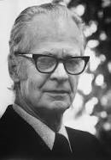
Behavioral Perspective
B.F. Skinner replaced Watson in Behaviorism
Skinner

Slide 73
Behavioral Perspective
B.F. Skinner 1904-1990
Skinner developed operant conditioning

Slide 74
Humanistic Perspective
Called the “third force” in psychology
Reaction to both psychodynamic theory and behaviorism
Focus on the person’s ability to direct their own lives
What makes us uniquely human
Humans have free will
Early founders

Slide 75
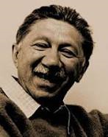
Abraham Maslow
1908-1970

Slide 76
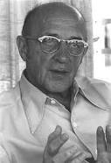
Carl Rogers
1902-1987

Slide 77
Humanistic Perspective
Emphasized human potential
Scientific study
Self-actualization
Therapy

Slide 78
Biopyschological Perspective
Human behavior is seen as a direct result of events in the body
Hormones, brain chemicals, tumors, and diseases are the causes of disordered behavior and mental illness

Slide 79
Cognitive Perspective
Focuses on how people think, remember, store and use information
Became a force in the field in 1960s
Branched off from Gestalt psychology
Other influences
Cognitive perspective

Slide 80
Sociocultural perspective
Combines two areas of study: social psychology and cultural psychology
Reminds people that they are influenced by their social environment
Sociocultural studies

Slide 81
Bystander Effect
The likelihood that a bystander will help someone is related to the number of bystanders available
Story of Kitty Genovese
Diffusion of responsibility
I was just following orders
Other people were doing it

Slide 82
Diffusion of Responsibility/Milgram experiment
Modern Day Milgram Experiment

Slide 83
Evolutionary Perspective
Seeks to explain general mental strategies and traits
Mind is an information processing machine designed by natural selection
Evolutionary explanation for forgiveness of infidelity
Evolutionary explanation for anorexia

Slide 84
Types of Psychological Professionals
Psychiatrist
Psychoanalyst
Psychiatric social worker
Psychologist

Slide 85
Scientific Method
1) Perceiving the question
2) Forming a hypothesis
Confirmation Bias
3) Testing the hypothesis
4) Drawing conclusions
5) Report your results
Empirical Questions

Slide 86
Descriptive Methods
Naturalistic Observation
Observer effect
Participant observation
Observer bias
Blind observer
Laboratory observation
Case Studies
Phineas Gage
Surveys
Representative sample
Population
Courtesy bias

Slide 87
Phineas Gage
1823-1860

Slide 88
Phineas Gage
Experienced significant personality changes following an accident where a railroad spike went through the frontal lobe of his brain
Case Study that helped establish the frontal lobe as the location of personality and impulse control in the brain
Movie

Slide 89
Correlations
A statistical technique
About finding relationships
variables
Correlation definition
Correlational Studies Examples
Correlation Coefficient
+1.0 to -1.0
Direction of Correlation

Slide 90
Correlations

Slide 91
Correlations
Correlation does not prove Causation

Slide 92
Correlations Strength
Determined by the correlation coefficient actual number
+0.89 = -0.89 in strength but not direction
-0.75 is stronger than +0.45

Slide 93
Experiment
The only research method that will allow researchers to determine the cause of a behavior
Confounding variable
Definition of Experiment
Sample Selection

Slide 94
The Variables
Operational definition
Independent variable
Dependent variable

Slide 95
Groups
Experimental Group
Control Group

Slide 96
Randomization
Once participants are selected randomly they must also be assigned to the experimental or control group randomly
Random Assignment
Extraneous variables
All confounding variables are extraneous variables but not all extraneous variables are confounding variables

Slide 97
Experimental Hazards
The placebo effect
The Experimenter effect

Slide 98
Experimental Hazards
Jessica is struggling with depression and joins a study testing a new drug. She arrives and takes the small blue pill. She has high hopes that this medication will work for her. She starts to feel better and when she fills out her symptom questionnaire she indicates that she is feeling better. The only problem is that Jessica has been given a sugar pill with no active medication but she does not know this.
This is an example of ?
(return after single-blind experiments)

Slide 99
Experimenter Hazards
Dr. Smith is testing a new drug that is supposed to improve behaviors in children with ADHD. He oversees the children taking the medication. He then fills out symptom reports for each child. He questions whether he should mark slight improvement or moderate improvement for a child who has taken the medication. He figures that it would probably make sense that the child has shown moderate improvement since he has taken the medication and so he marks this on the checklist.
What is this an example of?

Slide 100
Single-Blind and Double-Blind Studies
Single-Blind Study
Pygmalian in the Classroom
Double-Blind Study

Slide 101
Double-Blind Study
Dr. Smith is conducting a study looking at a new medication for ADHD. He is not told who has be given the medication and who has not. Also the children are not aware of whether they have been given medication or a sugar pill. He goes in each day to complete a daily assessment on all the children.

Slide 102
Quasi-experimental designs
Alternative research design
When participants can’t be randomly assigned to groups
For Example: if your study was looking at memory over age, you couldn’t randomly assign someone to be 20, 30, or 42

Slide 103
Ethics of Psychological Research
Why we have ethics
Ethics committees
Guidelines
Animals in research
Why Animals are used
Ethics of working with animals

Slide 104
Guidelines
1) Rights and well-being
2) informed decisions
3) deception must be justified
4) withdraw from the study
5) participants must be protected
6) debriefing participants
7) data must remain confidential
return

Slide 105
Critical Thinking
Four Criteria for Critical Thinking
1) few truths
2) all evidence is not equal
3) authority does not mean true
4) open mind

Slide 106
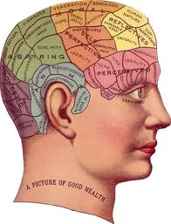
Pseudopsychologies- NOT ON TEST
Phrenology

Slide 107
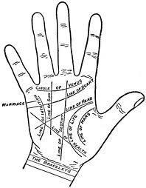
Pseudopsychologies
Palmistry

Slide 108
Astrology
Applying critical thinking to astrology
Are astrologer’s charts up to date?
What exactly is so important about the moment of birth?
Why would the stars and planets have any effect on a person?

