Slide 1
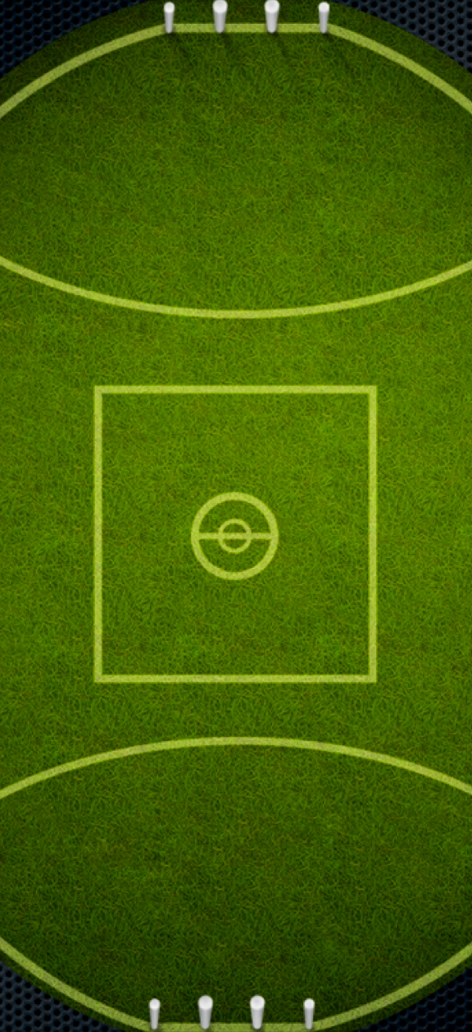
Grundy Run
Start
70% run
6
1
3
100% run
Finish
2
4
5

