Slide 1
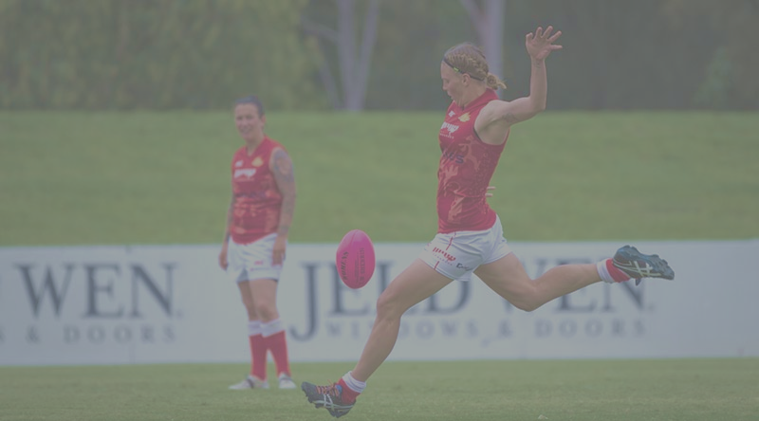
2020 ARMY WOMEN’S WARM UP

Slide 2
TRAINING FORMAT
COMPONENT | TIME | LENGTH | COACH | AREA | FOCUS POINTS
POP & TOUCH |  | 20 | PLAYERS | STRETCH HB/K | 100 Club (Kicks no more than 25 mt)
ACTIVATION WARM UP |  | 20 | AB | ACTIVATION COD & FAST FEET | ACCELERATION & DECELERATION FUNCTIONAL MOVEMENT
FUNDAMENTALS |  | 25 | ALL | MARKING, CRUMBING FIELD & GOAL KICKING, CLEAN HANDS, CONTESTED BALL WINNING, TACKLING | HIGH VIS VOICE, INTENSITY, SPEED
MINI GAMES or ISOLATION TRAINING |  | 15 | ALL
TOTAL TIME |  | 80 - 100

Slide 3
ARMY WOMEN’S 2020 WARM UP
Fundamental movement ( 3 Min)
Blood Flow
Leg range of movement
Stretch ( 3-5 Min)
Large muscle groups
AC Joints (Knee, Ankle, Hips & Groin)
Activation (5 Min)
Upper Body
Agility & Fast Feet ( 5-7 Min)
Fast Feet
COD
Cognitive Thinking
Touch and Feel (coaches feed a football at the end of the line)
Static leg swings

Slide 4
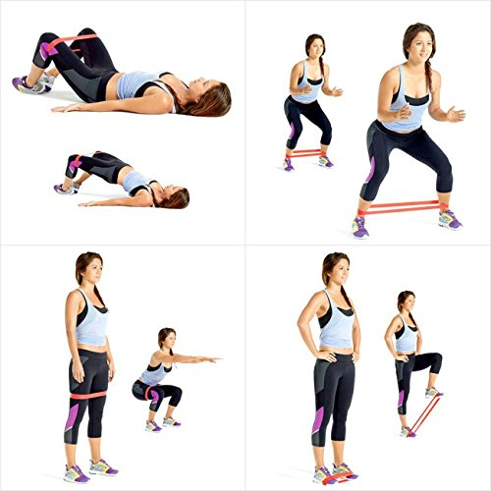
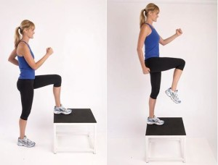
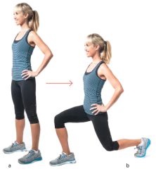
Activation – 5 Min
Summary
Step-up with a knee-up x 5 Bilateral
Do x 10 each bilateral
This is designed to activate and attune the brain to send signals to muscle groups, telling the body that we are about to work. A Series of push and hold actions are required and are concentrated on the lower part of the body including glutes and hips. This combined with stretching and range of movement actions help towards the prevention of injury to large muscle and tendon groups. Activation should take no more than 5 min to achieve.
Reverse lunge x 5 Bilateral
Crab walk - feet face forward (train tracks)
Wide to sh. Width
Supine bridge - double leg feet together
Single leg, keep hips high
Band Squat - above knee, keep knees out
Knee raise - fast contraction, slight pause

Slide 5
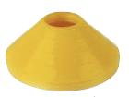
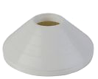
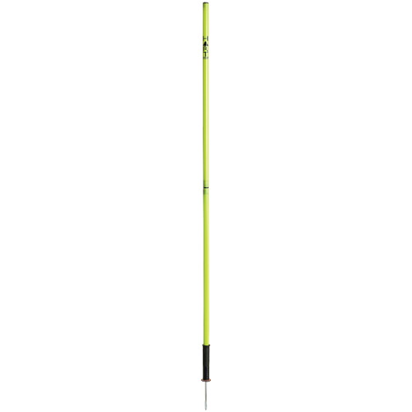
Fundamental Movements 5 Min
Summary
This is designed to get blood flowing to our major muscle groups prior to stretching. Short and sharp of 1 exercise rotation off a line for 5-6 different range of movement activities.
Boots to glutes
High knees
Walking ground touch
Sideways cross over
Skipping
Decel-Stop-Jump (2 foot)-Acel x 2

Slide 6
Stretching 5 Min
Summary
Stretch all main muscle groups work from bottom to top. To include open shut gate, lay on stomach scorpions and lay on back hip rotations. Finish on 5-10 x leg swings on each leg

Slide 7
Agility & Fast Feet 5 Min
Summary
Eg: Activity 3
Eg: Activity 4
Eg: Activity 1
Eg: Activity 2
This is designed to switch the brain on with reaction to commands and also to get our feet working quickly and further prepare our AC Joints that support the lower part of the body during agility movements.
Players start behind the yellow cone
Command a series of coloured cones that a player must move on the inside utilising fast feet prior to moving to decel at the agility pole to guard the mark
Player then acels to the white cone and reduces to decel through to the red cone
Last couple of run throughs is a complete movement from the yellow cone to the red cone at 100% on the outside of the cones. Players still move via cone combinations, around left or right agility poles at 100%. Simple maths (odds and evens can also be used to control movement directions.

Slide 8
End

