Slide 1
Testing Mason Pond

Slide 2
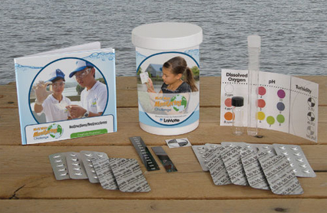
World Water Monitoring Challenge Kit

Slide 3
Dissolved Oxygen 0 ppm PH- 7

Slide 4
Temperature 14-16
Turbidity 40 JTU

Slide 5
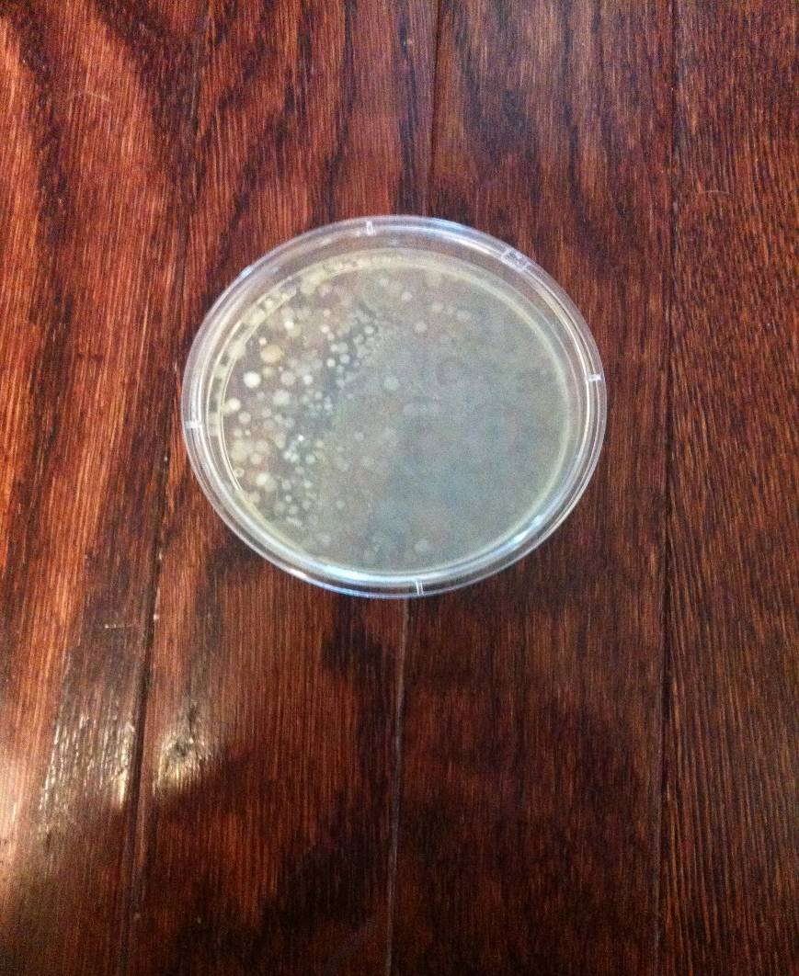
E.COLI!!
Day 1
Day 7
Day 3

Slide 6
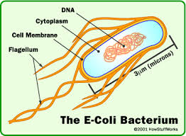
Health Effects of E.Coli
What is E.Coli ?
Escherichia coli (E.Coli) is type of bacteria most commonly found in human and animal digestive system. Normally harmless, but several strains can cause serious disease in humans.

Slide 7
Exposure to E.Coli
E.Coli can be found in water due to fecal contamination or runoff from a contaminated area.
Signs and Symptoms
Symptoms of exposure usually occur within 2-4 days. Symptoms include stomach cramps, diarrhea, vomiting and fever.

Slide 8
Who is at risk?
People of any age can become infected, but young children, elderly and those with a compromised immune system are more likely to become severely ill from E.Coli exposure .
Avoiding Exposure
Avoid swallowing lake or pool water
Drink municipal water that has been treated with chlorine or other disinfectants.
If in doubt, boil water for one minute at a rolling boil to avoid exposure.

Slide 9
Real World Application
Drinking and swimming in contaminated water can cause serious health
issues including diarrhea and vomiting
Anyone could buy the kit we used on the mason pond and conduct
their own experiments on drinking water or recreational water

Slide 10
Recreational Water
It is possible to become infected with E. coli after swimming in
contaminated water. Water can be contaminated in more than just
lakes, rivers, and ponds. Pool water can also be contaminated.
In 1998, E. coli in the water at a Six Flags water park made 26 people sick.
In 1999, water from Battle Ground Lake in Washington made 37 people sick.

Slide 11
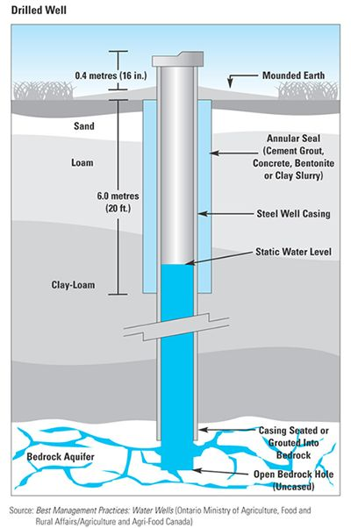
Well Water
It is recommended that people with wells test their water once a year or if water in the area is contaminated.
Well water can contain coliforms, which can make a person sick.
The pH of water is also important because acidic or basic water can damage pipes. If ongoing, this can lead to metal getting into the drinking water. It is especially important to test well water after floods, after heavy rainfall, or after snow on the ground melts.

Slide 12
How to teach kids about E.Coli

Slide 13
References:
"Basic Information about E. Coli in Drinking Water." Environmental Protection Agency. EPA, n.d. Web. 23 Feb. 2014.
"Escherichia Coli (E. Coli)." Centers for Disease Control and Prevention. Centers for Disease Control and Prevention, 03 Aug. 2012. Web. 21 Feb. 2014.
“Bacteria Contamination in Well Water.” Winnebago County Health Department. Winnebago County Health Department, n.d. Web. 25 February 2014.
“Dangerous Waters: E. Coli Threaten Swim Areas.” Food Safety News. Food Safety News, 2011. Web. 25 February 2014.
“Well Testing.” Centers for Disease Control and Prevention. Centers for Disease Control and Protection, 2010. Web. 25 February 2014.

