Slide 1

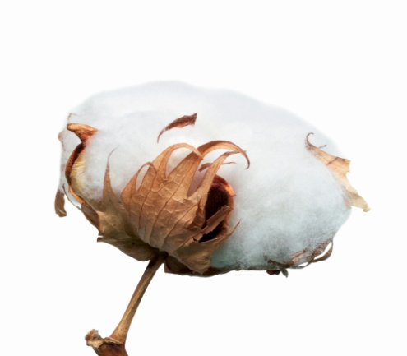



SORTING
As Easy As
1-2-3
1. BY FABRIC
2. BY COLOR
3. BY SOIL LOAD
Cottons from Polyester Whites from Colors Light Soil from Heavy
Improper sorting will cause redepostion, dingy and graying of linen…
Distributed By;

