Slide 1
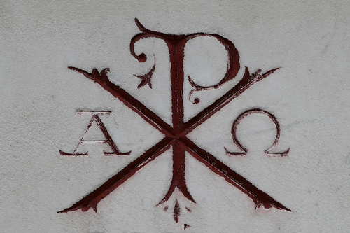
Transforming Glory Thieves

Slide 2
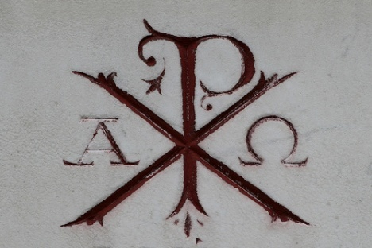
The Danger of Stealing Glory
“Now Herod was angry with the people of Tyre and Sidon, and they came to him with one accord, and having persuaded Blastus, the king's chamberlain, they asked for peace, because their country depended on the king's country for food. ”
- Acts 12:20, ESV

Slide 3
The Danger of Stealing Glory
“On an appointed day Herod put on his royal robes, took his seat upon the throne, and delivered an oration to them. And the people were shouting, ‘The voice of a god, and not of a man!’”
- Acts 12:21-22, ESV

Slide 4
The Danger of Stealing Glory
“Immediately an angel of the Lord struck him down, because he did not give God the glory, and he was eaten by worms and breathed his last.
But the word of God increased and multiplied.”
- Acts 12:23-24, ESV

Slide 5
The Danger of Self-love
We grow small trying to be great.

Slide 6
The Nature of Sin
“Incurvatus
In Se”
Curve in ourselves

Slide 7
The Result of the Fall
“The ruin that the Fall brought upon the soul of man consists very much in his losing the nobler and more benevolent principles of his nature, and falling wholly under the power and government of self-love.”
- Jonathan Edwards

Slide 8
The Result of the Fall
“Before, and as God created him, he was exalted and noble, and generous; but now he is debased, and ignoble, and selfish. Immediately upon the fall, the mind of man shrank from its primitive greatness and expandedness, to an exceeding smallness and contractedness.”
- Jonathan Edwards

Slide 9
The Danger of Self-love
The Love of Distinction destroys our Natural Nobility and Ability

Slide 10
The Love of Distinction
“But among all the passions which mislead, endanger, and harass the mind, none is more hostile to its peace, none more blind, none more delirious than the love of distinction.”
- Timothy Dwight, 1814 AD

Slide 11
The Love of Distinction
“Selfishness is its nature little and base. But no passion and no pursuits are more absolutely selfish than the love of distinction. One’s self is here the sole object; and in this object all the labors, pursuits and wishes terminate.”
- Timothy Dwight, 1814 AD

Slide 12
The Love of Distinction
“How terrible must be the account given of life spent only in laboring to acquire distinction. Adam indulged this disposition once and lost his immortality. Satan indulged this disposition once and was cast out of heaven.”
- Timothy Dwight, 1814 AD

Slide 13
The Love of Distinction
“What will become of him who has eagerly followed this career of his apostate first parent and of this apostate angel throughout the howl of his probation?”
- Timothy Dwight, 1814

Slide 14
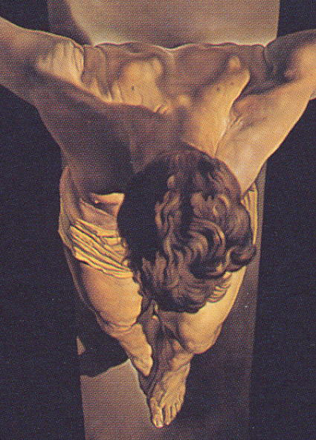
Transforming Glory Thieves
We are transformed from glory thieves to declarers of God’s glory when we follow in the paradoxical way of the Cross of Jesus.

Slide 15
Paradox 1
“…who, though he was in the form of God, did not count equality with God a thing to be grasped, but made himself nothing…”
- Phil. 2:6-7, ESV
Fulfillment is found in Emptiness

Slide 16
Fulfillment is found in Emptiness
“The Gospel reminds us that Christ was cosmically downsized to come and die for us. He was really something, but made Himself nothing.”
- Dave Harvey

Slide 17
Paradox 2
It is wrong to first think about our “rights”
“Do nothing from rivalry or conceit, but in humility count others more significant than yourselves. ”
- Phil. 2:6-7, ESV

Slide 18
It is wrong to first thing about our “rights”
“Few things are more depressing than that of a professed Christian defending his supposed rights and bitterly resisting any attempt to violate them. Such a Christian has never accepted the way of the Cross.”
- A. W. Tozer

Slide 19
Paradox 3
It is really something to be nothing
“taking the form of a servant,
being born in the likeness of men.”
- Phil. 2:7, ESV

Slide 20
It is really something to nothing
“In a fundamental sense slavery involves the absence of rights, especially the right to determine the course of one’s life and the use of one’s energies.”
- Murray Harris

Slide 21
Paradox 4
“I say to everyone among you not to think of himself more highly than he ought to think, but to think with sober judgment…”
- Rom. 12:3, ESV
In self-evaluation, don’t trust what you see

Slide 22
In Self-evaluation, do not trust what you see
“Ambition and self-assessment are inextricably linked. The selfishly ambitious are terrible at self-arithmetic. When they ‘count themselves,’ it’s always more than almost everybody else.”
- Dave Harvey

Slide 23
Paradox 5
“…to purify for himself a people for his own possession who are zealous for good works.”
- Titus 2:14, ESV
True Humility produces Godly Ambition

Slide 24
True Humility Produces Godly Ambition
“Ambitions for self may be quite modest….Ambitions for God, however, if they are to be worthy, can never be modest.”
- G. K. Chesterton

Slide 25
Lord,
it is my chief design to bring my heart back to You.
Convince me that I cannot be my own god, or make myself happy, nor my own Christ to restore my joy, nor my own Spirit to teach, guide, rule me.
Puritan Prayer
17th Century

Slide 26
Take away my roving eye, curious ear, greedy appetite, lustful heart.
Show me that none of these things can heal a wounded conscience, or support a tottering frame, or uphold a departing spirit.
Then take me to the cross and leave me there.
Puritan Prayer
17th Century

Slide 27
“Not to us, O Lord, not to us, but to your name give glory.” (Psalm 115:1)

