Slide 1
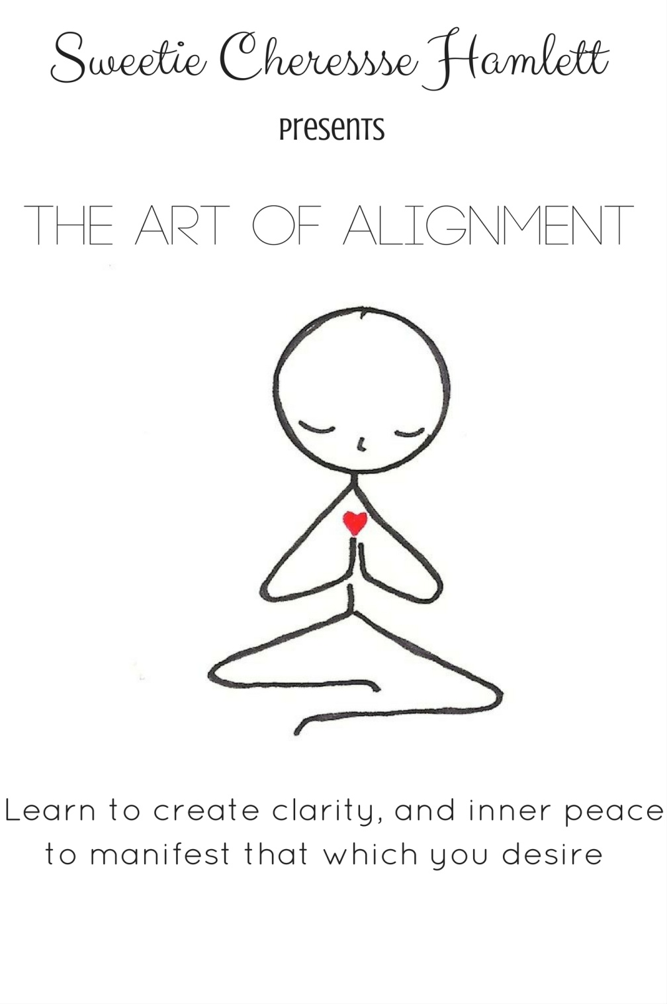

Slide 2
What is Alignment
It is managing and processing your emotions to be able to better choose your vibration for manifestation using the keys to alignment
What Alignment is not
It is not having all happy experiences, but flowing through them with eyes wide open

Slide 3
Keys to Alignment
Key1: cleanse
Removing blockages and stagnant energy
Key2: ground
Connecting with all your higher self and getting centered in universal energy
Key3: rise
Raising your vibration
Key4: Focus
Seeing what’s current and manifesting a better future
Key5: Flow
Being and staying in vibrational alignment with your higher self

Slide 4
Cleanse
Purpose
Cleanse to remove debris, negative energy, release tension and charge yourself with light and love.
2 Methods
Smudging and Salt

Slide 5
Smudging
Refers to the practice of burning the stems and leaves of certain herbs and plants tied in a bundle with the intent of purifying the space, people, and things with the smoke of your smudge wand.
The Science
Positive ions cause the “thick air” or tension in a room
Smudging turns the positive ions into negative ions thus neutralizing the tension in the air
Physically
Removes household odor
Quiets the nerves
Alleviates airborne germs
Metaphysically
Purifies a person, place, or thing
Protective
Longevity
Peace
How it works
As the smoke is released it attaches itself to the positive ions and transmutes them into positive one
Often used varieties
White sage
Drives out negative energy, spirits, and encourages sweet dreams
Sweet grass
Brings in positive energy after banishing negativity
Lavender
Restores balance and creates a peaceful environment

Slide 6
Salt
The science
Like smudging salt has an ionic affect on your environment
For the best results, salts should be dissolved in water and used as a soak, spray, mist, steam, or wash
Physically
Cleanse air
Reduces allergies
Lessons mold and bacteria in the air
Meta physically
Absorbs physic energy
Binds negative energy
Disable unwanted psychic phenomena
How it works
Salt absorbs and traps negative energy into it’s own molecular structure
Often used varieties
Table
Fine
Dissolves easily
Has anti caking chemicals added (sodium chloride)
Sea salt
Product of evaporated sea water
Mineral rich
Dead sea salt; it’s connection is to the “holy land” so it’s most popular for purification and protection
Himalayan pink salt
High in iron content
Iron represents the earth and the universe
Protective qualities
Purify and bless

Slide 7
Grounding
Purpose
To energetically connect to the earth’s core to remain present and connected with your human experience

Slide 8
Methods
Always set you intentions aloud before practice
Earthing
Walk, lie, or sit directly on the earth
Palms of hands and soles of feet should rest flat on the earth
Try earth that is not chemically treated
Gardening counts as earthing
Crystals
Wear, carry, or meditate with a crystal known for grounding
Crystals: Amber, Hematite, Black Tourmaline, Lava Rock, Smoke Quartz
Sounds
OHM, this is the meditation mantra that connects you to the earth
OHM is the sound of the earth’s vibration it can be both measured an heard
Affirmations are short phrases that you can use to remain present in the moment
“I AM” is the affirmation associated with the root chakra
I use the Affirmation “I am______” filled in with a verb that describes each chakra to connect each chakra to my intent to be grounded.

Slide 9
Affirmation to get grounded
Chakras Affirming verb
Crown Divine
3rd eye Connected
Throat Truthful
Heart Loved
Solar Plexus Strong
Sacral Creative
Root I AM Present

Slide 10
The Science
It’s all ionic really!
Negatively charged ions are found everywhere in nature, from waterfalls, to lightening and rain.
Physically
Expels stress, trauma, anxiety, and anger
Decreases blood pressure
Relieves depression
Metaphysically
Activates rot chakra
Restores your connection to source energy
Can strengthen your awareness of your purpose
Directions
Always cleanse first
Select your grounding method
Follow the steps of your selected grounding method
Do w hat feels good, do all three if need be

Slide 11
Rise
Purpose
To have a physical and metaphysical shift that will influence your feelings, thoughts, and or physical body and align you with your higher self to manifest your desires.

Slide 12
The Science
The remaining keys to alignment: rise, focus, and flow are inspired by the teaches of the “Vortex” by Abraham Hicks and the “law of attraction”
The science relates to quantum sciences, psychology, neuroscience, philosophy, and evolutionary biology, I recommend researching those sciences to deepen your understanding
Masaru Emoto has had some very compelling findings in his water experiments, showing that our thoughts and emotions can have affects on a molecular level.
Korean researcher Ji Young Et Al found the connection between positive thinking and overall life satisfaction in the population. Published in the Yonsei Medical Journal in 2007
You can find equal amounts of research and videos for and against these theories so always follow what feels good to you. Use your Solar plexus intuitive chakra
I encourage you to watch the movie “The law of attraction” and to check out Abraham Hicks “what is the vortex” on youtube to gain some perspective.
Physically
Improves mood, health, sleep, creativity
Metaphysically
Expand consciousness
Broaden perspectives
Live beyond fear

Slide 13
How it works
“Like attracts like” feeling good or better attracts things to you to encourage that feeling; same goes for feeling bad.
Methods
Sweetie’s 3 step Method
Seeing and focusing
Emotional processing and management
Building momentum
Seeing and Focusing
See what is Focus on what you desire to see
Seeing becomes focusing because of emotion
Seeing is awareness it is to “know of”
Focusing is continuously giving something your attention
Emotion is vibration, a form of energy
Everything in our reality is made of energy under the roper microscope you will see buzzing energy beyond solid matter
Your emotions are vibrational energy that you can use along with focus to manifest the reality you desire to see

Slide 14
Emotional Processing and Management
Emotional processing and management helps you raise your vibration when what you are “seeing” in your surrounding environment threatens to lower your vibration.
This is your POINT OF POWER: when your awareness now puts you in control of the situation
Processing
Sorting through what you are feeling
Management
What to do with what you are feeling
Emotional Processing
Ask Yourself
What are you feeling? Identify it on the Sweet Hearts chart
Now decide if you want to feel this or no
What happened to encourage the fee
What were you feeling previous to what happened
Has what happened magnified what you were feeling or has it introduced new feelings

Slide 15
Emotional Management
At this point you know what has happened and you know why you feel what you are feeling, now decide what to do with what you are feeling.
Good goes bad
When a situation changes your “good mood”
Recognize that these are not your feelings
Know that these vibes, energy, or emotions were sent to you and trash them
Never return to sender because everything returns to sender
Bad gets worse
When your low vibes attract more low vibes
Recognize that you were feeling “bad” before the situation
Make a conscious choice to shift your vibration upward
Now build momentum and go all the way up

Slide 16
Finding calm
Doing something that will get you to calm down, not a solution or conclusion just to calm
Methods
Take a walk or sit outside
10 deep full breathes
Say an affirmation or mantra
Drink some water
Take a sea salt bath or shower
Light white candles
Take a second alone
Get a hug
Building Momentum
With calm you can continue to build momentum and raise your vibration bringing you into alignment
Building momentum is when you intently invest positive energy into a particular subject.

Slide 17
Methods
Do things that literally make you feel great
Create a focus wheel
Craft a gratitude jar
Listen to uplifting music
Dance to your favorite song
Focus wheel
Is a tool where you are using positive statements about a subject to build positive energy toward the subject
USE:
Read each statement aloud 3 times and then read the center statement. Repeat to build more positive momentum, do this as much as needed.

Slide 18
Directions:
In each of the 12 boxes write a positive statement that feels truthful to you to support the subject
In the center box you can write the ultimate truth of the subject, the point or what you are achieving with the wheel.
EXAMPLE: Subject of wheel: happiness
12 boxes
I can smile more
I am grateful for my _____
Happiness is a choice
I make great choices
Sunshine make me happy
Ect……..
Center box
I choose HAPPINESS

Slide 19
Focus
Purpose
To use you high vibration energy to manifest that which you desire
It is the ability to channel your energy in your favor
Method
Visualization
Vision boards
The science
Refer to the Rise key of alignments the science section
Physically
A visual reminder of what you are achieving and of the personal power you have to achieve it
Metaphysically
Acts as a tool to build positive momentum and raise your vibration

Slide 20
Visualization meditation
Is the process of seeing through your “mind’s eye” and feeding positive energy into what you are manifesting
How it works
Find a quiet place to lay or sit and relax
Think of what you are manifesting and set up your environment accordingly
Keep this in mind and select music and scents to compliment what you are manifesting. If a spa play spa music if a night club play club music and literally see and feel yourself there
Position yourself comfortably in your quiet space
Close your eyes and take 10 deep, filling breathes; in through your nose and out through your mouth
Now visualize yourself walking down a hallway with a door at the end, a door with white light glowing from around it
As you approach the door feel the excitement of knowing that whatever you are manifesting is just on the other side
Open the door and enjoy your journey

Slide 21
Vision boards
A tool used to help you clarify, concentrate, and maintain focus on something you are manifesting
What you will need
Poster board
Scissors
Glue sticks
Magazines
Markers
How it works
Using what you are manifesting as inspiration go through your magazines and cut out pictures that relate to your subject be it words or images
Glue your picture to your liking
Put your board where you will see it on a regular basis
Remember to refer to your board when you are looking to build momentum

Slide 22
Flow and Alignment
Purpose
We flow so that resistance won’t disrupt our alignment and manifesting
How it works
This is a very personal experience that has a great deal to do with perception
One has to understand that good and bad, and right and wrong, are matters of opinion, which comes from your perception
Best advice is to not allow societies opinion to influence your perception and just breathe
Remember to cleanse, ground, rise, and focus to stay in your flow

Slide 23
Closing
The life experience can take you through many transitions, it is itself a series of transitions that can be challenge, but challenge doesn’t mean impossible. Impossible itself says I’m possible and it is possible to live a lifestyle of clarity, inner peace, beauty and wellness. There is no better time than now to unlock your future with the keys to alignment.

