Slide 1
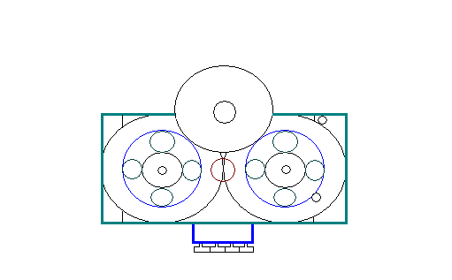
Golden Presentation
Game Changing Transmission
Giving cars a greater fuel efficiency, performance and durability at a lower cost.

Slide 2
The Golden Team
Jack Klovstad: Primary Inventor, BSEE, BSME (Aerospace), MSEE (MIT)
James Fortune: BSME, BSAM, MSME (Oakland U.)
Walid Elsady: BSEE, MSEE, (Control Systems, Mechatronics, Oakland U.)
Ford Powertrain Engineering Experts (retired):
Bill Baedke: 30 Years Product Development, BSME
Ed Debler: 30 Years Product Development, BSME
Oakland U. Professors:
Ka C. Cheok, Ph.D.
Michael A. Latcha, Ph.D.
Ching L. Ko, Ph.D.
Contact Information:
Golden Products and Services LLC.
6633 18 Mile Rd.
Sterling Heights, MI. 48314
w_elsady@yahoo.com
(586) 843-7280
Fax: (586)884-9331
5_E

Slide 3
Golden Partnerships
Business Development
Macomb Incubator- Legal, mentorship, accounting
Engineering
HGS: Prototype manufacture
Sensor Data: Validate all Energy Management claims
Katech Engineering: Efficiency and power testing
Prestige Group: Automotive integration experience
Our Customers: Letters to grant awarding agencies stating interest in our research

Slide 4
The Problem
Major Passenger Cars & Light Truck OEM
Primary pain point- CAFE standards
Willingness to pay for solution
Accelerated Development of New Technologies
Market Potential- $231M
 | 2011 | 2016 | 2025
Passenger Car & Light Trucks | 24.1 mpg | 38.5 mpg | 54.5 mpg
Penalties for Big 3 at $55/mph/vehicle without improvements |  | $7.4 B | $16.8 B

Slide 5
Technological Description
The product is a Cam based transmission utilizing simultaneously push and pull drive, capable of managing energy usage smoothly, to and from a potential energy storage device. Its unique energy management capabilities are partially the result of having an Infinitely Variable Transmission (IVT/CVT) with infinite variations from full forward to full reverse.
5_E

Slide 6
Competitive Advantage
Our transmission is the only transmission that we know of that can manage the rate of energy exchange between potential and kinetic energy sources smoothly for the entire range of possible gear ratios.
Energy Management is the key enabler for reducing engine weight and capacity without sacrificing performance. It can also allow existing overdesigned engines to perform far beyond their design specifications.

Slide 7
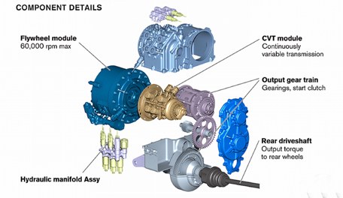
Sample Configuration (Volvo): Energy Management

Slide 8
Product Description
Full range IVT with Energy Management capability
Competitive Advantage | Value Proposition | Design Goals
CVT/IVT (sustained by IP) | Constant RPM, Torque Matching | Meet or exceed performance of other CVT/IVTs
Energy Management | Better Acceleration or Fuel Efficiency | Reduce 0-60 mph time by 50% or improve fuel economy by 25%
 | Smaller Engine | Reduce engine size 80%, remove torque converter
 | Superior Regenerative Braking | 30% greater energy recovery
Fewer Parts | Low Weight and Cost, Greater Reliability | 75% reduction in weight and cost, 200k-300k mile lifetime
Low Gear Ratio | Superior Towing | 100% greater towing capacity

Slide 9
Where we are today
Feasibility
Proof of Concept Completed- DOD TRL 3
Plans for 3D printing, Software Simulation and Prototype Model.
Validation
Continued market research and engagement with potential customers including GM, Ford, and Tesla.
Technological Protection
Patent Pending (with patent strength 3.25)

Slide 10
The Marketplace
Volvo is the only company that advertized using similar energy management technology to increase fuel efficiency.
No company has claimed using similar energy management technology to increase performance.
Golden is undertaking the challenge to work with energy management technology to increase both fuel efficiency and performance.
Our major need is to build prototypes to demonstrate technological capabilities with improved designs.

